Slide 1


Rochester Knighthawks Analytics:
A Beginning of Statistical Analysis in Box Lacrosse
Rob Weber
St. John Fisher College 20’
Eddy Tabone
St. John Fisher College 19’

Slide 2
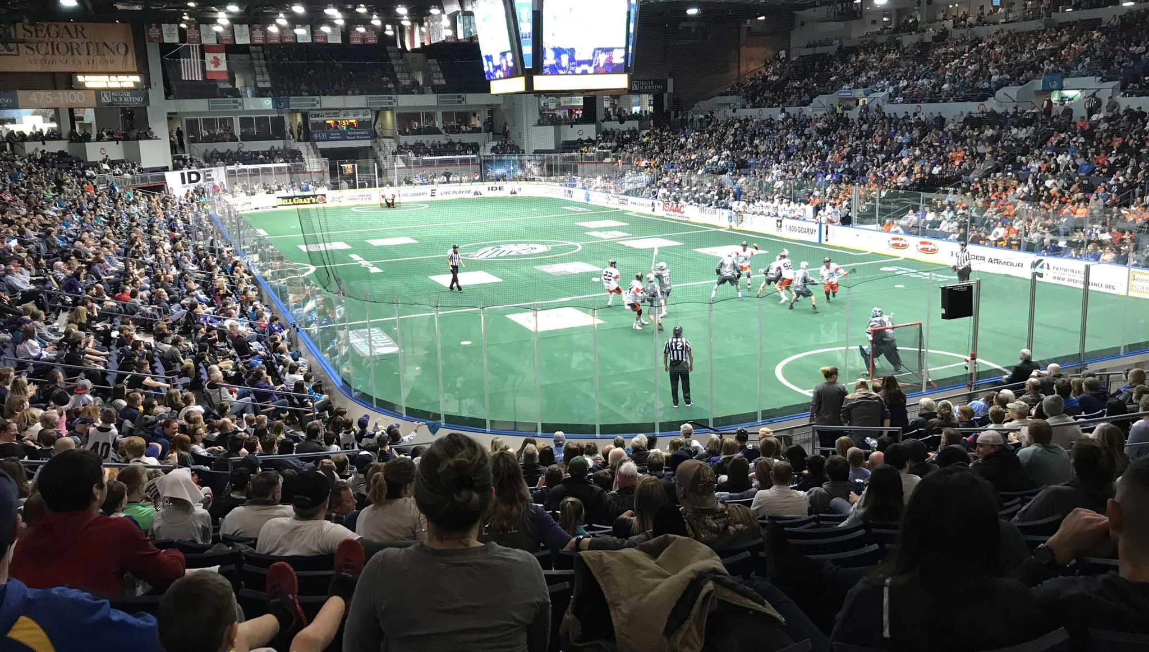
Brief Overview of
Box Lacrosse
Indoor Lacrosse played exclusively on hockey rinks
Conceptually, a mix of Hockey and Basketball
  5 on 5 with a goalie
  Over-and-Back rule and other Basketball Violations (Shot-Clock)
  Formation-wise it looks like Hockey, but player possession is more like Basketball

Slide 3
Where Our Story Starts…
Approached in Fall of 2017 by the Rochester Knighthawks to begin offering information through tracking and analysis
Met with Coaches and select members of the Front Office about interests and possible lanes of focus
  Location of shots (on field and on net)
  Loose-balls (because of previously less reliable numbers)
  5-minute intervals (Instead of Quarters because of T.V. timeouts)
Got 2 games in before realizing more help was needed

Slide 4
Season 1

Slide 5
Season 1
Began with tracking all shots in Knighthawks games by both Rochester and their opponent
Tracked:
  Shooting Player
  Location on the Field
  Location on Net or Where it Missed
  Game Clock and Shot Clock
  Set Offense or Transition Offense
  Result: Goal or Miss
4 games in, we began tracking the way each possession ended (shot, turnover, penalty, etc.)

Slide 6
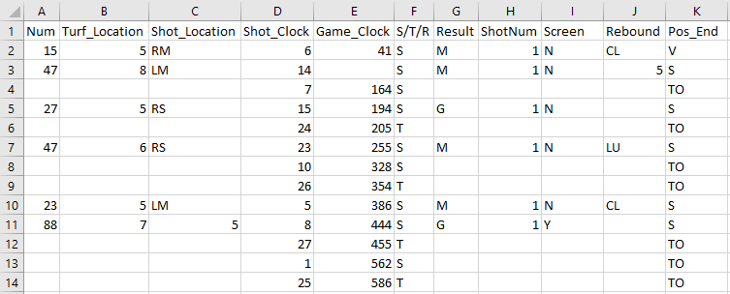
Season 1: Tracking
Sample of the Tracking Spreadsheet

Slide 7
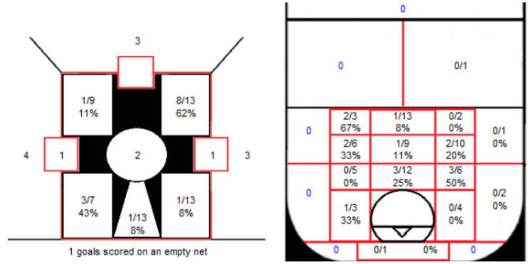
Season 1: Presentation
Sample of the Charts Used in Tracking with Short-hand and in Presentation as a Visualization

Slide 8
Season 1: Networking Project
Scope: 2018 NLL Finals (Rochester vs. Saskatchewan)
Tracked every offensive ball movement for two of the three games in the series – Movement, Pass, Shot
Passing Networks – Nodes are players, directed edges represent the event of passing from one player to another
  Also looked at turf location as nodes and the event of passing form one location to another as directed edges
Shot Assists – Gives the population of shots that goals come from
Network Statistics in the context of shot assist networks
  Centrality Measures: Which players are most frequently creating shot opportunities
  Full Network Measures:
    Diameter: Smaller networks = more balanced production in the lineup
    Reciprocity: Are people passing and shooting at the same frequency in their “relationship”

Slide 9
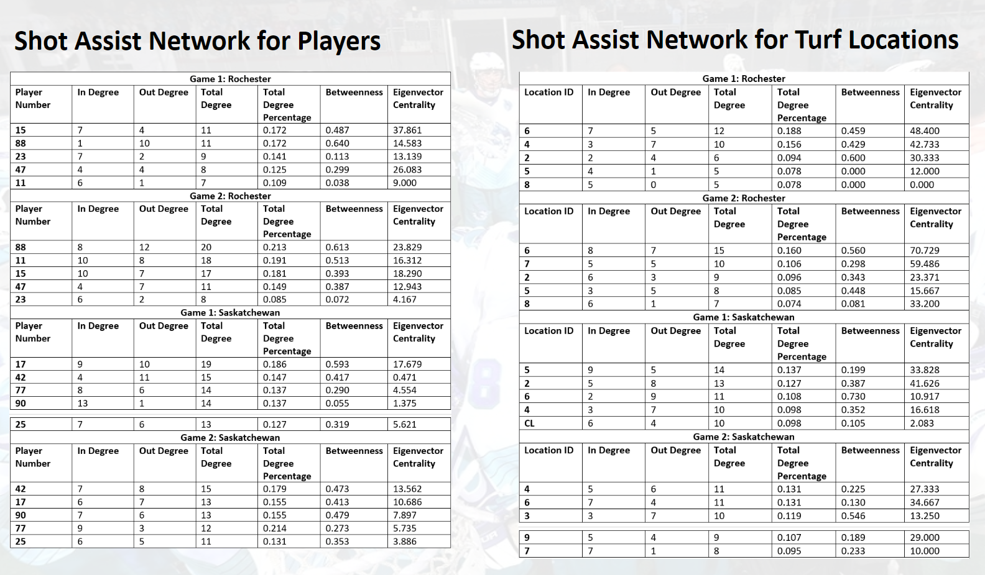
Tables

Slide 10
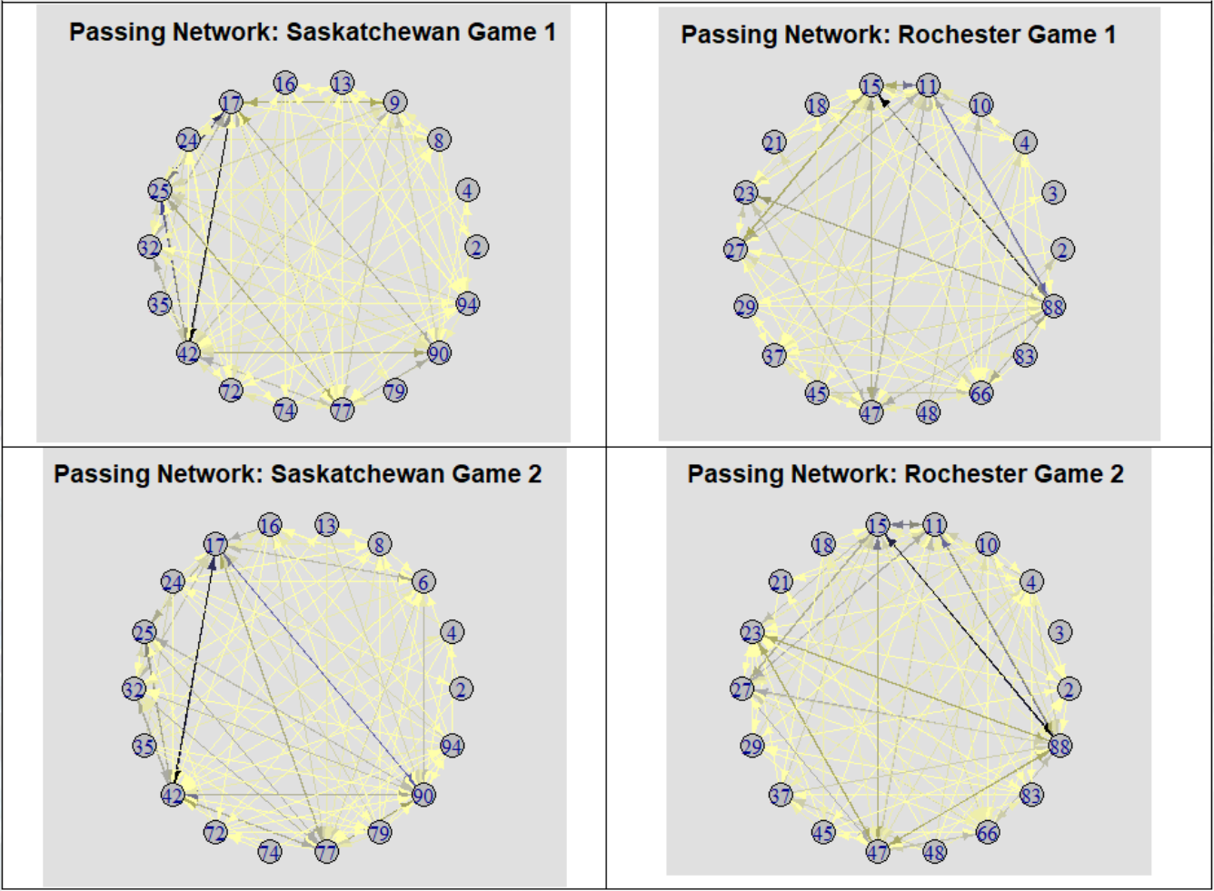
Network Graphs

Slide 11
Season 2

Slide 12
Season 2: Tracking App
The first app made was an interactive tracking app for data entry
A smoother tracking process let us track every single on-ball event in our games
A click-interactive Shiny plot of a picture of a Box field let us record approximate (x, y) locations of every event
Passes were tracked in a location1-to-location2 format and were the only events without player numbers (due to camera limitations)
Process:
  User enters information
  Information organized into a data-frame (df_1)
  Game’s .csv file read in as a different data-frame (df_2)
  df_1 is added as a new row to df_2
  Writes df_2 over the existing .csv file

Slide 13
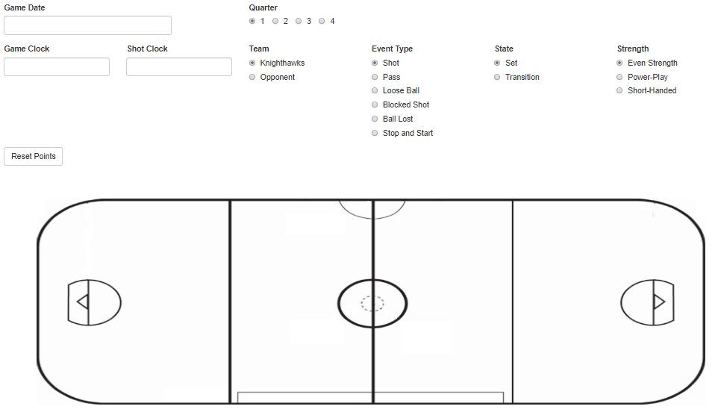
Season 2: Tracking App

Slide 14
Season 2: Game Report App
The second app was a game-report app that presented information both cumulatively and for individual games, this was updated after each game
Process and Structure:
  Presented advanced box-score summaries for both sides and each player on both sides
  Shooting, passing, and loose-ball summaries
  Shot-Contribution information for both sides
  Individual Player reports

Slide 15
Season 2: Scouting Reports
Tracked every regular season game in the league, gathering a level of information similar to Season 1 (All Shots and Possessions)
Shooting Information presented:
  Our shooting against their goalies
  Distributions of turf locations of our shots – with shooting percentages
  Distribution of shot locations of our shots – with shooting percentages
  Shot and goal creation tables (Broken down by player movement, shot-assists, and rebounds)
Possession information presented:
  Shots per possession
  How possessions started and ended
  How many possessions were Set or Transition
Roster Shot Contribution Distribution

Slide 16
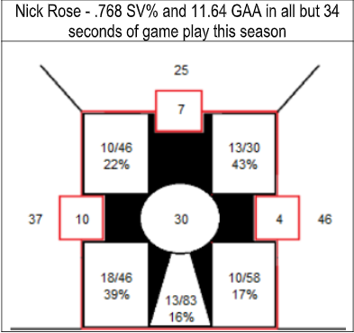
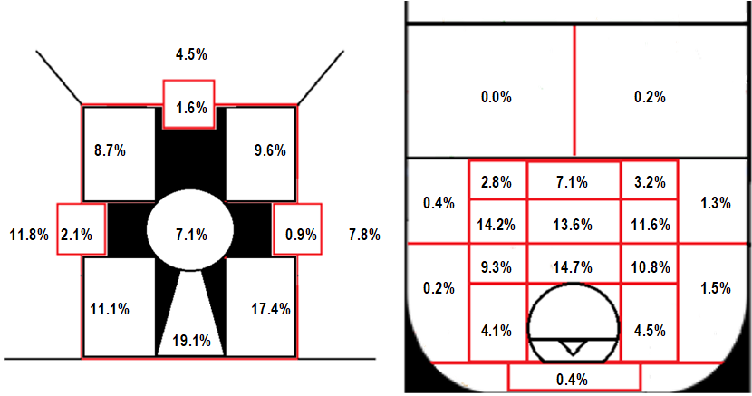
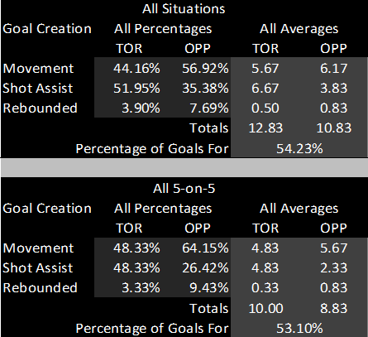
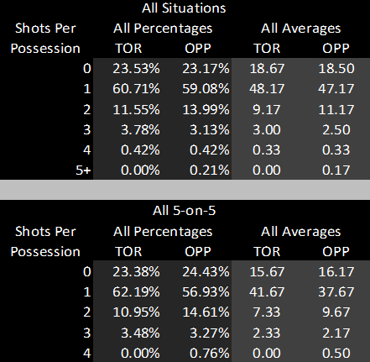
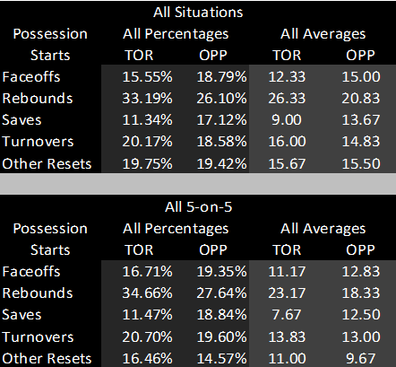
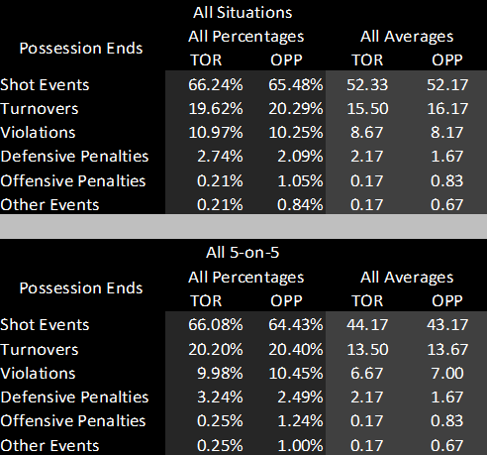
Season 2: Scouting Reports
Screenshots from out scouting report before the March 16th matchup against the Toronto Rock

Slide 17
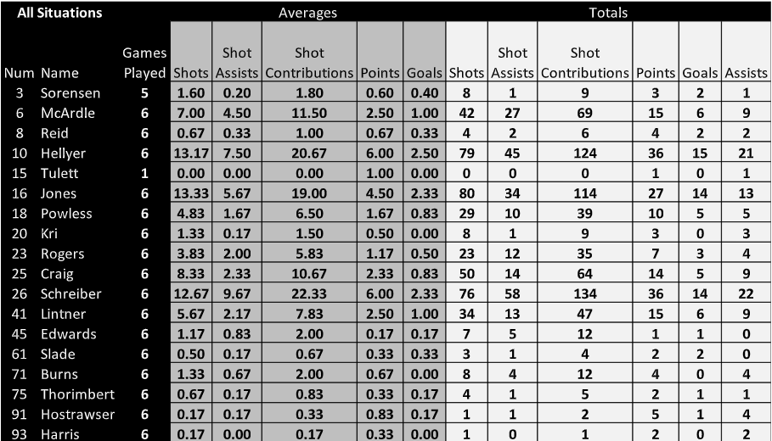
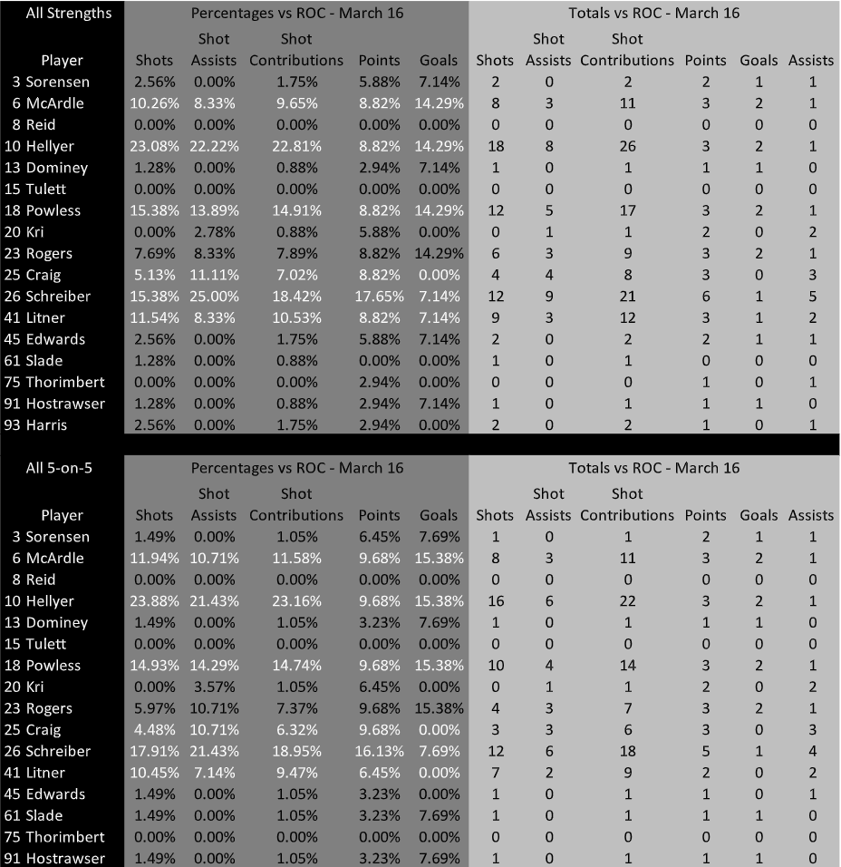
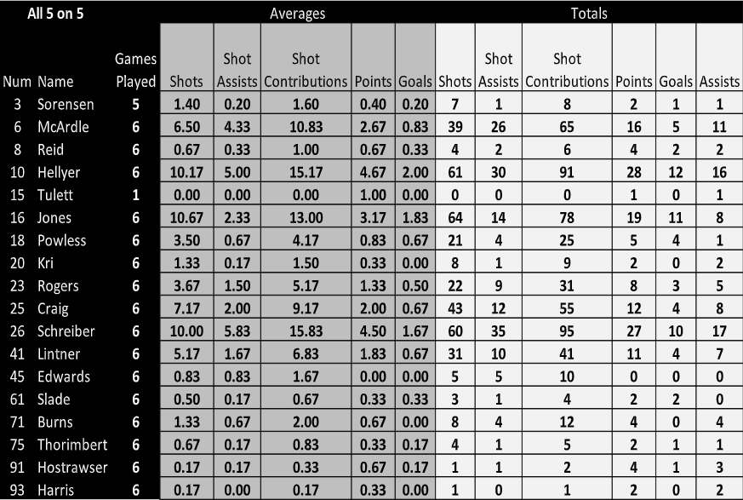
Season 2: Scouting Reports
Table from the 4/5 Report Showing Results from Game on 3/16
Table from the Report for 3/16

Slide 18
Season 2:
PPF Heat-Map Project
Created a Proximity-Percentage-Frequency Heat-Map using the approximate (x,y) locations of each shot
Takes the location of each shot and groups it together with any other shots within 0.05 units
  On-field locations exist on a 0 to 1 scale on both the x and y axes
Finds the shooting percentage of those shots
Multiplies that by the frequency of said group of shots
Plots the result for the group of shots with the assumption that it corresponds to the original single shot location

Slide 19
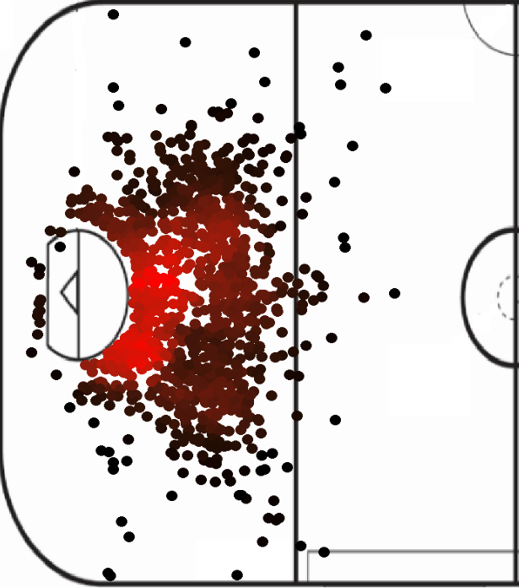
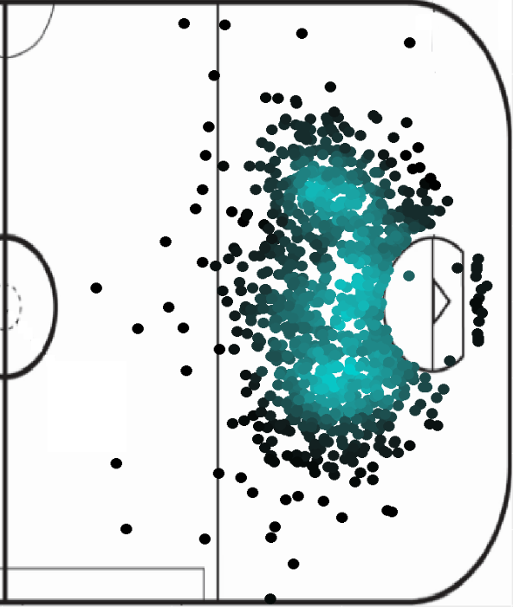
Season 2:
PPF Heat-Map Project

Slide 20
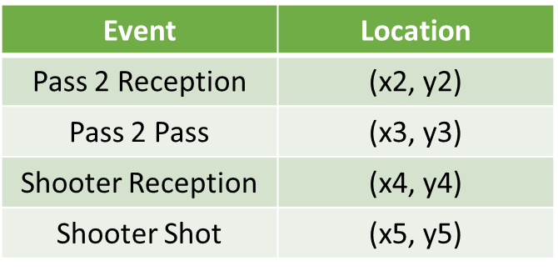
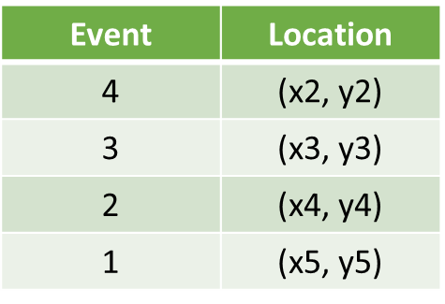
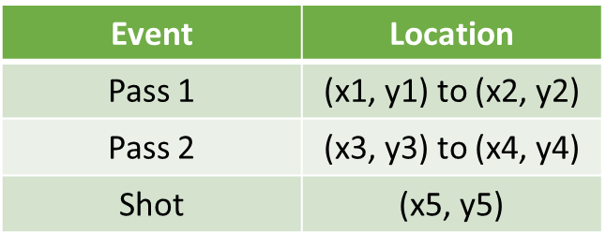
Season 2:
Sequential Pass Clustering
Filtered the tracking data from all tracked games down to possessions with shots
Filtered down to possessions with at least 3 passes before the shot to get shots that resulted from some amount of build up
Separated the passes into a sequence of (x,y) locations and grabbed the last 4
Numbered them backward from the shot

Slide 21
Season 2:
Sequential Pass Clustering
Clustered each possessions’ event 1 by x-location and y-location, then repeated that method for event 2, 3, and 4.
Each possession now has a “path” of clusters
Found the shooting percentage for each possible “path”
Used Bayes’ Theorem to find a backward-conditional probability of scoring using each path
Interpretation: The estimated probability of a shooting-possession in one of the Knighthawks’ games ending in a goal resulting from a given “path”.

Slide 22
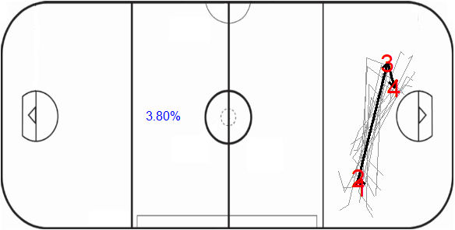
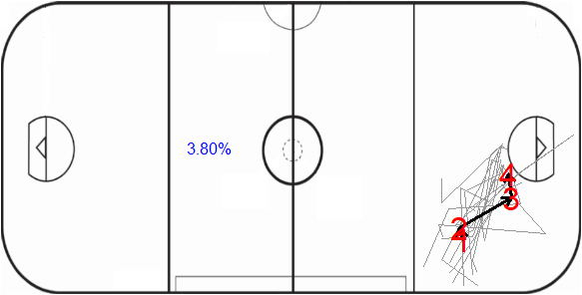
Season 2:
Sequential Pass Clustering

Slide 23
Season 3

Slide 24
Season 3
Before our third season with the team starts this December, we are planning on utilizing Shiny Dashboards for the game reports and revamping the tracking app
Tracking App
  Made so the entire app sits on one screen (no scrolling)
  More possible events to track in an intuitive way lets us track a lot more information in about the same amount of time
  Communicates with GoogleSheets so that there is no worrying about writing files, the location of those files, sending the files after tracking, etc.
We’ve also done some other side projects to help assist the new Front Office in the process of starting an Expansion team

Slide 25
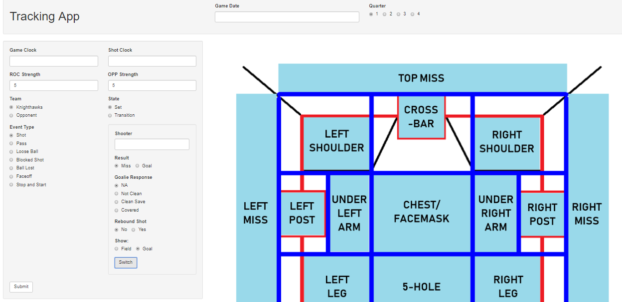
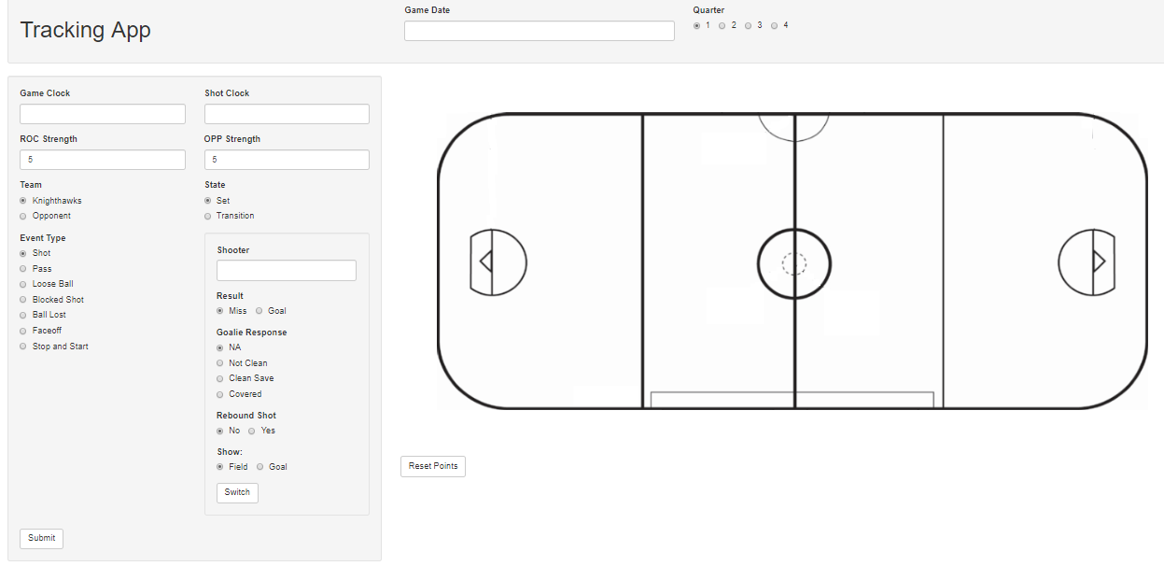
Season 3:Tracking App

Slide 26
Season 3 Preseason:
Expansion Draft App
To help in the assessment of available players in the expansion draft and to try out the capabilities of Shiny Dashboard, we put together an app that displays information on each available player gathered in the scouting project last season

Slide 27
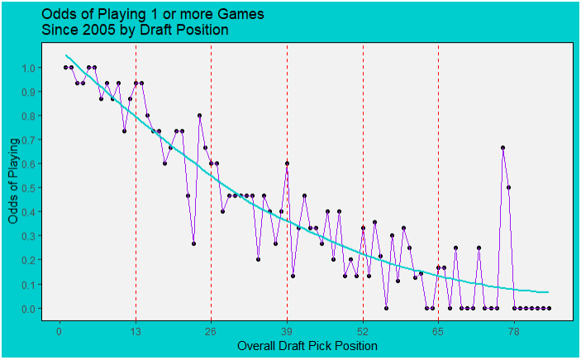
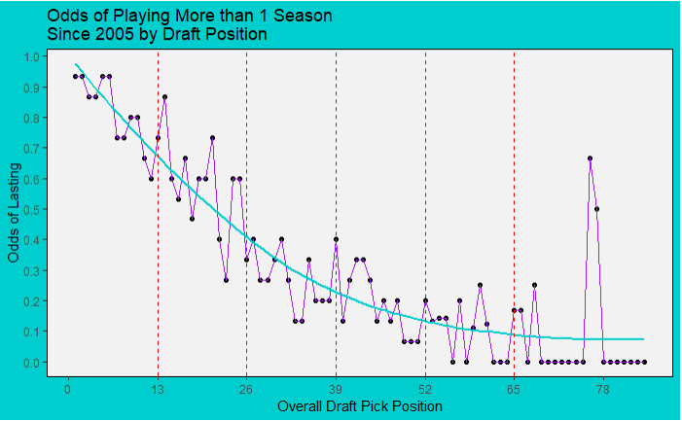
Season 3 Preseason:
Draft Analysis Project
Performed analysis of draft-pick position’s immediate and long-term success

Slide 28

Special Thanks to:
Our Team (Past and Present)
  Kaylee Gassner
  Jake Tarnowski
  Kaili Saffran
  Rachel Makowski
The Rochester Knighthawks Staff (Past and Present)
Dr. Barney Ricca
Matthew Hoffman, Ryan Stimson, and the RIT College of Science

Slide 29
Thanks to All of You for Listening
Rob Weber
  Twitter: @rweber44
  Blog: atypicalstatsguy.site123.me
Eddy Tabone
  Twitter: @Eddy_Tabone
NLL Single Game Tickets on Sale Soon. Go to Some Games. Box Lacrosse is Fun.

