Slide 1
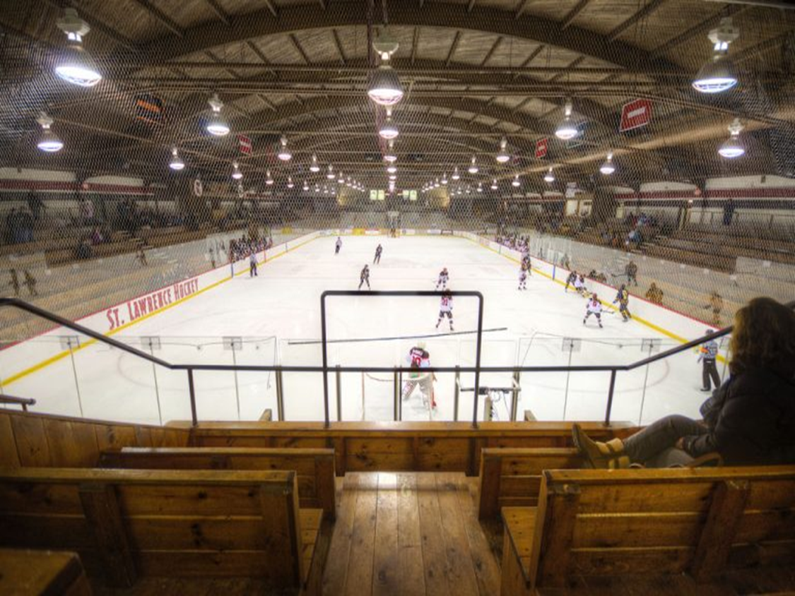
A New Perspective on NHL Shot Mapping
Michael Schuckers¹ and Lexi Joy ‘19^{1,2}
¹St. Lawrence University
²STOP Domestic Violence/Behavioral Health Services North
RITSAC19
September 14, 2019

Slide 2
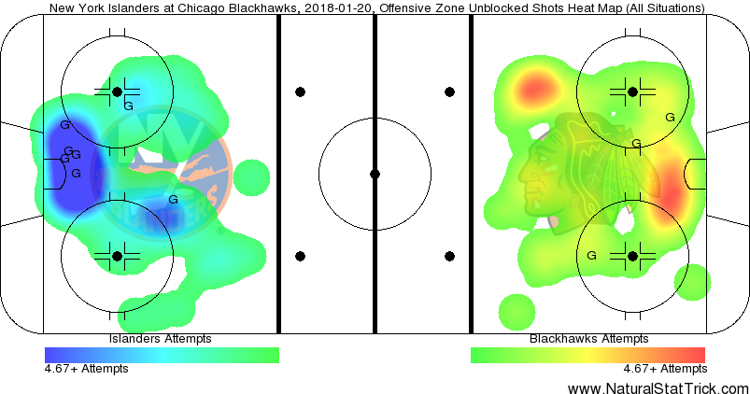
https://www.sny.tv/islanders/news/islanders-scratchpad-the-rocky-balboa-of-the-nhl/265088142/ http://www.NaturalStatTrick.com

Slide 3
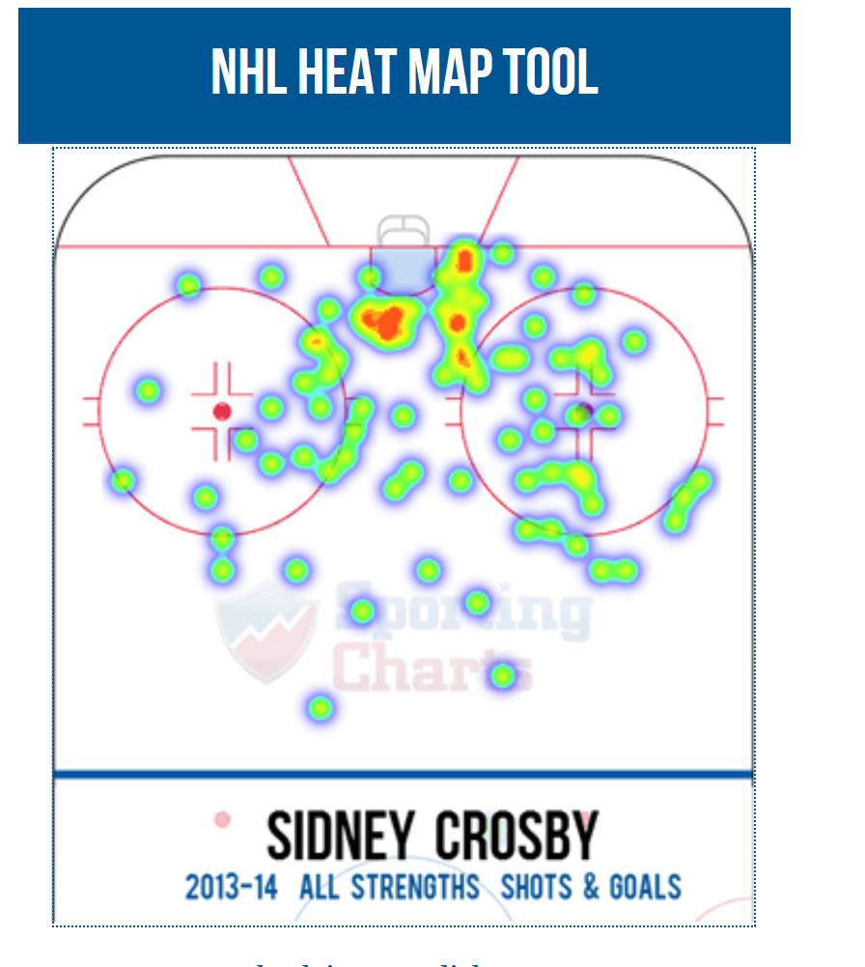
https://www.sportingcharts.com/nhl/

Slide 4
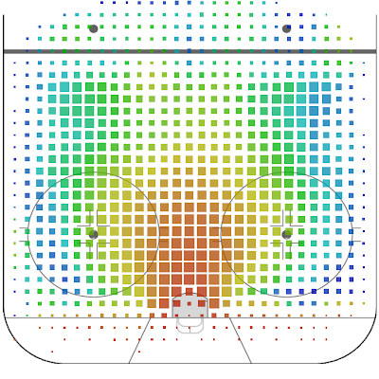
https://www.greaterthanplusminus.com/2014/04/nhl-heat-map.html

Slide 5
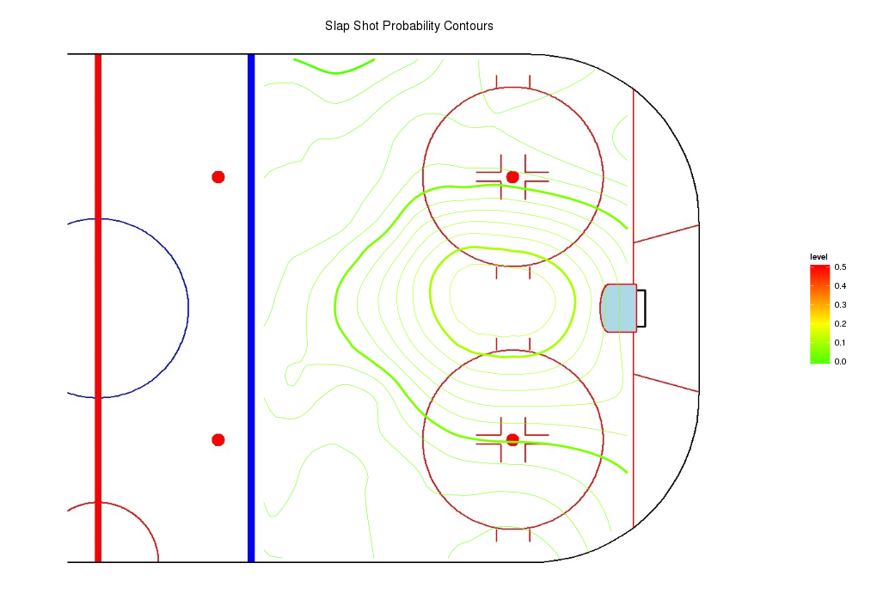
From Schuckers (2016)

Slide 6
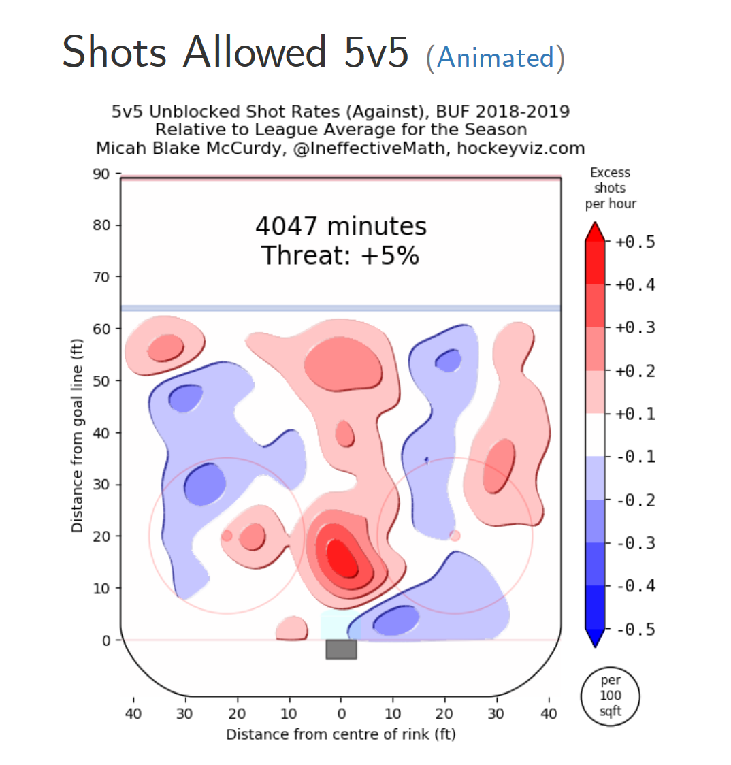
https://hockeyviz.com/team/BUF/1819

Slide 7
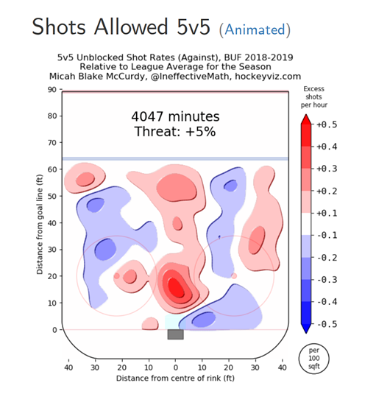


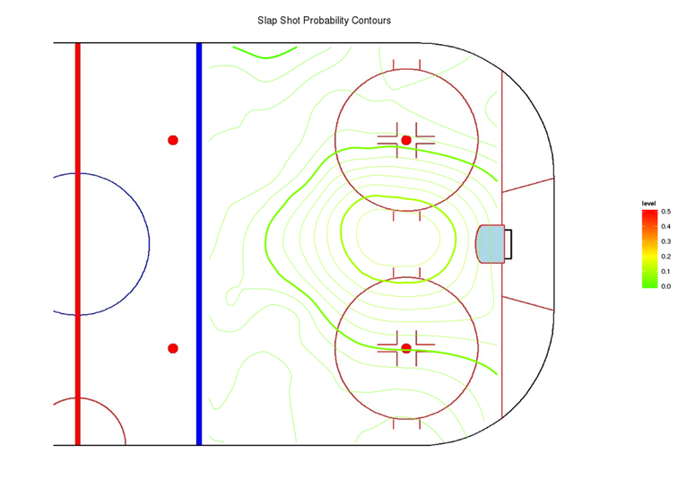
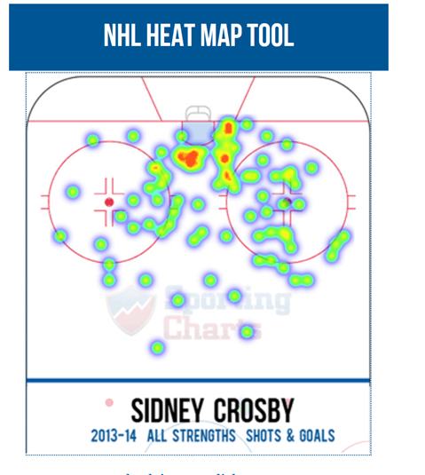
NHL Shot Maps

Slide 8
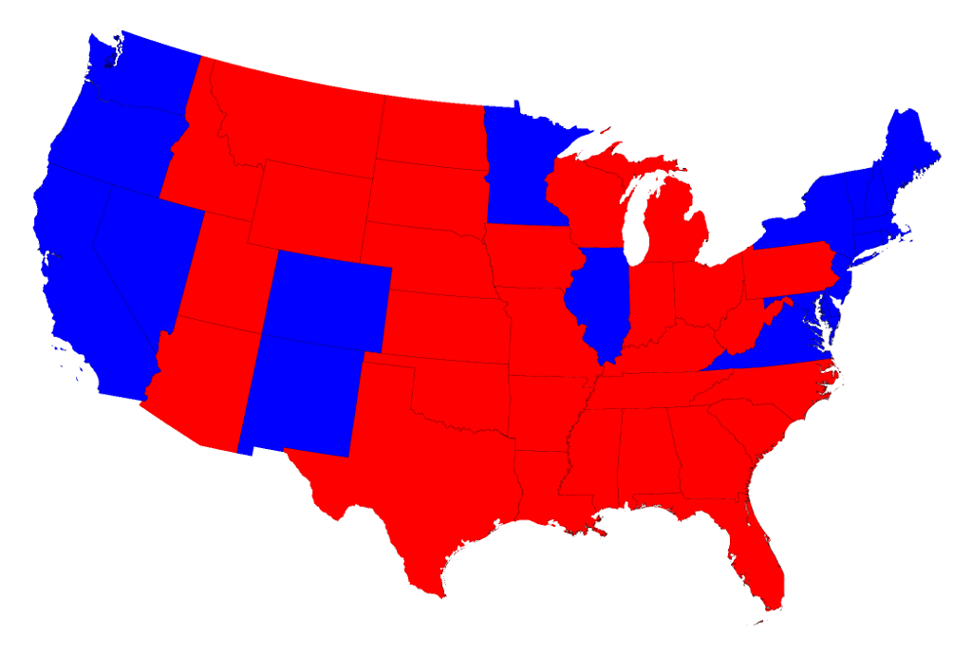
US States (Lower 48) by Area & Politics
http://www-personal.umich.edu/~mejn/election/2016/

Slide 9
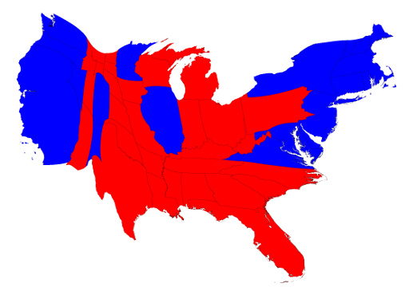
US States (Lower 48) by Area & Politics
http://www-personal.umich.edu/~mejn/election/2016/

Slide 10
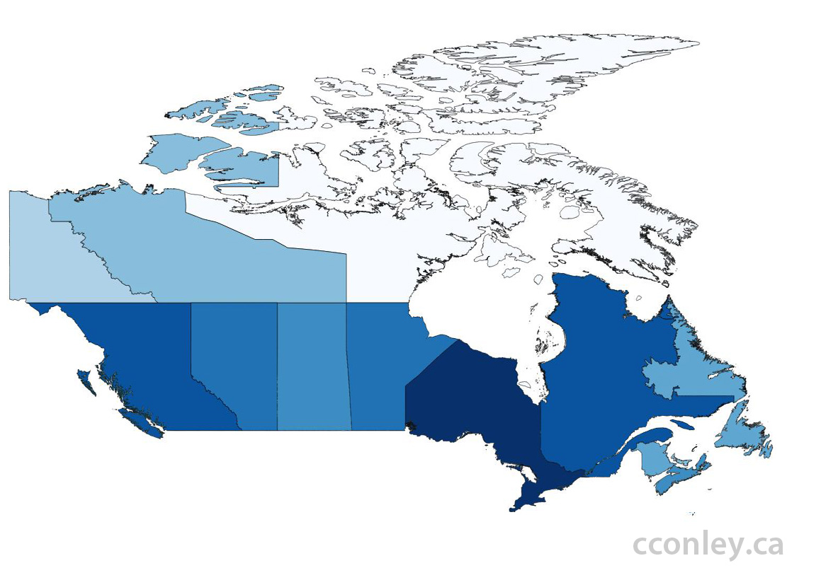
Cartograms: Canadian Provinces by Area
https://cconley.ca/2012/05/06/reshaping-the-country/

Slide 11
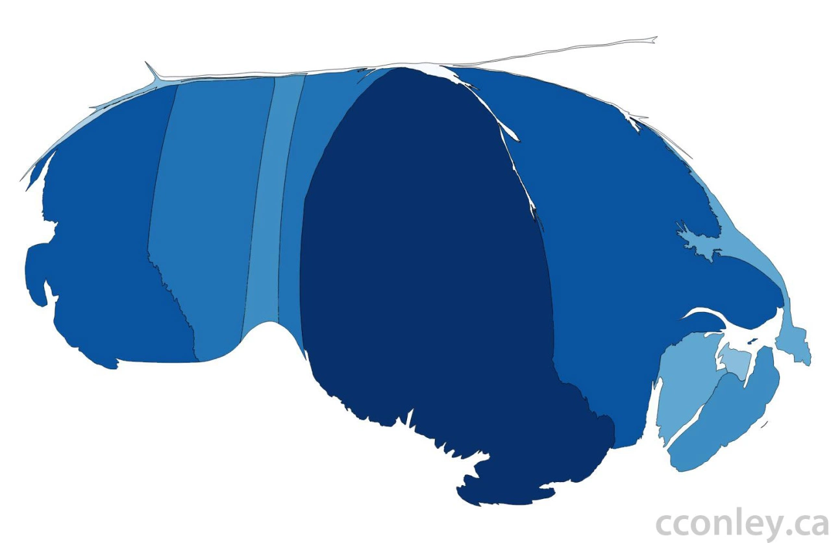
Cartograms: Canadian Provinces by Population
SOURCE: https://cconley.ca/2012/05/06/reshaping-the-country/c

Slide 12
Goal:
Make a
‘nice’ graphical representation of the ice
that (approx.) conveys:
x,y locations
shot probability at x,y
shot density at x,y

Slide 13
Data
Source: www.moneypuck.com
Even Strength
Goalies in net
2007-08 to 2018-19 NHL Seasons
Regular season games
Regulation, no OT
Ignore shot type
It is after all RTSS data

Slide 14
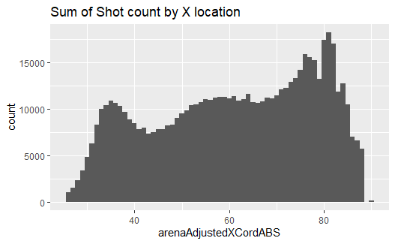
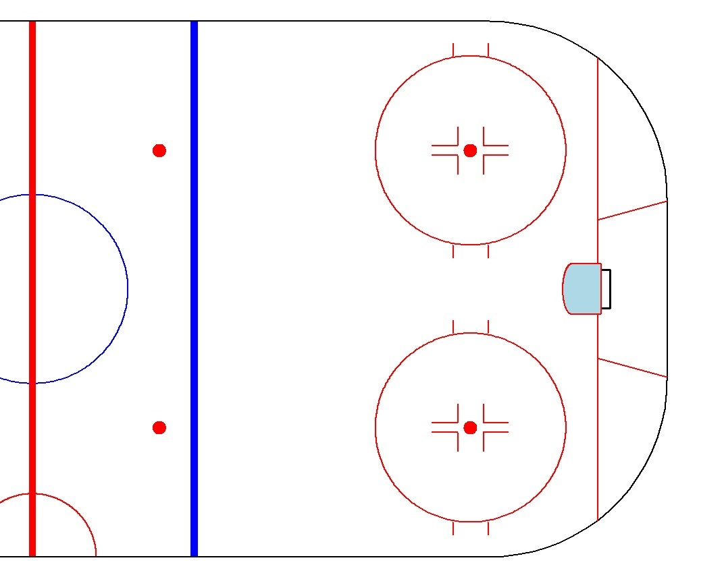

Slide 15
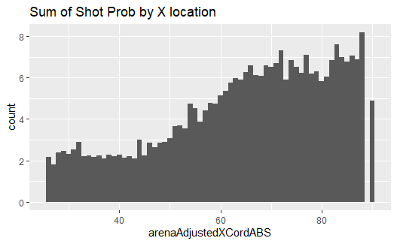

Slide 16
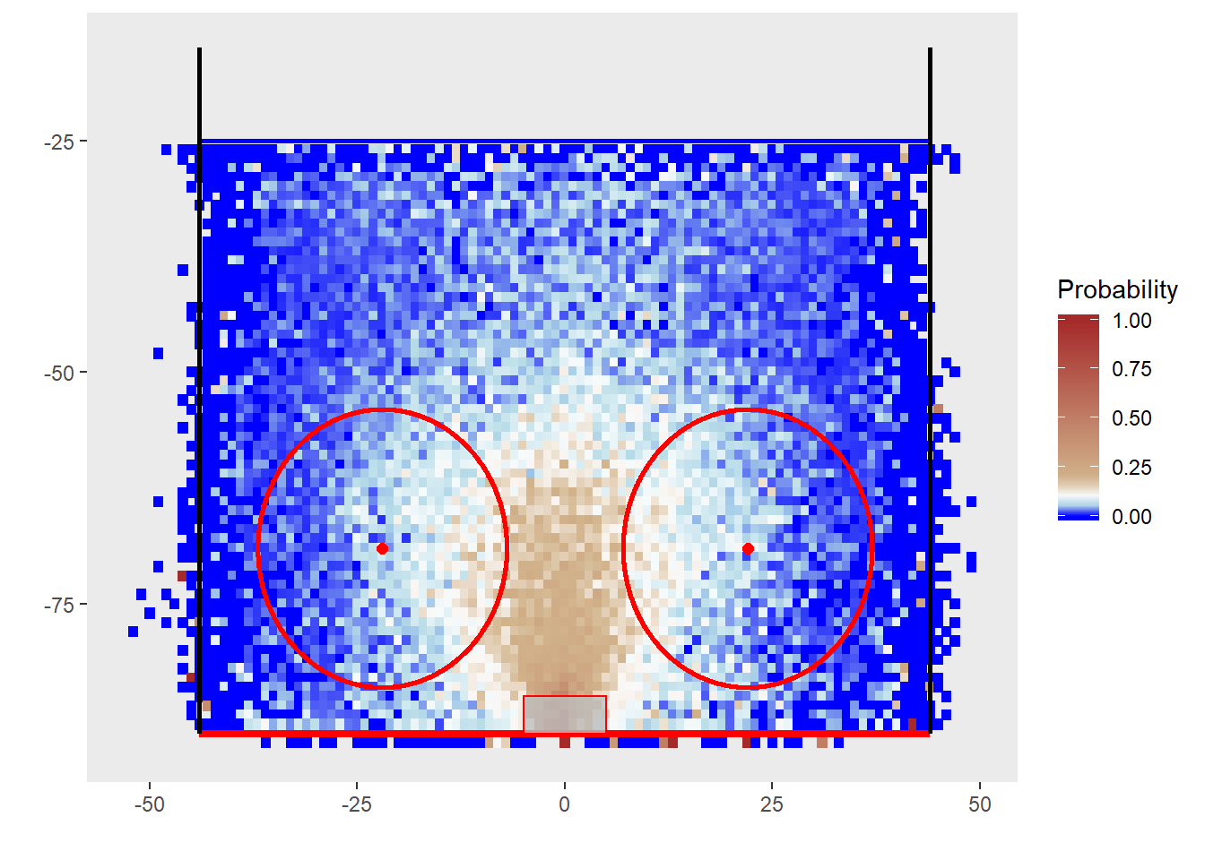
Heat Map: Shot Probability

Slide 18
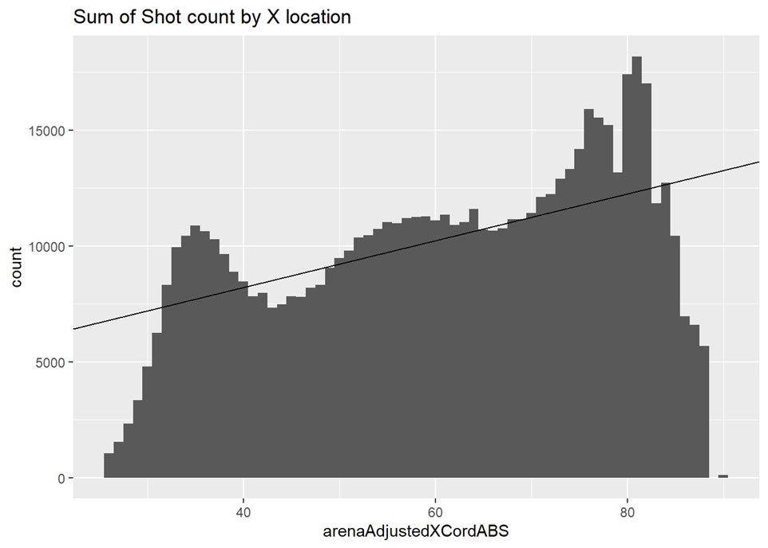

Slide 19
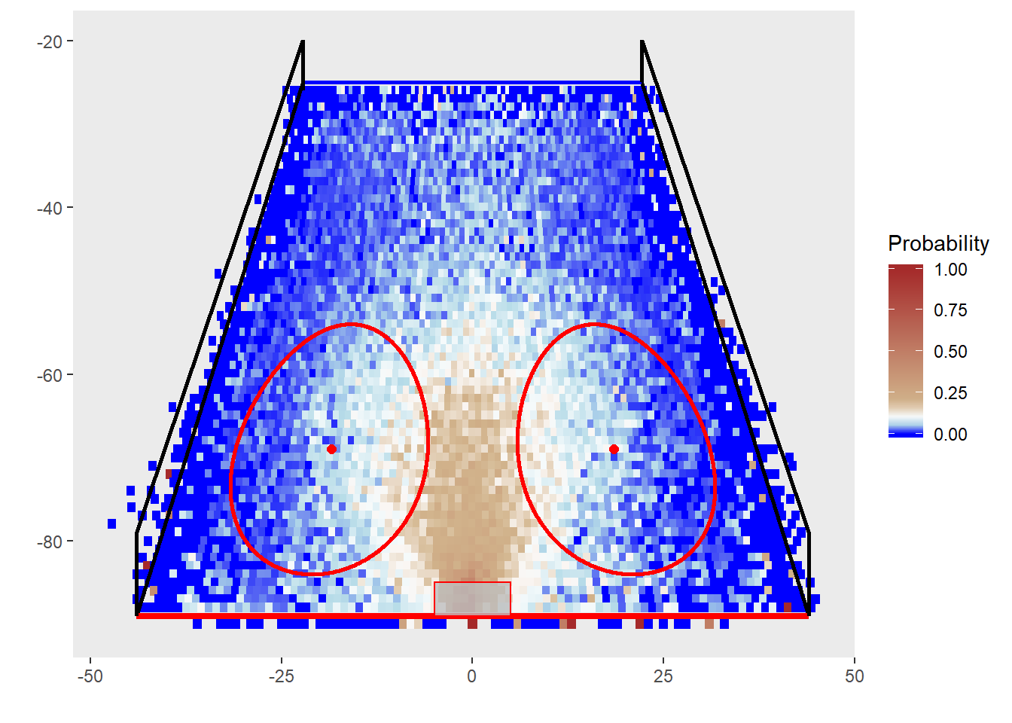
Color = shot probability
Width= Smoothed(# of shots)

Slide 20
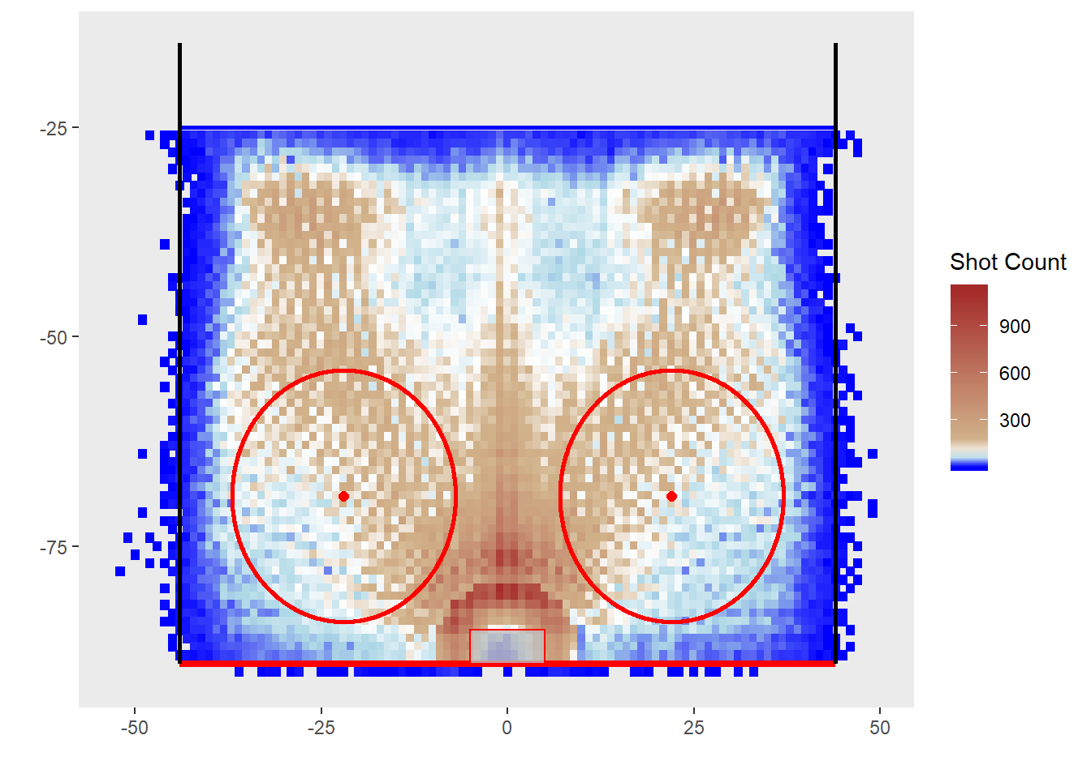
Heat Map: Shot Intensity

Slide 22
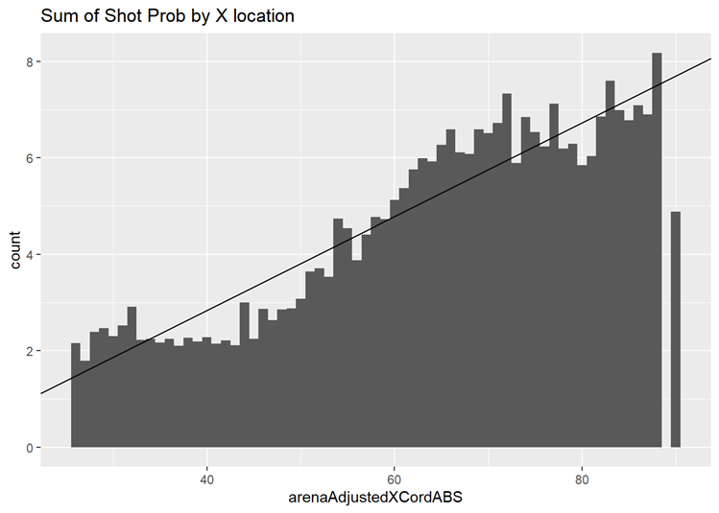

Slide 23
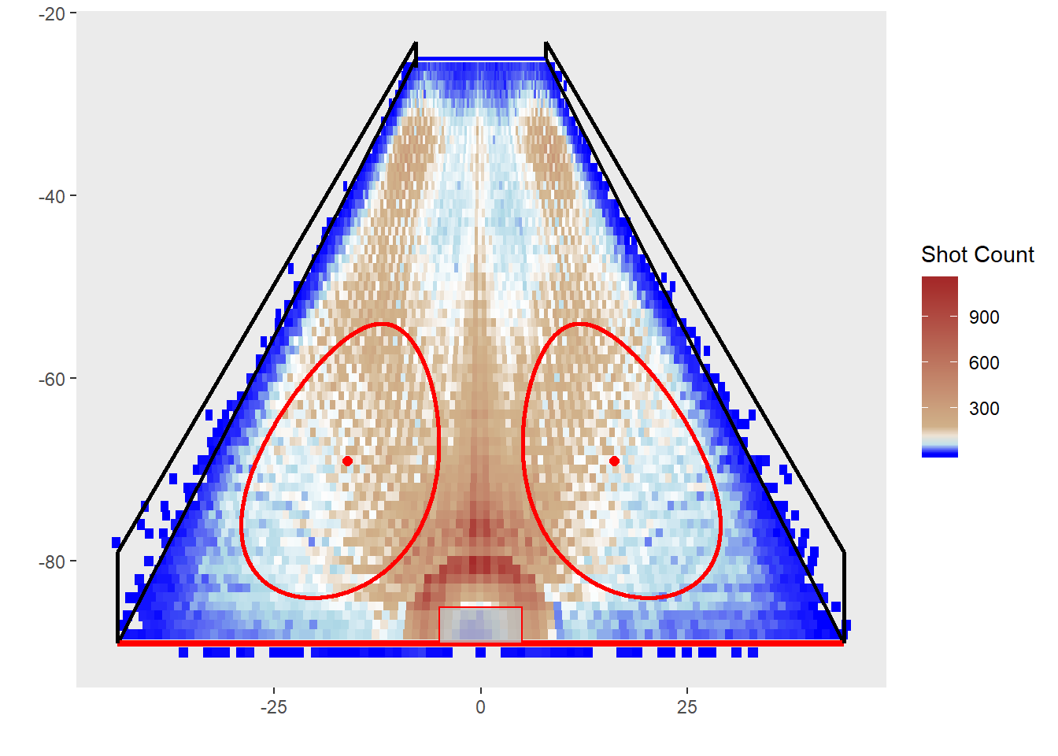
Color = # of shots
Width= Smoothed(shot probability)

Slide 24
Basic Process: Intensity as Color
1.Determine color variable: Intensity
2. Smooth Sum of Probability as function, f(t), to shot location t relative to Goal Line – OLS regression? f(t)
3. Make width of colored pixel at distance t, proportional to f(t)/f(t=Goal Line)
For Probability as color exchange Probability for Intensity.
Scaling based upon Intensity f(Blue Line)/f(Goal Line) ~ 0.5
based upon Probability f(Blue Line)/f(Goal Line) ~ 0.2

Slide 25

Next Steps
Make more plots
Best smoothing methods for perspective
Smoothing of plots
Statistical methods for shot heat maps: validity, reliability
Rmarkdown of the graphs in this talk at:

Slide 26

Plots need a name……
Prymaat?
Beldar?
Conehead Plots
Source: https://www.discogs.com/artist/1754616-Prymaat-Conehead

Slide 27
2019 Ottawa Hockey Analytics Conference
November 15, 16
Carleton University
www.statsportsconsulting.com/otthac19
Taking abstracts until Sept 25th

Slide 28
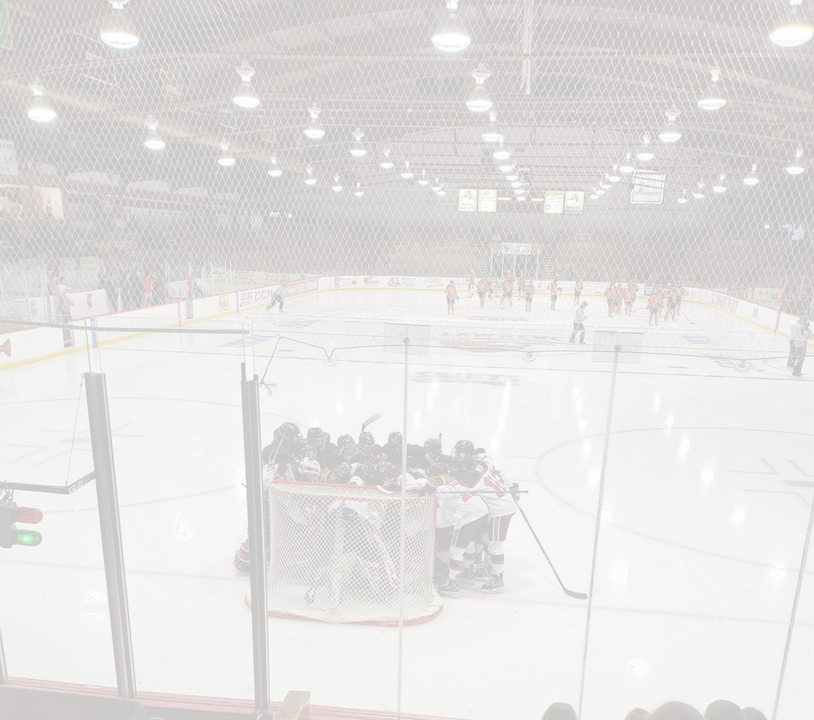
Thank you
schuckers@stlawu.edu
@SchuckersM

