Slide 1
Monitoring and Evaluating Tactical Systems in Ice Hockey
Shawn Ferris

Slide 2

What is this presentation about?
A way to combine coaching and “analytics” at many levels of hockey

Slide 3

Dataset

Slide 4
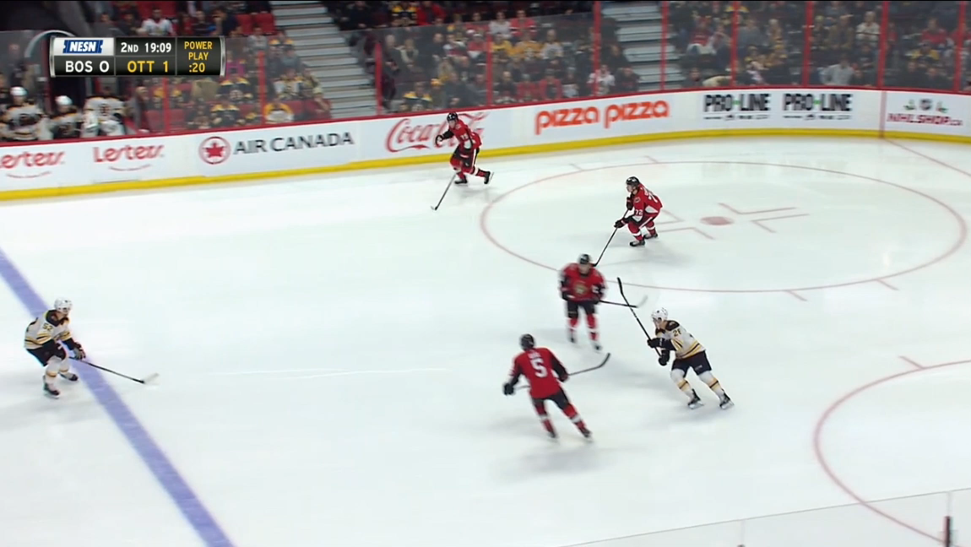
Extracting information from video

Slide 5
Extracting information from video
Formation: 1-1-2
Origin
Drop Pass?
Was the entry controlled, uncontrolled, or failed?
Shots from the entry

Slide 6
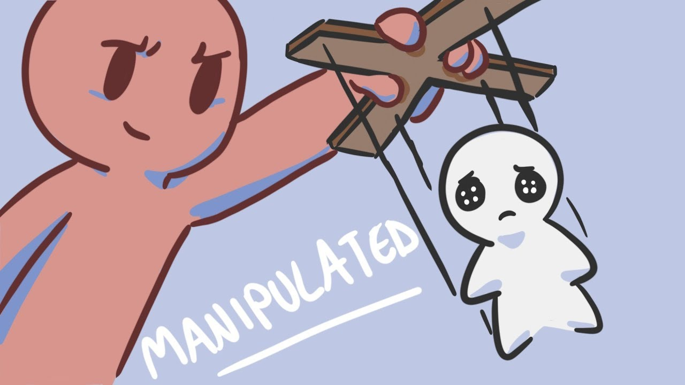
Monitoring
Visualization matters
What do you want to look at?

Slide 7
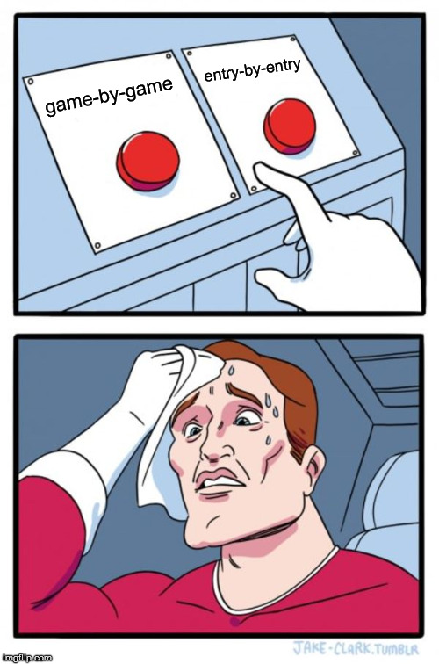
Monitoring
Looking at things over time
  Game-by-Game vs. Entry-by-Entry
  Method of choice

Slide 8
Monitoring
Game-by-Game
Entry-by-Entry
Distorted by samples in each game
Zoomed out
Able to better visualize adjustments
Bigger picture

Slide 9
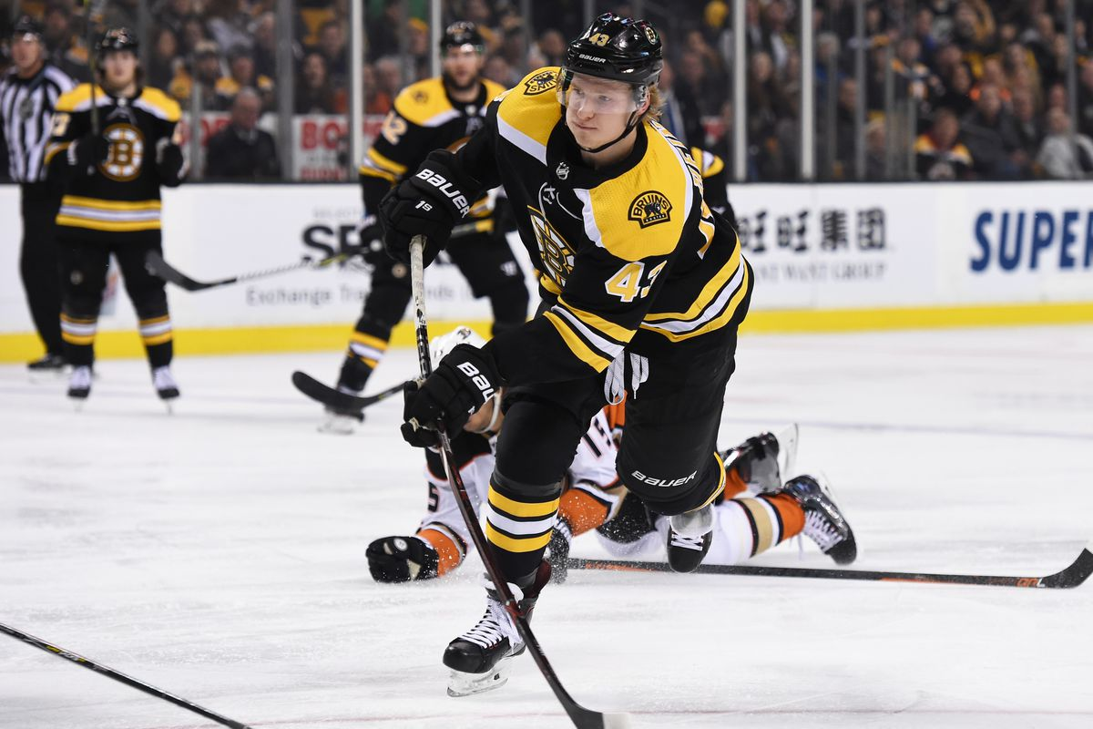
Why a Moving Average
Easy to understand
Better for real-time

Slide 10
Downside of Moving Averages
“One of the reasons that I do not use moving averages is that they handle initial cases very awkwardly. Strictly speaking there is no data for a five-game moving average until five games are played, and plotting the raw data anyway wrongly suggests that the variation is high at first and then settles down; this is very misleading.”
-Micah Blake McCurdy

Slide 11
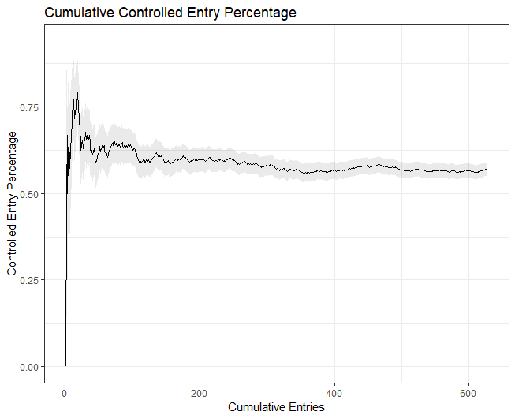
Picking the right moving average

Slide 12
Picking the right moving average
My Choice: 100-entry moving average

Slide 13
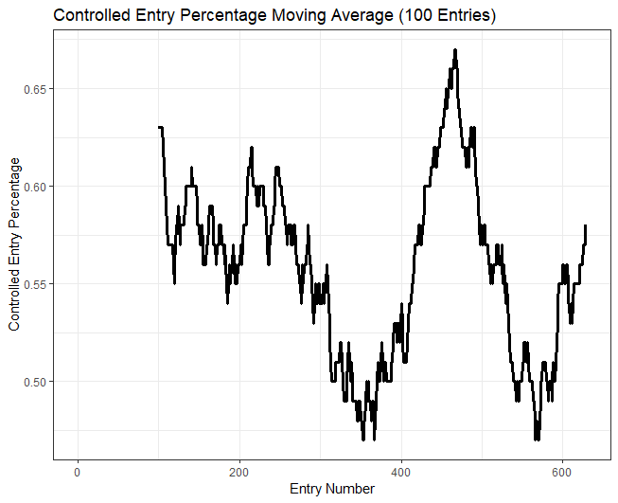

Slide 14
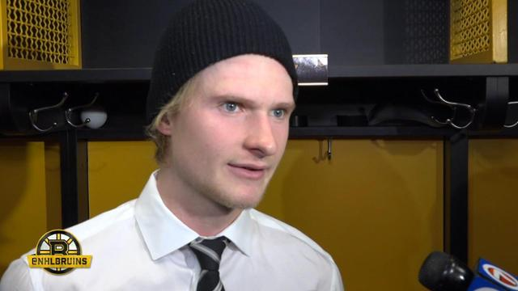
How do we know when there is a significant trend?
We expect variance throughout the season
Plotting confidence is important

Slide 15
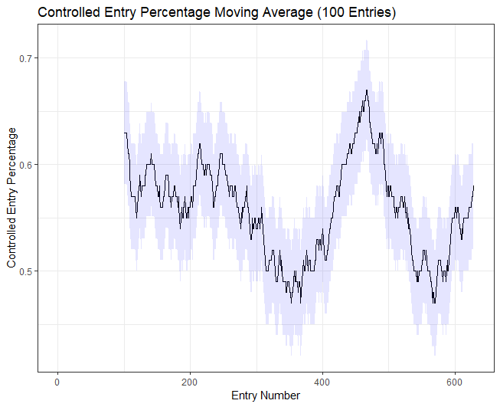
Plotting Confidence

Slide 16
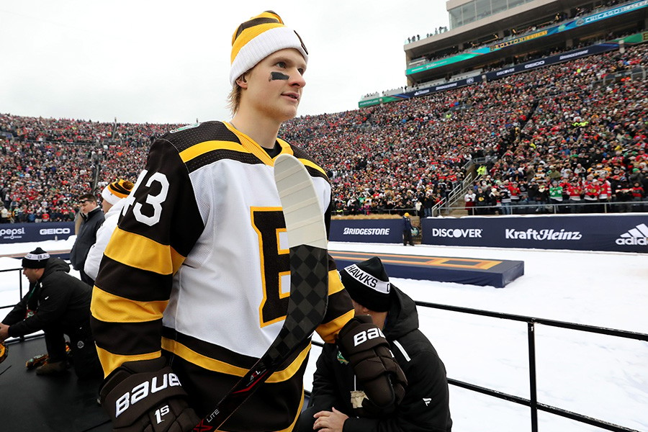
What do you do with this?
Practice around trends
Determine whether your changes helped or hurt
Review best and worst stretches

Slide 17
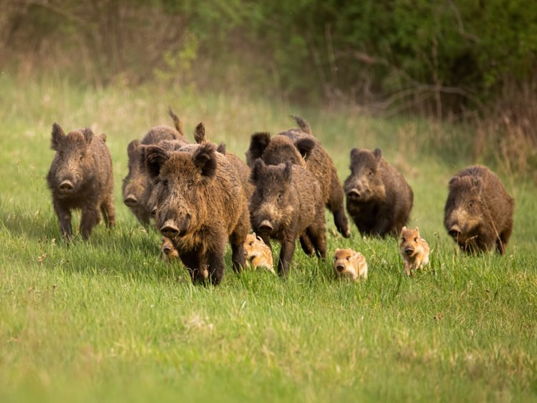

Slide 18
Evaluating
Formation | # of Samples | Controlled Entry %
1-1-2 | 339 | 56%
Miscellaneous | 128 | 70%
2-2 | 97 | 51%
1-3 | 57 | 46%

Slide 19
Evaluating
Against Drop Pass
Formation | # of Samples | Controlled Entry %
1-1-2 | 99 | 70%
2-2 | 25 | 56%
1-3 | 15 | 60%
Miscellaneous | 5 | 80%

Slide 20
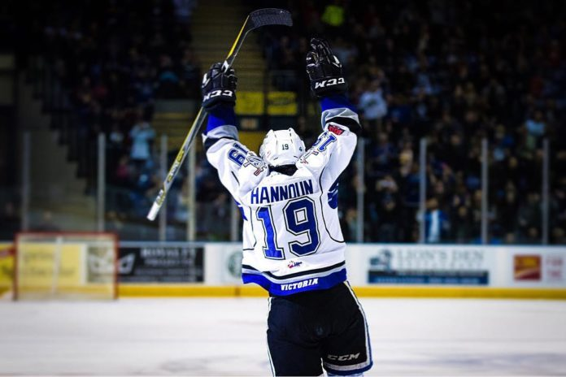
Evaluating
Weaker against drop pass
When the Bruins formed into another formation, they were more successful

Slide 21
Concluding Thoughts
This is easy enough for lower level teams to do
  Shiny App?
Can use in journalism
  geom_vline()
We need to put more research into special teams
  We have some lovely presentations on them today
Danton Heinen is awesome

Slide 22
Merci
@ShawnFerris98

