Slide 1
Fringe Sports Analytics
Lessons in Growth, Independence, Data Gaps, and Building Momentum.
Alyssa Longmuir @alyssastweeting

Slide 2
@stats_dril
i would never humiliate myself by "scraping" data. i only use 100% artisinal tracked data that is hand collected by a remote hill tribe in the andes that i will not name out of my deep respect

Slide 3

“Men’s sports have awesome data.”
“Men’s sports have awesome data.”
-Allison McCann

Slide 4

-Sue Bird
“Last season, Elena Delle Donne had a record-setting season — one of the highest PER’s ever among the WNBA and NBA. It was one of the best seasons ever by a female athlete. But few sports fans outside of the WNBA even knew it was happening … until it had already happened.”

Slide 5
So what data is out there?

Slide 6
In all of Women's professional sports there is just one.

Slide 7
A brief history of NHL tracking data
by someone who really should not be speaking about it

Slide 8
1917
Goals, Assists, Points, PIM

Slide 9
1922
Goals, Assists, Points, PIM, Event Times

Slide 10
1959
Goals, Assists, Points, PIM, Event Times, Shots per player

Slide 11
1967
Goals, Assists, Points, PIM, Event Times,
Shots per player, +/-

Slide 12
1967
Goals, Assists, Points, PIM, Event Times,
Shots per player, +/-

Slide 13
1997
Goals, Assists, Points, PIM, Event Times,
Shots per player, +/-, TOI

Slide 14
2005
Goals, Assists, Points, PIM, Event Times,
Shots per player, +/-, TOI, Shot Locations

Slide 15
Story Time

Slide 16


Slide 17







Slide 18


Slide 19
NHL
Goals - Assists - Points - PIM - Shots - ES Shots - PP Shots - PK Shots - Shift Count - TOI - Shift Chart - ES TOI - PP TOI - PK TOI
Shot Locations - +/- - Goals For - Goals Against - Shots For - Shots Against - Faceoff Wins - Faceoff Losses - Blocks - Hits
Takeaways - Giveaways - Corsi % - Corsi For - Corsi Against - Expected Goals For - Expected Goals Against - Game Score

Slide 20
AHL
Goals - Assists - Points - PIM - Shots - ES Shots - PP Shots - PK Shots - Shift Count - TOI - Shift Chart - ES TOI - PP TOI - PK TOI
Shot Locations - +/- - Goals For - Goals Against - Shots For - Shots Against - Faceoff Wins - Faceoff Losses - Blocks - Hits
Takeaways - Giveaways - Corsi % - Corsi For - Corsi Against - Expected Goals For - Expected Goals Against - Game Score

Slide 21
NWHL
Goals - Assists - Points - PIM - Shots - ES Shots - PP Shots - PK Shots - Shift Count - TOI - Shift Chart - ES TOI - PP TOI - PK TOI
Shot Locations - +/- - Goals For - Goals Against - Shots For - Shots Against - Faceoff Wins - Faceoff Losses - Blocks - Hits
Takeaways - Giveaways - Corsi % - Corsi For - Corsi Against - Expected Goals For - Expected Goals Against - Game Score

Slide 22
CWHL
Goals - Assists - Points - PIM - Shots - ES Shots - PP Shots - PK Shots - Shift Count - TOI - Shift Chart - ES TOI - PP TOI - PK TOI
Shot Locations - +/- - Goals For - Goals Against - Shots For - Shots Against - Faceoff Wins - Faceoff Losses - Blocks - Hits
Takeaways - Giveaways - Corsi % - Corsi For - Corsi Against - Expected Goals For - Expected Goals Against - Game Score

Slide 23
AWIHL
Goals - Assists - Points - PIM - Shots - ES Shots - PP Shots - PK Shots - Shift Count - TOI - Shift Chart - ES TOI - PP TOI - PK TOI
Shot Locations - +/- - Goals For - Goals Against - Shots For - Shots Against - Faceoff Wins - Faceoff Losses - Blocks - Hits
Takeaways - Giveaways - Corsi % - Corsi For - Corsi Against - Expected Goals For - Expected Goals Against - Game Score

Slide 24
AIHL
Goals - Assists - Points - PIM - Shots - ES Shots - PP Shots - PK Shots - Shift Count - TOI - Shift Chart - ES TOI - PP TOI - PK TOI
Shot Locations - +/- - Goals For - Goals Against - Shots For - Shots Against - Faceoff Wins - Faceoff Losses - Blocks - Hits
Takeaways - Giveaways - Corsi % - Corsi For - Corsi Against - Expected Goals For - Expected Goals Against - Game Score

Slide 25
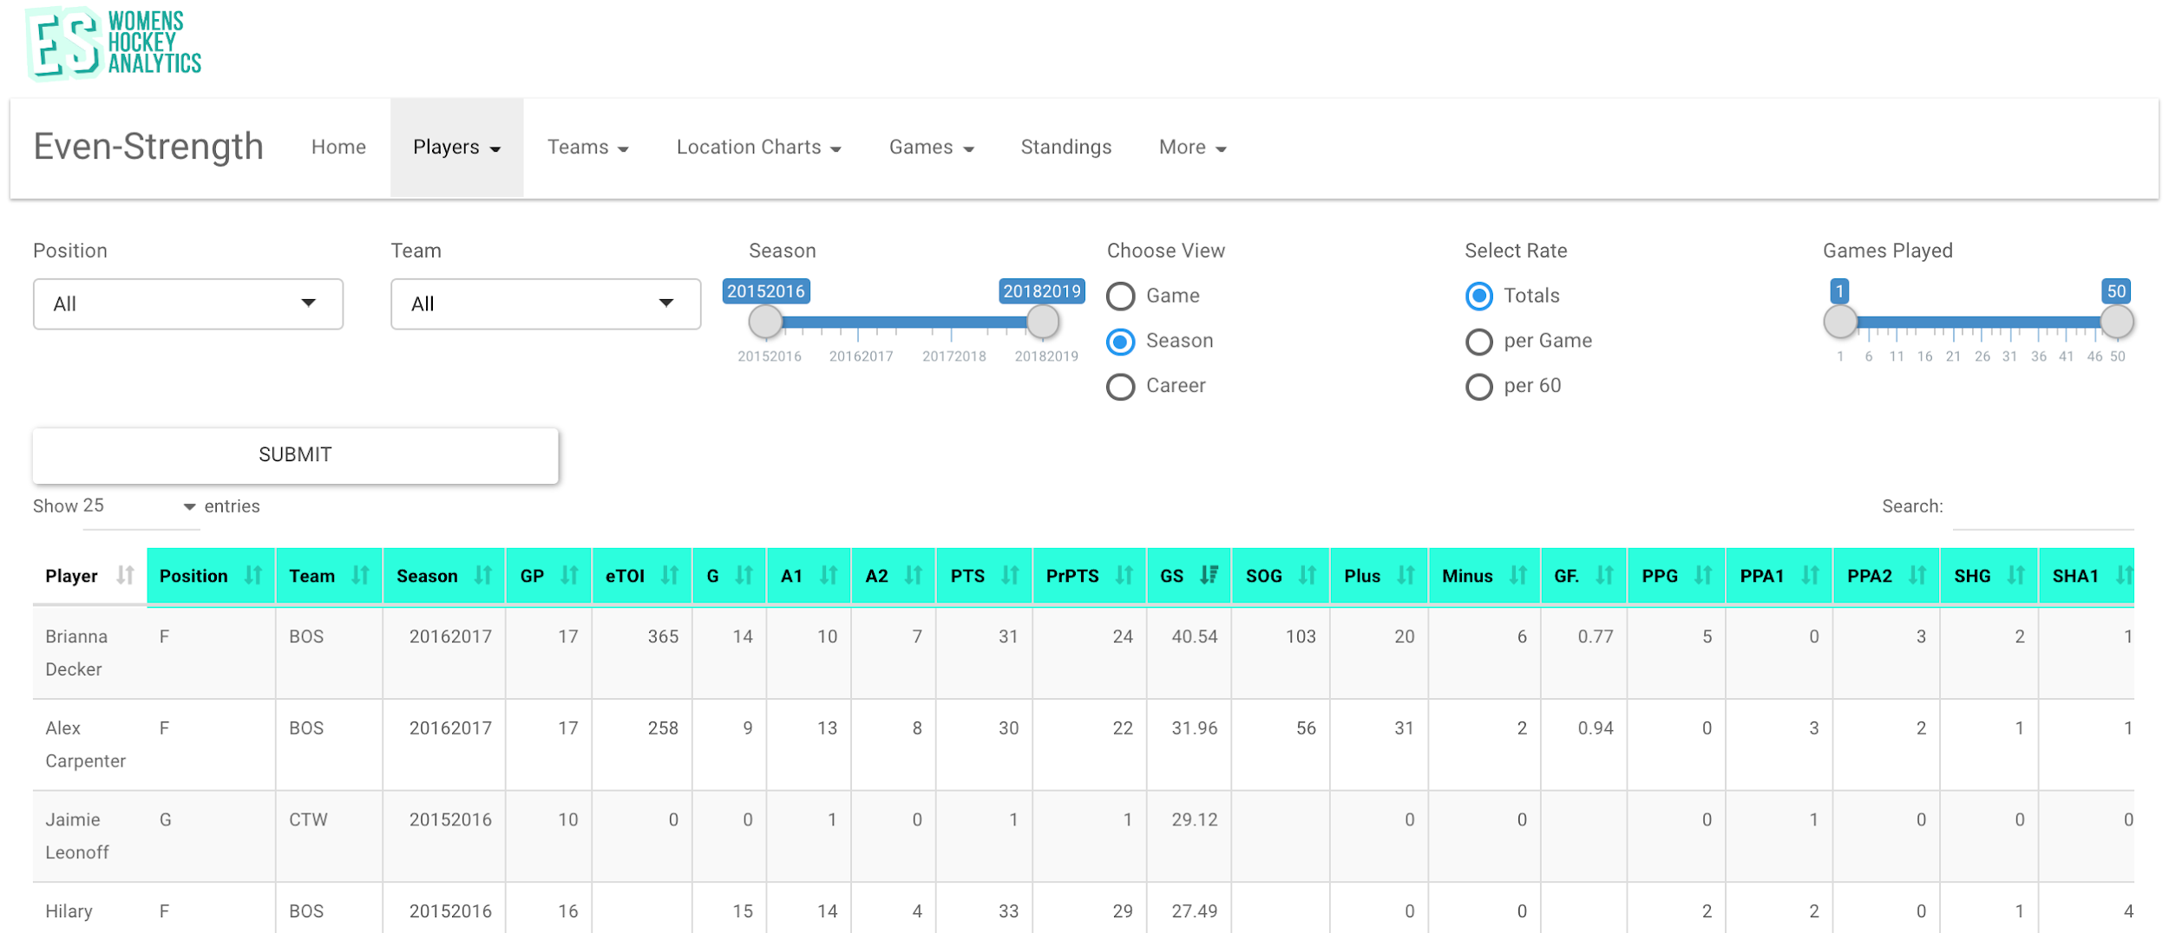

Slide 26
Available Data Sets
AWIHL
NWHL
2018-19
2016-17
2017-18
2019-20

Slide 27
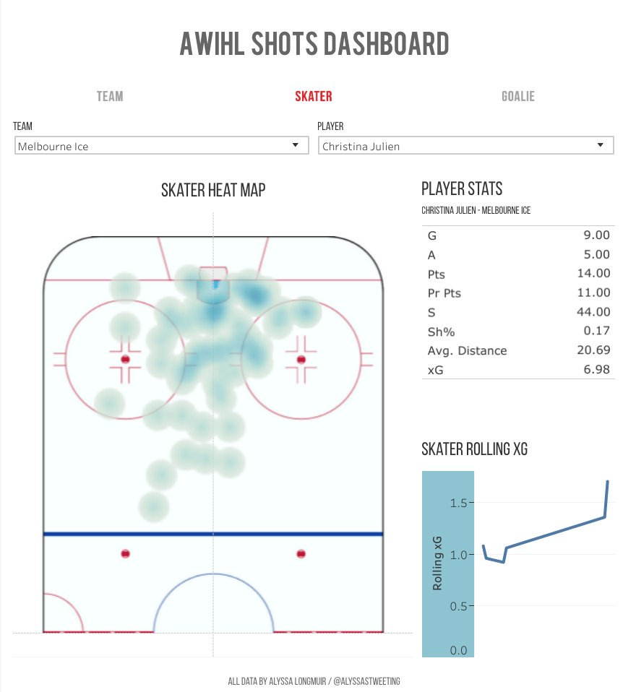
AWIHL
Dashboard

Slide 28
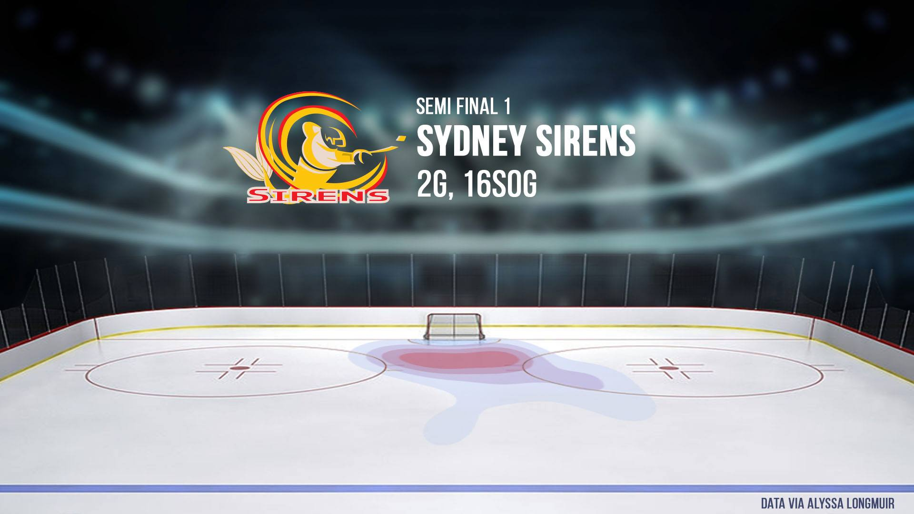
AWIHL
Broadcast

Slide 29
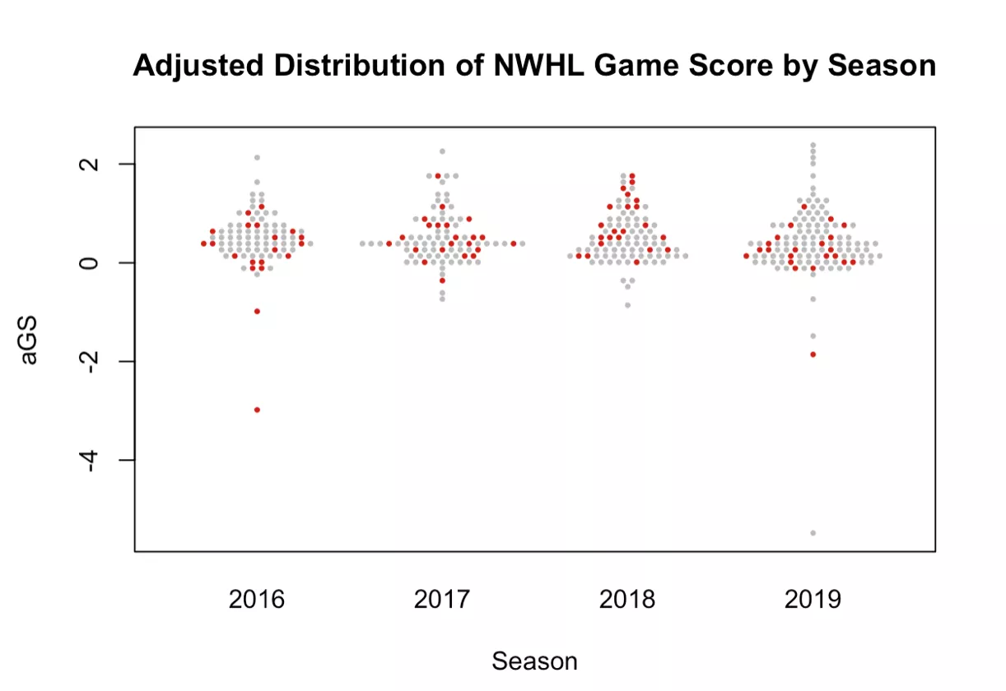

Slide 30
Tracking Stats Accurately
Making People Fix Your Stats
Providing Literally No Stats
Tired:
Wired:
Inspired:

Slide 31
Do Good Work
(With Womens Sports Data)

Slide 32
@
@
WBasketball Follows
@
@
HerHoopsStats
presidual
jessefischer33
NatStatWBB

Slide 33
@
@
Fringe Sports Follows
@
@
magnuscorsi
StatsBomb
MichaelRPoma
baseballpro

Slide 34
@
@
WHockey Follows
@
@
@
@
DigDeepBSB
quarkyhockey
CreaseGiants
hayyyshayyy
shawnferris98
Even_Strength

