Slide 1
Measuring Goals Added Through Passes and Skating in the NHL
RIT Sports Analytics Conference 2019
Nathan de Lara

Slide 2
What is playmaking ability composed of?
Passing the puck effectively
Skating well with the puck

Slide 3
Goal
Find a way to objectively measure the value of non-shooting motions

Slide 4
Definition of a good puck movement
A good puck movement is a movement that increases the likelihood of the attacking team scoring within that possession

Slide 5
How can we distinguish good movements from bad
Watching every game (about 1270 hrs)
Machine learning

Slide 6
Data
Event data with x, y co-ordinates, type of event and id of player responsible
Player and puck location at all times

Slide 7
Model features
x, y co-ordinate
Distance to closest defender

Slide 8
Model labels
xGF, probability of attacking team scoring within 30 seconds
xGA, probability of defending team scoring within 30 seconds

Slide 9
Expected Goal Differential
xGD = xGF - xGA

Slide 10
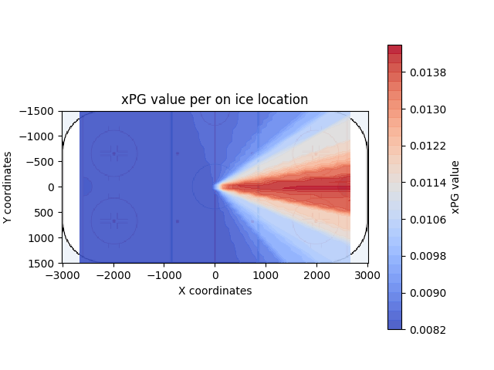
xGD value at location

Slide 11
Last part of xPG
Take the xGD from where the pass was made and a second xGD from the result of the pass
Subtract the first xGD value from the second xGD value to get xPG
xPG = xGDf - xGDi

Slide 12
Results
Z-Scores of the top 3 in xPG/GP
 | Player A | Player B | Player C
Position | F | F | F
xPG / GP | 2.86061 | 2.54234 | 2.1064
Assists / GP | 2.72747 | 2.72747 | -0.025249
Goals / GP | 1.92878 | 1.92878 | 0.532682
PC / GP | 0.672845 | 1.79409 | -0.644619
Shots / GP | 1.9237 | 2.47172 | 0.00566867
xPG/mvm | 2.29885 | 1.67954 | 3.15216

Slide 13
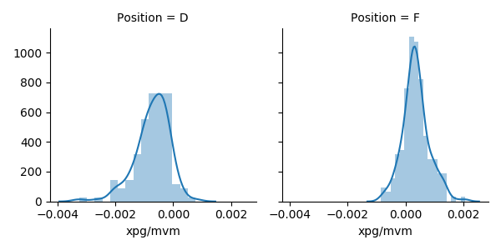
Results

Slide 14
So what?
Models can understand the value of different locations on ice in goals
When the puck is moved a tangible value can be attached to it defining its contribution to the possession
Don’t have to rely on only eye test to measure who’s a smart passer or skater

Slide 15
Limitations & future directions
Angle and Distance did not account for bad passes
Cant test for repeatability
Hard to test for importance of xPG
Making model more accurate and robust
Larger sample size

Slide 16
Thank you
Questions?
Email: natan.de.lara@gmail.com
Twitter: @Nathandelara2
Blog: delaraanalytics.com

