Slide 1
MARTIN-QUINN
or, The Projection Is Coming From Inside The WAR Model
Gordon Arsenoff
September 2019

Slide 2

Plan of the talk

Slide 3

Reality of the talk

Slide 4
What could NHL WAR models use next?
State of the WARt (Perry 2019, EvolvingWild 2019, etc.):
independent estimates per player-year
Real world: past outcomes inform future ability expectations
So: smooth WAR (component) estimates across years
But: account for player age in smoothing
Method: simple growth curve as Bayesian prior on abilities

Slide 5
SALO: Bayesian skater ability (Arsenoff, 2017)
Ordered logit model for net home shots & pens per 0.5 s:
Pr(Y = y) = Λ(y(X^{T}β_{Y} + Z^{T}γ_{Y}) – θ_{Yy})
Gaussian overall prior on ability parameters:
γ ~ N(0, 0.05)
Beta-binomial model for games played as function of ability:
G ~ BB(γ^{T}δ * 82, ϕ)

Slide 6
MARKOV: locally linear WAR (Arsenoff, 2018)
Translate parameterized short-term event probabilities
to game outcome probabilities with a Markov chain
Plug in player ability estimates; get individual win % effects
Derive replacement level from beta-binomial model
and subtract off to get WAR / g

Slide 7
MARTIN-QUINN: growth curve as prior
MARTIN-QUINN Assumption of Random Travel in Natural Quality Under Increasingly Negative Nudges
Originally: SCOTUS ideology scores (Martin and Quinn, 2002)
Gaussian prior on this year’s ability estimate centered at…
last year’s estimate, plus a constant, plus a slope in age:
γ_{Yt} ~ N(γ_{Y(t-1)} + α₀ + A^{T}α₁, 0.05)

Slide 8
What all these moving parts do
MARTIN-QUINN shrinks estimates toward the growth curve
Beta-binomial model fights survivor bias in the growth curve:
allows ability estimation for players with 0 GP!
An immediate consequence of the built-in growth curve:
projections of next year’s ability given this year’s

Slide 9
Computational methods
Fitted with No-U-Turn Sampler (Hoffman and Gelman, 2011)
Monte Carlo over 20K pars: very computationally intense
Sampling took two days and convergence was… dubious
hmu if you know sparse matrix techniques on GPU?

Slide 10
Things done: status of the project
SoG + pen WAR point estimates for the past nine years
SoG + pen WAR point predictions (iffy) for 2019-20
Aging curves (quite iffy) traced

Slide 11
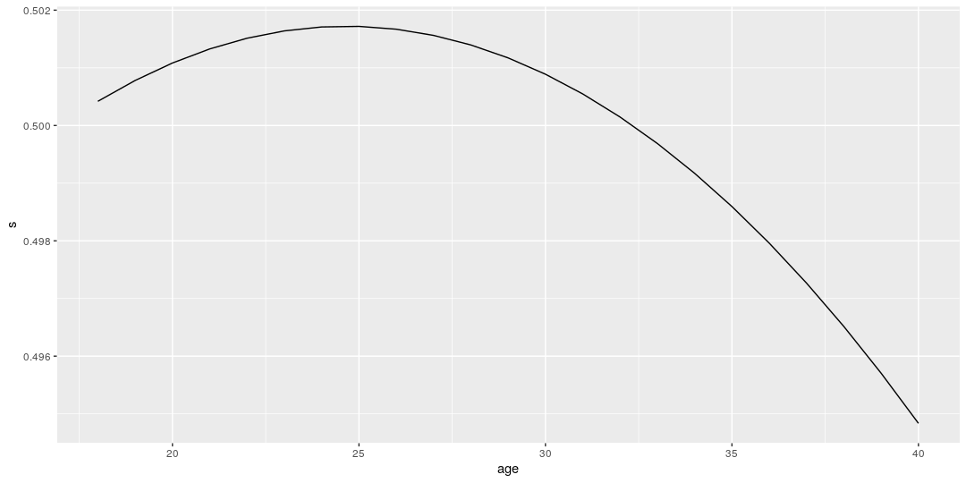
Aging curve in SoG% effect (50% at 17yo)

Slide 12
Aging curve evaluation
No real curve found in penalties effect at all:
unclear if it even points up or down
Curve in SoG% effect: right shape, but too flat?
An NHL-average 17yo should peak at 50.18% SoG for?
Can better estimates be found with longer computation?

Slide 13
Left undone: validation vs. other WARs
On paper: do 2018-19 WAR projections predict Corsica WAR?
In practice: run without 2018-19 data totally failed
Inexplicable bad initial values -> never reached target distro
Can eventually finish this with several days’ computation

Slide 14
Left undone: set the prior variances
On paper: can just MC sample prior variance parameters
In practice: slows convergence by orders of magnitude
Can be set with non-Bayesian methods instead, with effort
Can eventually finish this with several days’ computation

Slide 15
Left undone: error bars on WAR
On paper: immediate consequence of MC sampling
In practice: WAR takes 25 min. per sample, w. 1024 samples
Should parallelize? But not yet coded as such
Can eventually finish this with several days’ computation

Slide 16
Left undone: shot quality and shooting
On paper: just add more simple Bayesian model parts
In practice: 3x the params, 9x the effort or more
No idea if I can actually pull off this feature

Slide 17
Where to go from here
No high-quality estimates yet
Still interested to see if any can be obtained
Will keep attempting to improve this through January

Slide 18
Where to watch for progress on this project
Code: https://github.com/deepfriar
Results and writing: https://www.salohockey.net
Twitter: @deepfriar

