Slide 1
Shootout Success:
Is there a pattern?
Notes:
Wings last season at the Joe 16-17
-won 9 shootouts
Athanasiou and Larkin great at breakaways, bad at shootouts
Level of overthinking? Trying to much?
Shootouts have been proven important
-just this last season, carolina/columbus one point a part and could have changed the entire playoffs
If specific players aren’t predictors of success, then maybe it depending

Slide 2
1.
Prior Research
Notes:
Wings story here or on slide before???

Slide 3
Past Research: It’s a Crapshoot
“Impact of Going First on Winning an NHL Shootout” - Michael Schuckers, Zach Nelson
“On the Length of NHL Shootouts” – W.J. Hurley (2008)
“Examining the home advantage in the National Hockey League: Comparisons among regulation, overtime, and the shootout” – Matt D. Hoffmann, Todd M. Loughead, Jess C. Dixon, Alyson J. Crozier (2016)
Notes:
Prior research has covered:
-importance of shootout on playoff positioning
-away/home team win rates, what the impact of shooting order is
-the length of shootouts
-whether higher quality teams have an advantage in the shootout
-lots of studies about if it’s a crapshoot aka past performance is predictive of future performance with shooters and goalies (no because of sample size)
-Gabe Desjardins and Schuckers articles

Slide 4
Past Research: It’s a Crapshoot
“NHL Shootout is a Crapshoot” – Michael Schuckers (2010)
“Shootouts: Does past performance mean anything?” – Gabe Desjardins (2009)
“Is the Shootout Really a Crapshoot?” – Eric Tulsky (2012)
“Predicting coin flips using resampling and hierarchical models to help untangle the NHL’s shoot-out” – Michael J. Lopez and Michael Schuckers (2016)
Notes:
Prior research has covered:
-lots of studies about if it’s a crapshoot aka past performance is predictive of future performance with shooters and goalies (no because of sample size)
-Gabe Desjardins and Schuckers articles
-final article: present idea that “there is variability in performance that exceeds what we would expect due to chance alone”

Slide 5
2.
Methodologies
Notes:
Explain my mental process, instead of considering every player separately because they change what they are doing, consider what they’re doing
Some players do the same thing every time ie Tarasenko
But most people don’t

Slide 6
Methodologies
783 shootout shots from the 2017-2018 season
  242 Goals
  384 Saves
  157 Misses

Slide 7
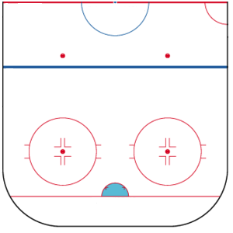
Zone Locations
1
3L
2L
1L
2
1R
2R
3R
3
4
5
6
7
Notes:
Tracked for a multitude of factors including shot plot data, amount of movement between zones, time length of shot, amount of puck handling

Slide 8
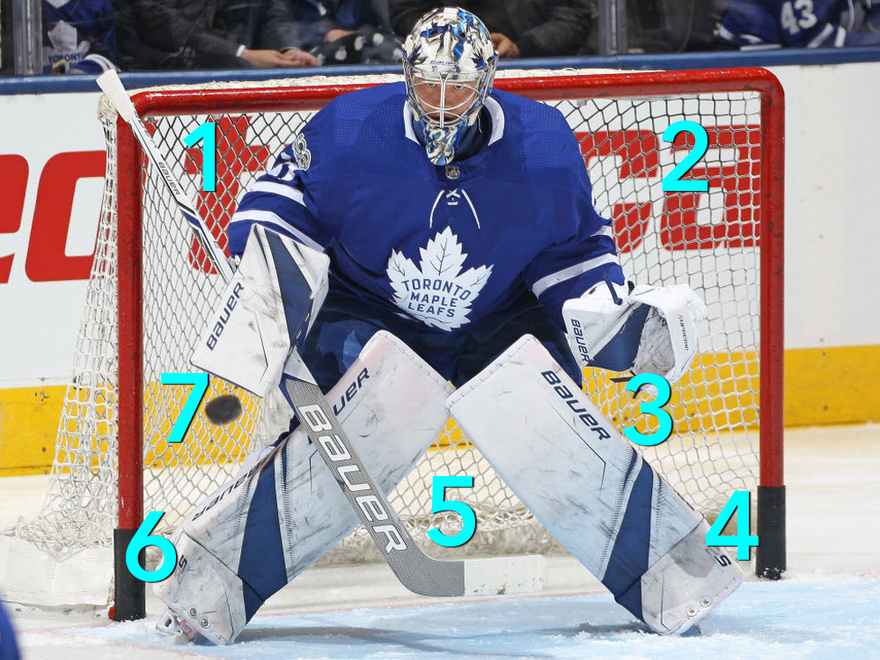
Goal Aim Locations
Notes:
And where the puck was aimed to try and cover everything that may impact shooter success.

Slide 9
3.
Findings

Slide 10
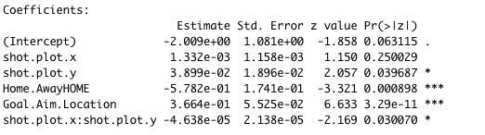
Binomial Logistic Regression
Statistically Significant Factors:
  aim location
  whether a player was home or away
  shot location
Notes:
After running a binomial logistic regression on the data, several factors were statistically significant: aim location, whether a player was at home or away, and shot location.

Slide 11
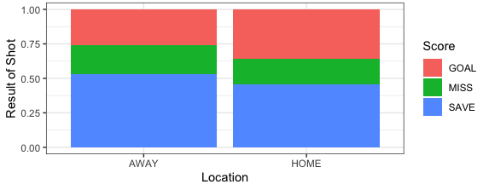
Proportional Total by Home/Away
Notes:
Not something that can be changed, but interesting to see if this would be something that held over a larger dataset

Slide 12
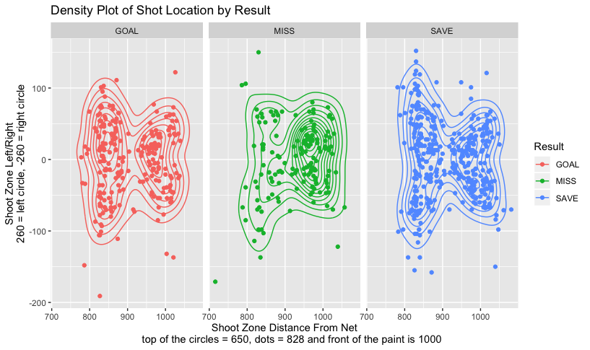
Shot Location by Result

Slide 13
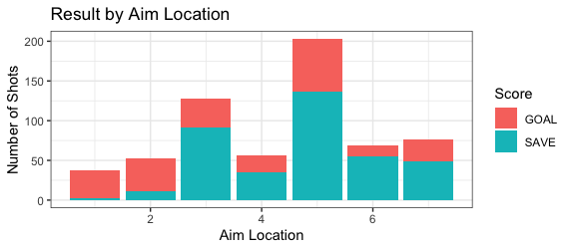
Result by Aim Location

Slide 14
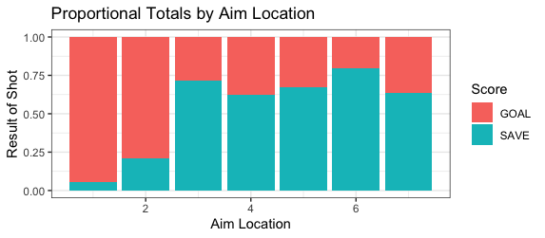
Result by Aim Location

Slide 15
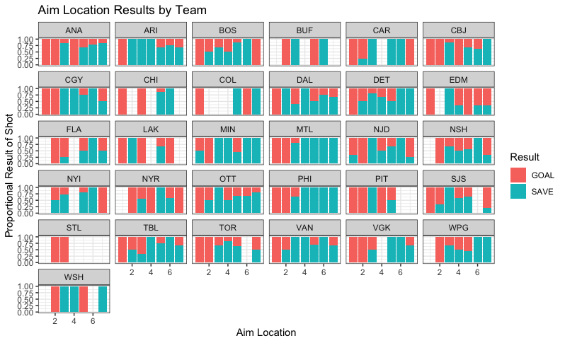
Proportional Aim Location Results by Team

Slide 16
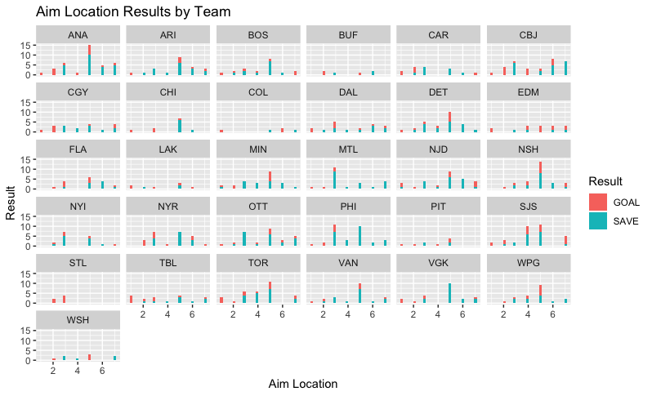
Aim Location Results by Team
Notes:
The aim location data could be used to better strategize for success during the shootout and consequently, potentially impact team standings.

Slide 17
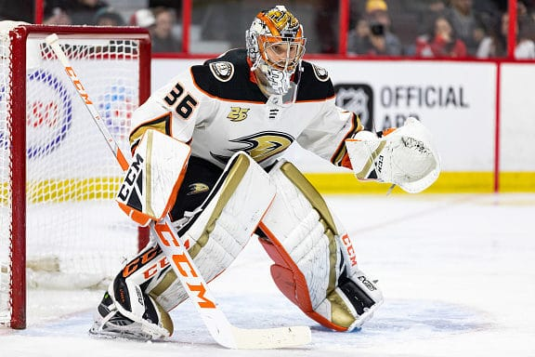
Further Research
Notes:
I tried to track goalie movement and how far they left their crease, but the goalies aren’t shown throughout the course of the shot frequently so it was impossible to get accurate data
Furthermore, it is likely that increased data will allow for a greater understanding of shooter success as well as allowing for insight into goaltender strategies.

Slide 18
Acknowledgements
Michael Schuckers
Hockey Graphs Mentorship Program
https://shotplot.app/ by Andrew Pucci
Presentation template by SlidesCarnival

Slide 19
Thanks!
You can find me on Twitter at
@abby_asma
Notes:
Grey #454f5b
Light grey #738498
Neon green #c7f464
Aqua #4ecdc4

