Slide 1
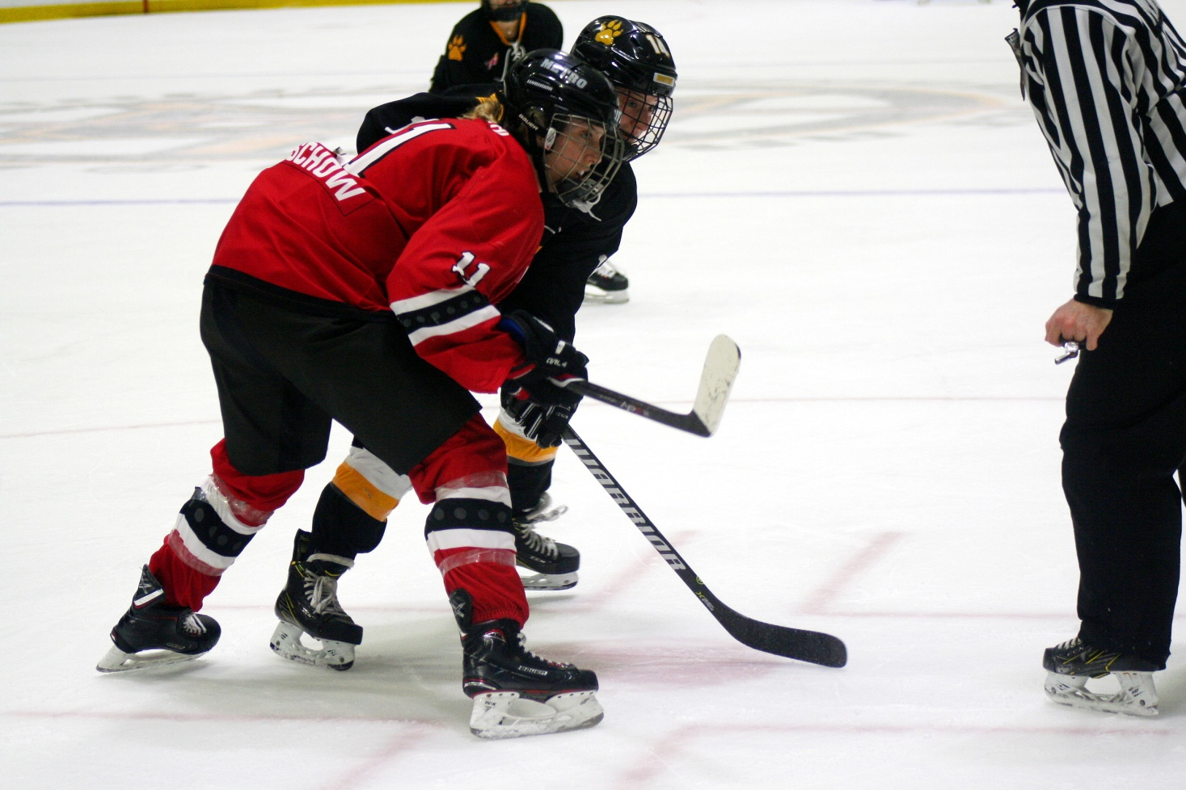
Women’s Hockey Analytics
Mike Murphy | @DigDeepBSB

Slide 2
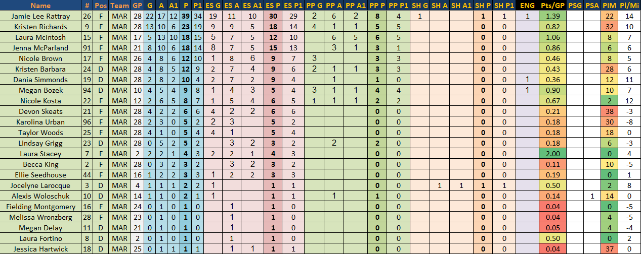
Primary Point Project

Slide 3
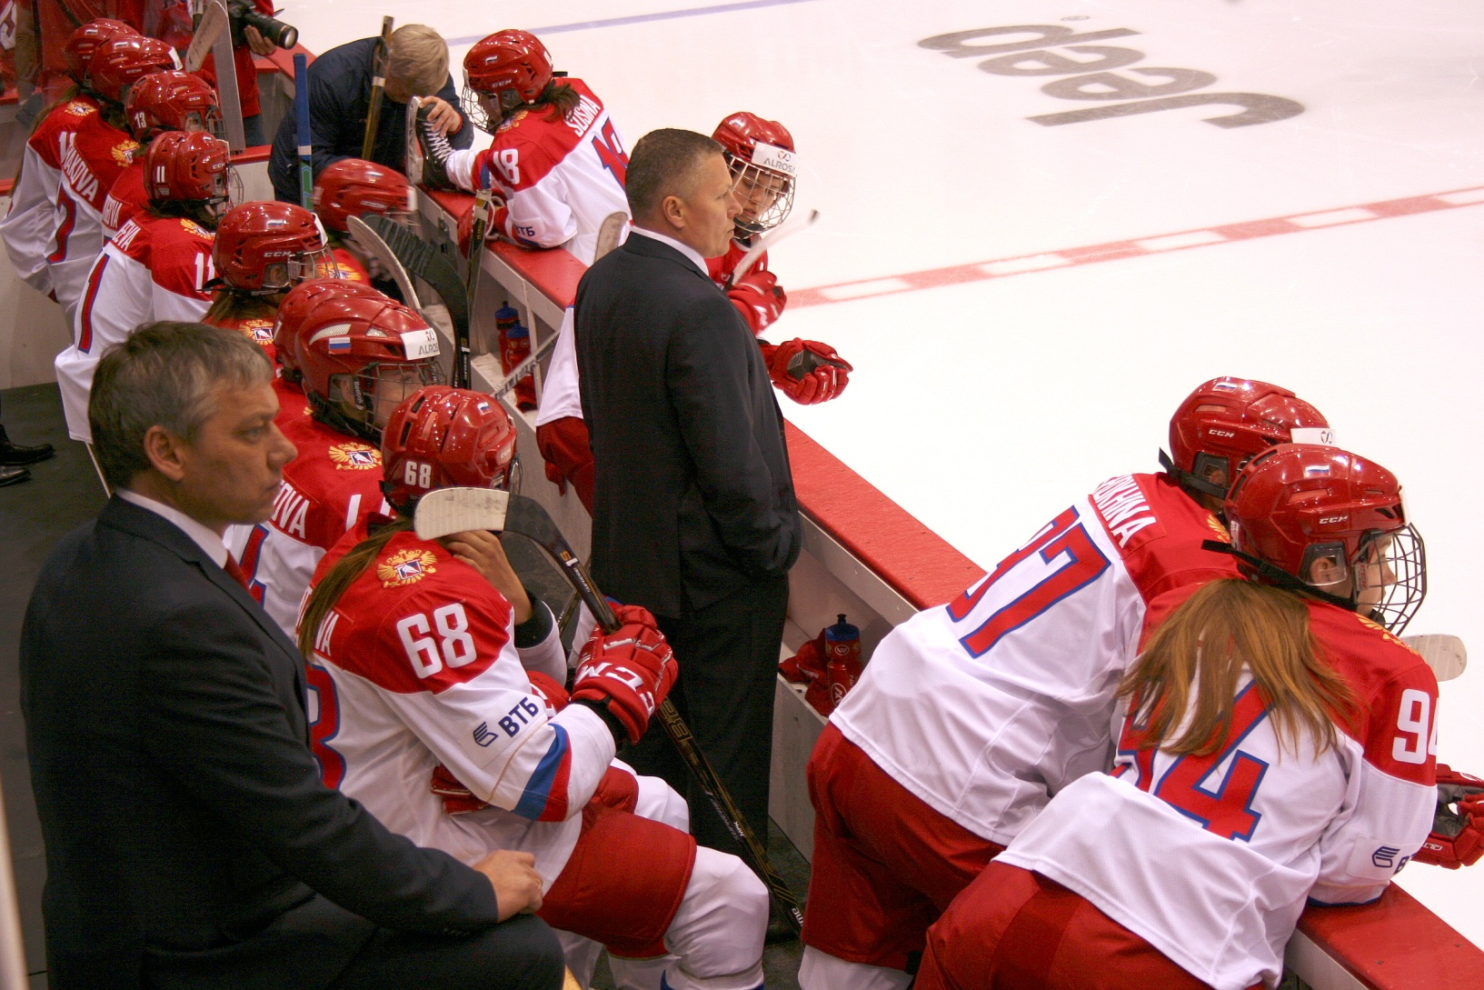
Myths and Misconceptions

Slide 4
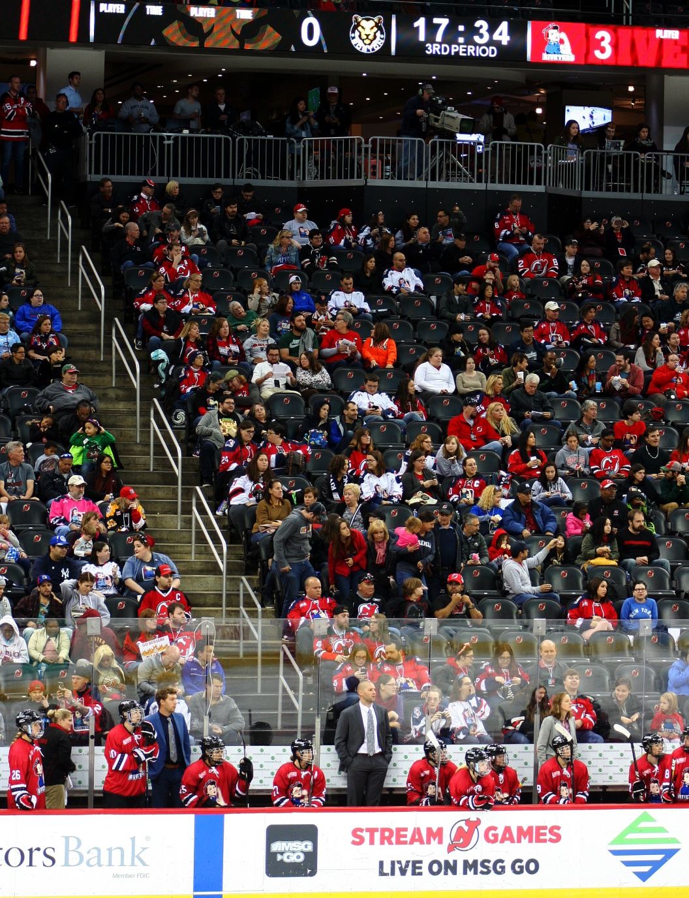
“No one cares.”
  More fans and bigger audiences than ever before.
  4.65% growth in women’s registrations with USA Hockey in the last year.
  0.72% growth in men’s registrations.

Slide 5
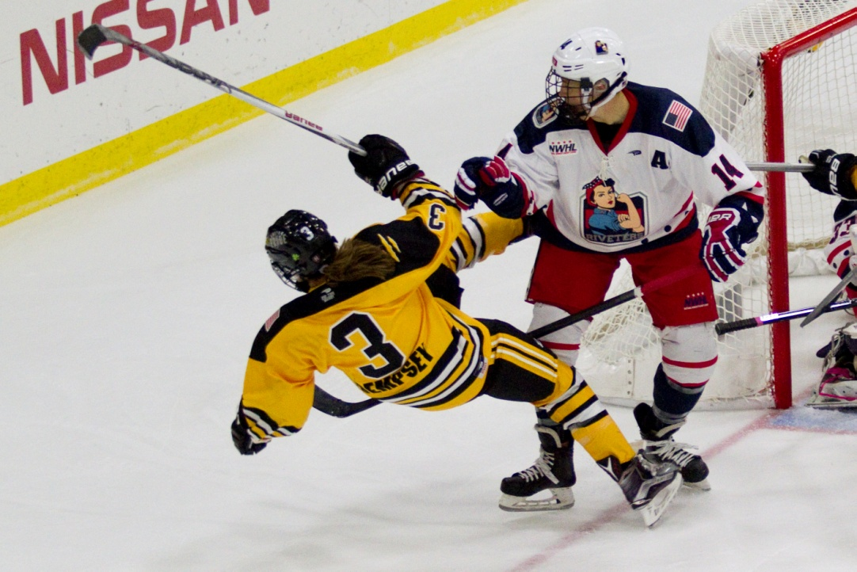
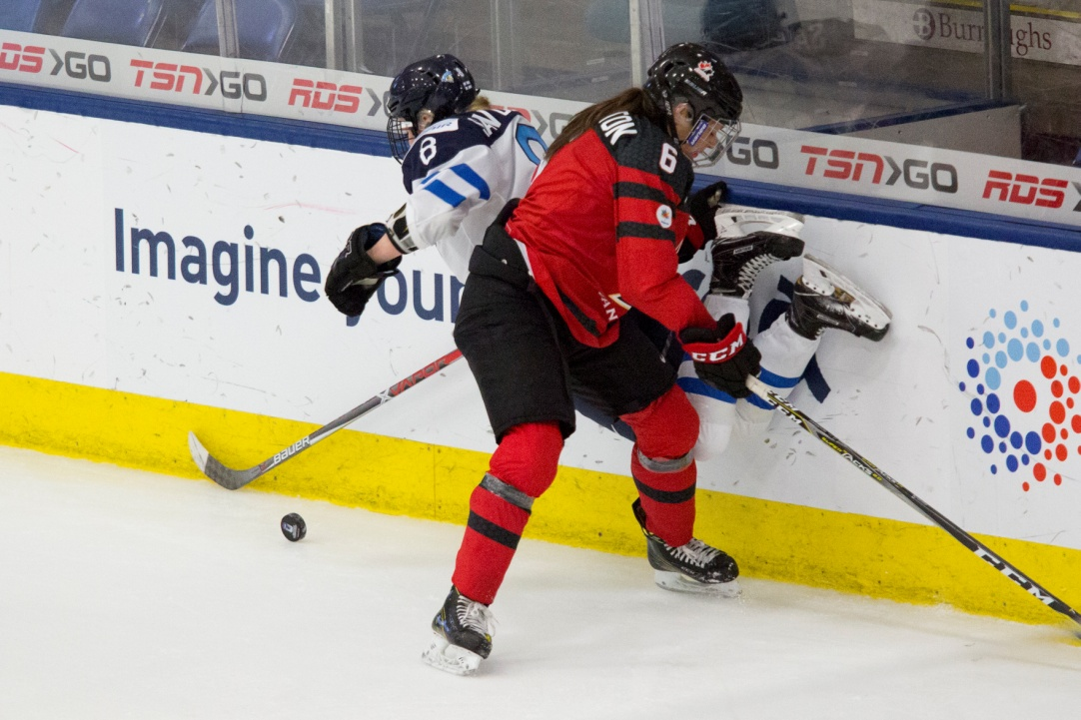
“There’s no hitting.”
Photos courtesy of Michelle Jay

Slide 6
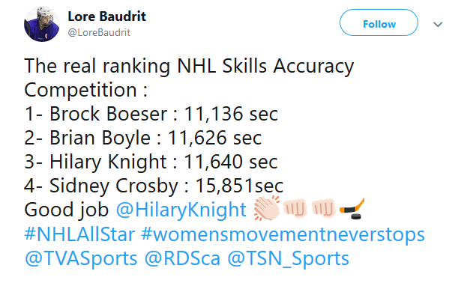
“They are not as skilled.”
Different is not lesser.

Slide 7
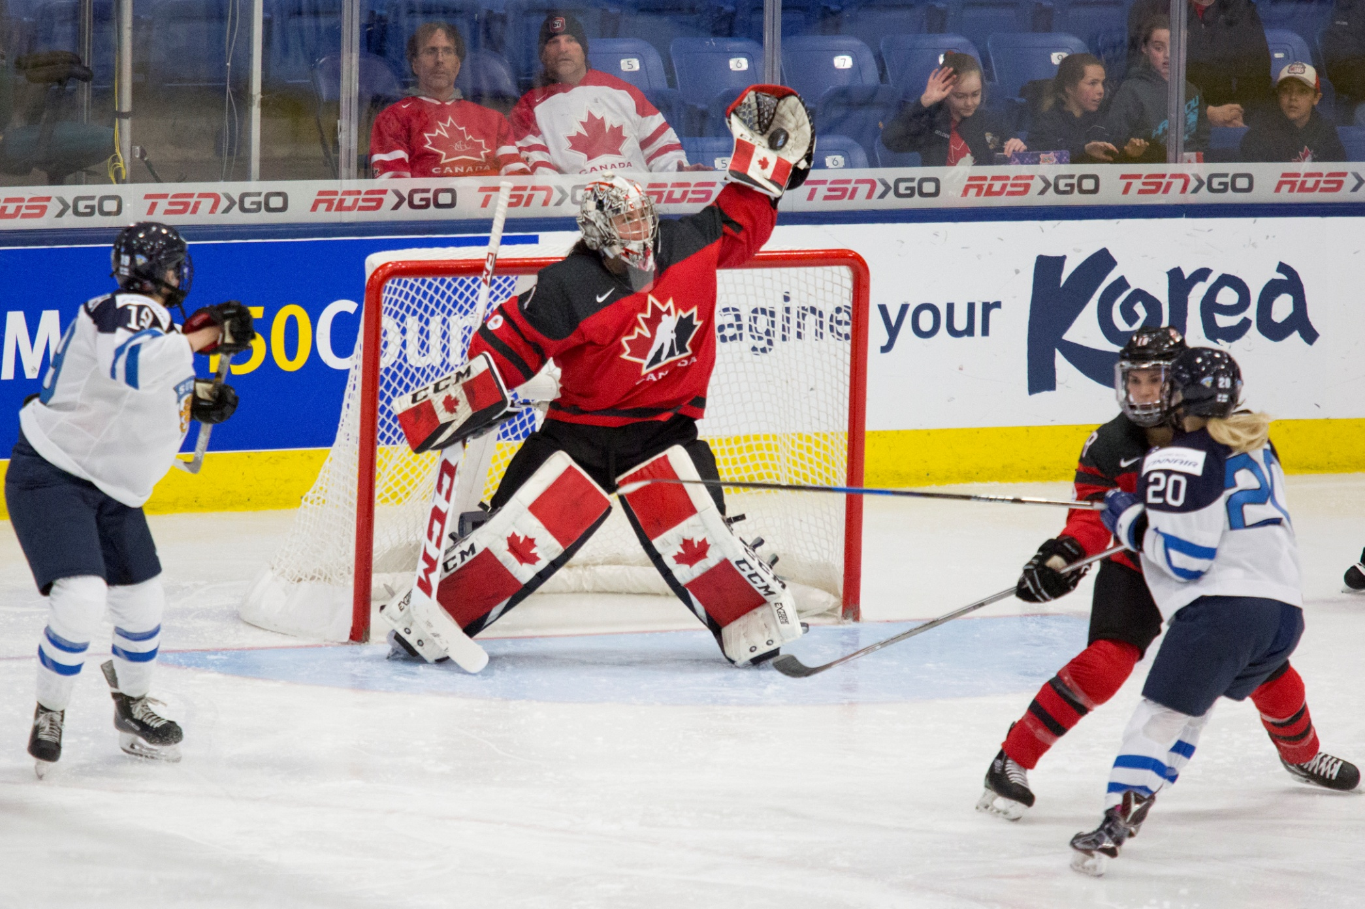
Photo: Michelle Jay

Slide 8
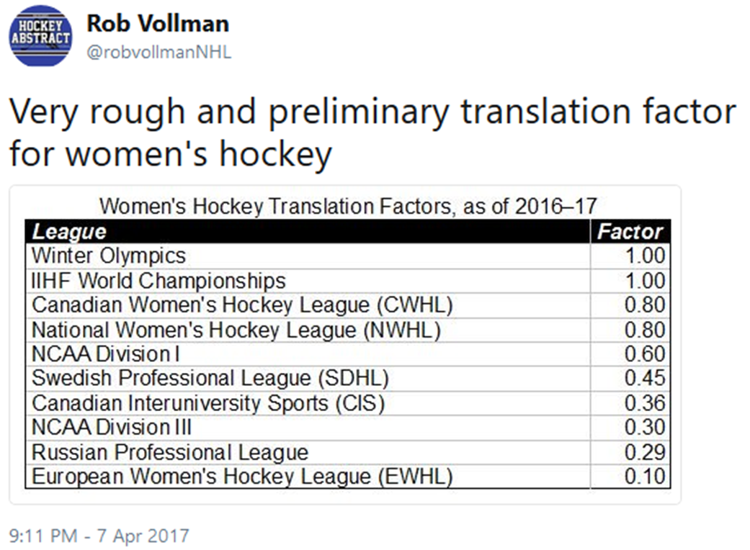
A Tale of Two Leagues
The Canadian Women’s Hockey League (CWHL) – Est. 2007, currently has six teams in three countries.
The National Women’s Hockey League (NWHL) – Est. 2015, currently has five teams in the United States.

Slide 9
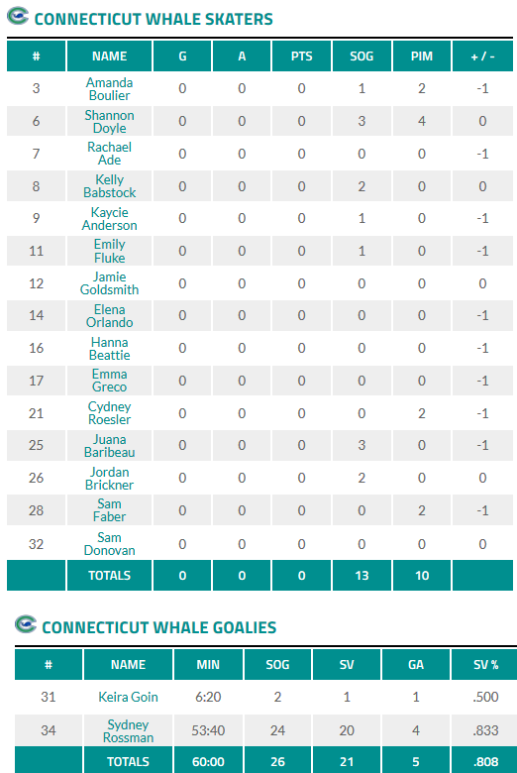
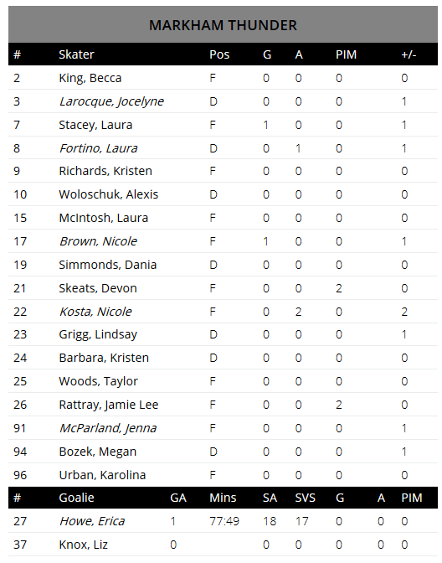
NWHL Box Score
  CWHL Box Score

Slide 10
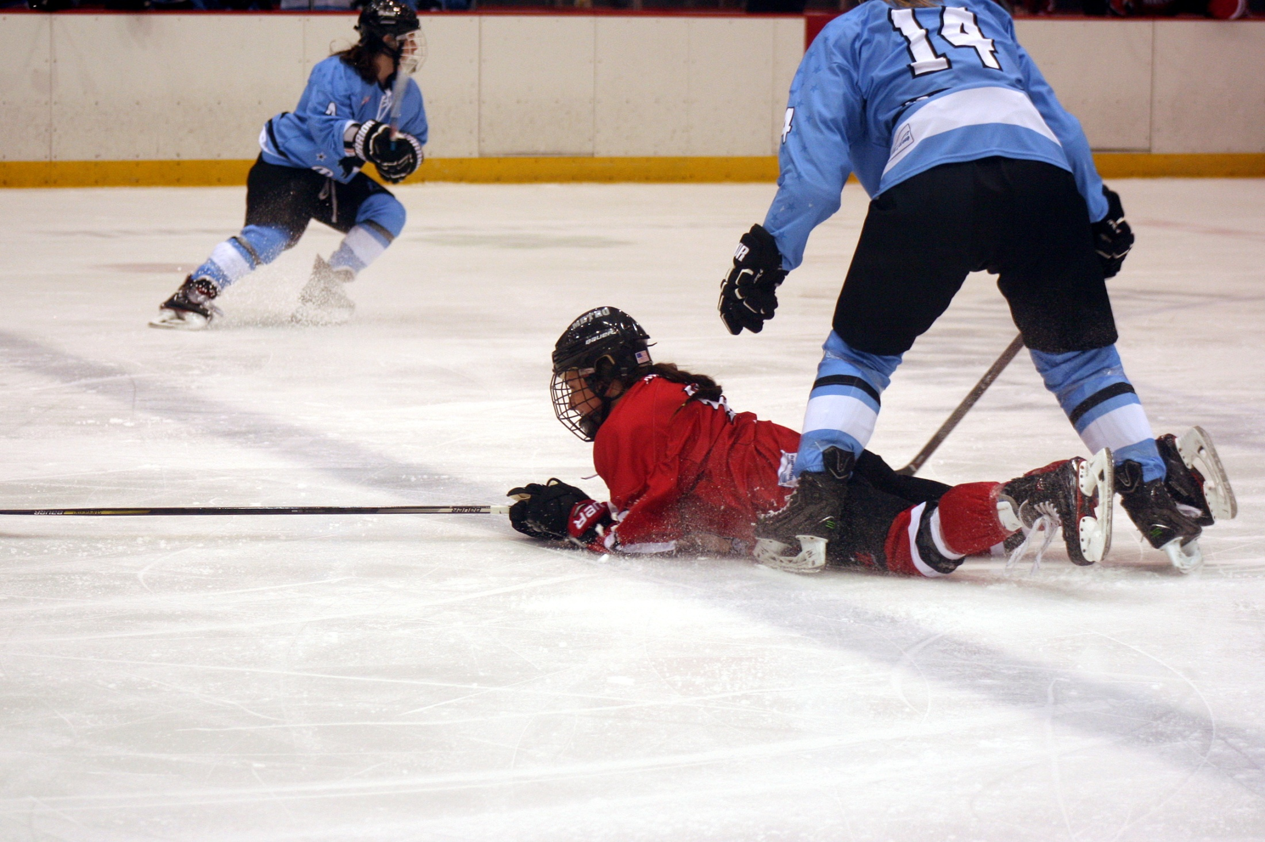
Obstacles in Women’s Hockey Analytics
Problems similar to the early days of men’s hockey.
Only the most basic statistics are available.
Quality of data.
Comparing levels of competition.
The NWHL has more stats, so more work is being done with NWHL data.

Slide 11
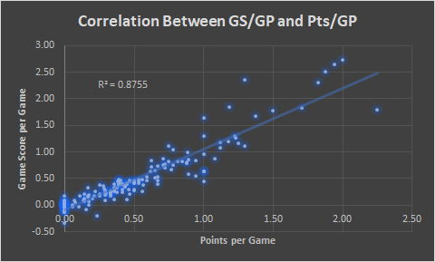
NWHL Game Score
Shawn Ferris | hockey-graphs.com
Skater Game Score =
G + (.64*A) + (.11*SOG) + (.12*FOW) – (.12*FOL) – (.17*PEN)
Goalie Game Score =
(.14*SV) – GA

Slide 12
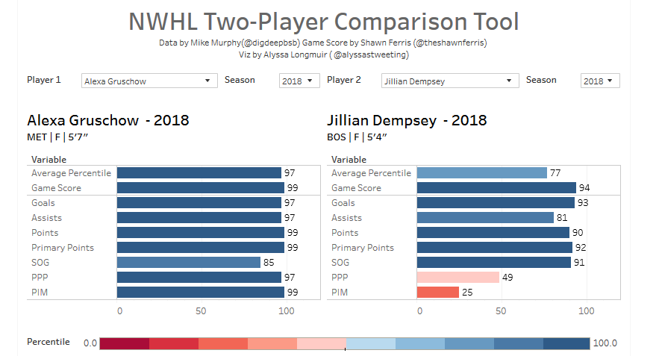
Alyssa Longmuir’s Work

Slide 13
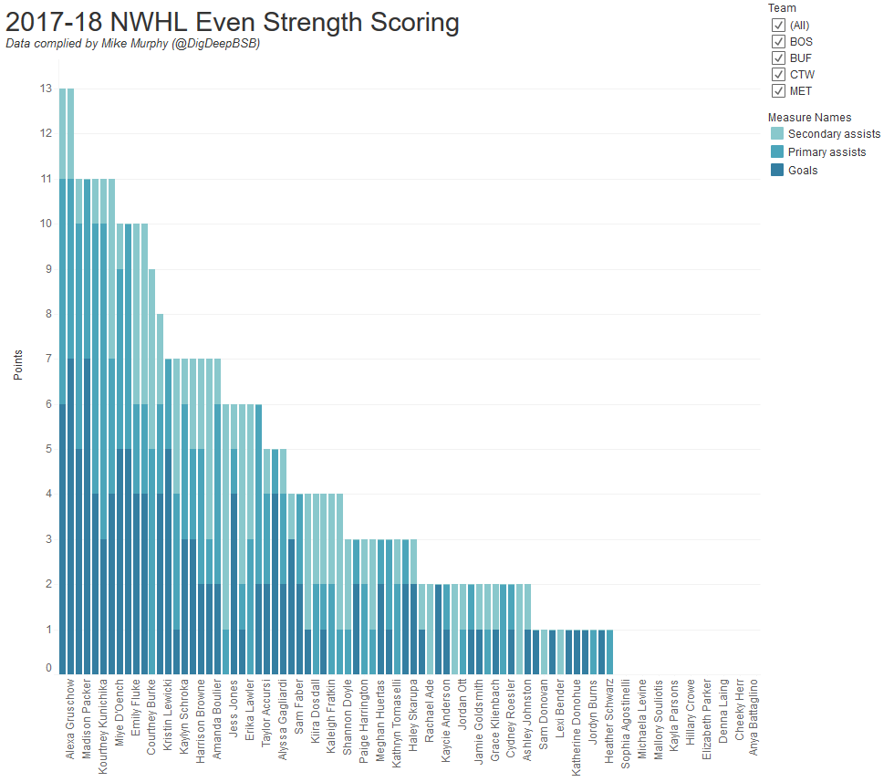
Visualizations
Shayna Goldman and others are making stats more accessible to fans.

Slide 14
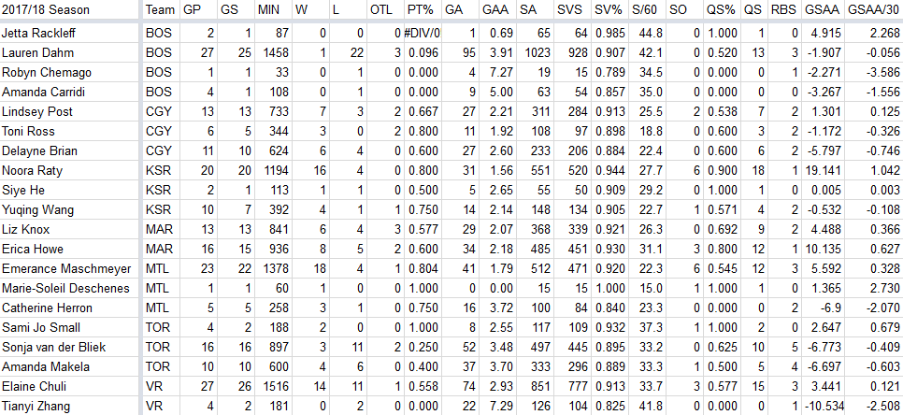
Goaltending
The work of @CreaseGiants shows us how much we can get out of basic goalie stats.

Slide 15
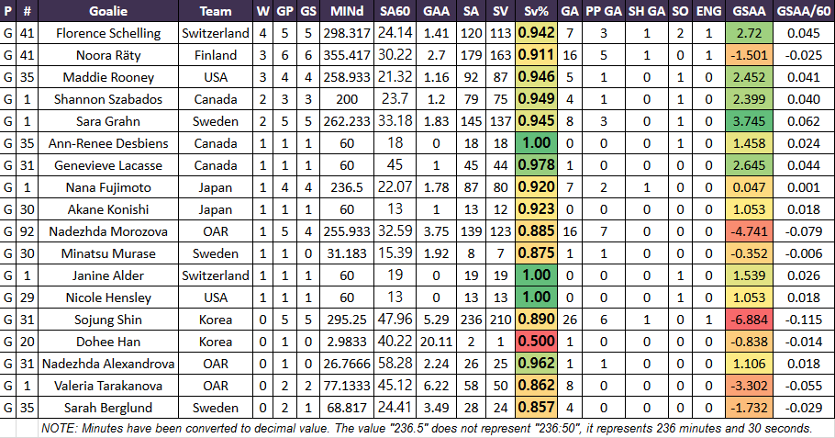
Goaltending Data from Pyeongchang

Slide 16
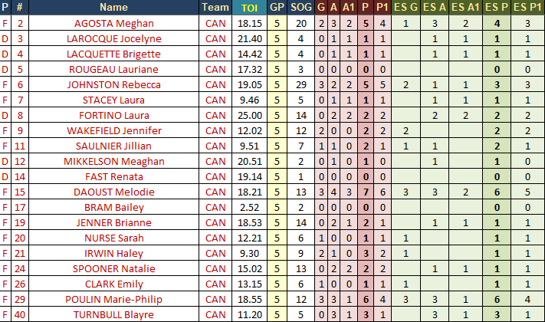
Pyeongchang and Next Steps
Pyeongchang: more resources = more data
Olympic data is great, but has its own issues
What else can we do with what we have?
What do we need to take analytics in women’s hockey to the next level?

Slide 17
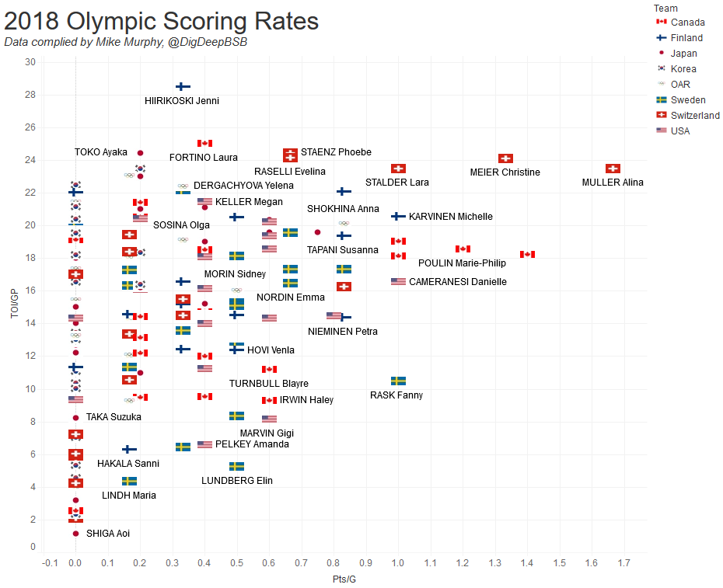
Time on Ice AKA the Holy Grail
Viz by Shayna Goldman

Slide 18
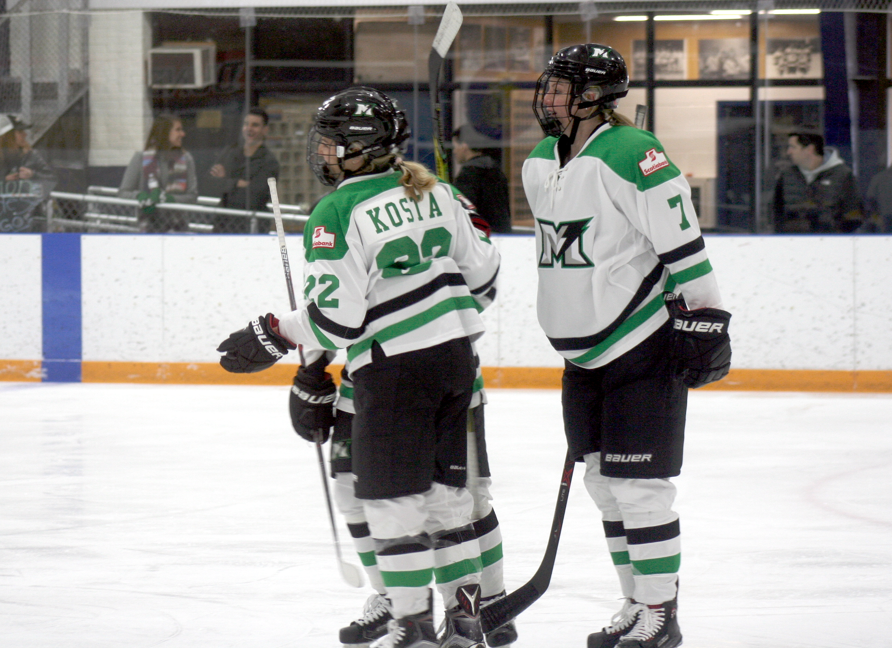
A Worthwhile Frontier
The women’s game has never been bigger.
Recording history.
Gain a better understanding of a frequently misunderstood and underpublicized sport.
Expand our knowledge of hockey as a whole.

Slide 19

Spotlight
Alyssa Longmuir | @alyssastweeting
  theicegarden.com | aklongmuir.com
Shawn Ferris | @TheShawnFerris
  hockey-graphs.com | stanleycupofchowder.com
Rob Vollman | @robvollmanNHL
  hockeyabstract.com
Adam Gavriel | @nerdhockeyAG
  Nerdhockey.com | NWHL.zone
@CreaseGiants |
  creasegiants.wixsite.com
Shayna Goldman | @hayyyshayyy
  blueshirtbanter.com | theathletic.com | hockey-graphs.com
All pictures property of Mike Murphy unless otherwise noted.

