Slide 1
Hurry Smart
By Matt Cane
@Cane_Matt
An Introductory Look at Curling Analytics

Slide 2
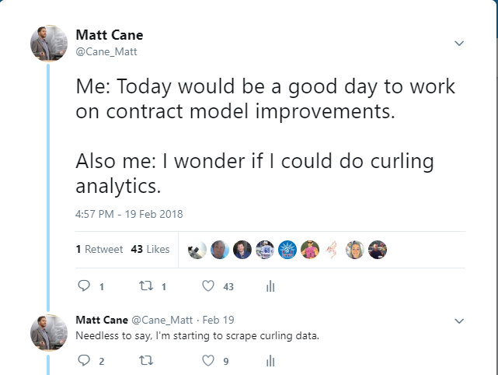
Why Curling?

Slide 3
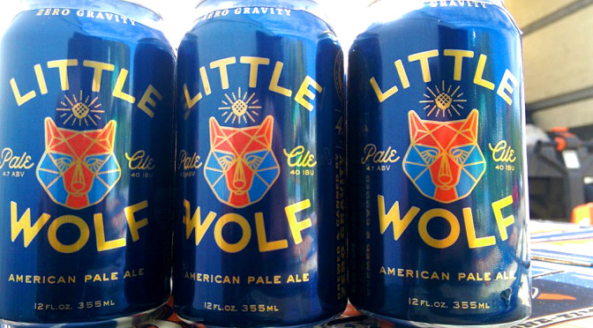
But really was caused by this…

Slide 4
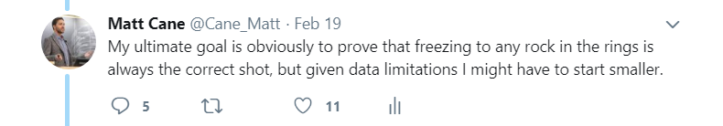
And kinda a little bit by this…

Slide 5
What is Curling?
A sport beloved by dozens of Americans and approximately 36.29M Canadians
  Roughly the same fan base as the World Junior Hockey Championship
Most importantly:
  Curling is a drinking sport
  Fun fact: Not legally allowed to operate a curling club without a liquor license

Slide 6
Rules And Terms
Each team has 4 players (Lead, Second, Third, Skip)
  Teams and players alternate shots, each player takes two shots
End: The completion of 16 shots (2 for each player). A standard game is 10 ends long.
Rings/House: The scoring area – a stone has to be in the rings to score points
  Button: The center of the rings

Slide 7
Rules And Terms
Hammer: Last shot in an end.
  The hammer is decided by a coin-toss or a competition to shoot a single stone closest to the button.
  In subsequent ends the hammer goes to the team who conceded a point last
Steal: Scoring one or more points without the hammer
Blank: When no teams score and the team that previously had the hammer retains it

Slide 8
Rules and Terms: Shot Types
Guard: A shot that sits above the rings that aims to make it more difficult to hit/shoot into the rings
Draw: A softer shot that aims to get as close to the button as possible
Hit/Take-out: A harder shots that aims to hit a stone and eliminate it from play
Raise: Hitting a closer stone into a stone that’s further back
Freeze: Placing a stone directly in front of another stone
In-turn/Out-turn: The direction the shooter spins the shot
4-Rock Rule: Teams can’t eliminate stones outside the rings until after the 4th shot

Slide 9
Curling Points System
Each shot is scored by judges on a 4 points system
  A shot executed correctly gets 4 points
  A complete miss gets 0 points
  Partial points are given for partially successful shots
Players are evaluated at the end of the game on their overall point total vs potential point total.
This system is somewhat arbitrary.

Slide 10
Data Sources
End-by-End Results for Canadian Women’s (Heart) and Men’s (Brier) Championships
  Data back to 1980
Play-by-Play Data for Men’s and Women’s Olympic and World Championships
  5 Tournaments, 2017-2018
  405 Games
  8192 Ends
  60404 Shots, including turn, points, and aim (hit/draw/guard)

Slide 11
Objectives
Curling Analytics are relatively non-existent
  Kevin Palmer: http://curlwithmath.blogspot.com
  Focus on win probability, situational evaluations
In this talk our aim is:
To use data to understand the flow of a curling game
  How do scoring rates/steals/blank ends change during the game
  How difficult are various shots
To use data to evaluate curling strategies
  What’s the value of having the hammer to start the game?
  Would you rather enter the 10th end down 1 with the hammer or tied without the hammer?
  How aggressive should you play early in an end?
To evaluate whether the curling scoring system even makes sense

Slide 12
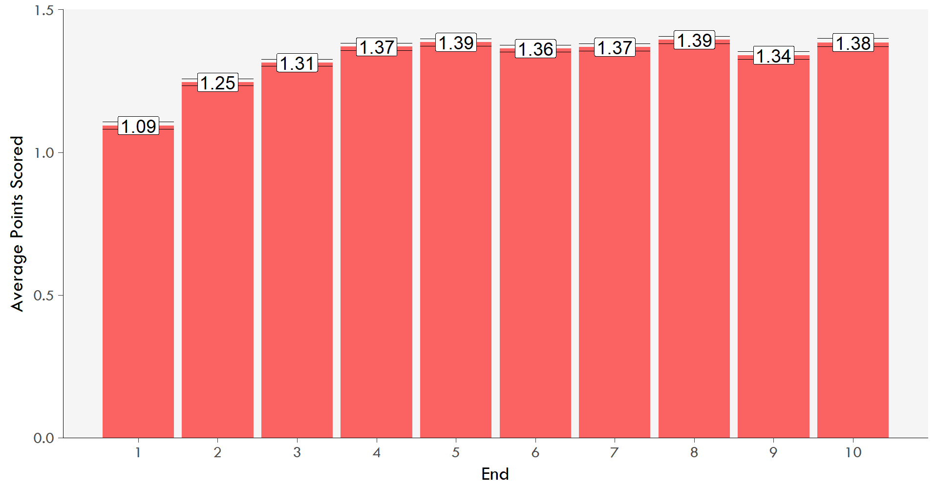
Scoring Trends

Slide 13
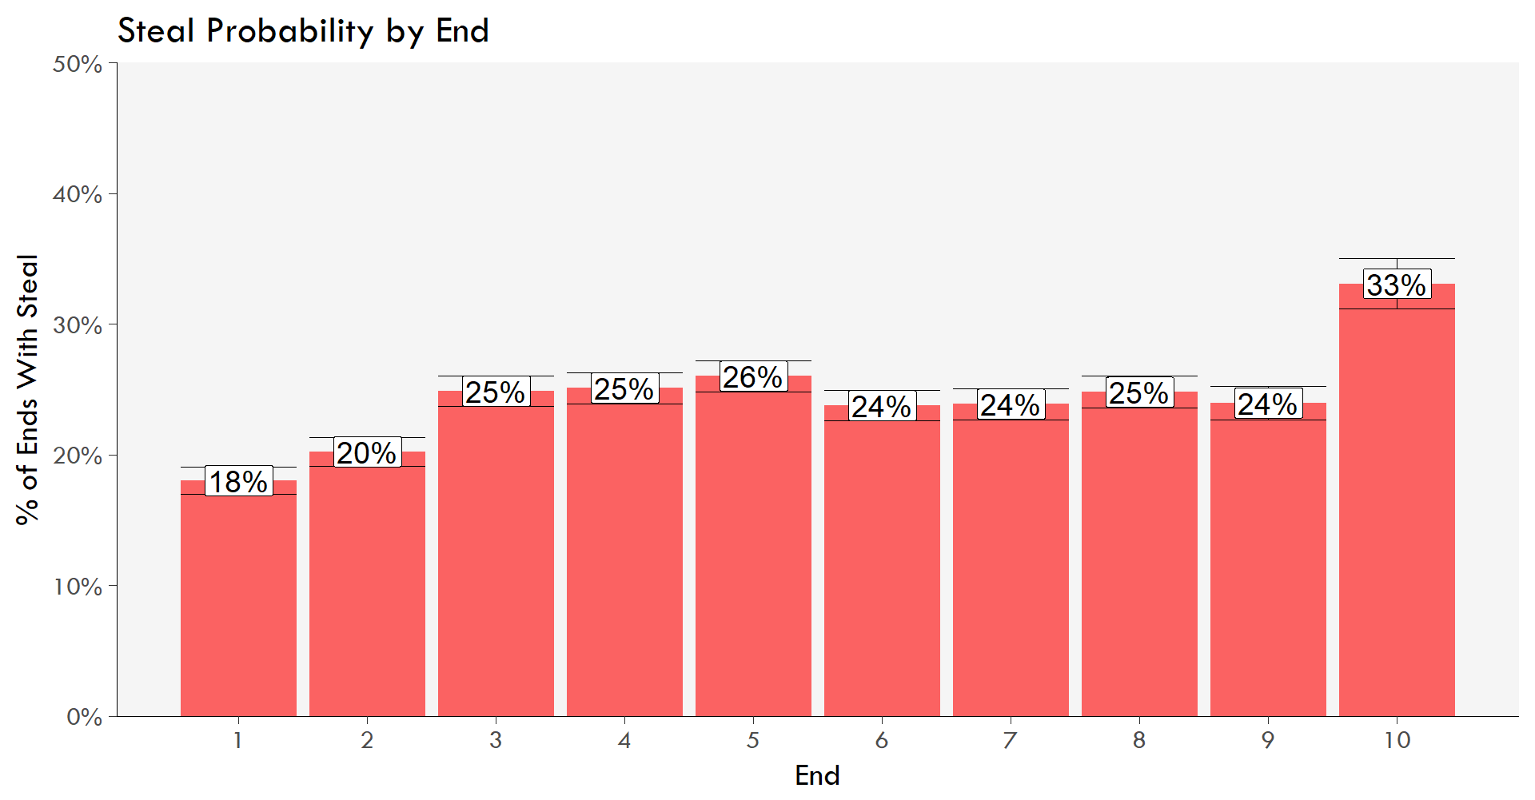
Steal Trends
Notes:
2 interesting things:
-The “game stages’ that we saw in the score are a bit different – rounds 3-9 are mostly the same, with 1&2 lower and 10 much higher
-You may think end 10 may just be desperate teams that need to score multiple points giving up steals
-If you eliminate teams that are down 2+ the rate in end 10 drops 10 31%

Slide 14
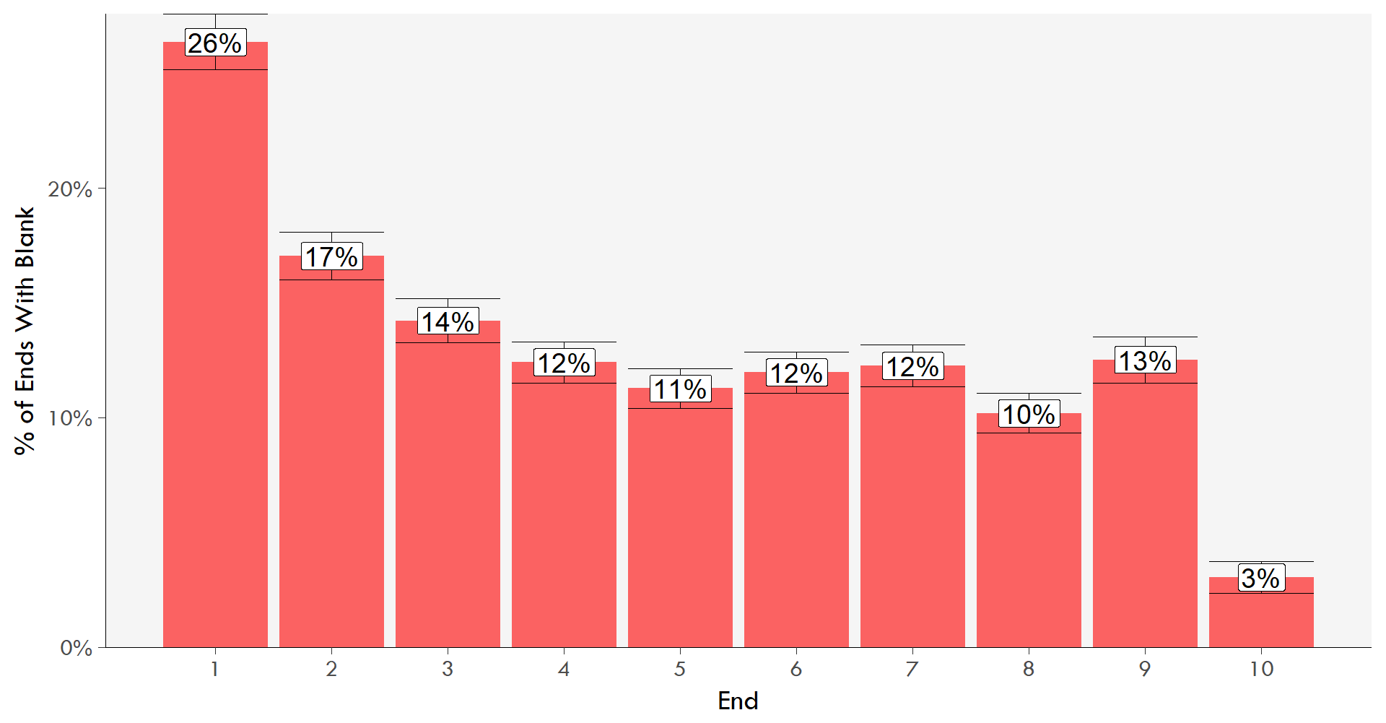
Blank Trends

Slide 15
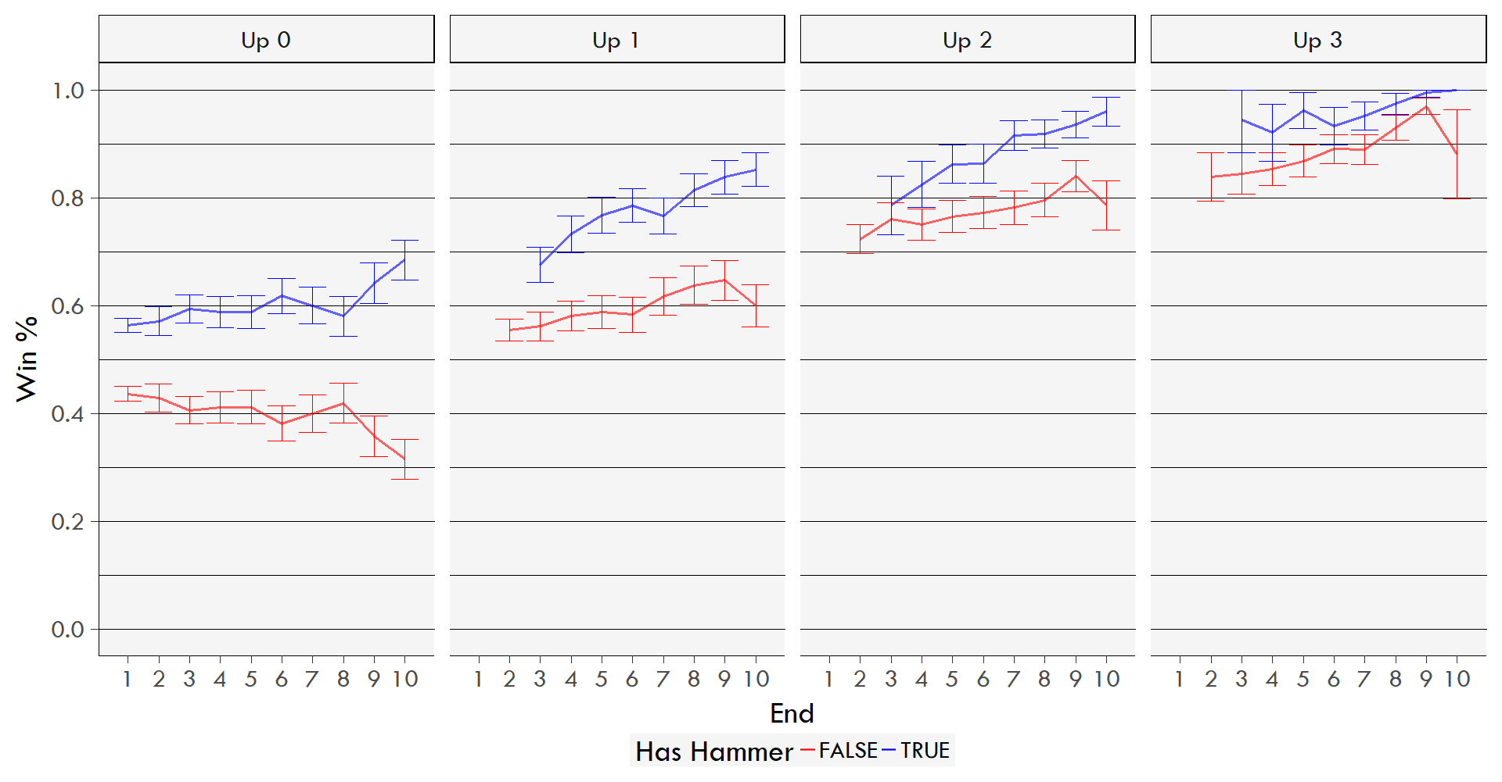
Win Probability
Notes:
First, look at the value of having the hammer to start the game: teams win ~57% of games when they start with the hammer.
Second, the value of the hammer in a tie game increases as the game goes along – the lines in the Up 0 box (tie box) diverge
3rd, a lead of 2 ore more points rarely loses in the second half of the game

Slide 16
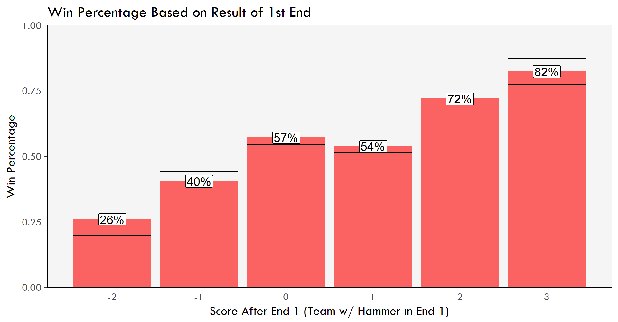
Would you Rather Blank the 1st or Score?
Notes:
Contrary to conventional wisdom, blanking the 1st doesn’t appear to have that much advantage over scoring 1
Scoring multiple puts you in a very good position to win

Slide 17
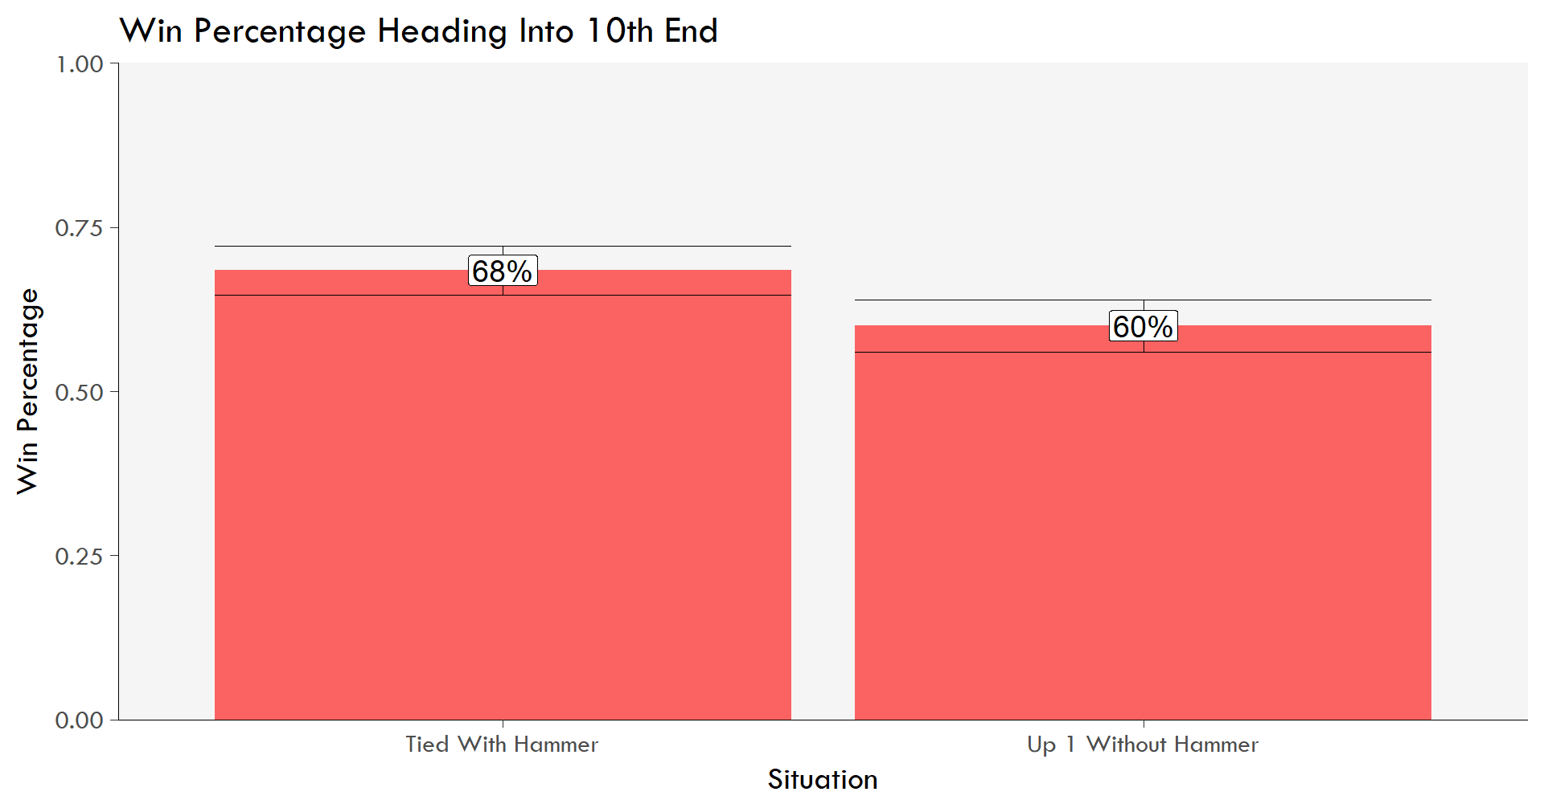
Up 1 Without Hammer or Tied With Hammer?
Notes:
If you have the hammer in a tie game in the 9th, it’s better to try to blank than to score 1
Conversely, if you don’t have the hammer in a tie game in the 9th, it’s better to concede 1 than let your opponent blank

Slide 18
Score Effects
Score effects are a common phenomenon in many sports
  Team that’s leading tends to sit back while team that’s trailing tends to push to tie
Do score effects exist in curling?
  Can look at steal and blank percentage (% of ends with a steal occurring) to look for clues

Slide 19
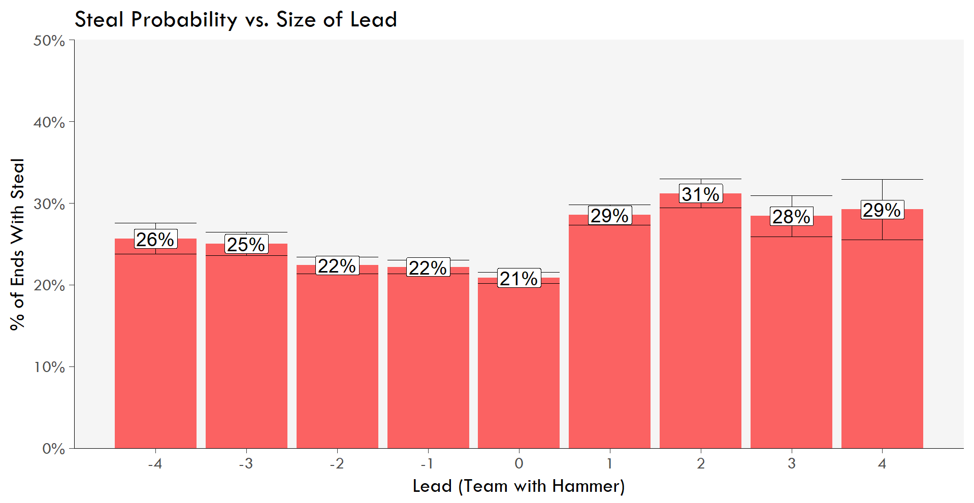
Teams with the lead give up more steals

Slide 20
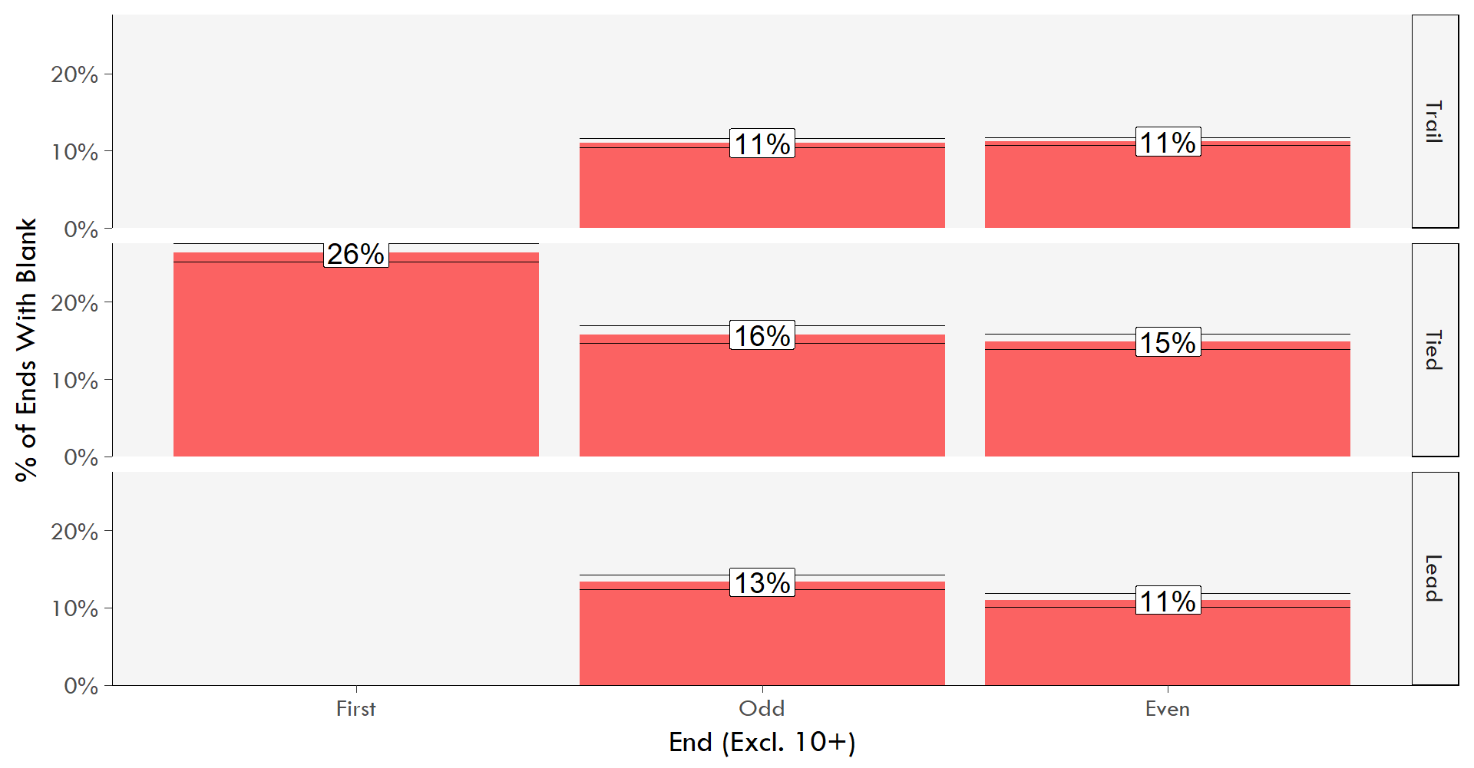
Teams with a lead blank more in odd ends

Slide 21
Evaluating Strategies
Early on in the end teams have to decide whether to guard or put stones into the house (draw)
SHOT NUMBER | Front/Guard % | Draw %
1 | 57.2% | 42.8%
2 | 32.8% | 67.2%
3 | 58.7% | 41.3%
4 | 81.6% | 18.4%

Slide 22
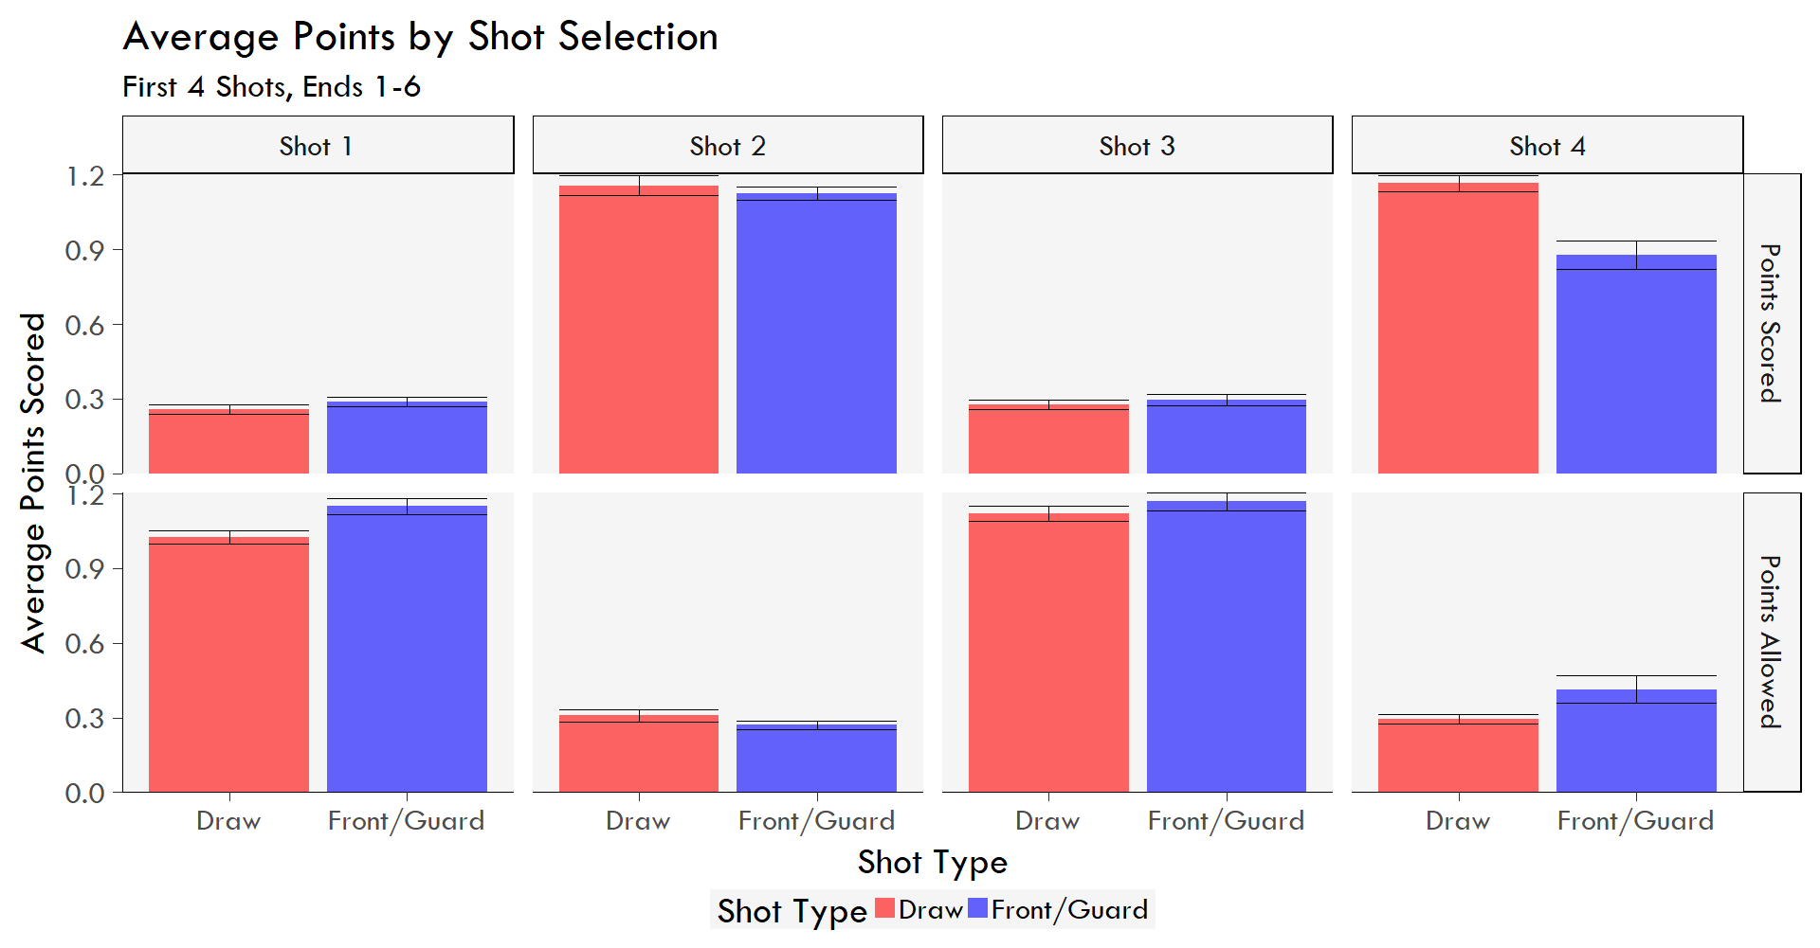
Average Points By Shot SELECTION

Slide 23
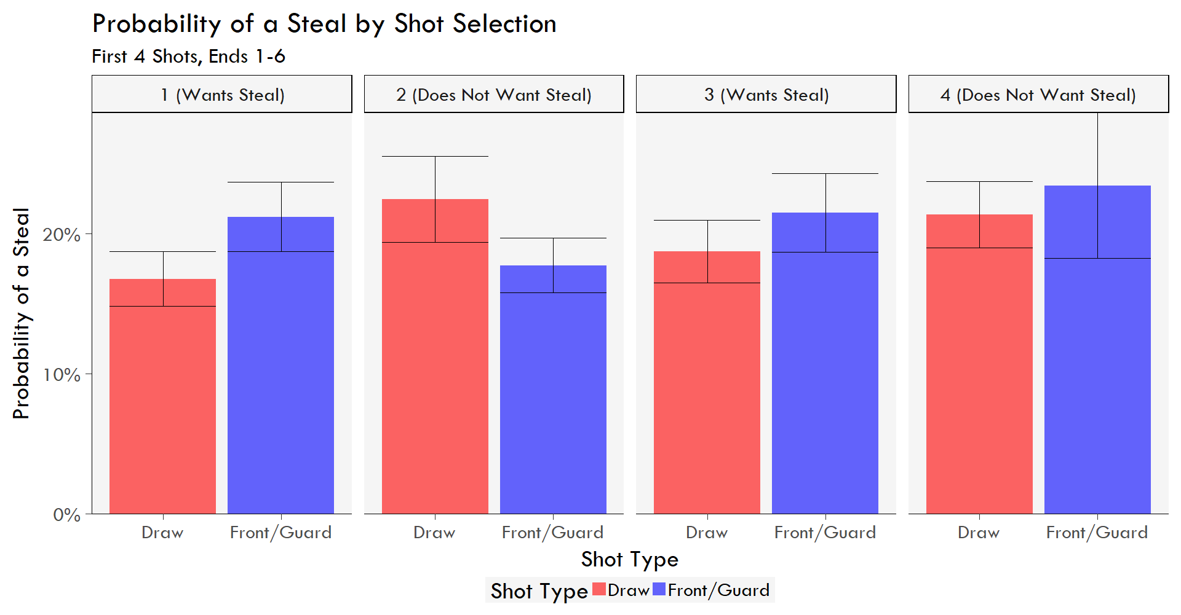
Steal Probability By Shot Selection

Slide 24
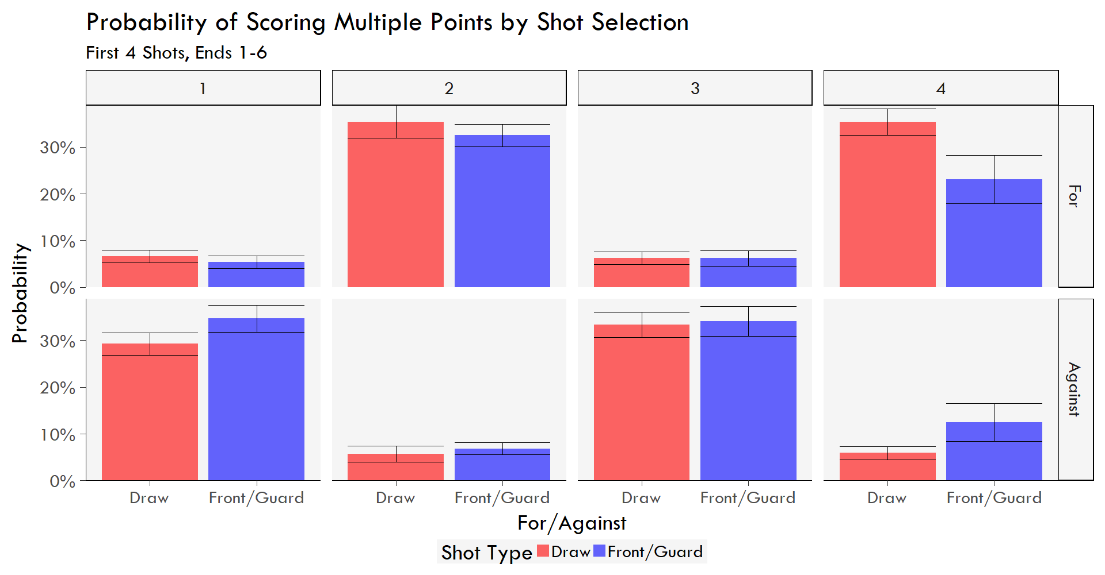
Multiple Point Probability By Shot Selection

Slide 25
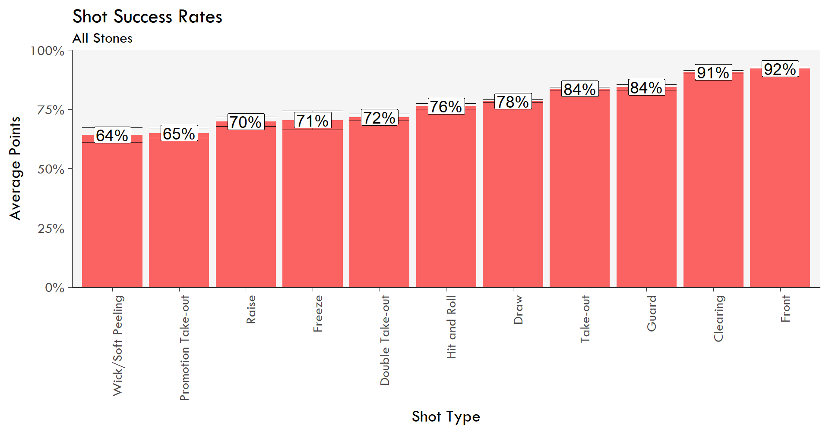
Shot Success Rates By TYPE
Notes:
Practical application – combine with win probability numbers to choose whether to play a more difficult shot to get 2 or to draw to take 1

Slide 26
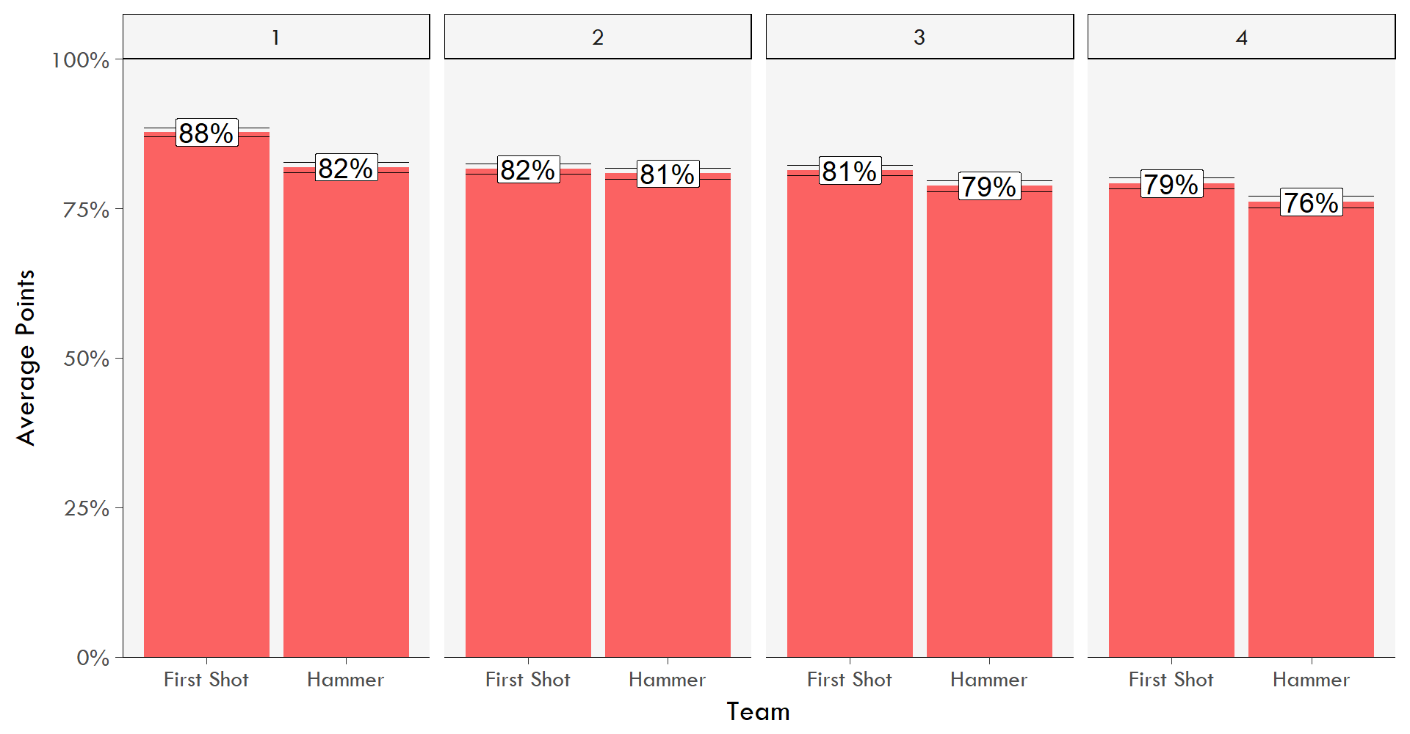
Shot Success Rates By Position

Slide 27
Does A Player’s Score even matter?

Slide 28
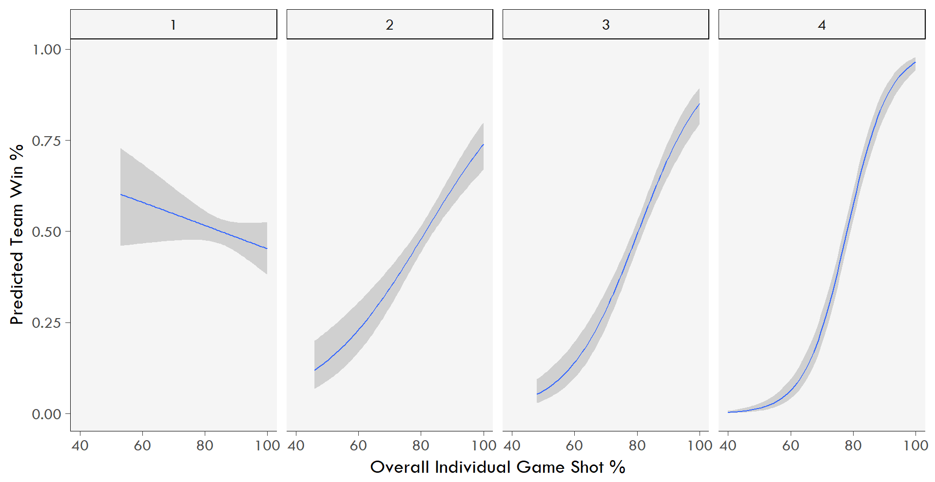
Kind of?
Notes:
3 things to note here:
The range of predicted outcomes is wider for the later shooters – later shooters have a stronger impact on win percentage
The error range on later shooters is narrower – later shooters have a more predictable impact on win percentage
Leads/1st shooters might not matter much for shooting (there will be few leads who ever shoot ~40% so it’s not really a fair comparison at that end of the curve) but may matter a lot for sweeping – difficult to measure

Slide 29
Next Steps
Shot position data
  For World Curling Federation events stone locations are recorded after each shot
  Look at expected points and win probability based on stone positions
  Create a better player evaluation system
Examine shot sequences to better identify strategic considerations
  Does Guard-Draw perform better than Guard-Guard?

Slide 30
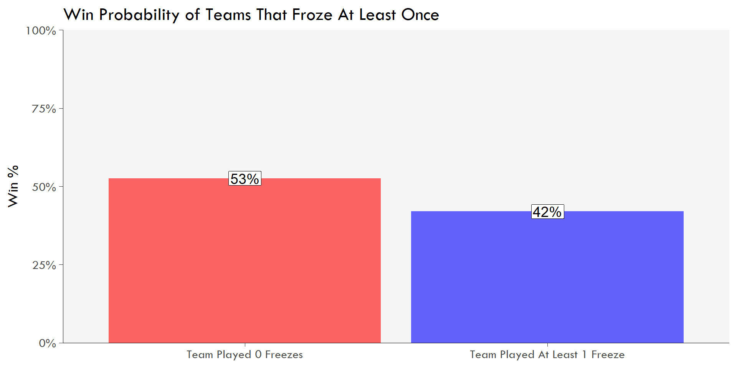
Last but not Least…

