Slide 1
Ice, ICE Baby: IT’S TIME FOR FOURPLAY

Slide 2
Contents
Why 4Fs on ice
ICE Ratings
What makes a forward?
Creating the Forwardness Rating
What does it mean?

Slide 3
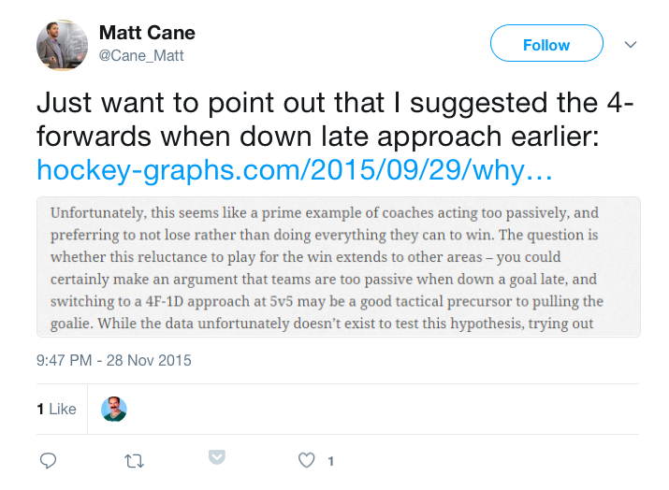
The history of 4 forwards at 5v5

Slide 4
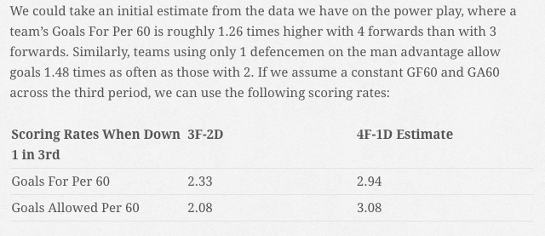
Matt Cane is so smart…

Slide 5
ICE v2. (ICE ICE baby)
- Much better repeatability
.39 R^2 w/ WAR
.85 R^2 w/ GS
.33 R^2 w/ Carry in %
.32 R^2 w/ Break up%
Metric | Repeatability (YOY R^2)
Shooting | .53
Passing | .31
Skating | .50
Size | .61
Shot Creation | .53
Transisition | .42
2 Way Play | .52

Slide 6
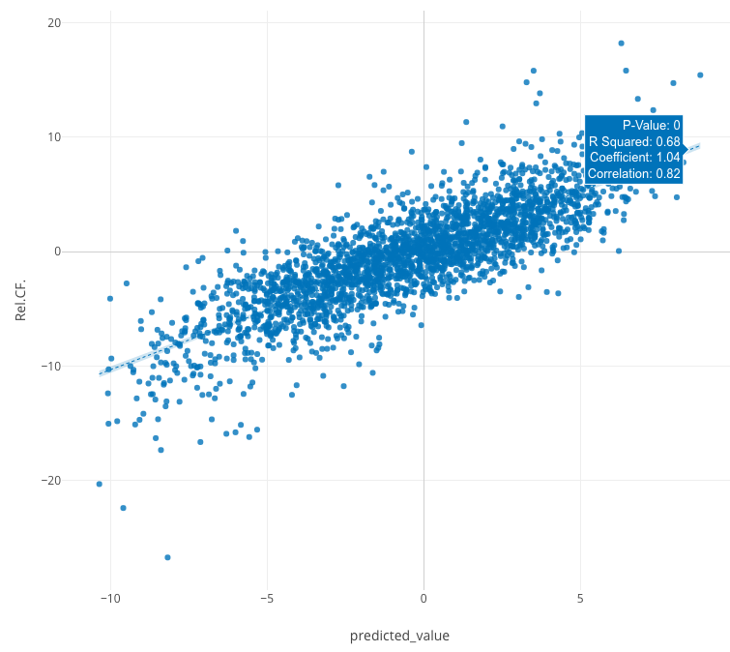
ICE Strong correlation w/ on-ice shot rates

Slide 7
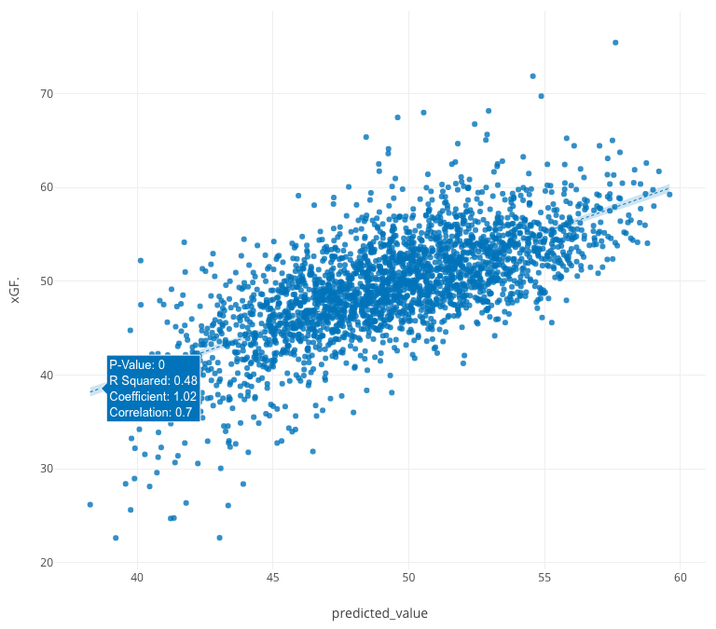
Predicted Individual Impact (rel XG%)

Slide 8
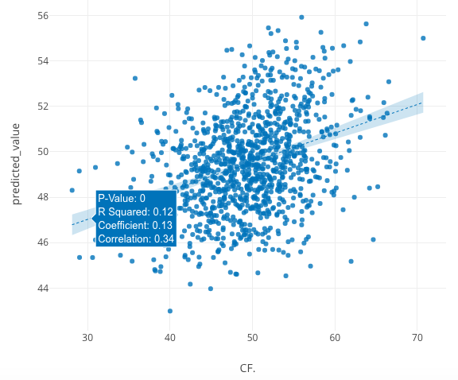
Last Year’s Combined ICE Ratings
Predicts CF% as well as last years CF%

Slide 9
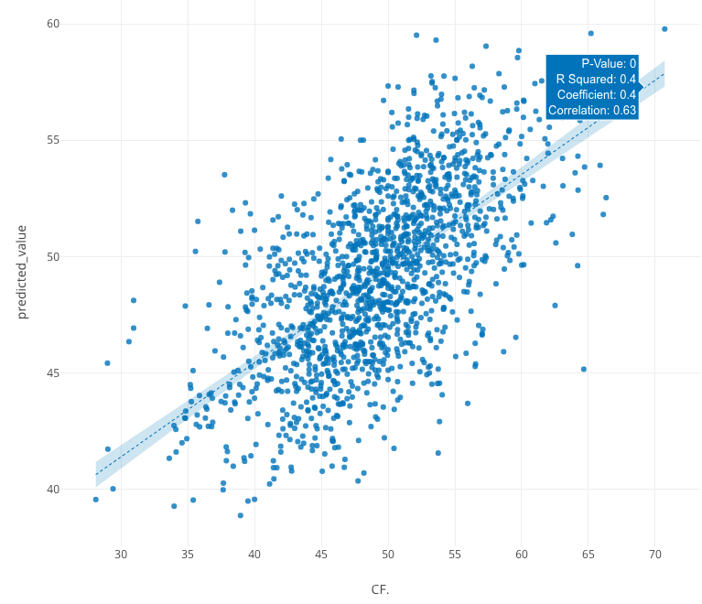
Predicting this year’s results
Predicts this year’s CF% as well as the combining individual CF% of the pairing

Slide 10
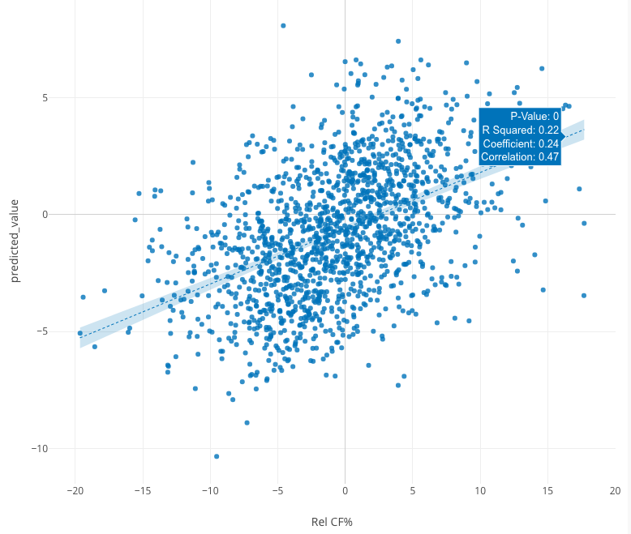
ICE Does a pretty decent job of projecting D-pairing shot effects (but just combine their CF%)

Slide 11
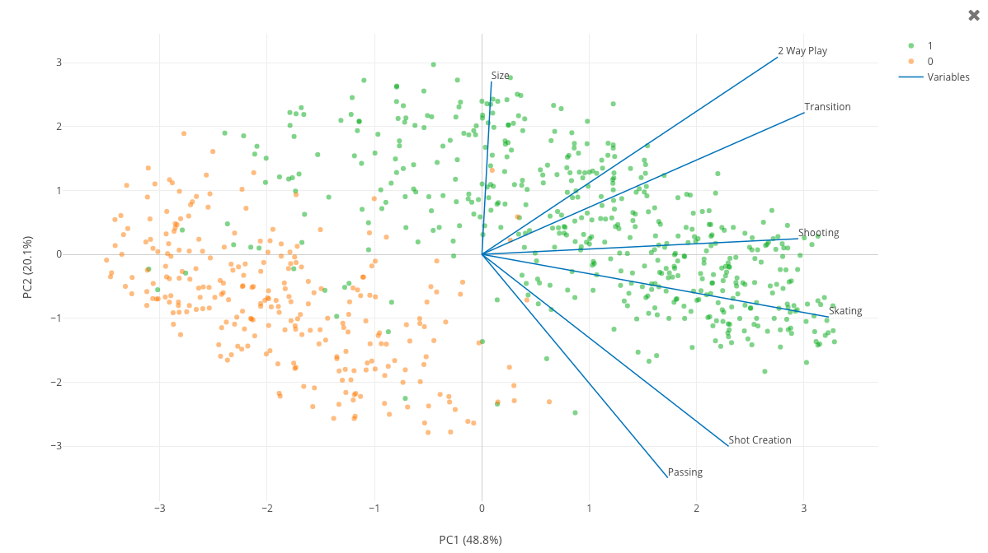
Utilizing the ICE Ratings, we can reliably identify the positional designations

Slide 12
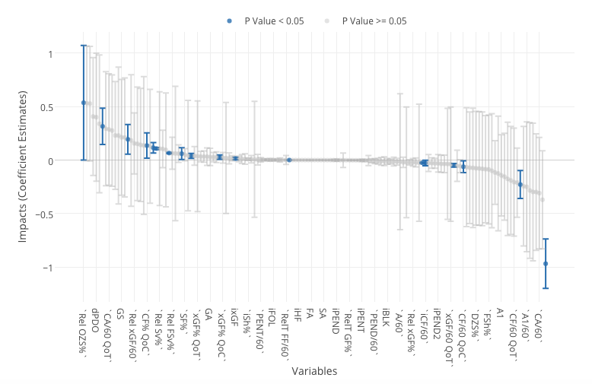
Identifying the key traits between the classes

Slide 13
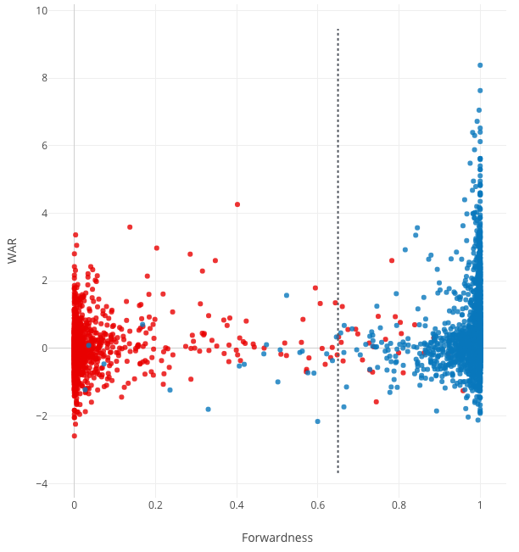
Initial Classification
- Random Forest Model
- 98% Accuracy Rate
- Maybe too good…

Slide 14
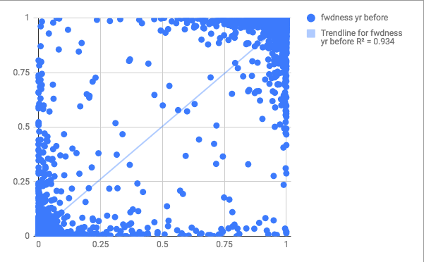
Year over year R^2 of .93 for first pass of forwardness score

Slide 15
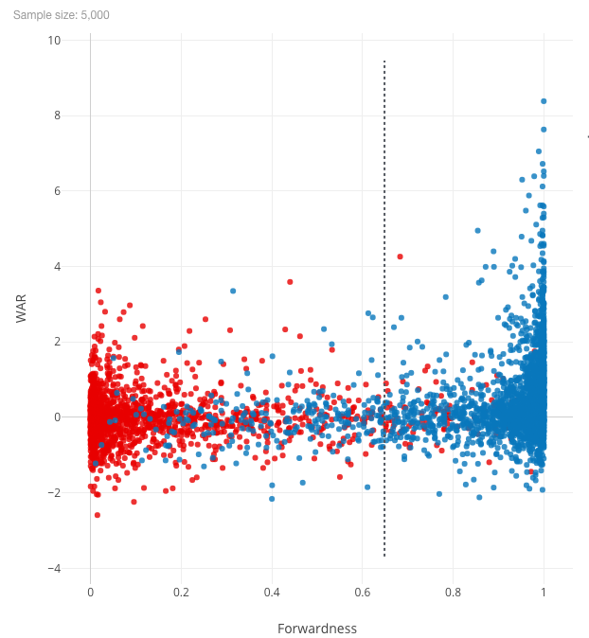
Follow-up classification
- The model has beer goggles now
- 92% Accuracy Rate
- Much more overlap

Slide 16
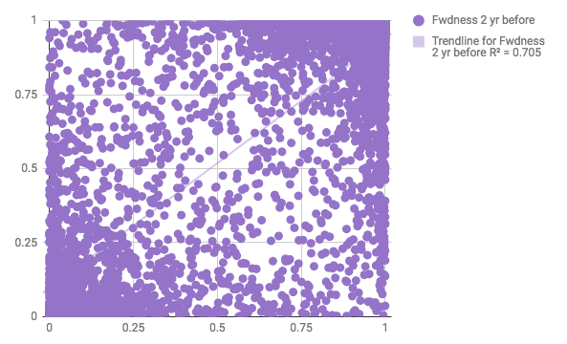
Year over year R^2 of .71 for first pass of forwardness score

Slide 17
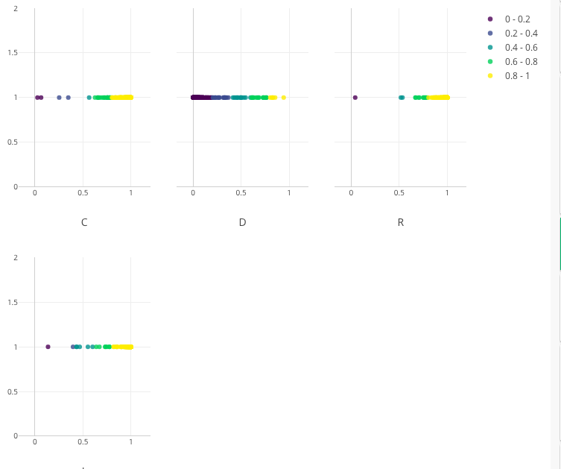
Breakdown by position
- Wingers almost never qualify
- Dmen have the most fluidity

Slide 18
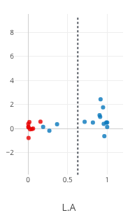
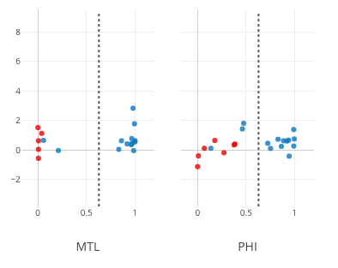
2016-2017 examples
- PHI:
Bellmare, Giroux, Voracek
- L.A.:
Shore, Nolan Kempe
- MTL:
Tomas Plekanec

Slide 19
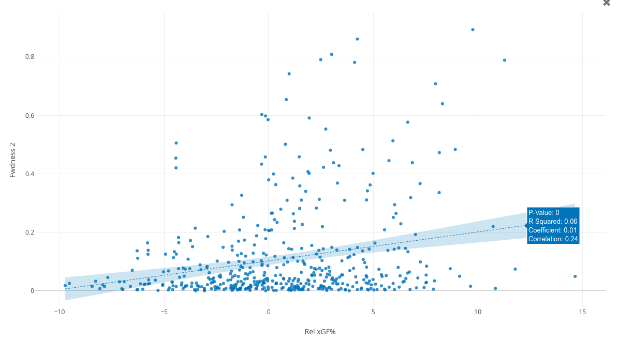
Forwardness of the D-pairs has a small but statistically significant effect on shot outcomes…

Slide 20
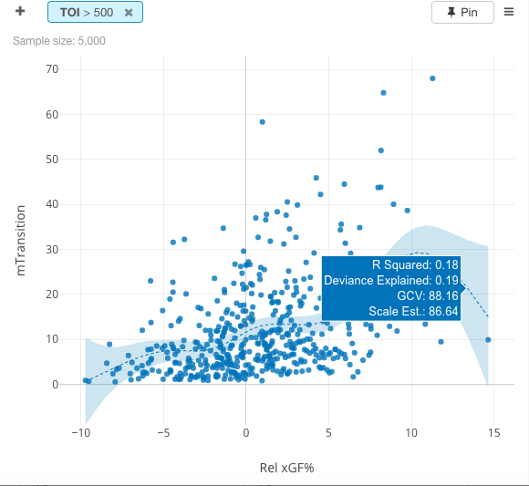
…mainly driven by increased competency in the Neutral Zone

Slide 21
On average, between a .5% to 1.5% increase in CF
I wonder what the bottom 3 have in common?
Forward | D-man | 2018 Improvement
Alex Burmistrov | Ben Hutton | +2.11 CF
Josh Ho-Sang | Dennis Seidenberg | +3.95 CF
Alex Burrows | Ben Harpur | +2.13 CF
Chris DiDomenico | Ben Harpur | +2.11 CF
Filip Chilapik | Ben Harpur | +3.86 CF

Slide 22
