Slide 1
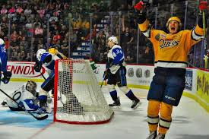
Determinants of Game-to-Game Performance Variance of Junior Hockey Players Across the CHL
Rodney J. Paul – Syracuse University
Nick Riccardi – Syracuse University

Slide 2

Introduction
Second Moment of the Distribution is typically important, but is often ignored in statistical analysis of athletes
  Consistency in players may help to yield consistency in teams
  Alternatively, streaky players may prove useful/detrimental in certain circumstances
    Playoff Runs
    Fantasy Sports
We aim to investigate variance of performance stats for hockey players and be able to determine what factors change output in these statistics from game-to-game

Slide 3

CHL Hockey
The Canadian Hockey League (CHL) is the top junior circuit with teams in both Canada and the United States
Consists of three leagues – arranged geographically:
  Ontario Hockey League (OHL)
  Quebec Major Junior Hockey League (QMJHL)
  Western Hockey League (WHL)
Each league competes independently; has a regular season followed by playoffs
  Each league champion and the host city play for the Memorial Cup

Slide 4

Overall Premise
Examine Variance of Performance of CHL players throughout season
  Across selected statistics gathered on a game-by-game basis
    Goals
    Assists
    Points
    Shots on Goal
    Penalty Minutes
Illustrate how similar or different the top scorers in each league are from one another as it relates to consistency
Statistically model game-to-game performance for players based upon a variety of factors

Slide 5

Presentation Outline
Visualize variance in player performance for each league
Show some player examples of different levels of variance in play by using some top NHL draft picks in the CHL in 2017-18
Model and show the results of game-to-game performance

Slide 6

I. Visualization of Player Statistic Variance
For each league – will show variance of:
  Goals (vertical)
  Assists (horizontal)
  Shots on Goal (color)
  Overall Goals (size)
2 slides for each league:
  Top 300 scorers
  Top Goal Scorers (30+ goals in 2017-18 Season)

Slide 7
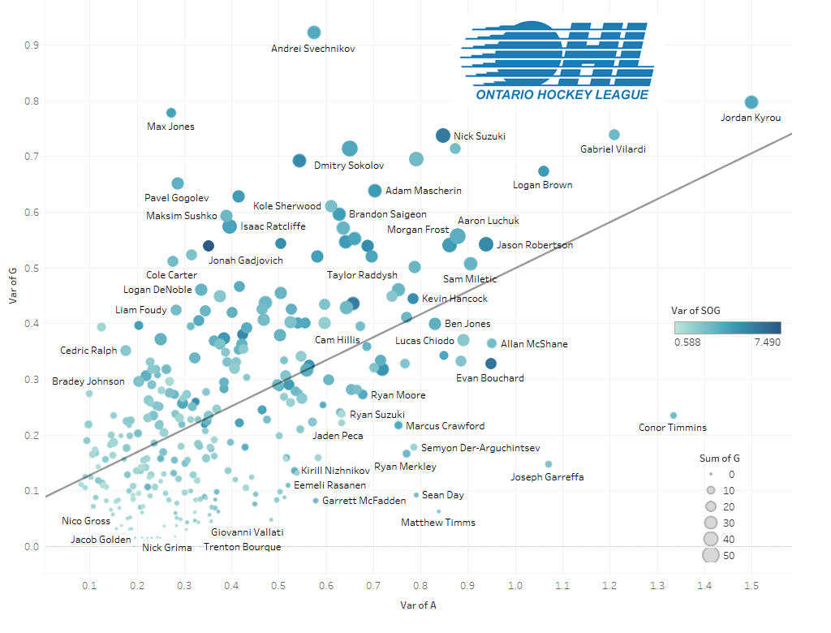

Slide 8
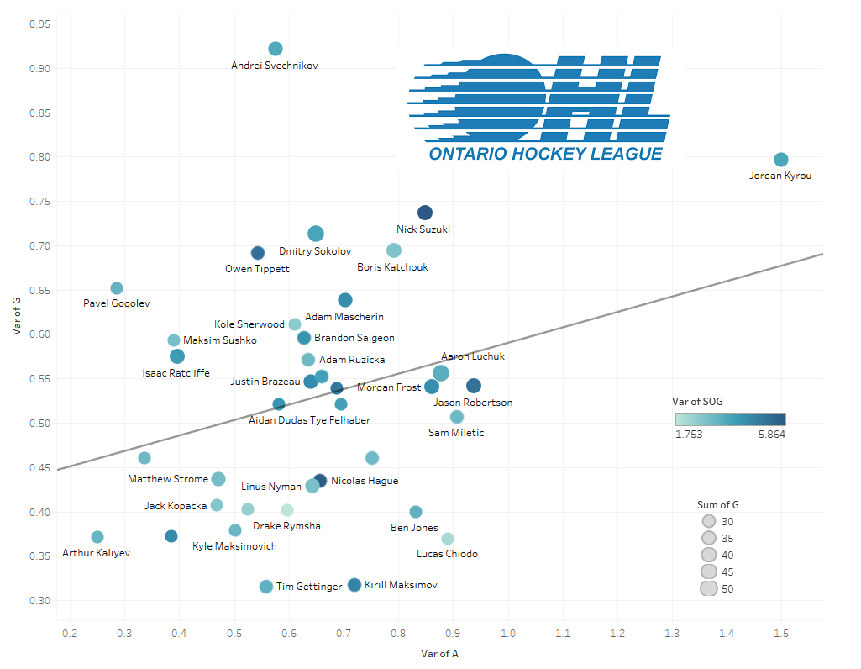

Slide 9
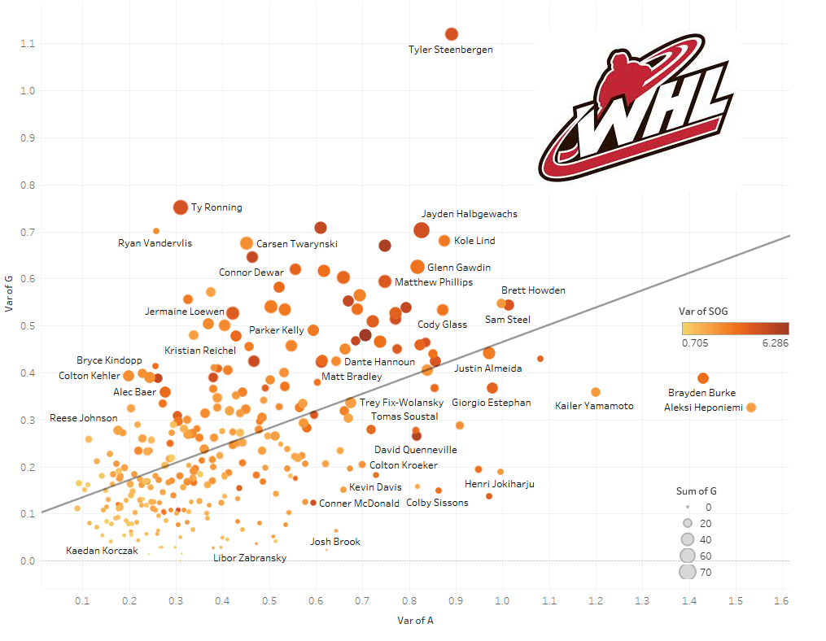

Slide 10
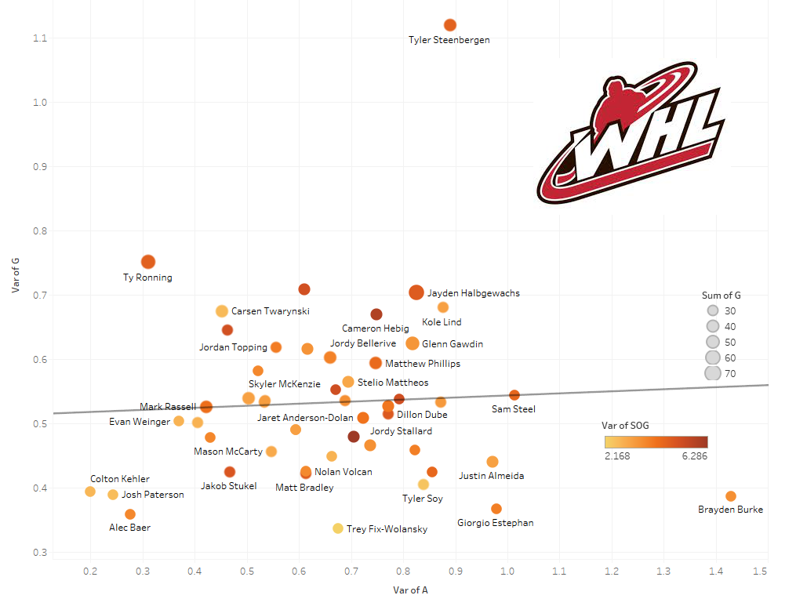

Slide 11
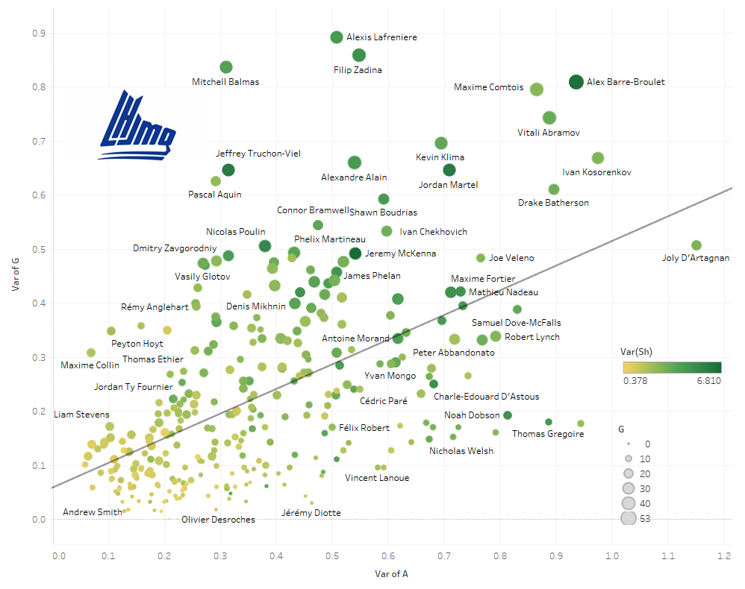

Slide 12
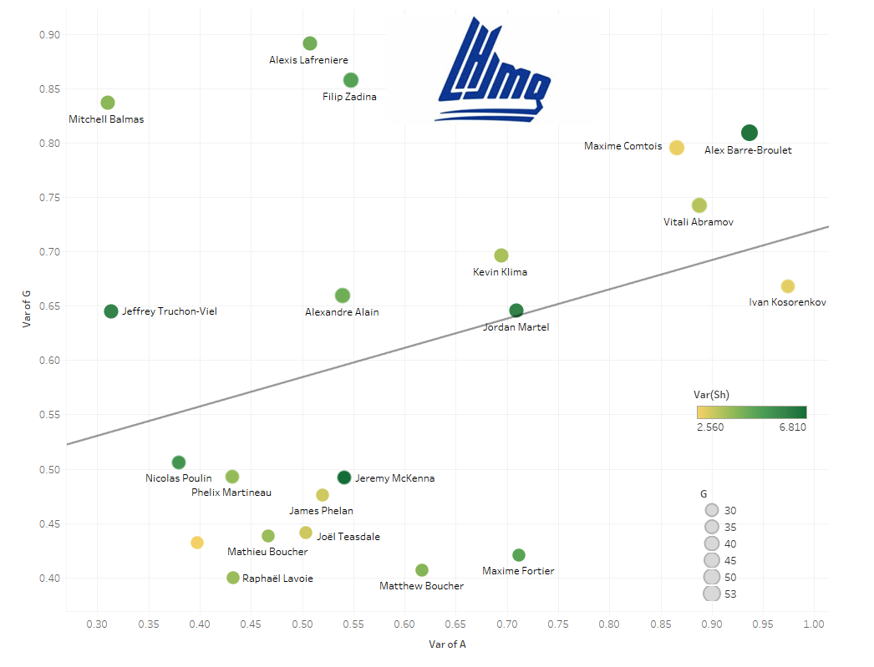

Slide 13
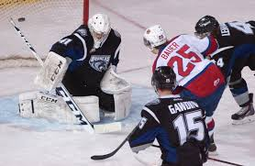
Player Cards of Select Drafted Players
Card of Player Performance/Variance
  Waterfall chart of Goal Scoring throughout 2017-18 Season
  Goals and Assists Scored by Opponent
  Points-per-Game Average by Opponent

Slide 14
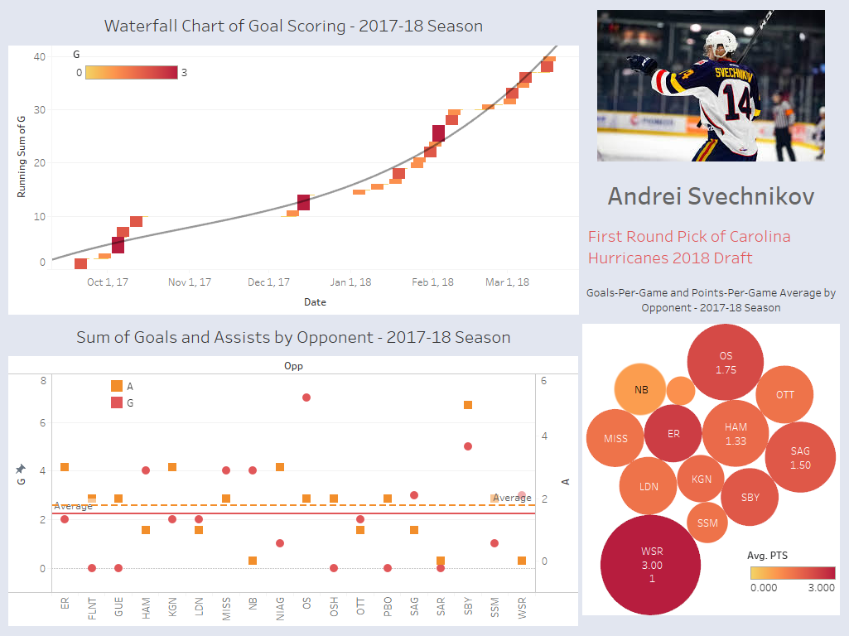

Slide 15
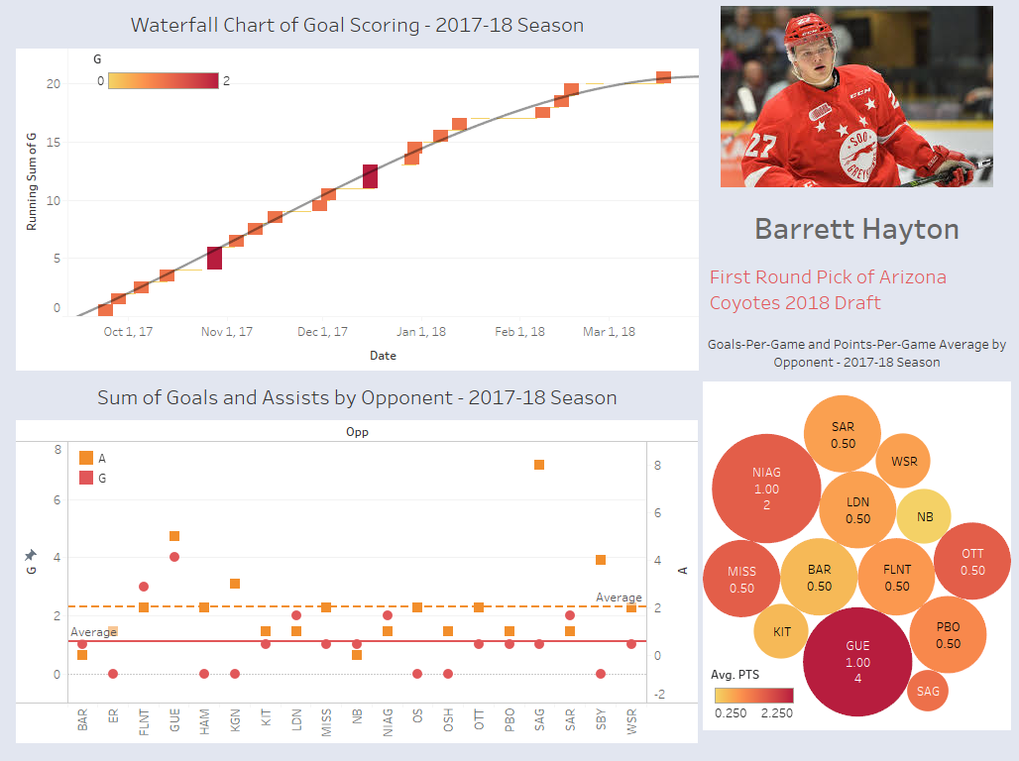

Slide 16
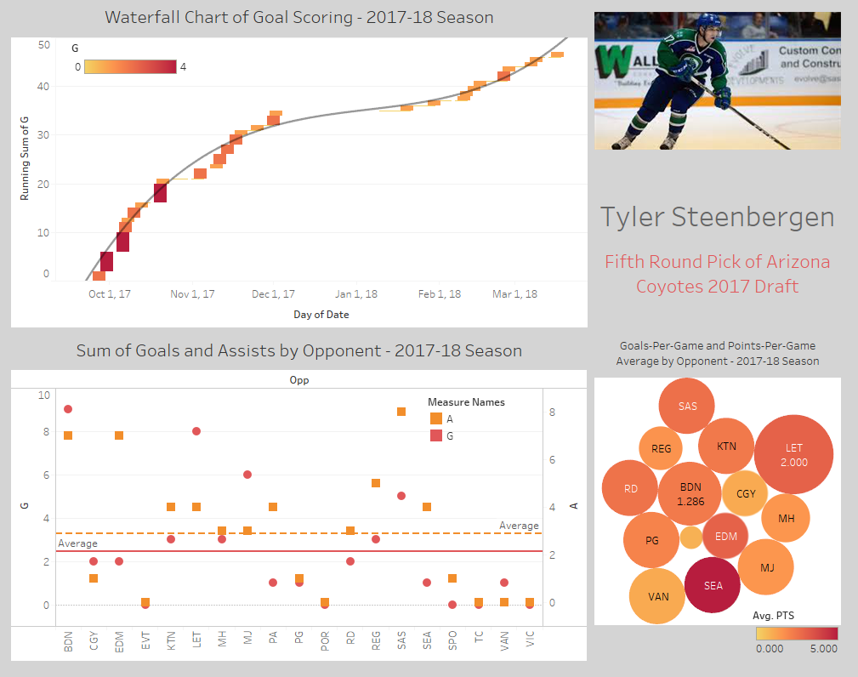

Slide 17
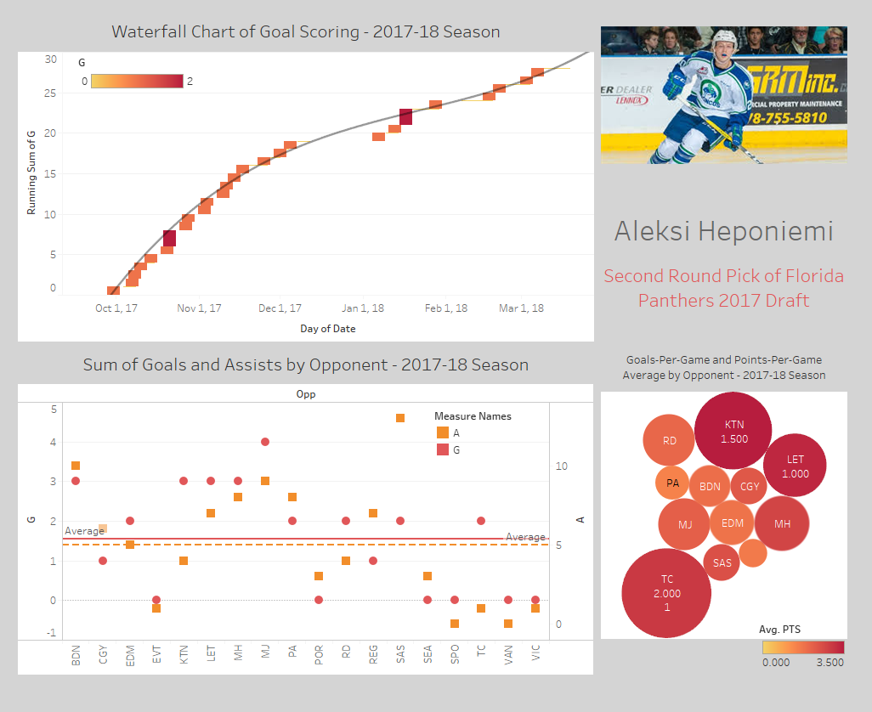

Slide 18
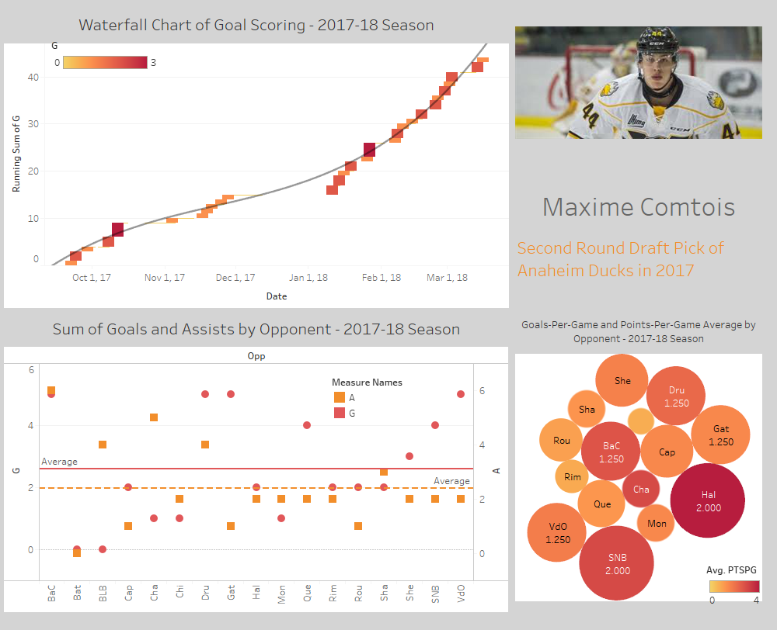

Slide 19
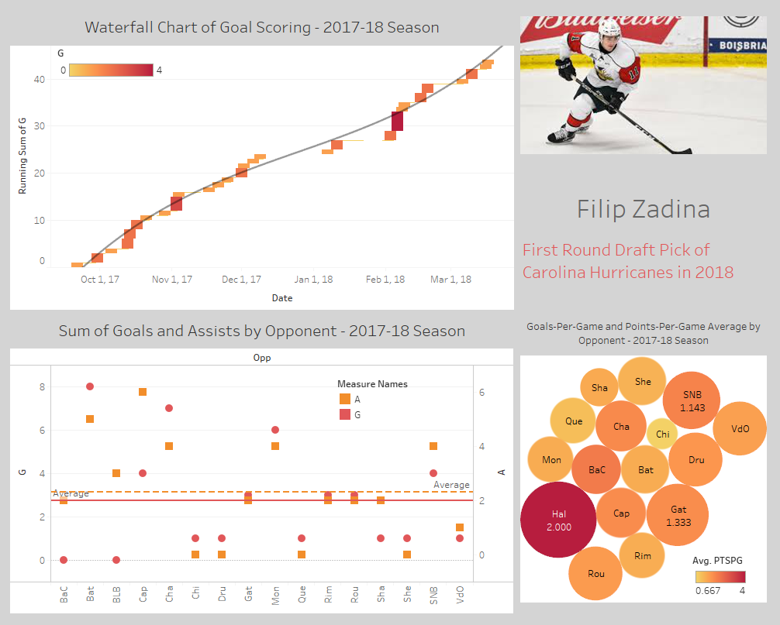

Slide 20

OLS Regression Model of Game-to-Game Performance
Dependent Variable: Performance Measure per Game
  Points
  Goals
  Assists
  Shots on Goal
  Penalty Minutes
    All taken from the OHL, WHL, and QMJHL websites

Slide 21

OLS Regression Model of Game-to-Game Performance
Independent Variables:
  Playerhome – dummy variable – 1 if player is at home
  Agedays – age in days of player – (date of game – birthday) and square
  Daysbetween – Days Between Games – max of 10
  Travel1 – Distance from city of game to home city
    Travel2 – Distance from last game to this game (if within 2 days)
  Htinch – height in inches
  Weight – weight in pounds

Slide 22

OLS Regression Model of Game-to-Game Performance
Weather Variables:
  Temperature
  Humidity
  Barometric Pressure
Dummy Variables:
  Position (C is reference category – so D, LW, RW)
  Handedness (L is reference category – so R)
  Team Dummies
  Opponent Dummies

Slide 23
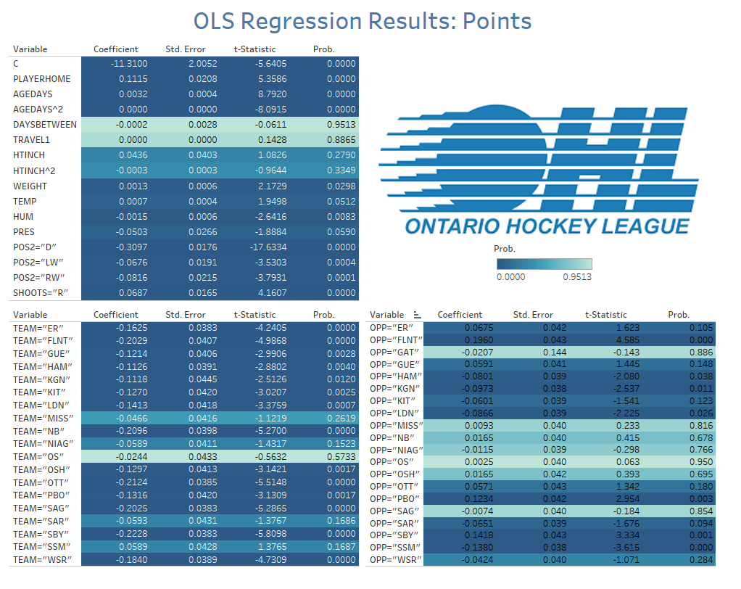

Slide 24
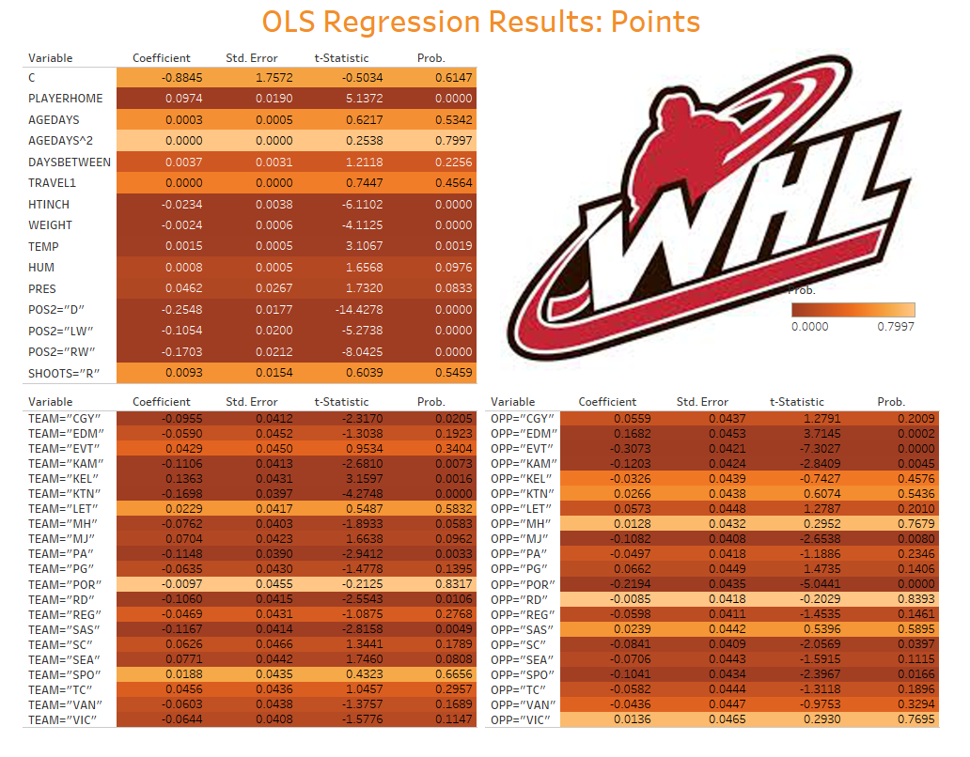

Slide 25
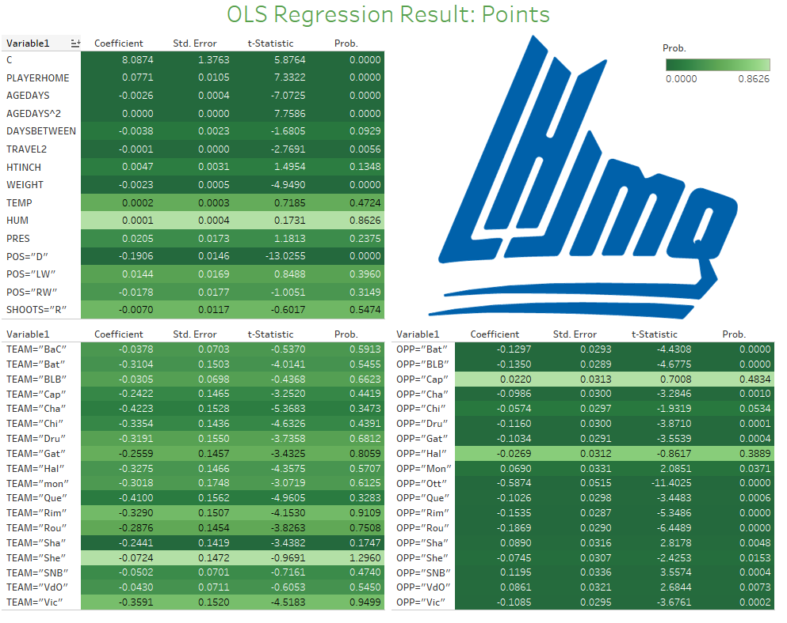

Slide 26
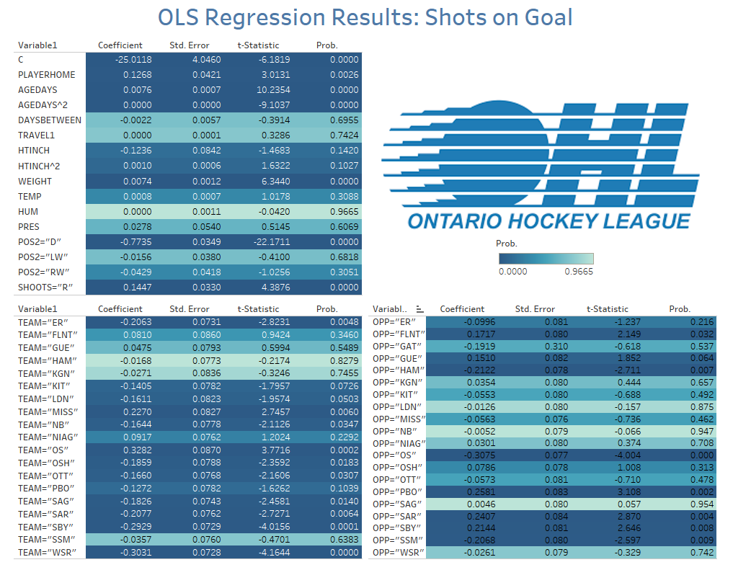

Slide 27
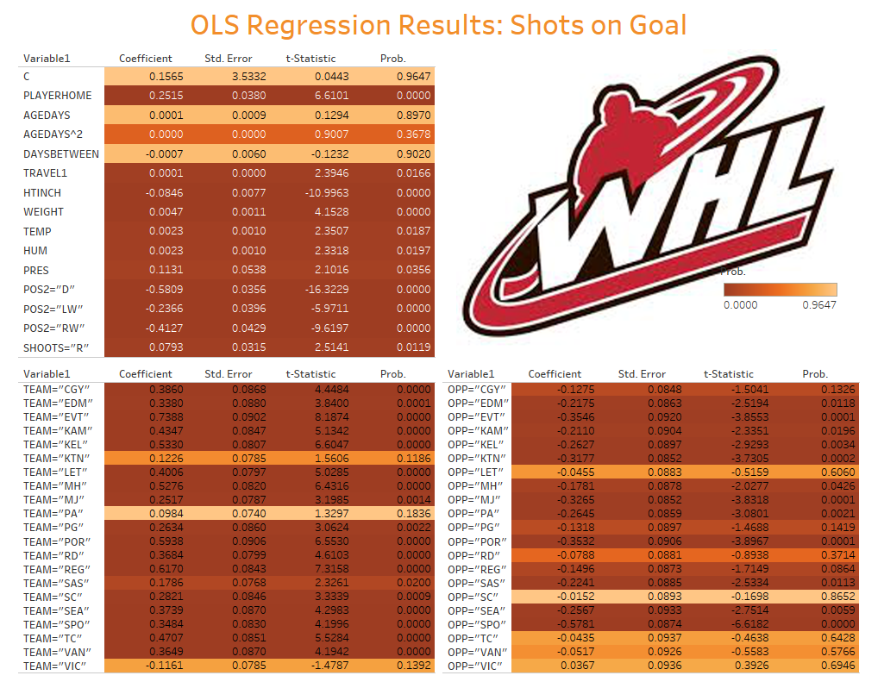

Slide 28
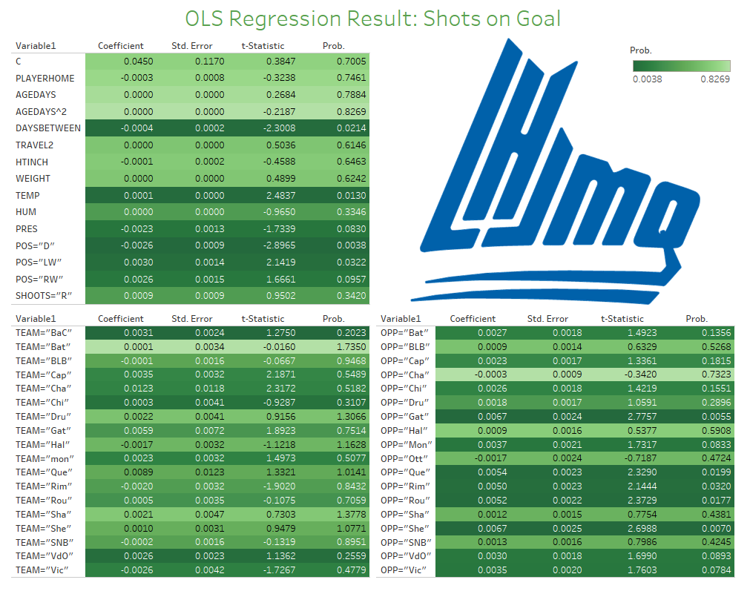

Slide 29
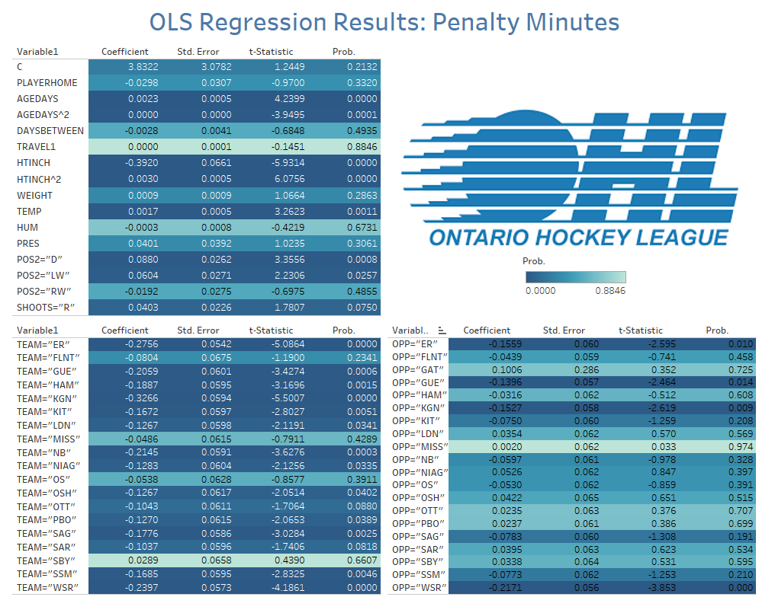

Slide 30
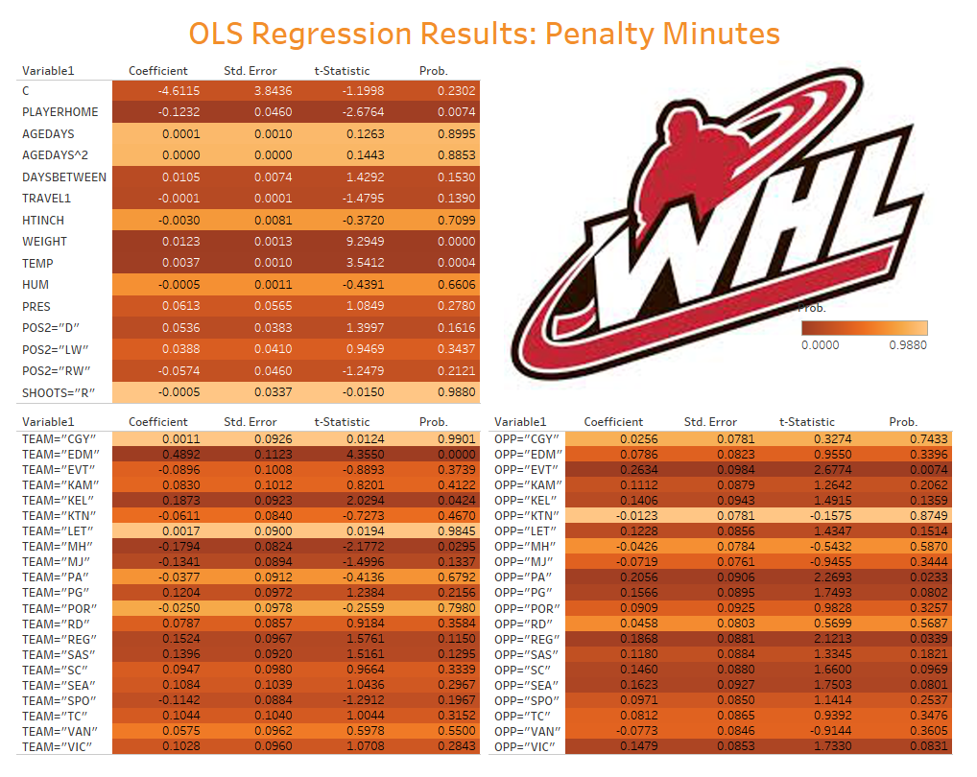

Slide 31
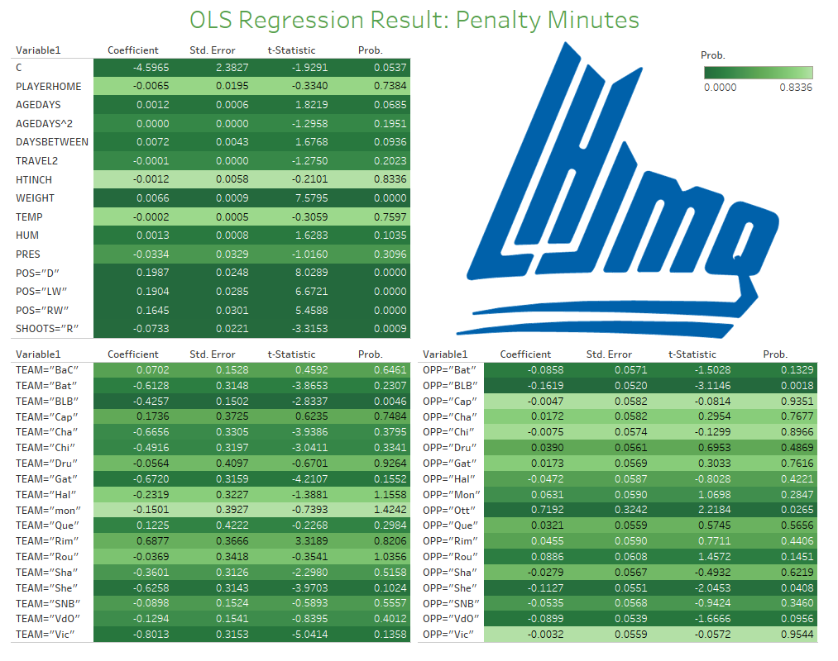

Slide 32
League Regression Results Summary:
Statistically Significant Ind. Variables
 | Points | Shots on Goal | Penalty Minutes
Home | OHL 0.11 | OHL 0.13
 | WHL 0.10 | WHL 0.25 | WHL -
 | QMJHL 0.08
Age | OHL +,+ | OHL +,+ | OHL +,+
 | QMJHL -,+ |  | QMJHL +,-
Days Off | QMJHL - | QMJHL - | QMJHL +
Travel | QMJHL - | WHL +
Height | WHL - | WHL - | OHL -,+
Weight | OHL + | OHL +
 | WHL - | WHL + | WHL+
 | QMJHL - |  | QMJHL +
Temp | OHL + | WHL + | OHL +
 | WHL + | QMJHL + | WHL +
Humidity | OHL -
 | WHL + | WHL +
Pressure | OHL - | WHL +
 | WHL + | QMJHL -

Slide 33

Pooled Regression Results: CHL
Following are results from pooled regression across all 3 leagues:

Slide 34
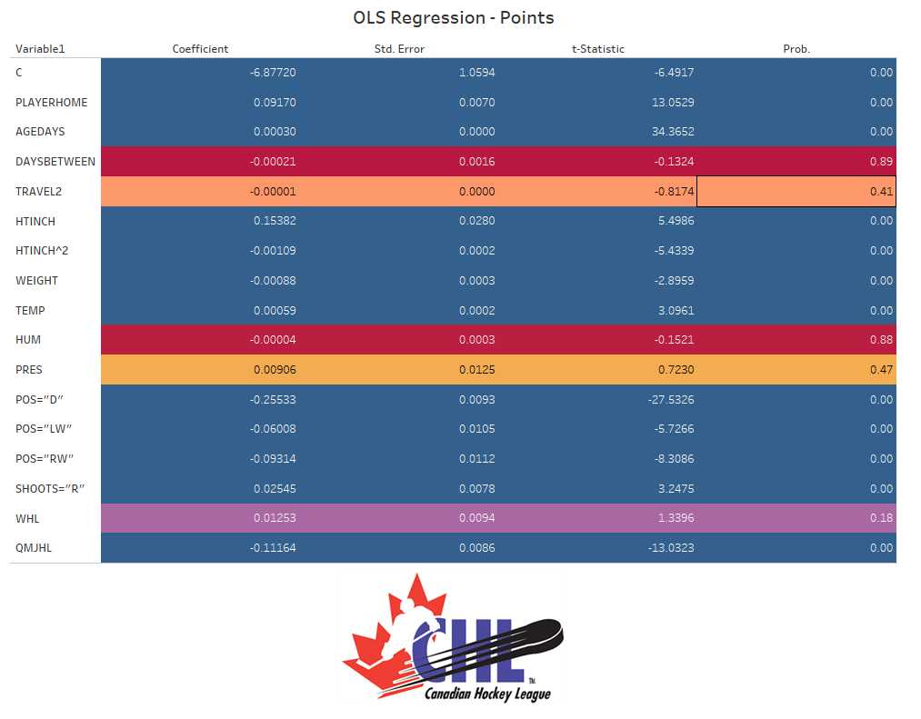

Slide 35
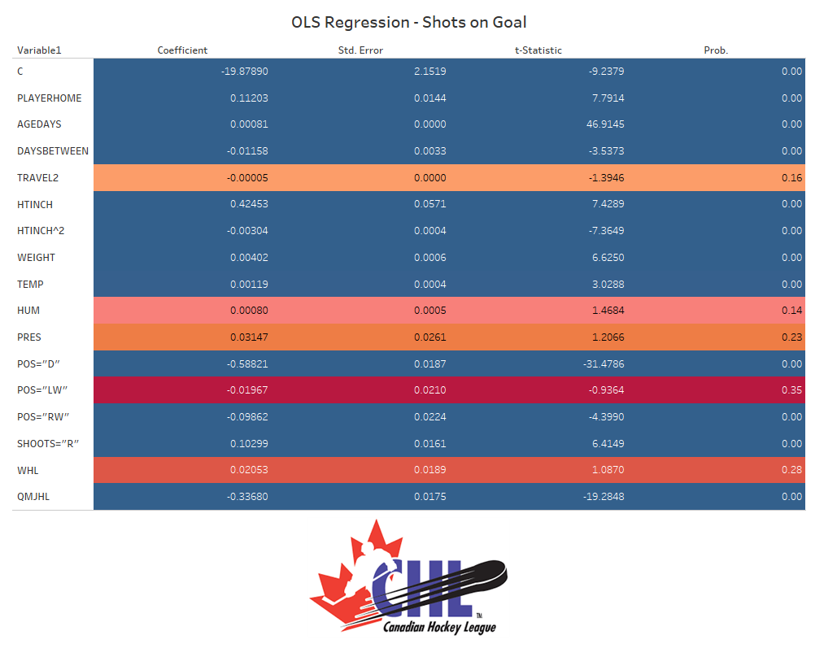

Slide 36
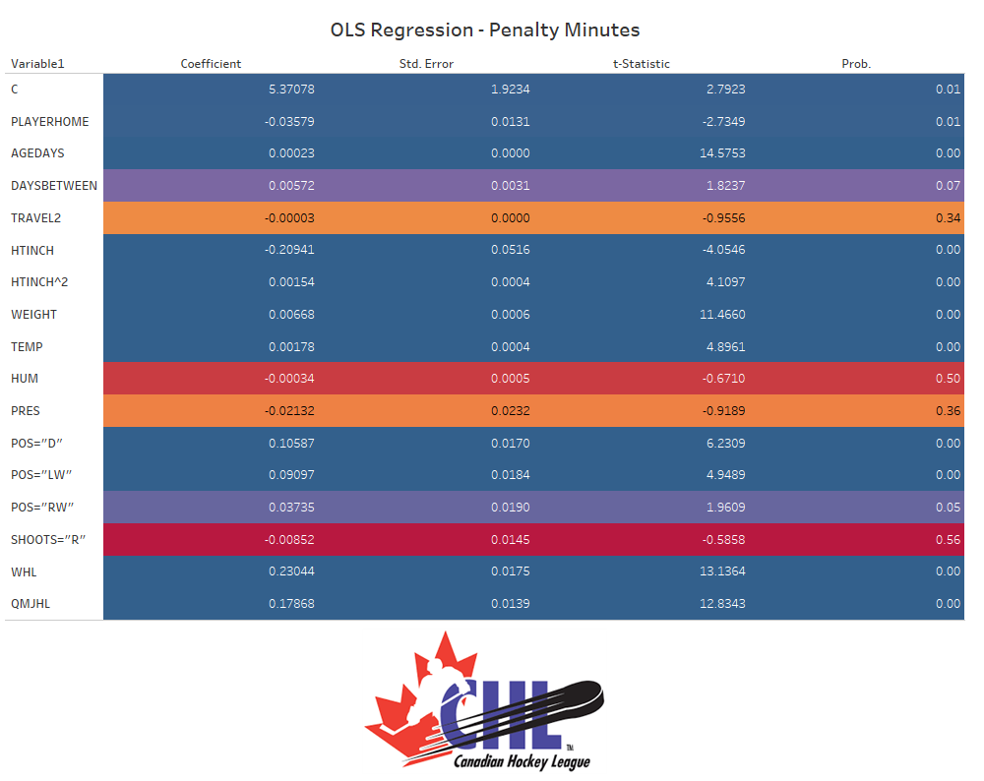

Slide 37

Biggest Takeaways of Regression Model of Game-by-Game Player Performance
Players are more productive at home, as would be expected, but distance of travel or frequency of road games are not statistically significant
  No major impacts overall of how far need to travel or days off (except in individual regression in QMJHL)
Age, Height, and Weight all play significant roles
Temperature, on a game-by-game basis, is statistically significant for all the dependent variables studied
  Could be impacting ice conditions
  Could just be impact of higher temperature impacting behavior (i.e. penalty minutes rise with heat)

Slide 38
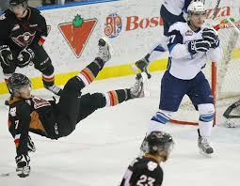
Going Forward – Next Steps
Control for differences in game-to-game by player location/league
Gather prior years of same data
Merge with draft data
Determine if player consistency/consistency has any predictive power for future success
  Also, test if streakiness continues over career or dissipates

