Slide 1






Identifying and Evaluating Successful
Team Compositions in League of Legends
Ivan Ramler and Choong-Soo Lee
August 11, 2018
2018 RIT Sports Analytics Conference

Slide 2

Presentation Outline
1
Introduction
Brief background on eSports and League of Legends
2
Methodology
Data Collection
3
Data Analysis
Meta Roles, Team Compositions, and Win Rates
4
Future Work
St. Lawrence University

Slide 3
Electronic Sports (eSports)
Taken from Ray Stefani’s article in Significance, March 2017 (emphasis mine)
Physical Sport: A physical sport is a competition with a set of rules for determining the winner, requiring physical prowess and skill to move the physical competitor and/or a physical object as required by the rules.
Taken from Ray Stefani’s article in Significance, March 2017 (emphasis mine)
electronic Sport: An e-sport is a competition with a set of rules for determining the winner, requiring physical prowess and skill to move the virtual competitor and/or a virtual object as required by the rules.
St. Lawrence University

Slide 4
Why analyze eSports data?
Lots of data with multiple levels of competition
  Many studies use 100,000+ participants
  Highly Competitive to Casual matches often available
Shared goal with many sports analytics studies: Describe → Predict → Prescribe
  Potential for results to be applied to “everyday folk”
Constantly evolving game/rules keeps things moving fast
  Major rule changes can happen between competitive seasons
  “Balance patches” (aka tweaks) added on a regular basis (mid-season too)
St. Lawrence University

Slide 5
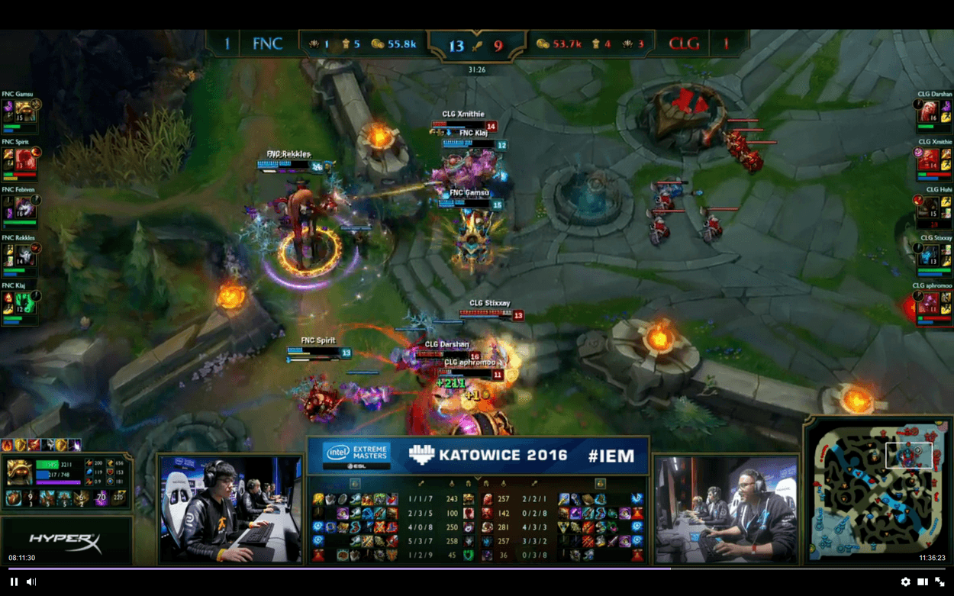
Background on League of Legends (LoL)
Multiplayer Online Battle Arena (MOBA)
Released in October 2009 by RiotGames
Players pick a champion and typically form teams of five
  Basic goal is to destroy opposing team’s base
  Fight through three lanes plus a “jungle”
Still one of the most popular eSport games
St. Lawrence University

Slide 6





Meta Composition in League of Legends (LoL)
T
J
M
Community defined roles (meta roles)
Meta composition (TJMAS)
Similar idea as the “standard” positions (C, PF, SF, SG, PG) in Basketball
A
S
St. Lawrence University

Slide 7

Project Goals
Research Questions
Is the meta composition dominant?
Are there any non-meta compositions that are more successful than the meta composition?
St. Lawrence University

Slide 8
Presentation Outline
1
Introduction
Background on League of Legends and Project Goals
2
Methodology
Data Collection
3
Data Analysis
Meta Roles, Team Compositions, and Win Rates
4
Future Work
St. Lawrence University

Slide 9
Data Collection
Data Set
Queue Types
RiotGames API (Application Programming Interface)
2015 Season
Over 10 million matches
Over 100 million participants
Ranked (Team, Solo queue)
  Most competitive mode
Unranked PvP (Draft, Blind)
  More casual
St. Lawrence University

Slide 10
Data Collection
Response Variable
31 Explanatory Variables
Participant’s “Meta Role”
5 levels
  Top
  Jungle
  Middle
  ADC
  Support
API only provided end-game information
We used only “build related” information
Player “spells”
  Static throughout match
Items
  Note: These can change during the match (typically upgraded throughout)
  Focus on attributes (Physical damage, Magic damage, Defense, etc.)
St. Lawrence University

Slide 11
Presentation Outline
1
Introduction
Background on League of Legends and Project Goals
2
Methodology
Data Collection
3
Data Analysis
Meta Roles, Team Compositions, and Win Rates
4
Future Work
St. Lawrence University

Slide 12
Classifying Participant Roles
Train and Tune Support Vector Machine (SVM) from
20,000 randomly selected teams (100,000 participants) from Ranked Team queue type in which the team followed the meta composition (TJMAS) based on ChampionGG primary role designations
  ChampionGG – One of several popular fan sites that provides information about standard ways to play most champions
Why these participants?
Ideally need a ground truth about team roles to make comparisons
No “truth” can be readily observed, but Ranked Teams seeming to follow ChampionGG designations should get us close to the truth
Classification Results on Training Data
96.6% of the predicted roles matched the ChampionGG primary role.
St. Lawrence University

Slide 13
Results: Meta Compositions
Queue Type | Prevalence Rate (%) | Win %
Normal Blind | 48.0 | 51.3
Normal Draft | 63.2 | 50.9
Ranked Solo | 69.7 | 50.4
Ranked Team | 72.8 | 50.5
More meta compositions in ranked (competitive) than unranked (casual).
Meta compositions win rate is about 50%.
St. Lawrence University

Slide 14

Results: Winning Non-meta Compositions
8 unique compositions were identified as more effective than the meta in at least one queue mode.
Adjusted for Multiple Comparisons (5% level)
Most Popular: 2 Mid, No Top (JMMAS)
At least 8% appearance across all queues, slightly above 51% win rate vs meta compositions in ranked play
Rare but effective in Ranked Team play
TTMAS (0.2% appearance, 56% vs meta)
TMMAS (0.9% appearance, 53% vs meta)
JJMAS (1.2% appearance, 54% vs meta)
St. Lawrence University

Slide 15
Results: Winning Non-meta Compositions
Digging a little deeper (an example)
TTMAS (0.2% appearance, 56% vs meta)
  Jungler is seemingly missing from this composition
  Both “Tops” regularly had builds consistent with the Top build
  Of the winners, ~85% had a dedicated Jungler
    based on other end-game metrics that were available
St. Lawrence University

Slide 16
Presentation Outline
1
Introduction
Background on League of Legends and Project Goals
2
Methodology
Data Collection
3
Data Analysis
Player Roles, Team Compositions, and Win Rates
4
Future Work
St. Lawrence University

Slide 17
Future Work – Deeper Analysis
Riot Games API Changes
Longitudinal Study
Match’s timeline added to API
Follow and investigate player’s progression within a match
  Can role shift midgame?
    Track Item progression
Use newest season to compare and contrast team compositions
  See if non-meta trends hold (or are season specific)
St. Lawrence University

Slide 18

Thank you, and
Any Questions?
Additional details about the study are published in the
Proceedings of Foundation of Digital Games 2017
P.S. St. Lawrence University has an opening for a
Tenure-track Statistician/Data Scientist
Applicants are welcome!
St. Lawrence University

