Slide 1
Exploring the Impact of Passing Angles on Expected Goals in NCAA Hockey
By Matthew Hoffman and Ryan Stimson

Slide 2
Data Collection and Methods
For the past 3 years we have been working RIT’s men’s hockey team
Shot and shot assists are recorded by mouse click using an HTML app that was built by RIT student Benjamin Liu
The app records (among other things):
Shot Distance
Pass Distance
Shot Angle
Pass Angle

Slide 3
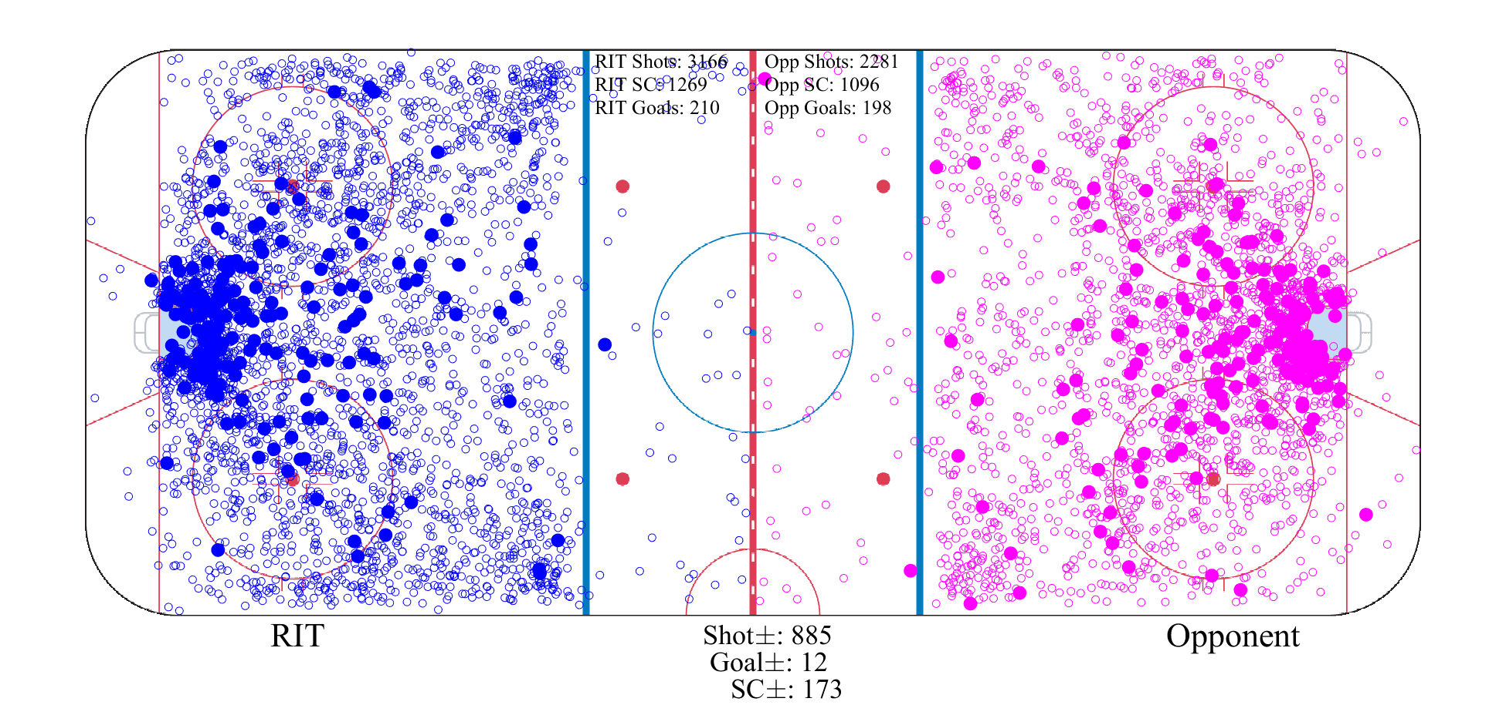
Data Overview
3 years of RIT games from 2015-2017
7179 shots by both teams (5445 5-on-5 shots)
622 goals (408 5-on-5)

Slide 4
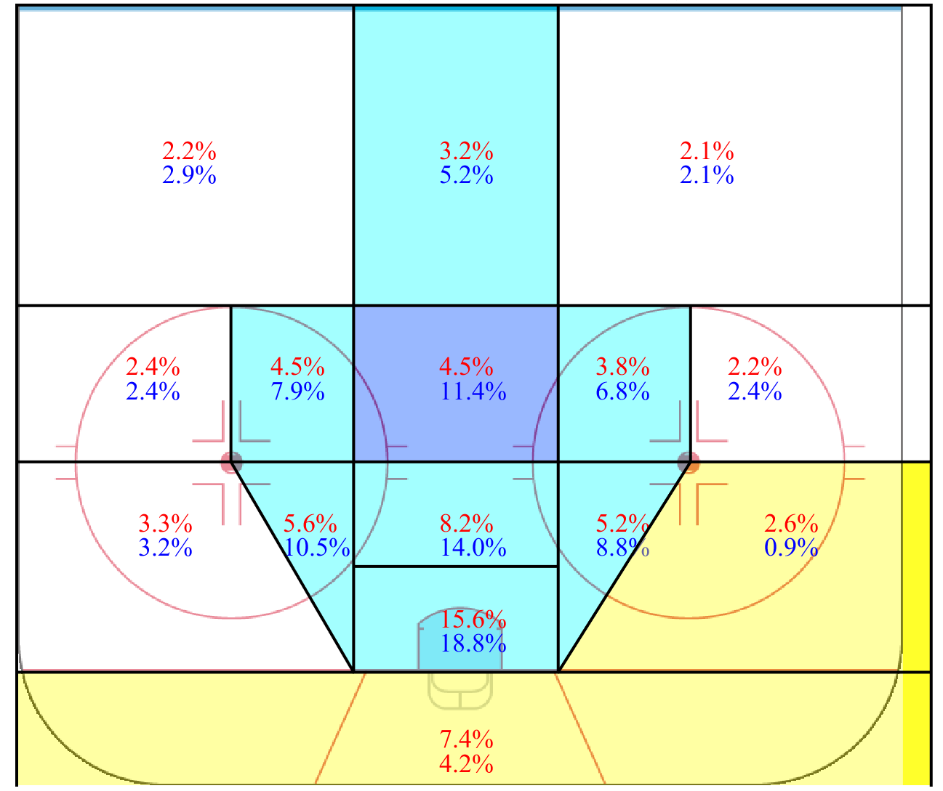
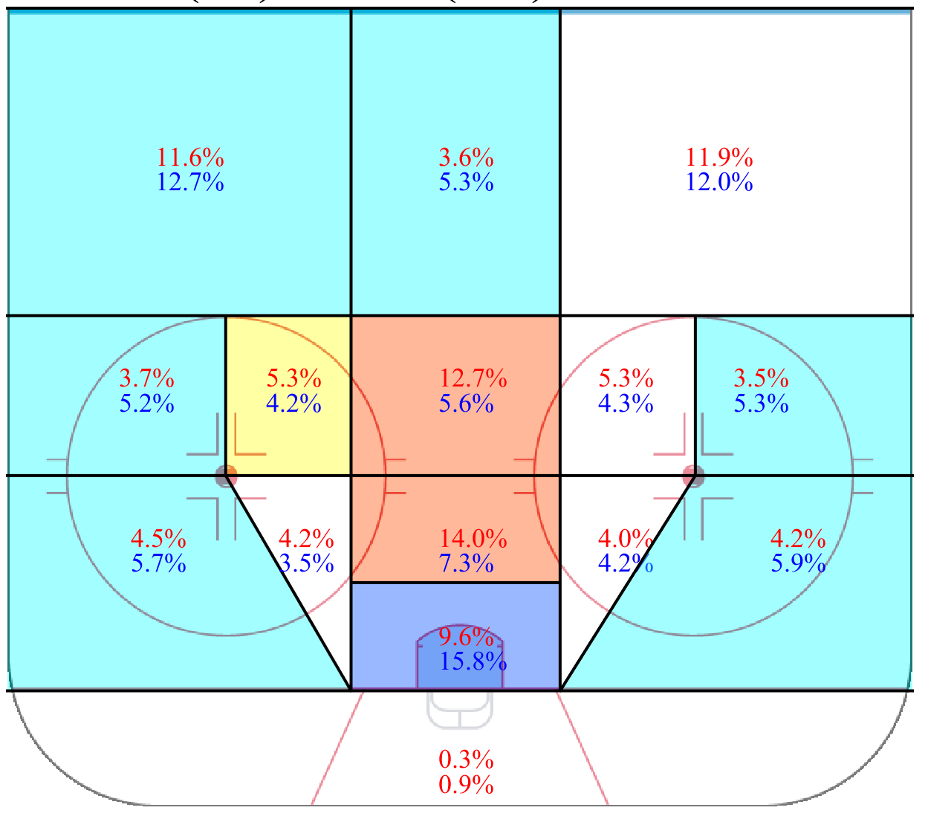
Data Overview
Comparing to Emmanuel Perry’s 2015 NHL data we can some differences in shooting percentage (7.5% vs. 5.2%) and shot selection
NCAA vs. NHL Shooting Percentage
NCAA vs. NHL Shot Distribution

Slide 5
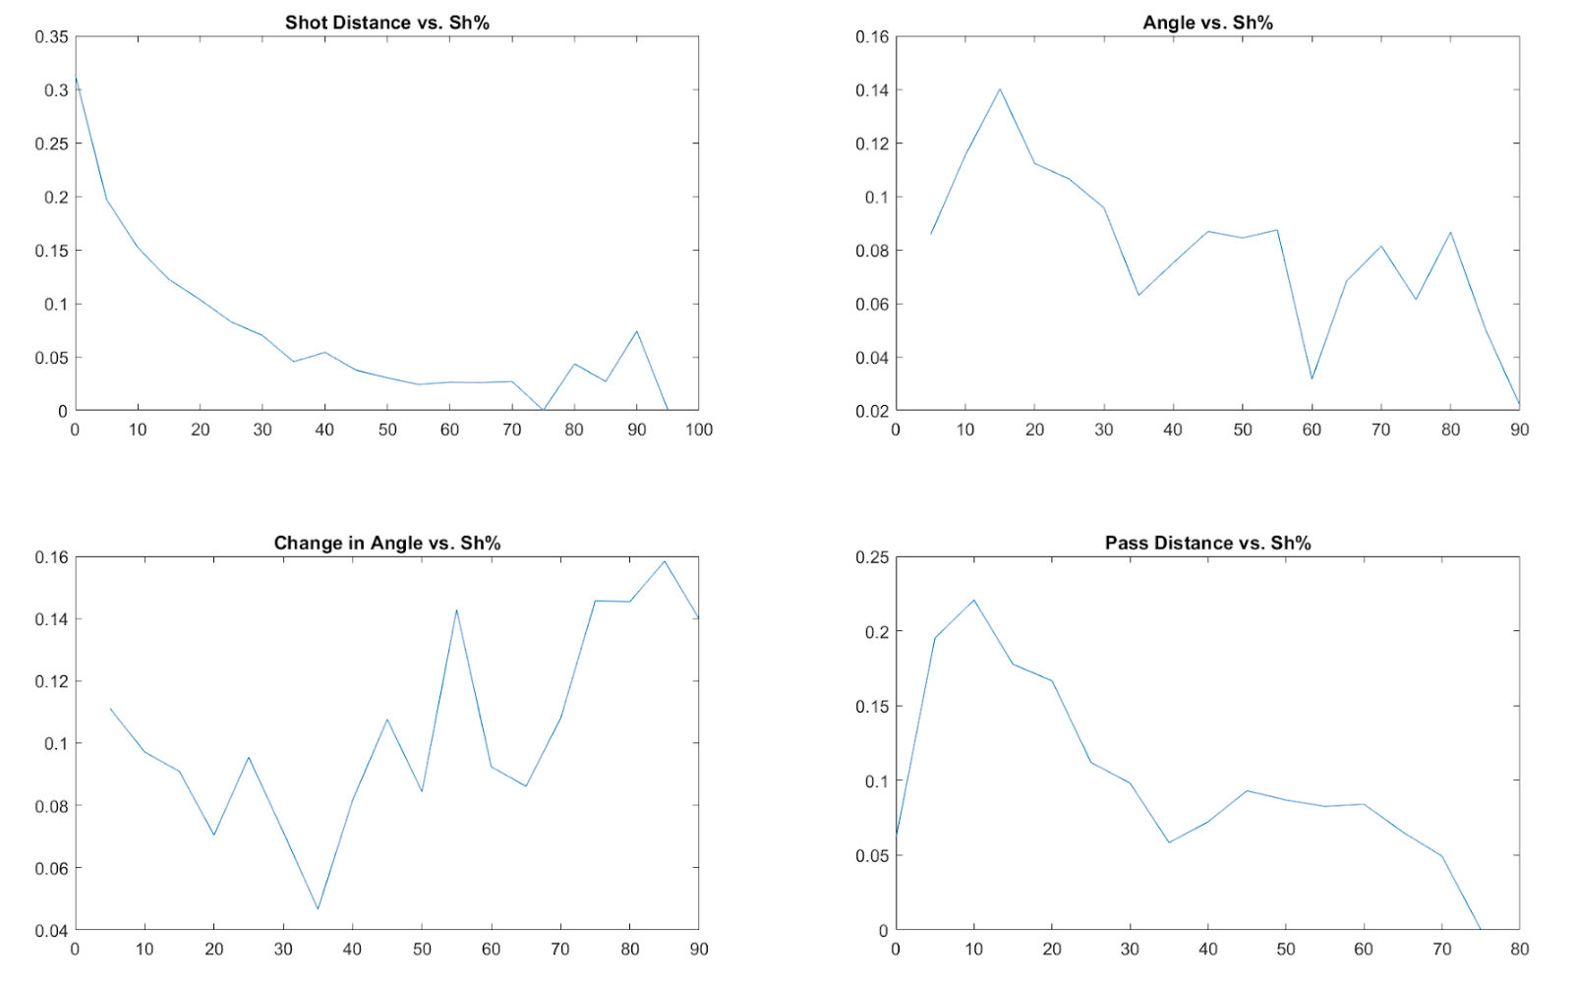
Expected Goals Model
To describe quality of shots we fit an expected goals model to the data using a linear regression
Variables used are shot type, shot distance, shot location, pass distance, and change in angle from the pass
We fit shot distance as a quadratic and everything else as linear
Choices were made for simplicity

Slide 6
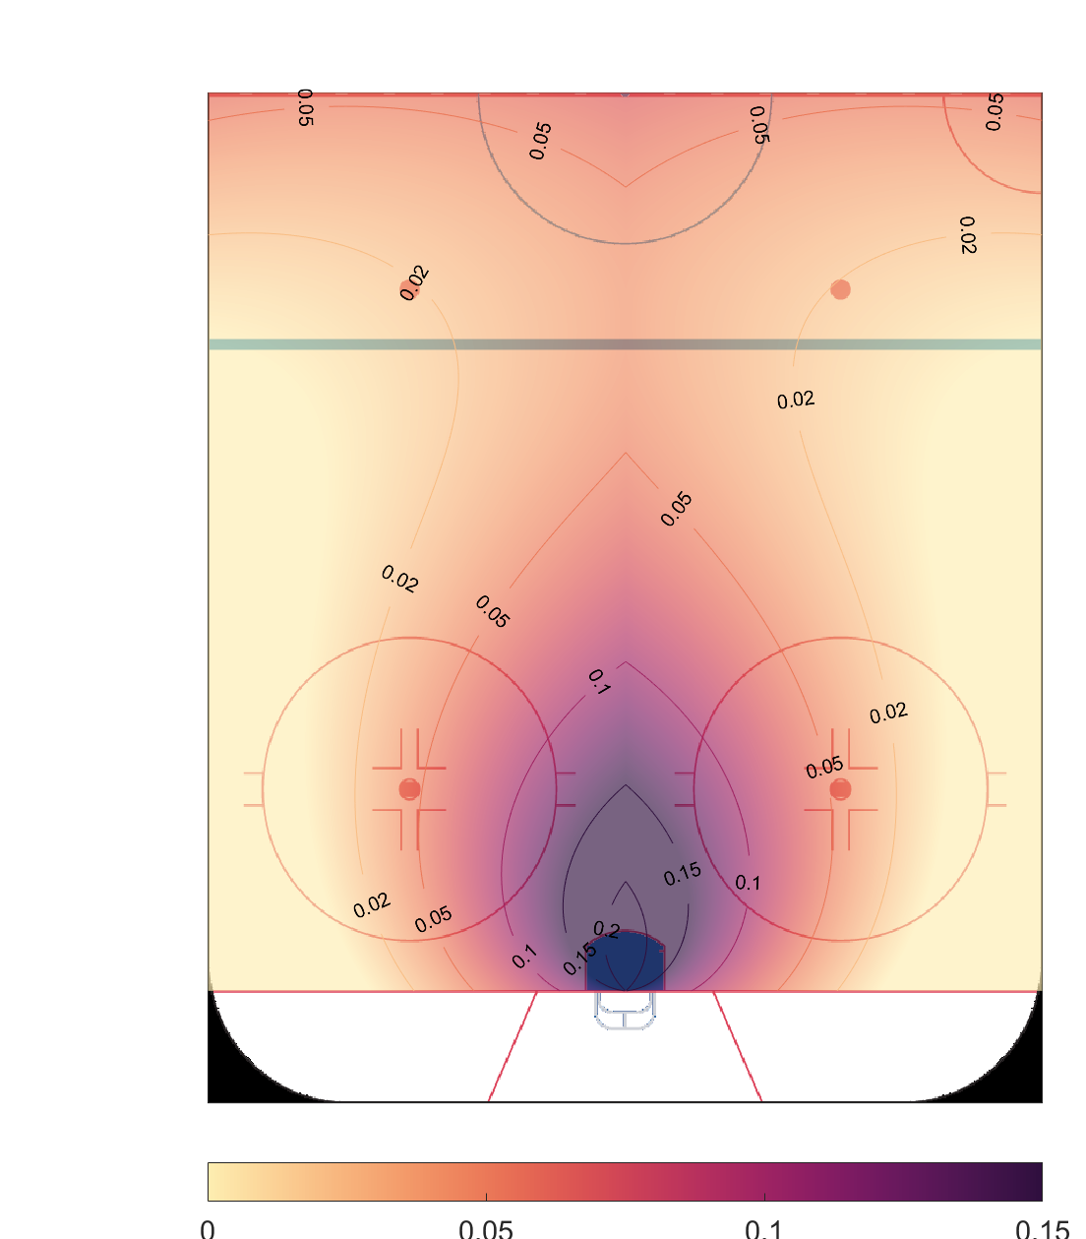
Expected Goals Model
xG from unassisted shot
For an unassisted shot, the xG values look similar to other models and are symmetric by construction
In the linear model the regions are flame shaped

Slide 7
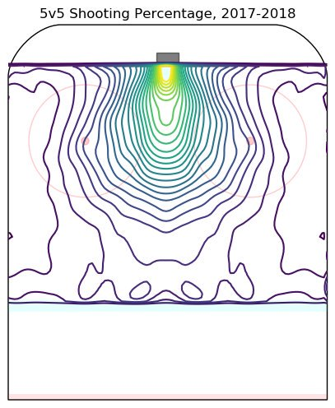
Expected Goals Model
xG from unassisted shot
The xG model compares qualitatively to the NHL shooting percentage map
2017-18 NHL Shooting Percentages from Micah Blake McCurdy

Slide 8
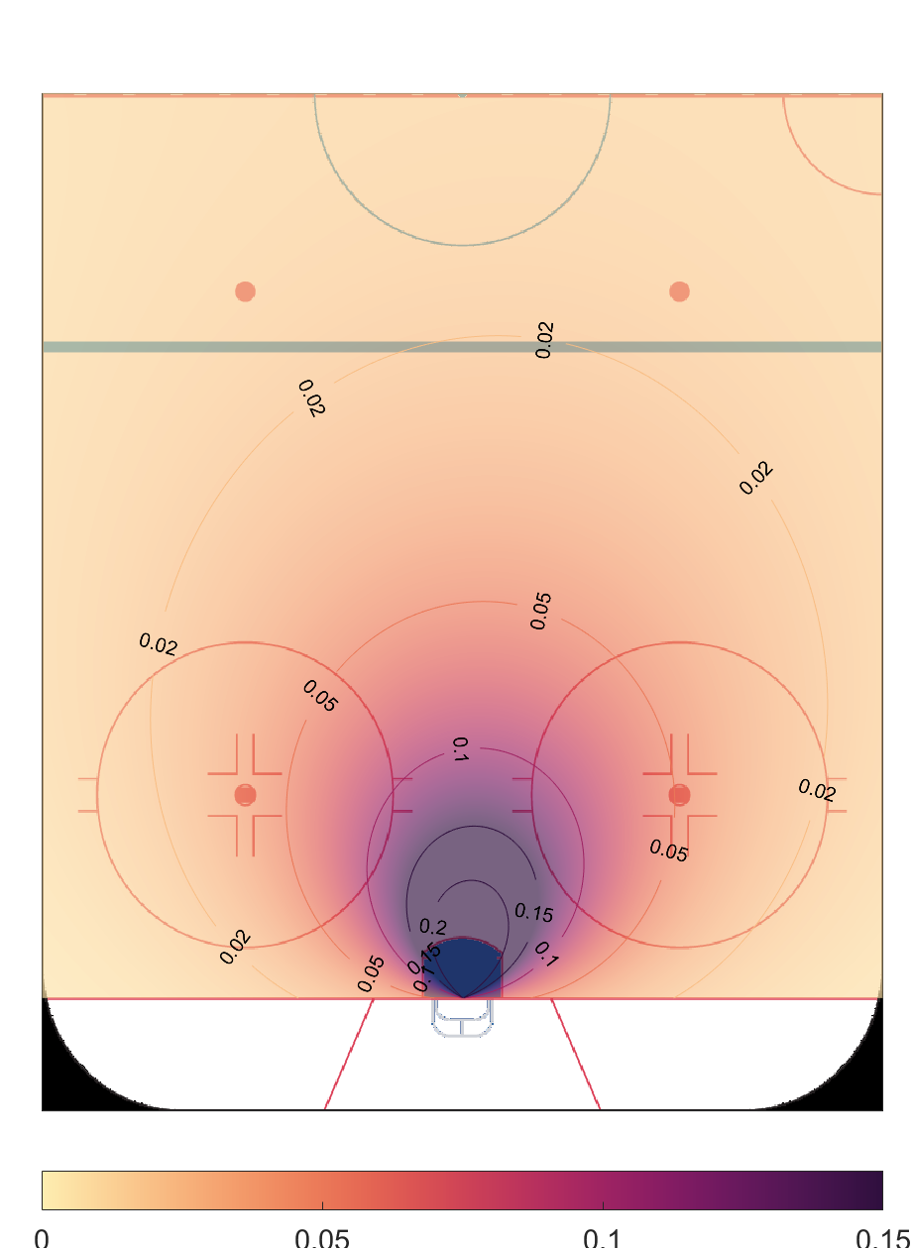
Logistic Expected Goals
xG from unassisted shot
We add complexity by modeling angle as a fourth degree polynomial and change in angle and pass distance as quadratics
No absolute values are used on angles
The fourth degree polynomial allows for more asymmetry in shot angle
A logistic regression is used as well

Slide 9
xG Model Coefficient Impacts
Regression was done by splitting data into 2 and averaging the models using each half as training
Average R² was 0.698 without including passes and 0.773 when including passes
Variable | Coefficient
Shot type | 0.00285
Shot Distance | -0.00685
Shot Angle | -0.00138
Change in Angle from Pass | 0.00026
Pass Distance | 0.00015

Slide 10
Value of making a pass
We can find the value of a shot and pass easily enough, but how can we attribute value of a player electing to shoot or pass?
Take the expected goal value of the location the player passed from and measure it against where the shot was eventually taken.
Do players stack value this way? Can we identify players that are able to “see the ice” better than other players?

Slide 11
Angle Change Bucket | Shooting Percentage
<10 | 8.0%
10-19 | 7.4%
20-29 | 7.0%
30-39 | 5.8%
40-49 | 9.3%
50-59 | 12.5%
60-69 | 8.8%
70-79 | 12.9%
80-89 | 15.3%
90-99 | 19.2%
100-109 | 17.5%
110-119 | 11.2%
120-129 | 7.2%

Slide 12
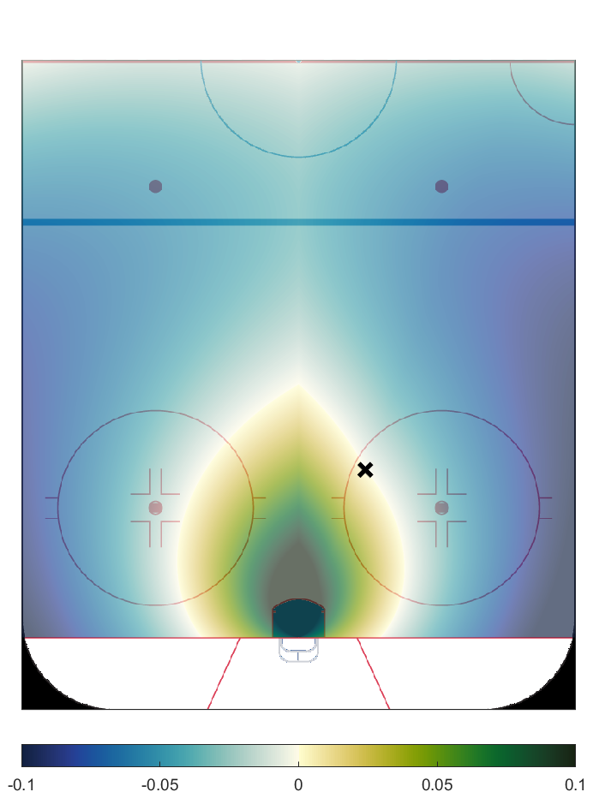
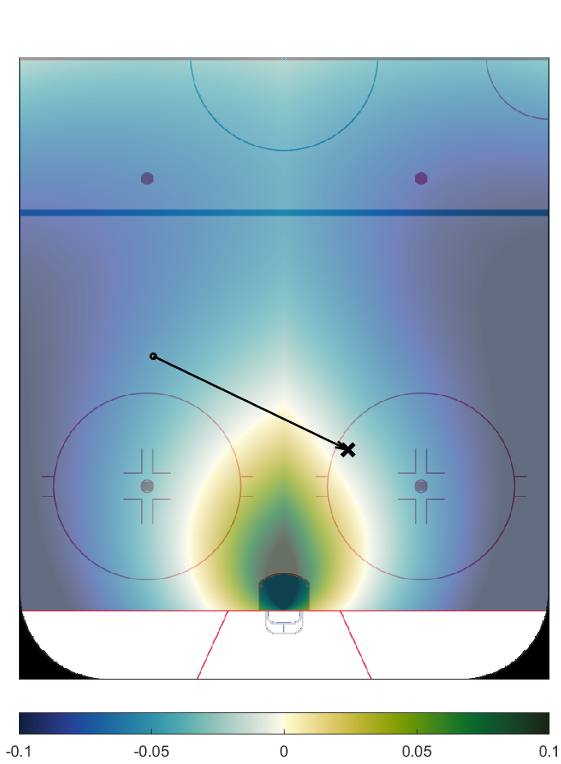
Value of making a pass
Here is one example
Notice slight asymmetry in the map because of value of longer pass
Notice the initial location is more valuable after a pass, so the positive value region is smaller
xG increase w/ next pass
xG increase w/ next pass

Slide 13
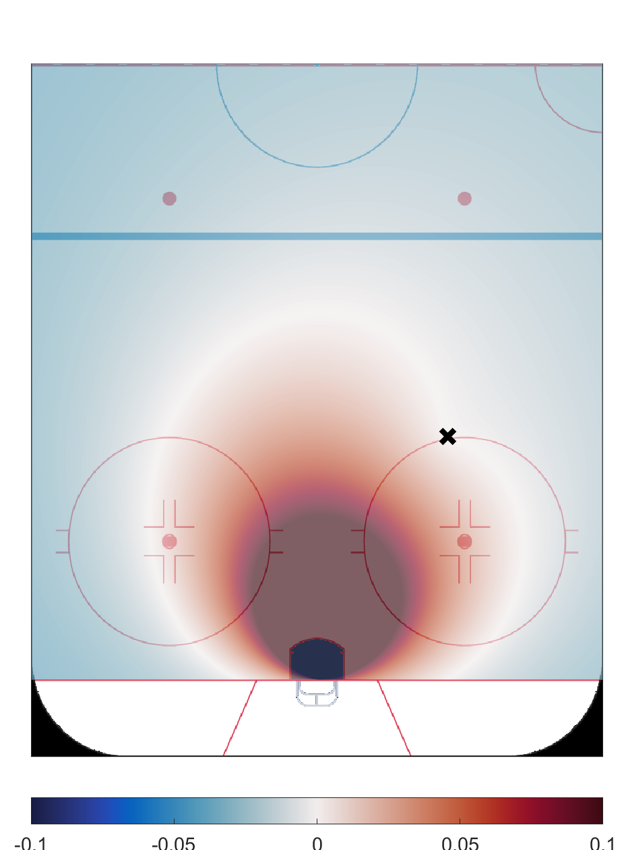
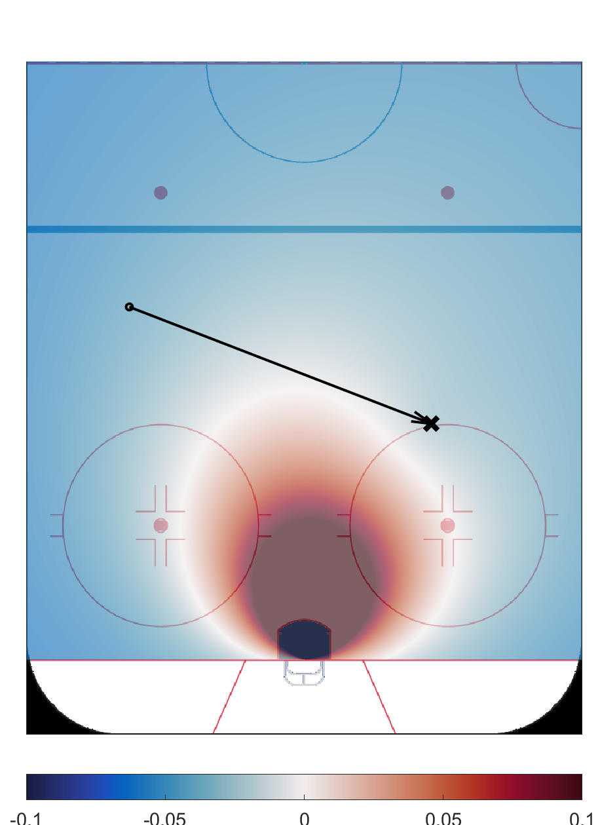
Value of making a pass (logistic model)
Here is another example, this time with the logistic model
Notice the lobes of red due to increased angle of an extra pass
xG increase w/ next pass
xG increase w/ next pass

Slide 14
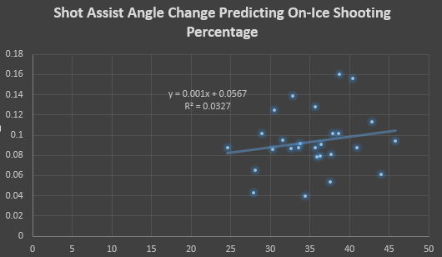
Players have very small, but measurable impact on on-ice shooting percentage

Slide 15
Overall xG Improvements per Shot Assist
Forward | xG Gained | Forward | xG Gained
Jake Hamacher | 0.155 | Garrett McMullen | 0.062
Josh Mitchell | 0.126 | Shawn Cameron | 0.061
Jordan Peacock | 0.106 | Ryan Kruper | 0.048
Alden Dupuis | 0.077 | Myles Powell | 0.047
Caleb Cameron | 0.074 | Erik Brown | 0.045
Todd Skirving | 0.070 | Gabe Valenzuela | 0.041
Danny Smith | 0.069 | Max Mikowski | 0.041
Abbott Girduckis | 0.064 | Alex Perron-Fontaine | 0.031
Liam Kerins | 0.063

Slide 16
Limitations
Without spatial tracking, we don’t have a comparison of what was available if no pass is made. Can punish players who create good scoring threats and shoot rather than pass.
The opposite is true as well! Not sure if a better option was available
No measure of distance traveled with puck – how much did the shooter create on their own after the pass?
Obviously one team over three seasons is not a huge sample.
There will be some uncertainty in recorded angles and distances due to human error in translating locations from video to the tracking app

Slide 17
Actionable Scenario
Average passing angle on shot assists for RIT forwards was 34 degrees.
Through video coaching with players, can that be improved? How much?
Average angle change on plays from behind the net: 89 degrees
Add two plays from below the goal line to replace two average shots and you get an improvement of 110 degrees per game. (178 – 68)
Individually, players would have improved team shooting percentage by (0.001 * 110) 0.110 percentage points.
Over three seasons, team would have added 22 goals. RIT lost 10 1-goal games in 2018 alone. 3 points out of a bye.

Slide 18
Incremental improvement is still improvement!
As Hockey Analytics grows, gains made will be marginal.
Passing angle is one small piece of the larger picture.
Learning more about what impacts shooting percentage (and ways to measure it) offers coaching opportunities

Slide 19
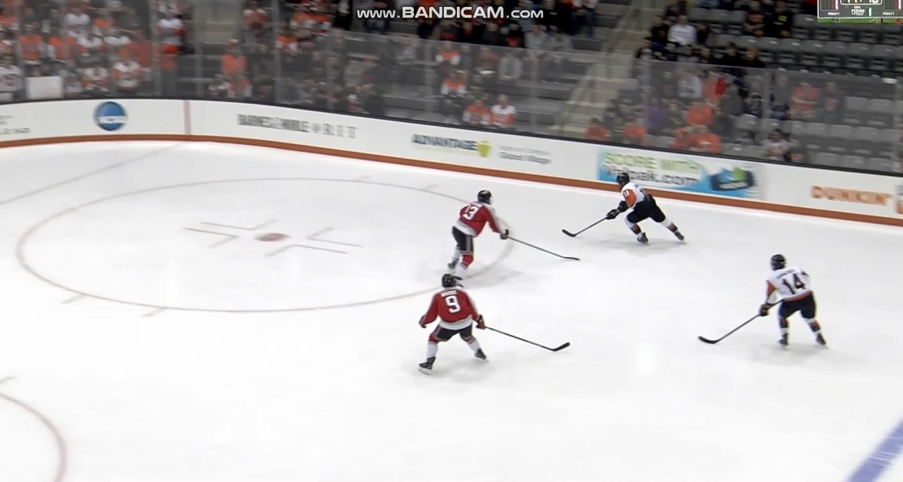
From 1% to 20%

Slide 20
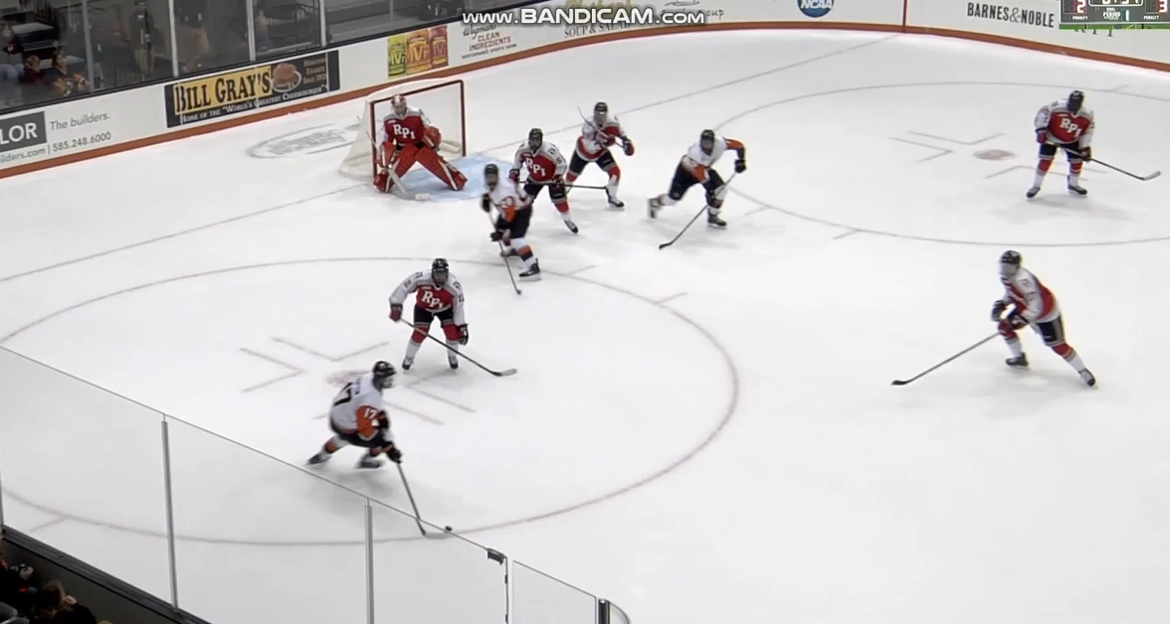
From 1% to 5%

