Slide 1
Impacting Decisions In Professional Sports or Fun & Profit
August 11, 2018
Seth Partnow, Director of Basketball Research – Milwaukee Bucks

Slide 2

Obligatory: About Me

Slide 3
“What Are We Doing Here?”
More pertinently, what aren’t we doing here?
    We are NOT
      Proving our intellectual superiority
      Disrupting entire industries
      Living the glamorous life of professional sports
    We ARE
    Providing the best information possible to enable better decision-making, ensuring more favorable long-term outcomes

Slide 4
Impacting Decisions In Three Maxims
Be selective and succinct
Be accurate over precise
Be humble yet confident

Slide 5
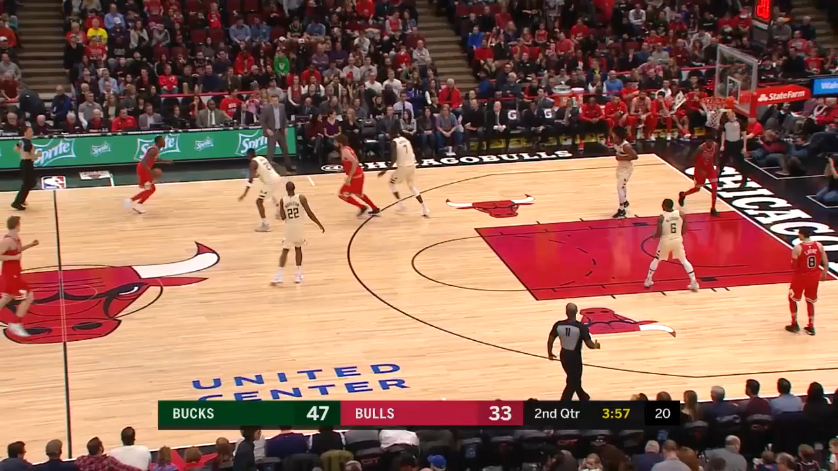
Be Selective and Succinct
Information overload is a real thing:

Slide 6
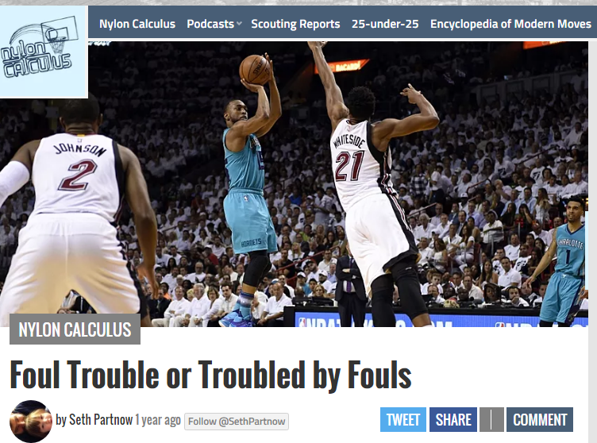
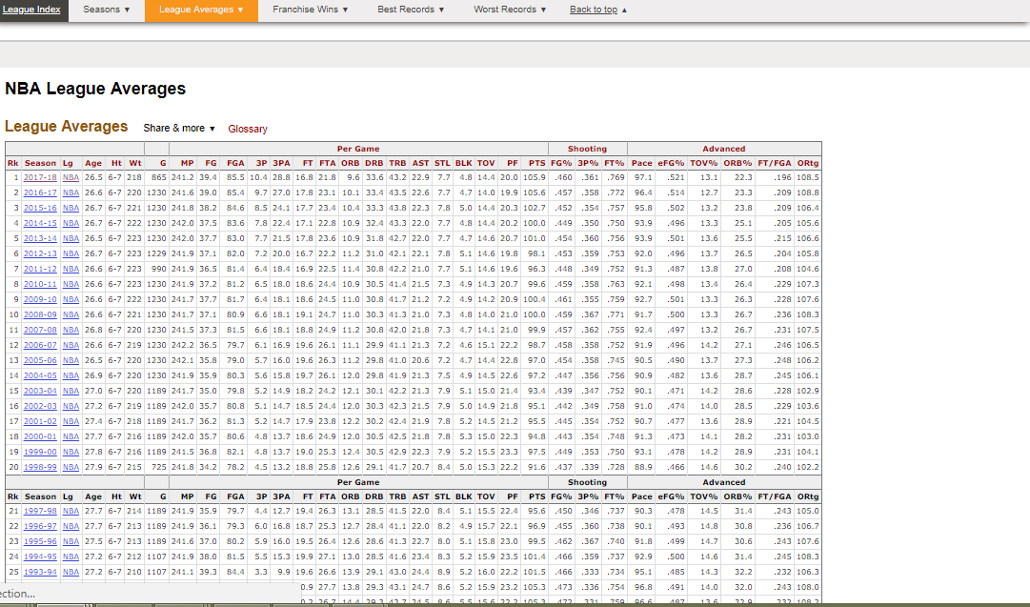
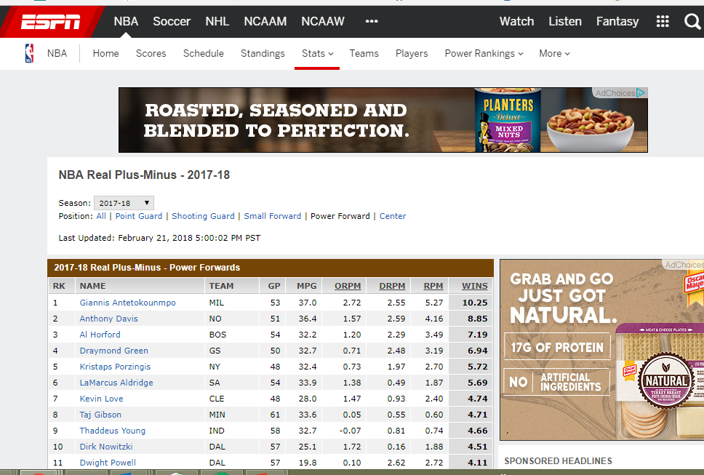
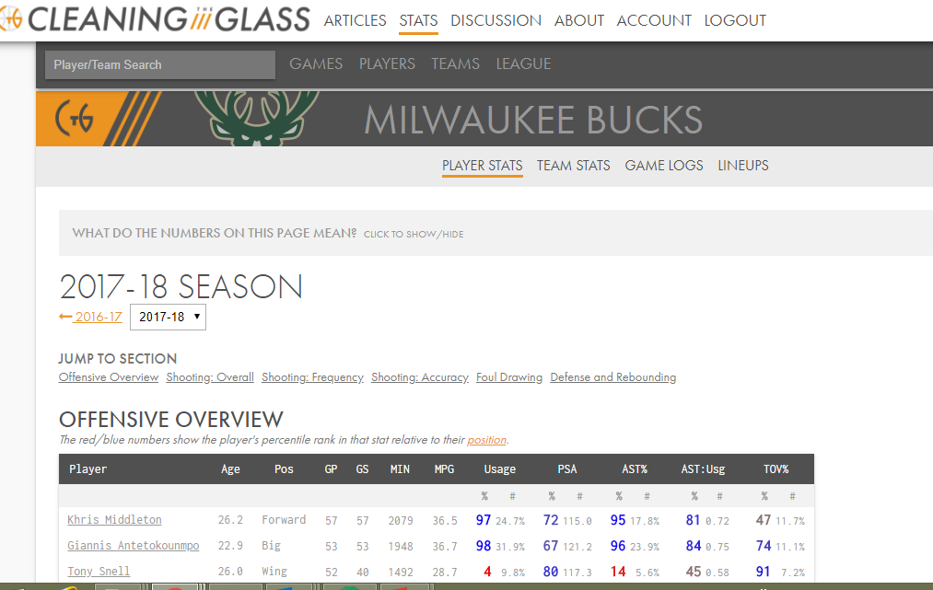
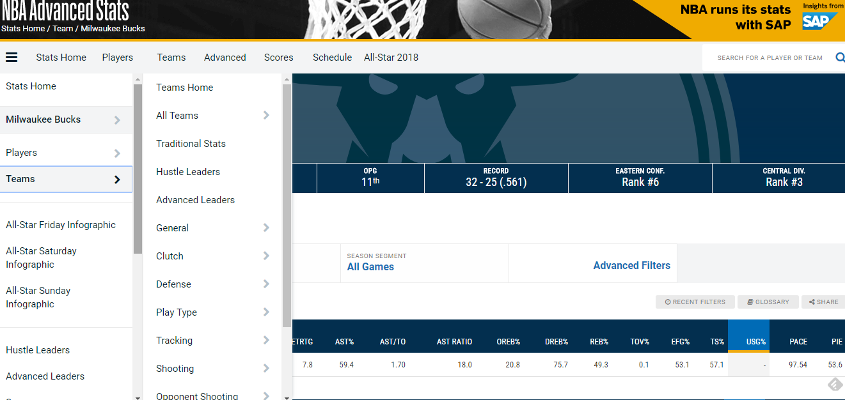
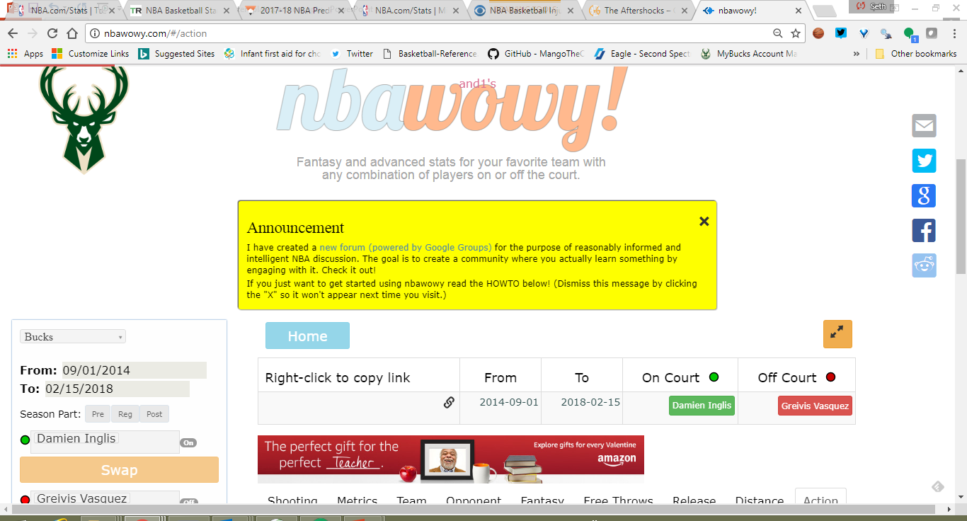
Be Selective and Succinct

Slide 7
Be Selective and Succinct
Understand the call of the question
Recognize the decision-making context
Give them what they want. And no more
But be prepared to give more

Slide 8

Be Accurate Over Precise
Which presentation better enables a decision-maker to decide?
Sam has a 32.4% chance of getting injured if he plays tonight

Slide 9
Be Humble Yet Confident
Humility:
    Recognize and respect subject matter expertise
    Understand the a high bar to clear for improvement
    Question your own results first
    Causality is hard

Slide 10
Be Humble Yet Confident
Confidence:
    Know what you can prove, what you know and what you think to be true
    Take the next shot
    Live with the results, understand if you were right to be wrong

Slide 11
A Final Word
“The Numbers” Do Not Say Anything
As an analyst…
YOU SAY

Slide 12
Answers to FAQ
I can’t talk about that. Not that either.
I’m not interested in your player value metric (basketball only).
No I can’t get you Giannis’s autograph.
The best way to get into sports analytics is to start doing sports analytics.
Yes, Die Hard is a Christmas movie.

