Slide 1
Burn The Bridge Deal
AFP Analytics (@afpanalytics)
Presenters: Kyle Stich & Justin White
Contributor: Patrick Salmon
Notes:
Kyle

Slide 2
Presentation Outline
How Teams Tend to Operate
Player Contract Timeline & “The Critical Decision Point”
Finding the “Breakeven Point”
A look at William Nylander
Long-term contracts & buyouts
A look at Sam Reinhart
Buyout likelihood through simulation
A look at Nikita Kucherov
Notes:
Kyle

Slide 3
How Teams Tend to Operate
Often give leverage to the players/agents in negotiations
  Short term offers
Rarely trade players with RFA status
Concept is unique to NHL because free agent status rules
Generally pay based on past performance
Notes:
Justin

Slide 4
Player Contract Timeline: Our Focus
Enter the League
Sign Second Contract
1st Eligible for UFA
19
20
21
22
23
24
26
27
Notes:
Justin

Slide 5
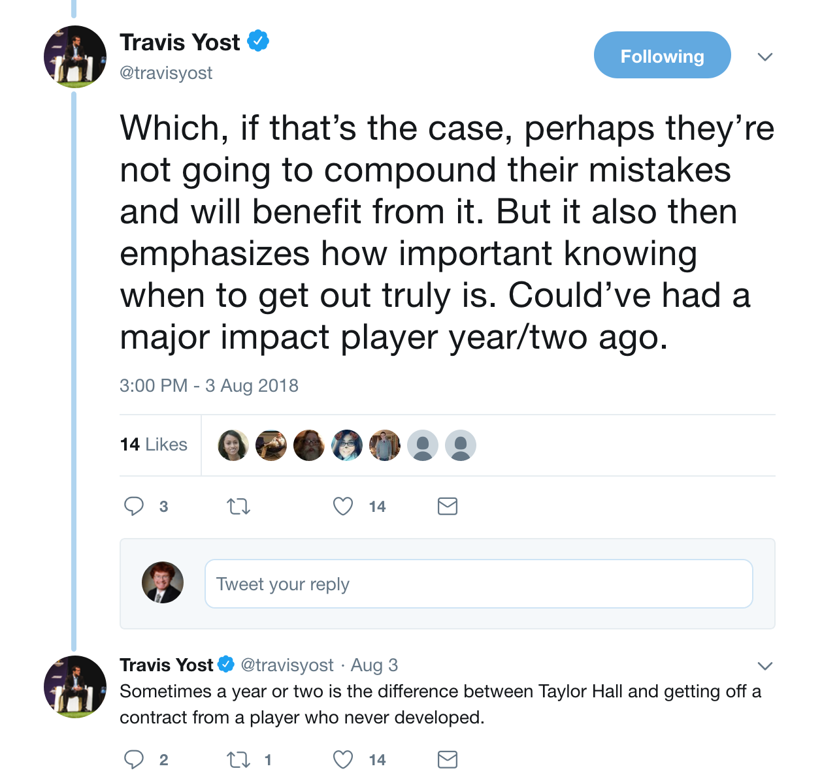
The Critical Decision Point
After a player’s Entry Level Contract (ELC) expires, team has options:
  Sign the player to a long-term contract
  Sign the player to a short-term contract
    You’re betting the player will get worse!
  Trade the player
Notes:
Kyle

Slide 6

A Quick Finance Lesson…
Theory: Time Value of Money
  “A dollar today is worth more than a dollar in the future”
  Why?
    Dollar can be invested OR
    Inflation naturally raises prices
  Quick example
    Let’s think about buying a candy bar
A team’s goal should be to minimize a player’s cap
hit in terms of present value
$$PV= \frac{Dollar Amount}{{(1+inflation rate)}^{Year in Future}}$$
Inflation Rate = 4.59%
Notes:
Kyle

Slide 7
“The Breakeven Point”
For 2nd contract player can sign:
  Short-term (Contract A)
  Long-term (Contract B)
Question is: What contract (Contract C) would need to be offered after Contract A expires to make the total, in present value equal to Contract B?
Notes:
Kyle

Slide 8
“The Breakeven Point”
Contract B
Contract A
Contract C (6 years)
2 Years
8 Years
If team’s goal is to minimize the present value of the player’s cap hit, their goal is to determine what contract proposals would make the present value equal between the two options
Notes:
Kyle

Slide 9
Getting to the “Breakeven Point”
Critical Formulas:
  Contract A * (1+x%) = Contract B * (1+y%) = Contract C
  PV Contract A + PV Contract C = PV Contract B
  x% is known
  Solve for y% by minimizing difference (difference cannot be negative)
Notes:
Kyle

Slide 10
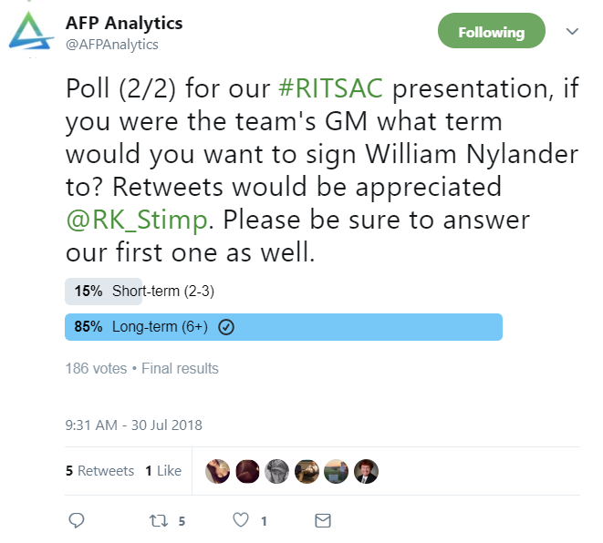
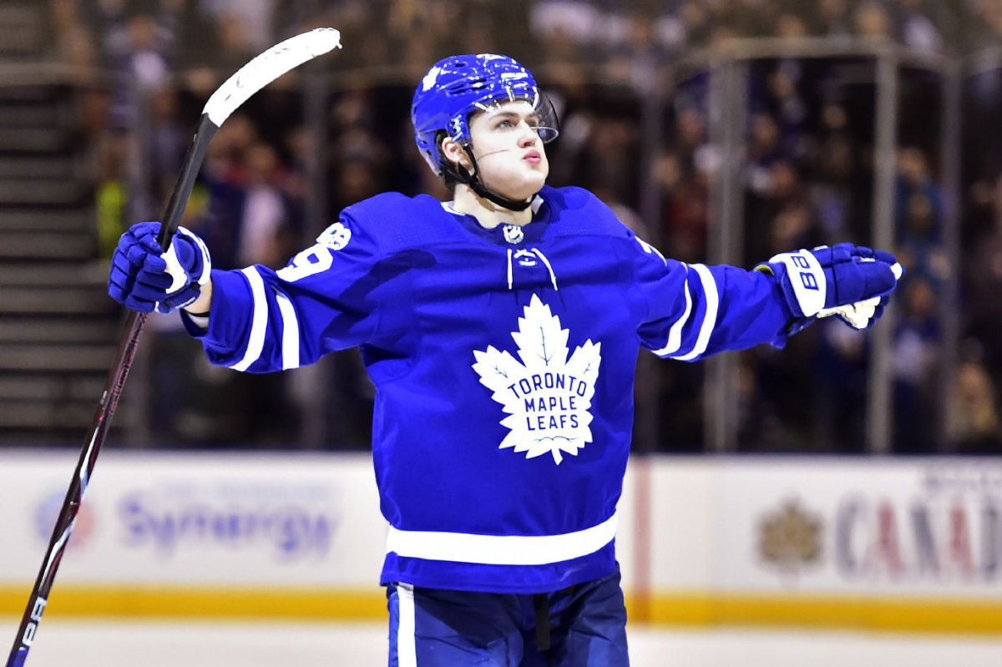
Case Study: William Nylander
Notes:
Justin

Slide 11
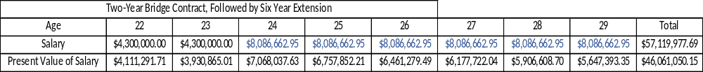
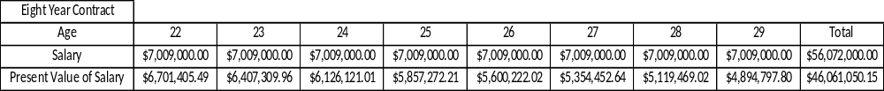
William Nylander: Contract Options
Difference in cap is most important in year 3
The larger the contract, the larger the savings
Savings of nearly ~$1M dollars against the cap in years 3-8
Notes:
Justin

Slide 12
Why are long-term contracts not prevalent
General Managers are risk averse
  Their job is on the line
  Do not look long term
Bridge contracts are the status quo
Fear of the Buyout
  Hand in hand with risk aversion
Notes:
Justin

Slide 13
Buyout window
If younger than 26 then 1/3rd of the remaining contract value is paid out
  Older than 26 2/3^{rds} of the contract must be paid
Think back to our timeline, by year 2 or 3 of a long term deal the player is still young enough to only be a 1/3rd hit
Notes:
Kyle

Slide 14
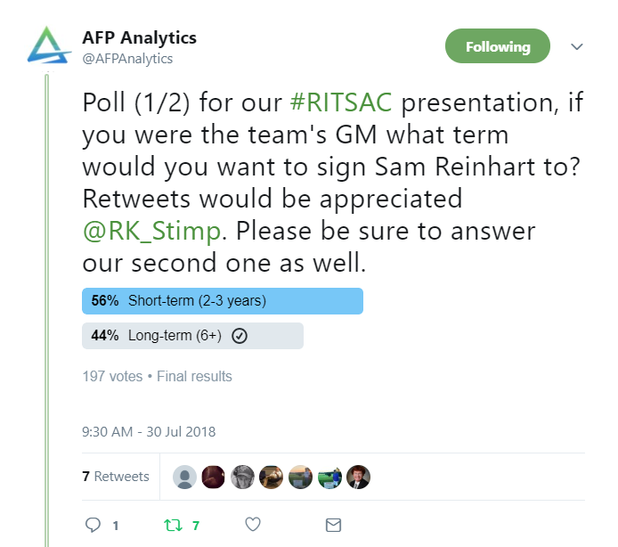
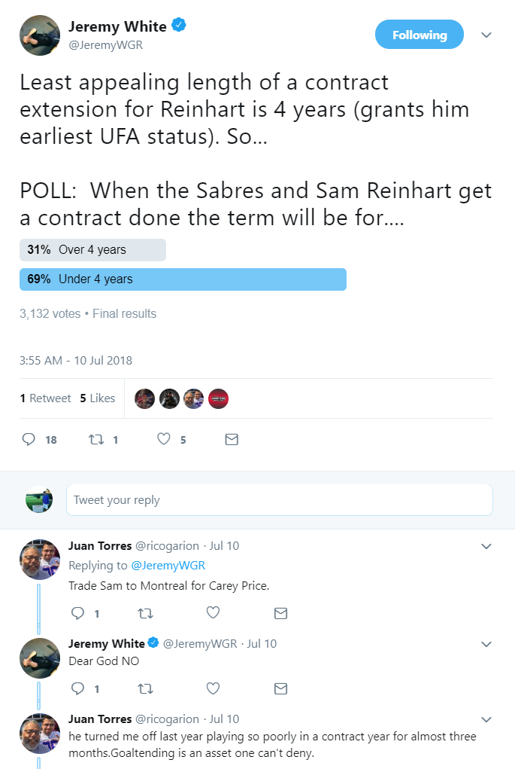
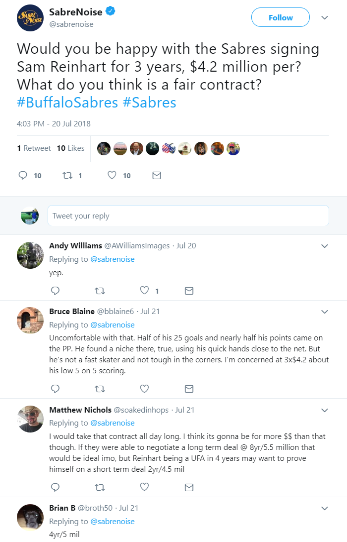
Case Study: Sam Reinhart
Notes:
Kyle

Slide 15
Sam Reinhart: Contract Options
Difference in cap is most important in year 3
From a cap management standpoint, the Total Dollar amount does not matter
Savings of nearly $500,000 dollars against the cap in years 3-8
Buyout cap hit: $867,666.67
Inflation of $5.2M = $5.7M in two years
Notes:
Kyle

Slide 16
How likely is a buyout?
Buyout Risk vs. Risk of bridge getting a large extension
  Betting against the odds
Worst case scenario when signing a long-term contract:
  Player is awful and team buys out the player
    Probably thinking: How likely is that?
    We figured it out through simulation
Notes:
Kyle

Slide 17
Simulating Player Performance
Sample: All players who were 23 in 2014 and appeared in 2015 and 2016, broken by position
  Meaning players had to play in NHL at age 23, 24, & 25
Ran Monte Carlo Simulation (normal distribution) to determine probabilities of player regressing from age 23 to 25
Repeated process for players 30 to 32
Notes:
Kyle

Slide 18
Probability of a Younger Player not Getting Worse in 2 Consecutive Years
Forwards, age 23-25:
CF% | TOI/GP | Goals/60 | First Assists/60 | Total Points/60 | iCF/60
80% | 86% | 85% | 86% | 88% | 85%
Defense, age 23-25:
CF% | TOI/GP | Goals/60 | First Assists/60 | Total Points/60 | iCF/60
81% | 87% | 89% | 79% | 82% | 91%
Notes:
Kyle

Slide 19
Probability of a Older Player Getting Worse From 30 -31
Forwards, age 30-31:
CF% | TOI/GP | Goals/60 | First Assists/60 | Total Points/60 | iCF/60
43% | 54% | 58% | 72% | 72% | 62%
Defense, age 30-31:
CF% | TOI/GP | Goals/60 | First Assists/60 | Total Points/60 | iCF/60
60% | 55% | 47% | 65% | 65% | 50%
Notes:
Kyle

Slide 20
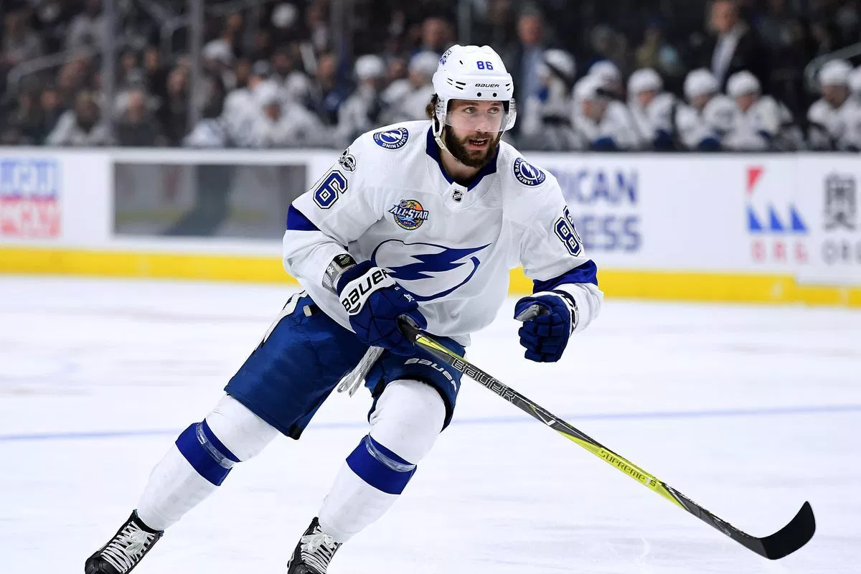
Case Study: Nikita Kucherov
Notes:
Both

Slide 21
Nikita Kucherov
3 year bridge, followed by 8 year extension
Initial reaction to the bridge was, great deal at the time… salary cap issues to follow
Was this the right thing for Tampa to do?
  Cap situation aside
Notes:
Both

Slide 22
Nikita Kucherov: Contract Options
3 years of paying more than the bridge
5 years of savings once the extension kicked in
Is it reasonable to expect him to sign for $9.5M in year 9
Notes:
Both

Slide 23
Conclusion/Wrap-Up
By offering RFA players short-term contracts teams are:
  Betting the player will get worse
  Giving leverage to players with minimal to no leverage
Using long-term instead of short-term deals creates favorable future cap savings
  More critical than ever with league trending younger
Notes:
Kyle

Slide 24
Thank You!
Follow us on Twitter: @afpanalytics
For a detailed writeup of the presentation please visit: afpanalytics.com/blog
Notes:
Kyle

