Slide 1
The 2016-17 Boston University Power Play
J U D Y C O H E N
@judylee_c
judypuck.wordpress.com
RIT Sports Analytics Conference
August 11, 2018
Notes:
- Judy Cohen
- talking about 2016-17 BU PP
- excerpt/abridged version because cannot fit into 20 mins
- if you want to follow, go to my blog judypuck.wordpress.com

Slide 2
Intro and personnel
Intro and limitations
Looked at BU’s top two power play units during the 2016-17 season (the two units most frequently used during the season based on video I had)
Only had access to 21 total games from the season, 16 of which were home games
PP did not perform statistically significantly better at home (16-75, 21.3%) than on road (13-70, 18.6%), despite the team performing better at home (13-3-2) than road (8-6-1)
PP1 used 31 times in seven games (32:09), PP2 used 17 times in six games (12:49)
Small sample size!
Notes:
- general overview detailing what went into the project
- looked at BU's top 2 units during this season, two units most frequently used based on the video I had
- only had 21 total games, usually 38-40 games in college season
- 16 were home games were is concerning
- but PP did not perform statistically significantly better at home vs road despite stark difference in record
- PP1 31 times in 7 games, 32:09 TOI
- PP2 17 times in 6 games, 12:49 TOI
- small sample size, not trying to make sweeping generalizations or apply this to hockey in general
- looked specifically at how these PPs did in their TOI

Slide 3
Intro and personnel
Methods
Shots and passes
  Went through video and tracked shots and passes using tracking tool Ryan Stimson gave me access to
  Got x,y coordinates for each event in addition to shot angle, shot distance, pass distance, and more
  Exported data as csv and used Python (matplotlib, seaborn) to create visualizations of what I tracked
Notes:
- read the slide
- went through vid to track shots and passes and used a tracking tool Ryan generously gave me access to
- click around on rink and get xy coordinates, shot distance, pass distance, shot angle, etc
- exported as csv and used python (matplotlib, seaboard) to make viz

Slide 4
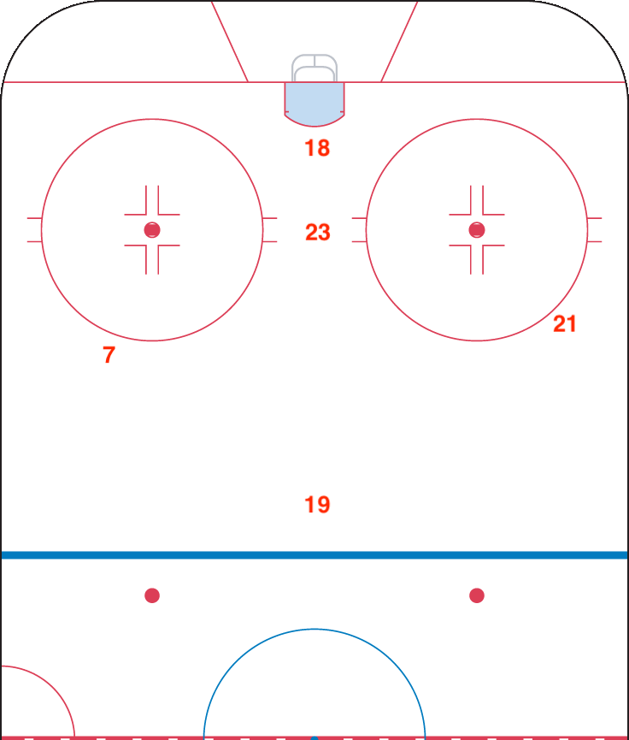
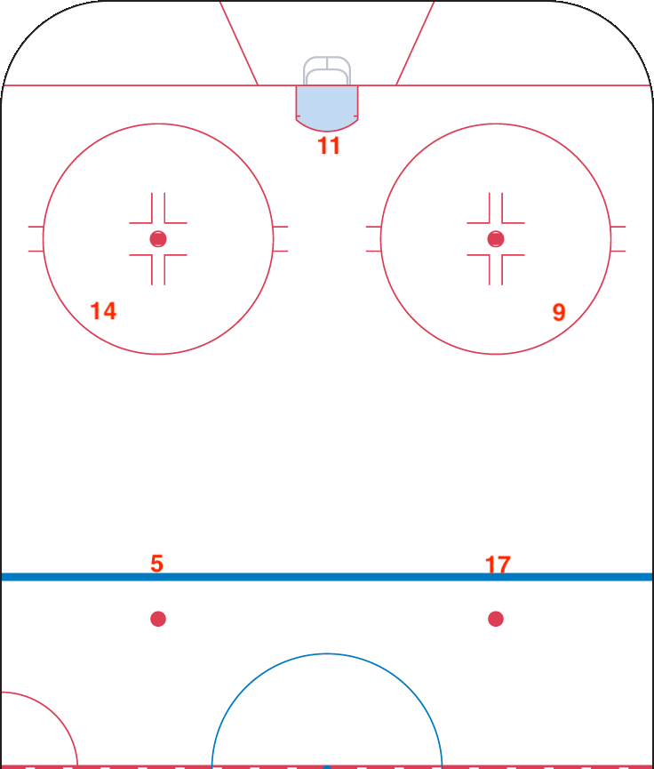
Intro and personnel
Units and power play shape
PP1: 1-3-1 || 4F1D || mobile
PP2: Split || 3F2D || stationary
Jordan Greenway (18), Jakob Forsbacka Karlsson (23),
Patrick Harper (21), Charlie McAvoy (7), Clayton Keller (19)
Bobo Carpenter (14), Patrick Curry (21), Kieffer Bellows (9), Chad Krys (5), Dante Fabbro (17)
Notes:
- actual hockey part of this PP
- PP1 ran 1-3-1, 4F1D, very mobile slid around to fill in spaces
- JG net, JFK slot, Chuck left, Pat right, Clay on the point doing whatever he wanted
- PP2 split, 3F2D, very stationary did not move at least in terms of shots
- Pat net, Bobo left, Kieffer right, Chad left point, Dante right point
- all four wall guys are on their off sides (oppo of handedness): Chuck, Harper, Bobo, Kieffer, get one timer in as option

Slide 5
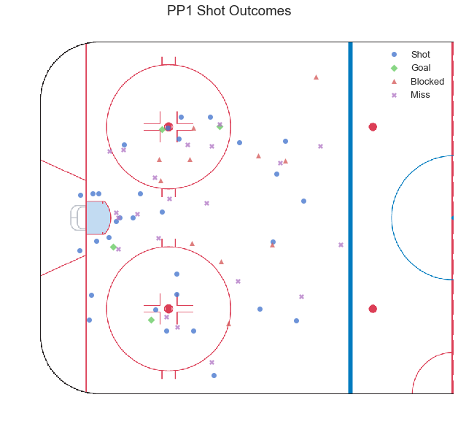
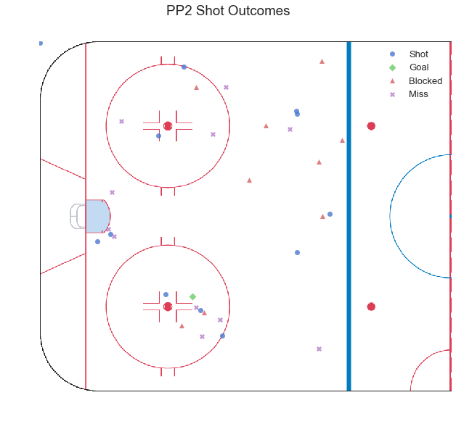
Unit shot profiles
Unit shot locations and outcomes
Notes:
- overview of shot locations for both units
- see PP1 a little messy but shape is there, that diamond with slot presence
- 31 SOG (35 w 4 goals), 21 misses, 11 blocked
- PP2 sample size makes it looks bare, but distinct areas where people were shooting
- 12 SOG (13 w 1 goal), 11 misses, 9 blocked

Slide 6
Unit shot profiles
Average shot distances (in ft)
Notes:
- variance in shot distance for both units
- not too big, but can see PP2 was super set in positions compared to PP1
- Kieffer 2 ft radius, Chad and Dante did not want to leave blue line
- PP1 some more variance (Clay)

Slide 7
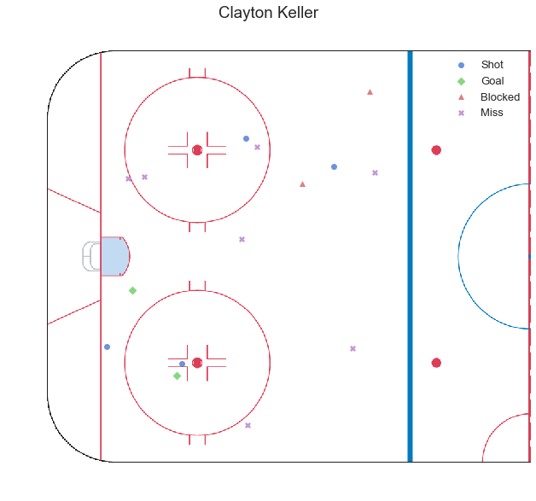
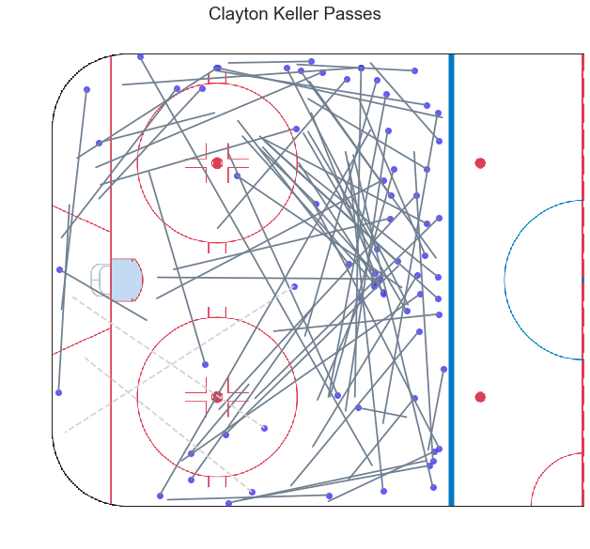
Individual player profiles
Clayton Keller – point
Notes:
- gonna show couple examples of player profiles
- each player has shot maps, pass maps, primary shot assist maps
- shots from everywhere (could see in shot distance table)
- passes a lot from all over the place compared to other guys whose passes are more localized even if they do slide around a bit
- see how responsible he was for this PP and how much freedom he had
- when you look at other two I'm showing you'll see how different that is from everyone else
- dotted lines here mean indirect passes so they start and end where you see but their paths were not straight (off boards or rimmed)
- Keller had 71 total passes, 25 went to harper, 24 went to McAvoy
- PP1 moved the puck a lot in that high triangle which you might have known based on this PP

Slide 8
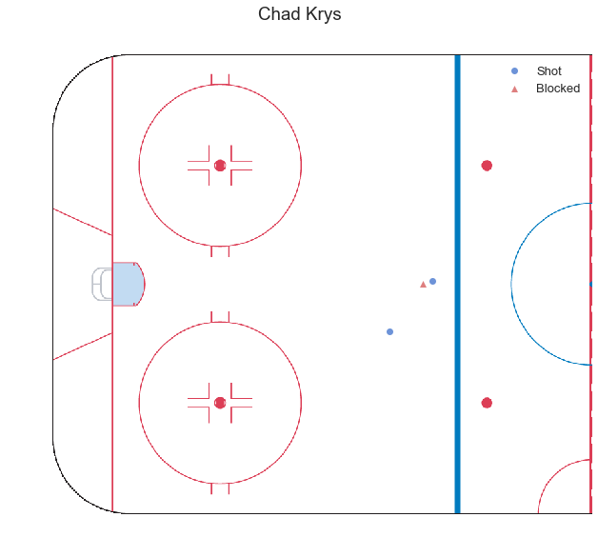
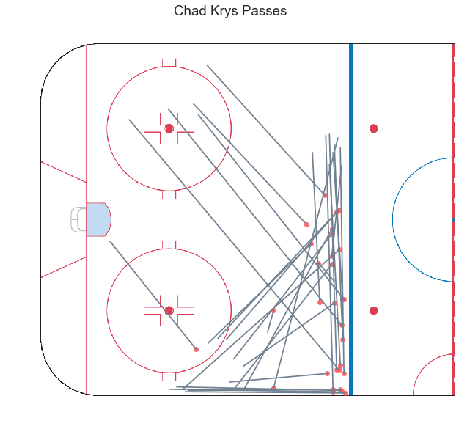
Individual player profiles
Chad Krys – left point
Notes:
- only PP2 member I'm showing
- his pass map is a bit different than other two in that 3 of his passes came from more than 15 feet away from the blue line, otherwise just sliding that line and walking the line
- even shots he doesnt really step up for them though its only three but he did get two through from that far so thats pretty good
- Chad ran PP2 with Fabbro those two were in charge of passing the puck and getting things moving
- Krys' primary shot assist rate is high, but he's not passing to super dangerous areas, only a couple here I would consider dangerous passes or dangerous shots
- you'll see in next table too, shots taken after a Krys primary shot assist are on average 38.98 feet away from the goal whereas someone like Keller with a similar primary shot assist rate, shots taken after those passes are taken from average 28.88 feet out

Slide 9
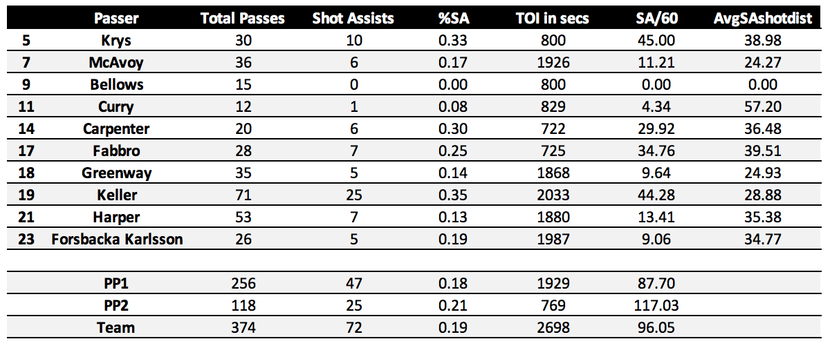
Individual player profiles
Primary shot assist rates
Notes:
- total passes, how many of those passes were shot assists, the percentage of that (Krys example)
- every instance of the letters S and A here means shot assist not shot attempt
- TOI in seconds, shot assists per 60 (this is where you can see Krys' rates are similar to Keller's, but if you look at last column you can see shots are closer on Keller passes)
- not trying to equate Krys and Keller with each other, just saying they were in charge of their PP units

Slide 10
Passes vs. the penalty kill
Opponents’ forecheck and penalty kill formation
Notes:
- table up top just shows each opponent and what pk and forecheck they used
- BU played each team once except Maine who they played twice in a home and home one weekend
- PP1 and PP2 columns just indicate whether that unit faced that particular PK or opponent
- two tables underneath show pass and shot rates per 60 vs each specific penalty kill
- against 1-1-2, PP2 seems to be shooting at a higher /60 but otherwise pretty even
- don't want to put too much stock into that because they played less than half the time PP1 did, not clear it would be maintained
- PP2 on pace to surpass PP1 passes/60 against Controlled and Wedge+1
- Wedge more guys on perimeter for more guys to chase

Slide 11
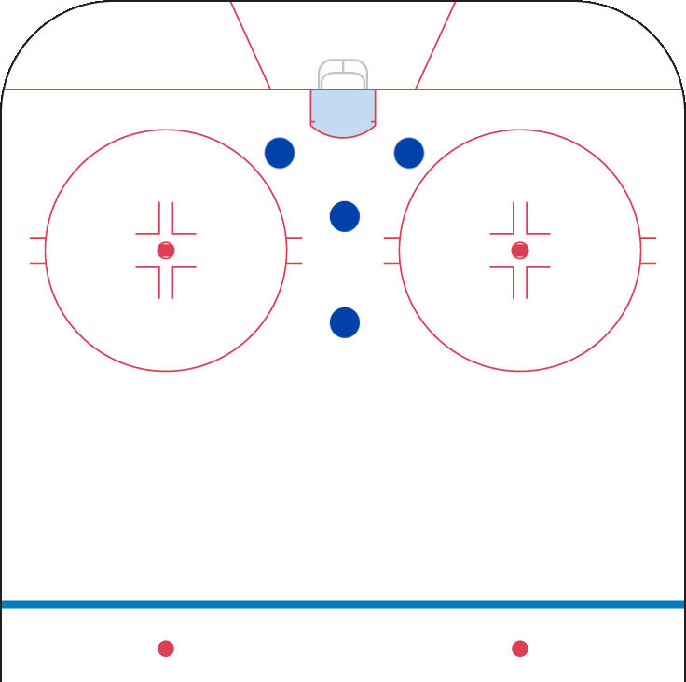
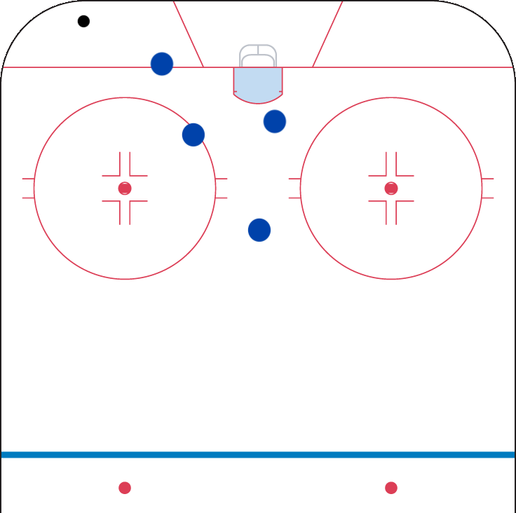
Passes vs. the penalty kill
1-1-2
Notes:
- only included two examples of PKs here, rest are on blog
- similar to a Wedge+1 but instead of sending top guy out to chase puck, send two guys out to pressure puck and leave two in vertical line in slot
- Maine used this PK against BU in both games vs both units

Slide 12
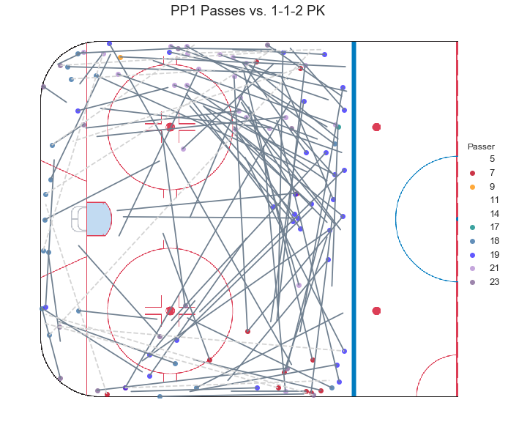
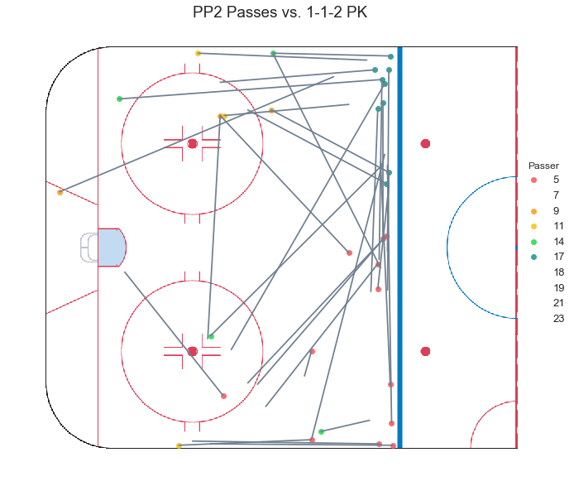
Passes vs. the penalty kill
1-1-2
Notes:
- PP1 very full, nice shape
- concentration on right side where Harper and Keller are
- PP2 not as many but can see how much is going on on that blue line and how much goes back and forth between Fabbro and Krys
- PP1 has more slot presence than PP2

Slide 13
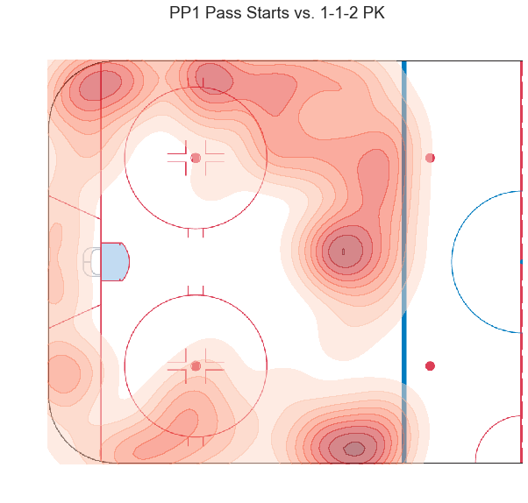
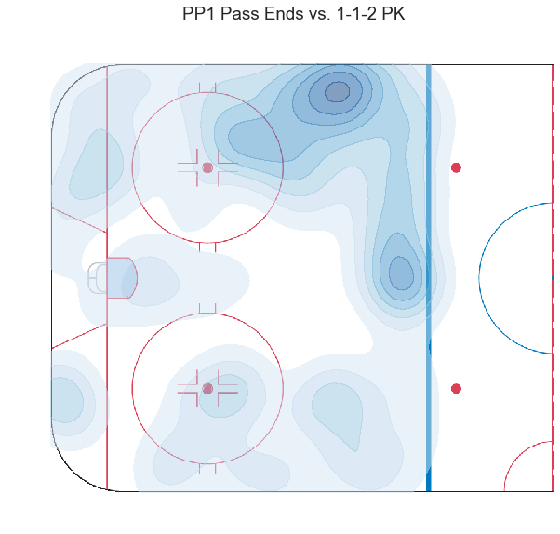
Passes vs. the penalty kill
1-1-2
Notes:
- density plots based on where passes start and where they end (didn't know how to do it without being too overwhelming to look at
- PP1 zero passes from inside faceoff dots or below the center points
- passes are going to front of the net though

Slide 14
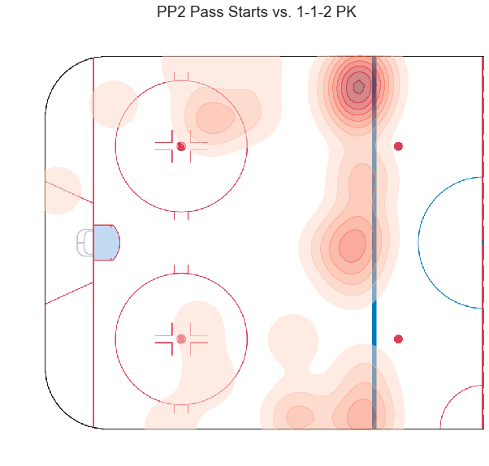
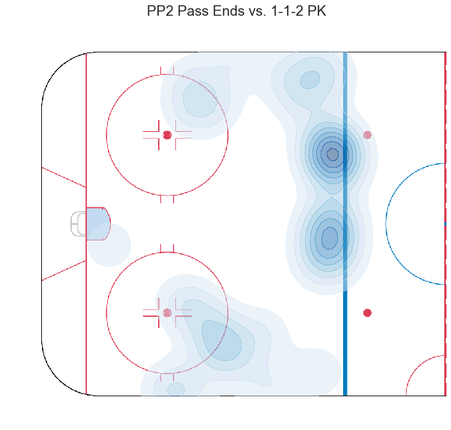
Passes vs. the penalty kill
1-1-2
Notes:
- PP2 all concentrated on that blue line
- might like to see them get a little closer but four of their five guys are above the dots so thats where most of the action is likely going to happen

Slide 15
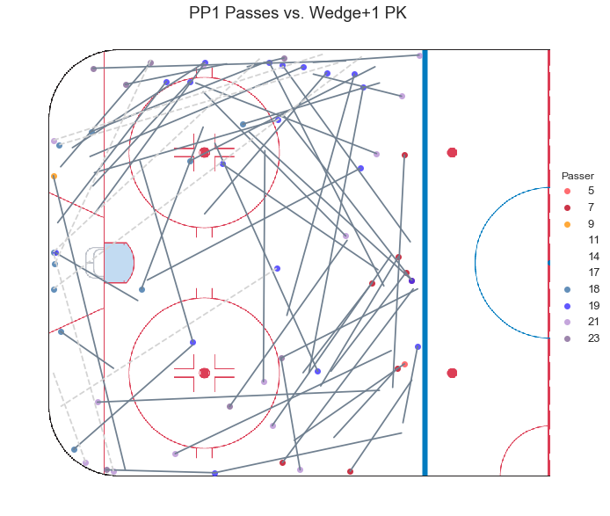
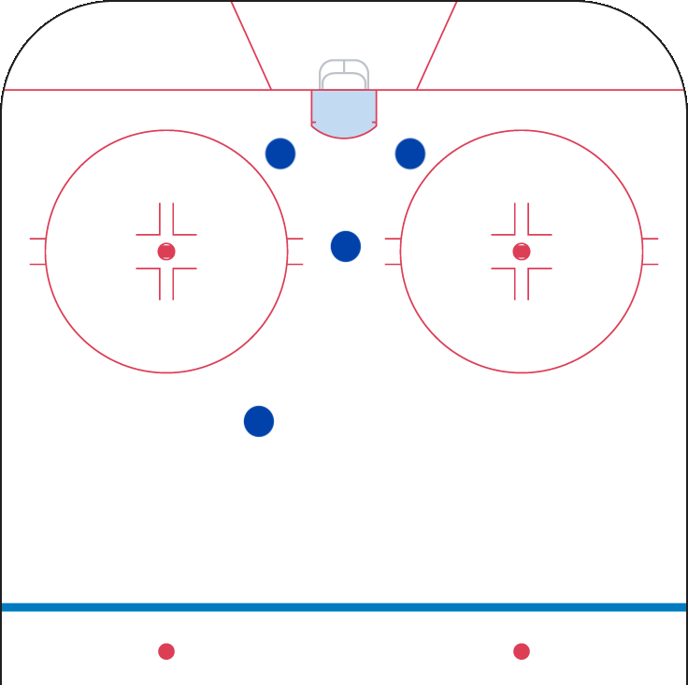
Passes vs. the penalty kill
Wedge+1
Notes:
- triangle in front of the net, one guy running out to chase the puck (can switch the +1 depending where the puck is, slide in or out of that triangle)
- Merrimack used this against PP1, UMass used it against PP1 and PP2
- PP1 lots more going on in the middle of the ice than the 1-1-2 PK, but not a Ton happening front of the net, front three guys prob kept away
- right side concentration again (Harper Keller, some JFK)

Slide 16
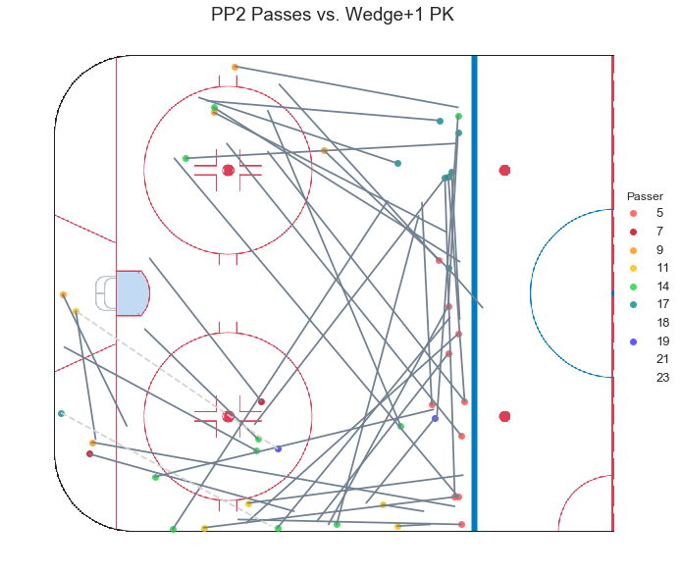
Passes vs. the penalty kill
Wedge+1
Notes:
- PP2 lot of good movement
- still mostly on blue line but you have passes coming from and going to below the dots and some stuff going on behind the net
- shape of passes doesn't change too much depending on PK, PP will run how it runs (PP2 through defensemen, PP1 through Keller and sometimes Harper)

Slide 17
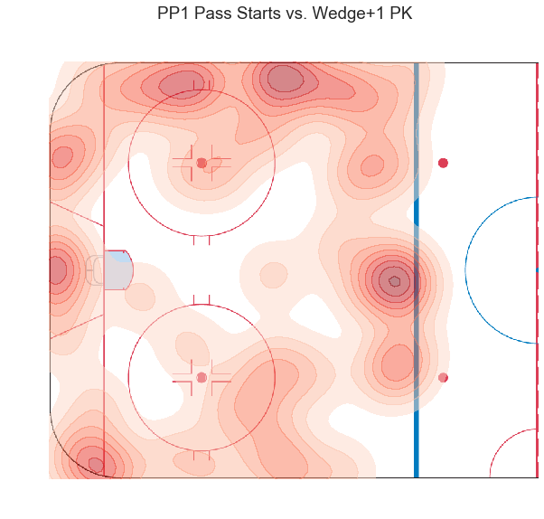
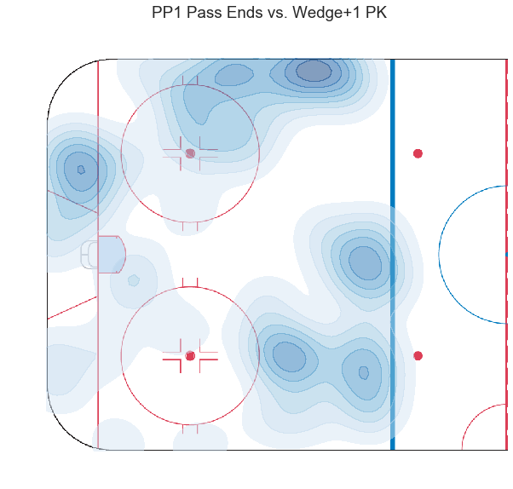
Passes vs. the penalty kill
Wedge+1
Notes:
- PP1 lots more going on here in the middle at least in terms of pass starts, more inside presence

Slide 18
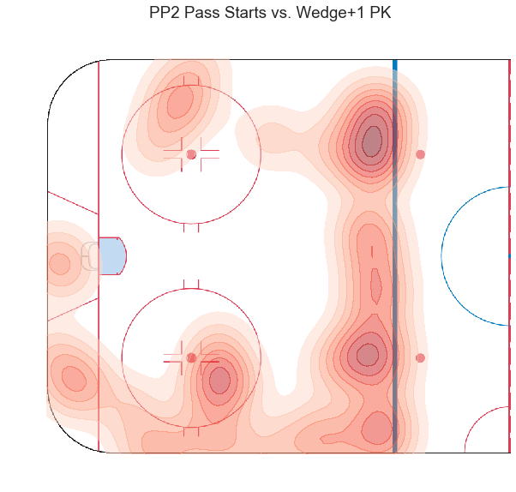
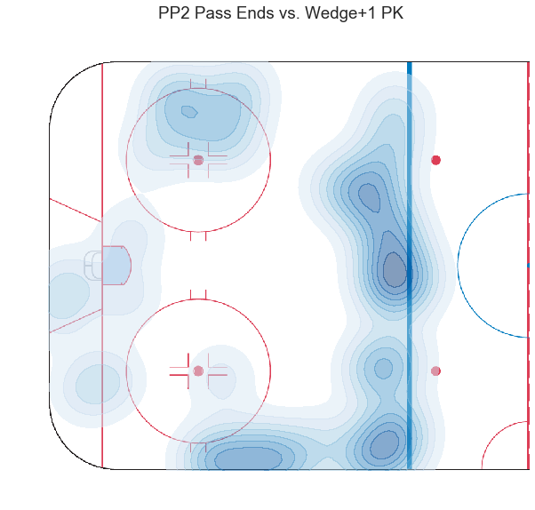
Passes vs. the penalty kill
Wedge+1
Notes:
- PP2 does have more going on down low but still it's pretty bare

Slide 19
Conclusion
Questions and goals
Want to look at larger samples of this data, this obviously doesn’t tell us too much (ex. NHL team over season, college team over season)
How much can we learn from these maps and how can they be used?
Can they be used in scouting or even individual player/tactic evaluation?
Look at blog for:
  Player profiles
  Primary shot assist locations
  More PK breakdowns
  Breakouts and entries
Notes:
- goal is to see how this look over larger sets of data and whether the pass shapes normalize or if they diverge more from one another
- tells a very specific story for a very specific power play compared to maybe what it would tell us if we looked at an NHL team over the course of the season or even BU over the course of the season
- how much can we actually learn from these maps and what can they be used for?
- can they be used in future scouting or for individual player/tactic evaluation
- these are other parts of this project that are on my blog

Slide 20
Acknowledgments
Thank you!
Ryan Stimson, for helping make this project the best it could be and answering any questions I had
Matthew Barlowe, for helping me with my Python questions
FC Python, for inspiring these pass maps
Hockey Plays and Strategies by Ryan Walter and Mike Johnston, for being my textbook
You! For listening!
Notes:
- Ryan
- Matt
- FC Python
- Hockey Plays and Strategies
- You!

