Slide 1
Estimated Shot Assists for NHL Skaters
By Alan Wells
No credentials
Extremely unqualified
Department of not even that smart at all
donotemailme@gmail.com

Slide 2
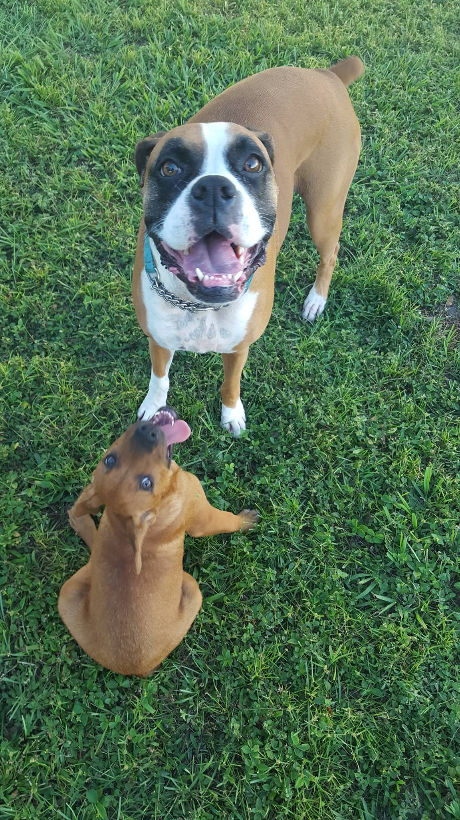
Background
  Shot Assists <- passes that leads to a shot
    Primary, secondary, tertiary
  Shot Contributions <- shots + shot assists
    More predictive of future scoring than points
  Passing data is not provided by the NHL (get it together over there, c’mon.)
    Requires hours of manual tracking by volunteers to collect

Slide 3

Questions to be answered in this study:
  Can we estimate shot assists (and therefore shot contributions) to supplement manual tracking work?
    If yes:
      Are estimated shot contributions a good predictor of future scoring for skaters?
      Are estimated shot assists a good predictor of shooting percentage at the team level?
    If no:
      Crushing failure

Slide 4

Approach
  Identify publicly available stats that could be a proxy for how frequently a player passes the puck
    1) On-ice shot per individual shot
    2) Assists per individual shot
  Players who take few shots tally a high number of assists per on-ice shot might be players who pass more frequently.

Slide 5
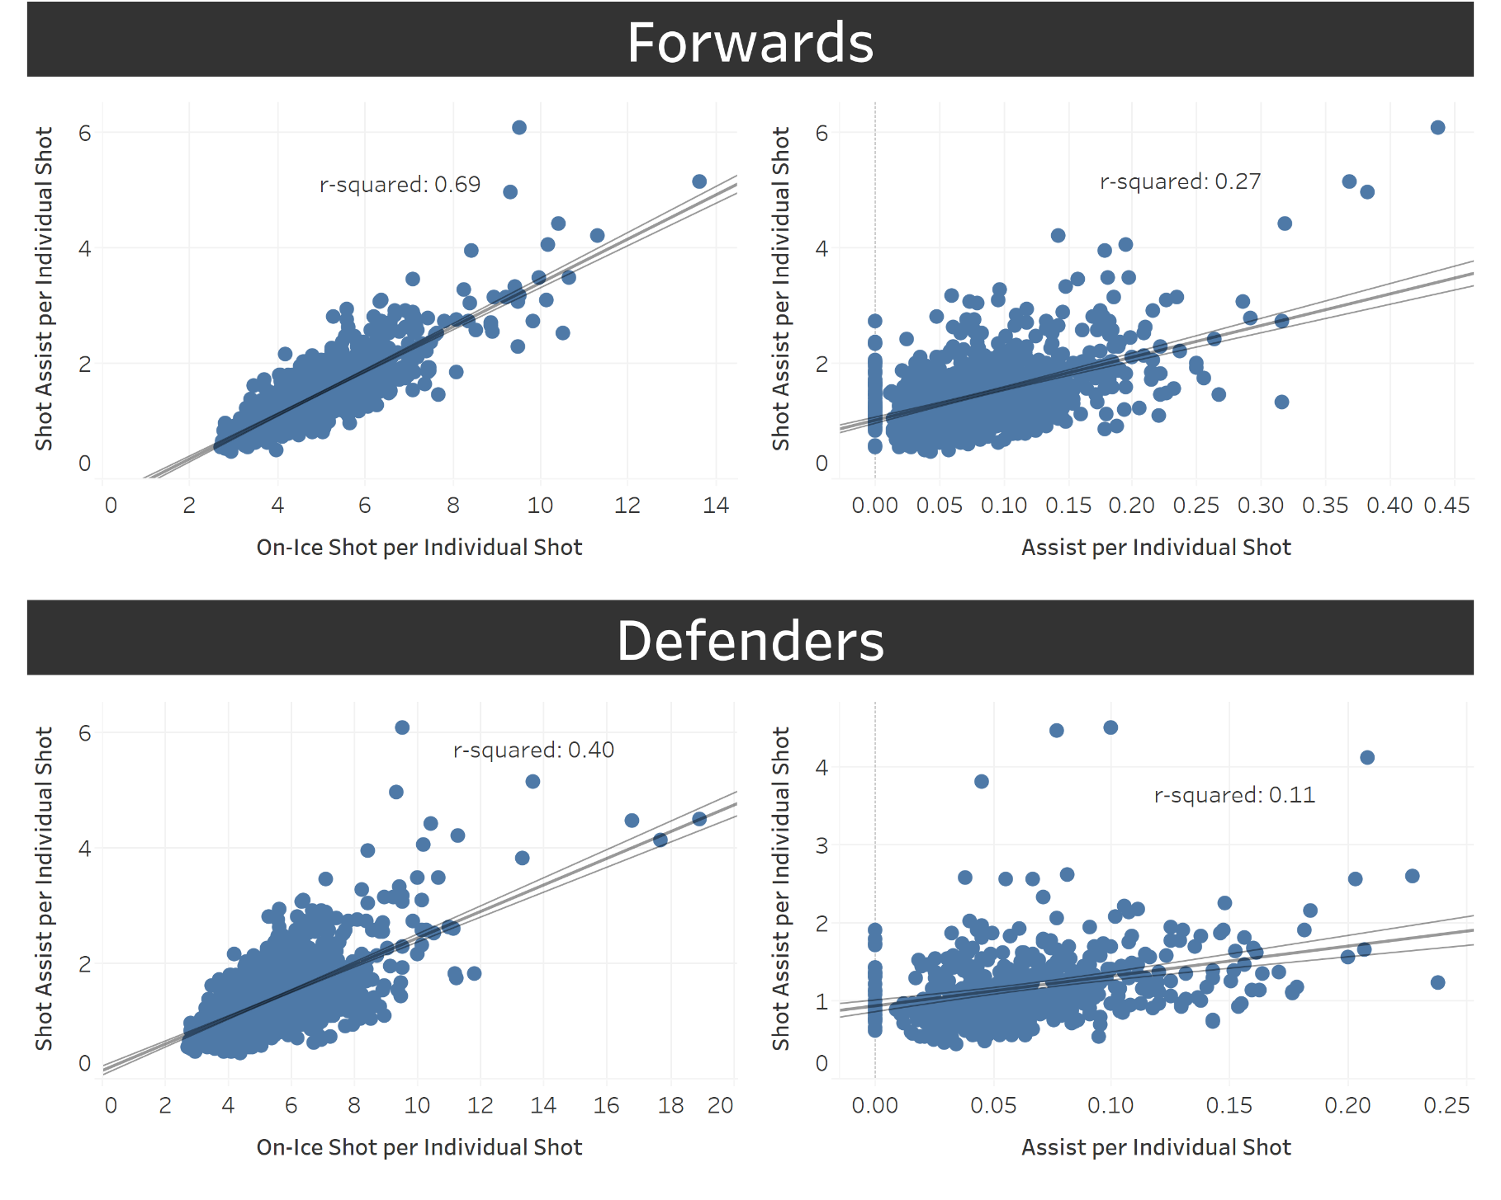
In-Sample Correlations
Boooo! Hissss!!!
Get to the good stuff!!!
Show us the out-of-sample correlations, you fraud!!!!

Slide 6
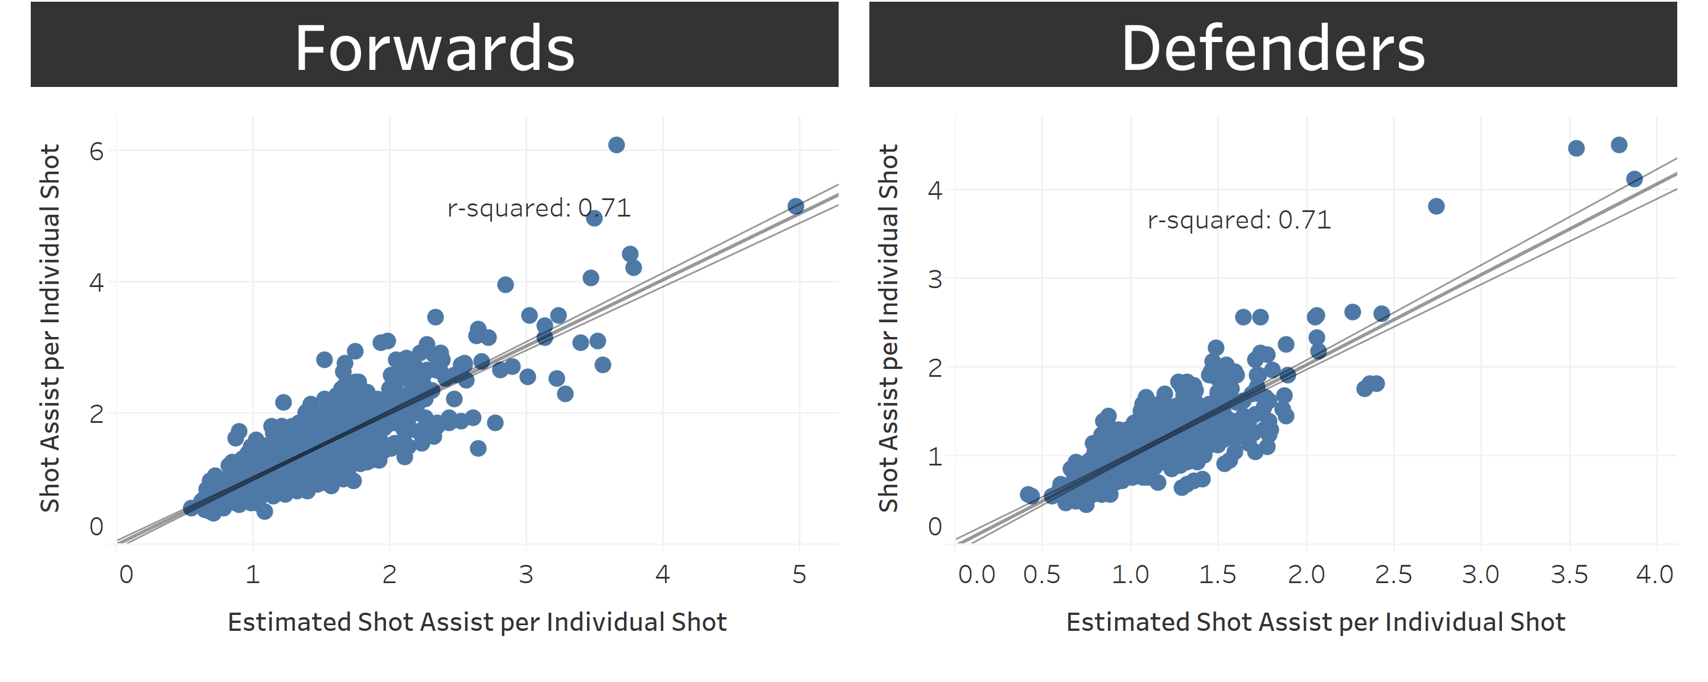
More In-Sample Correlations!

Slide 7
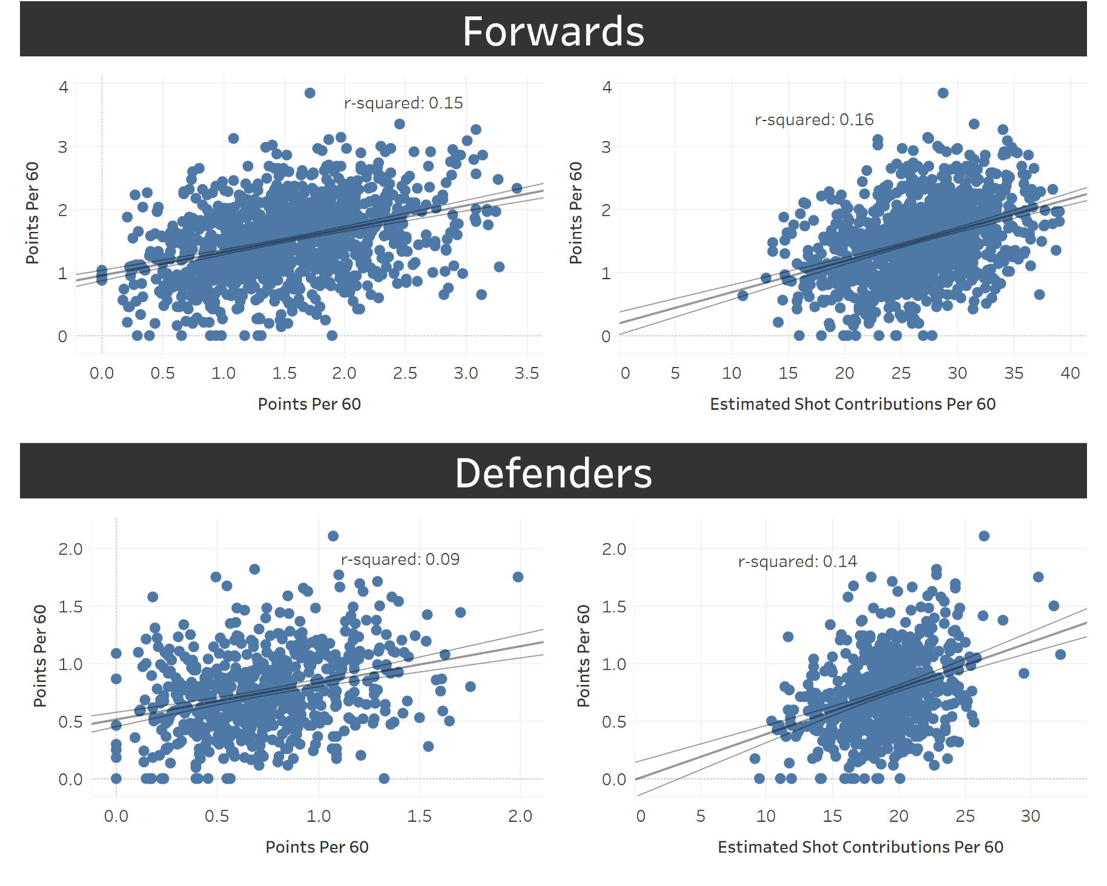
Predicting Future Scoring
Oh, yea!!
That’s what I’m talking about!!!
It’s a little bit better!

Slide 8
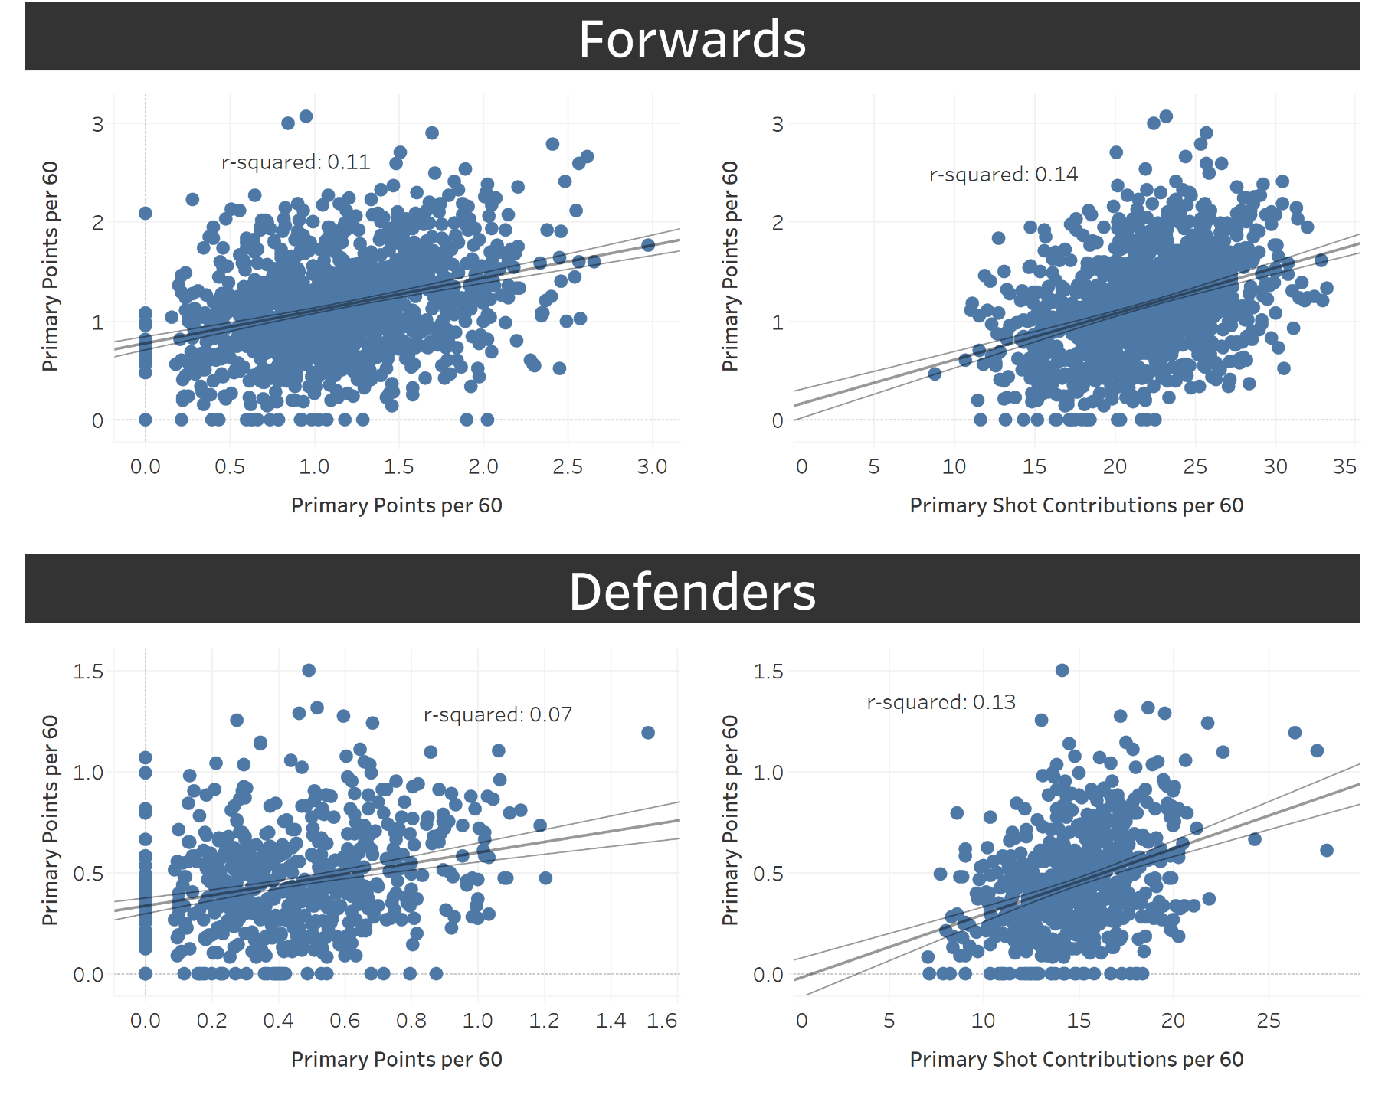
Predicting Future Primary Scoring
Ok, that’s enough scatter plots.

Slide 9
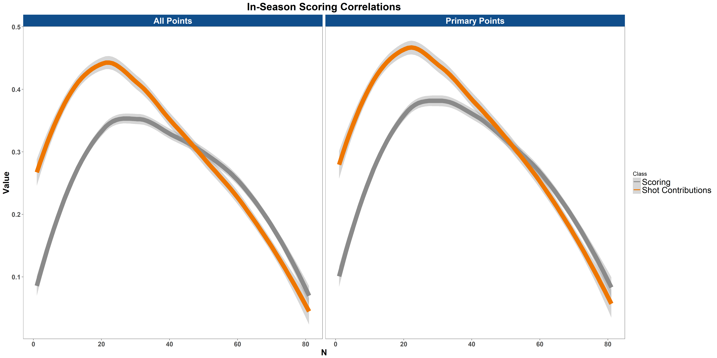
Predicting future scoring In-Season

Slide 10
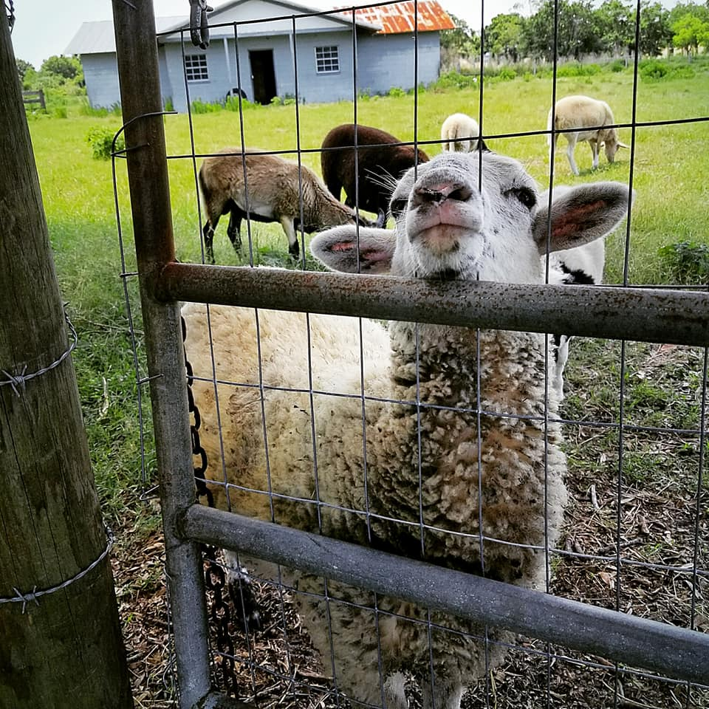
Team Shot Quality
  Public data is of little help
  Manually tracked passing data provides an improvement
  Can estimated shot assists help?
    Will shot assists per shot be an indicator of shot quality?

Slide 11
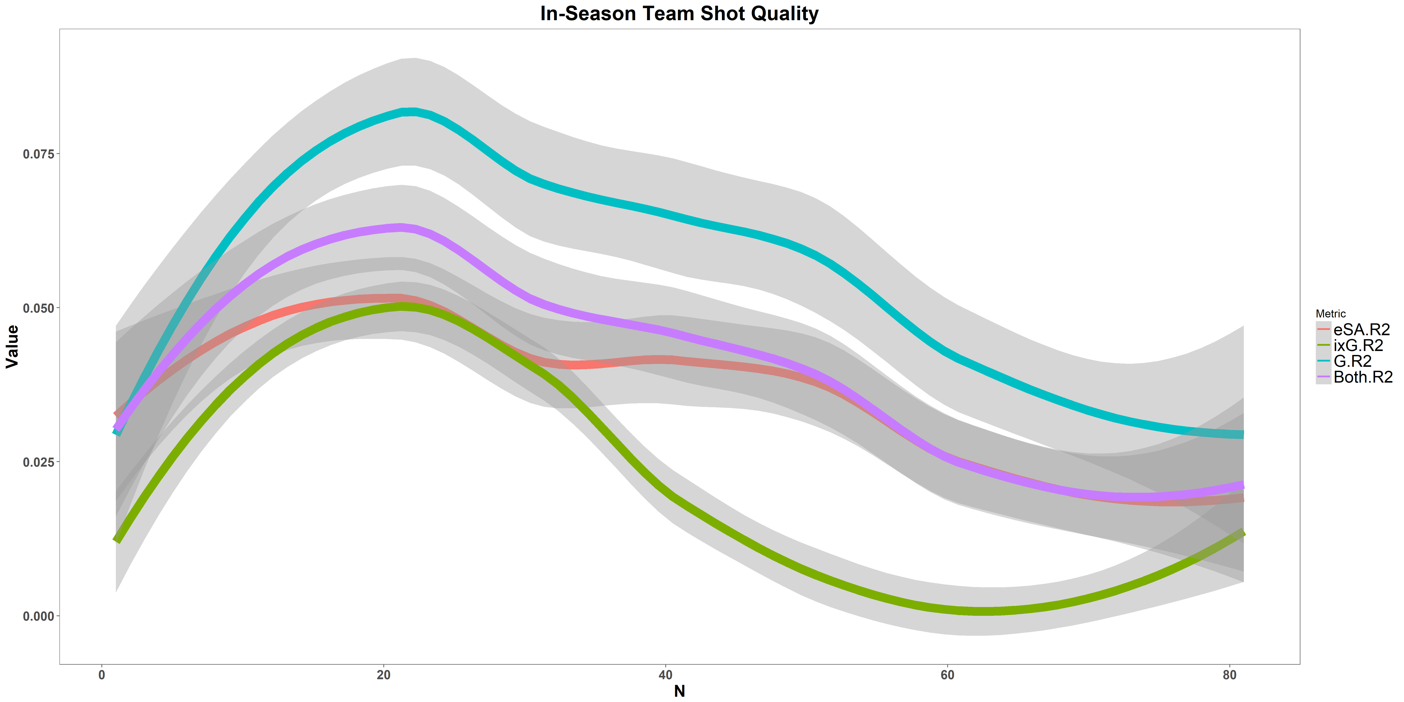
Predicting Shooting Percentage In-Season

Slide 12
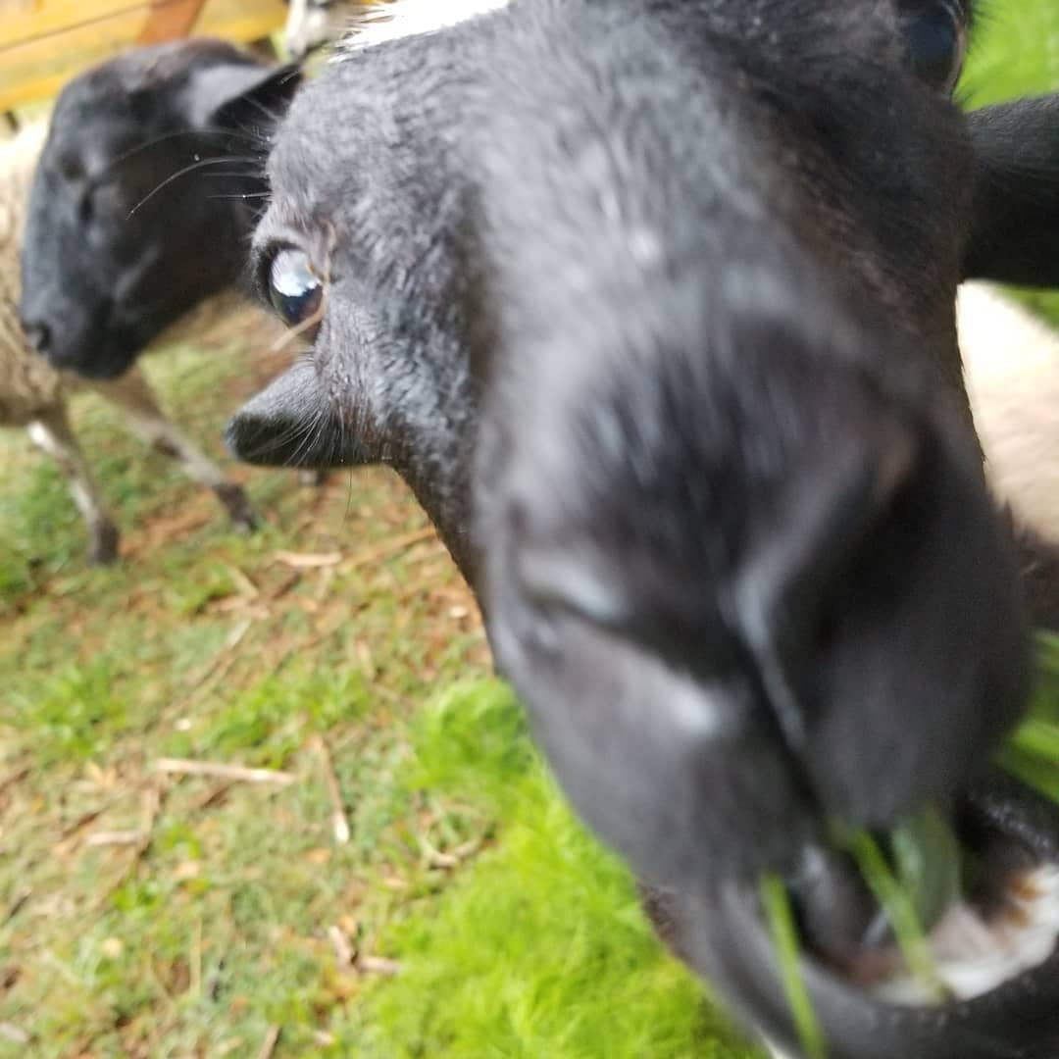
Takeaways
  Estimated shot assists are an effective way of filling gaps in tracked data
  Estimated shot contributions are better predictors of future scoring than scoring itself
  Rolled up to a team level, estimated shot assists are a meaningful descriptor of team shot quality

Slide 13
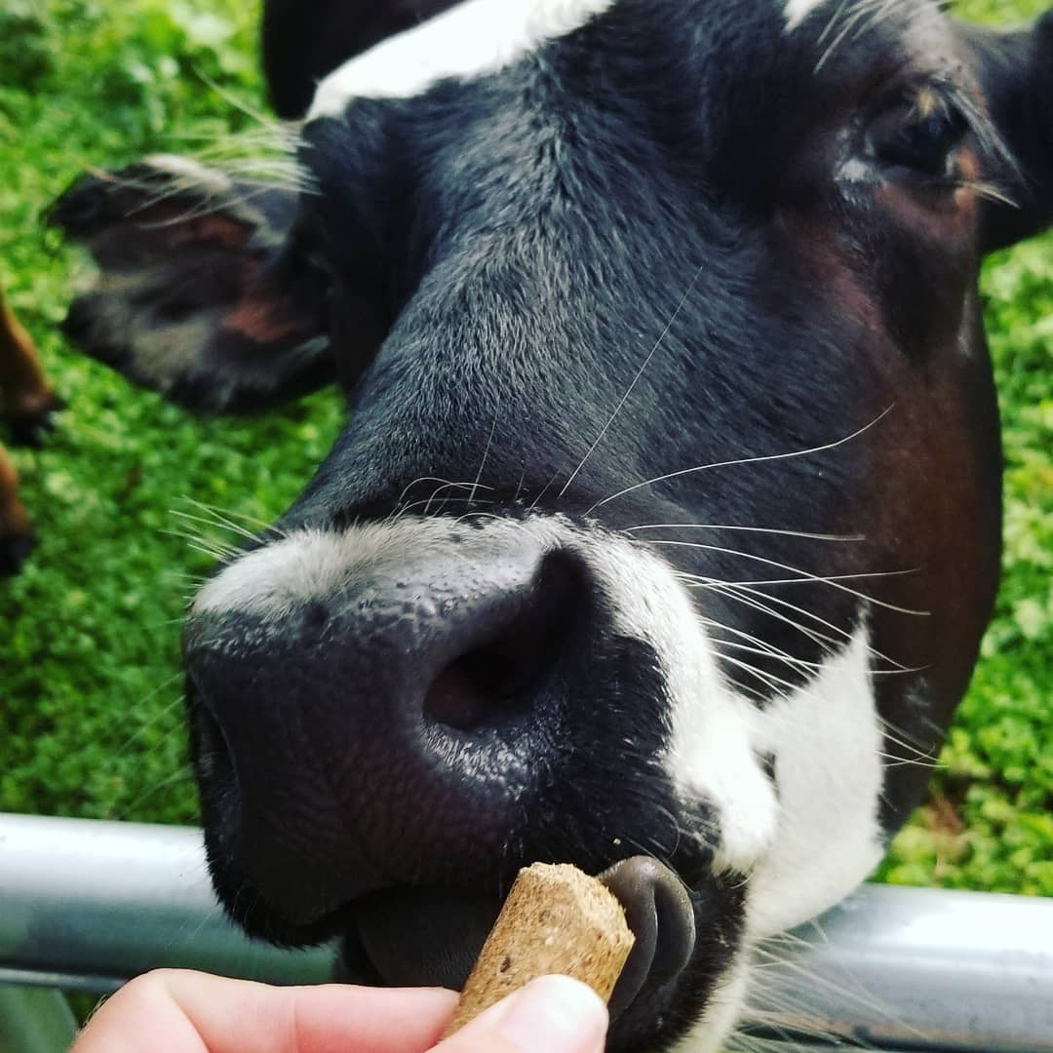
Implementation
  Use passing data in your player evaluations!!!
    Seriously
    We know it’s important
    We have plenty of evidence
    If you don’t, I’m judging you
  Play with incorporating estimated passing data in your xG models
    Maybe? Idk
    Shot quality will kill us all

Slide 14

Acknowledgements
  Ryan Stimson for organizing the passing project
  Cory Sznajder for being some sort of hockey tracking cyborg
  Manny Perry and Corsica.Hockey for providing what the NHL won’t.
  Offsidesreview.com, Naturalstattrick.com
  Hockey Graphs for editing the original article
  Stack Overflow for making it so I never have to actually learn or remember anything

Slide 15
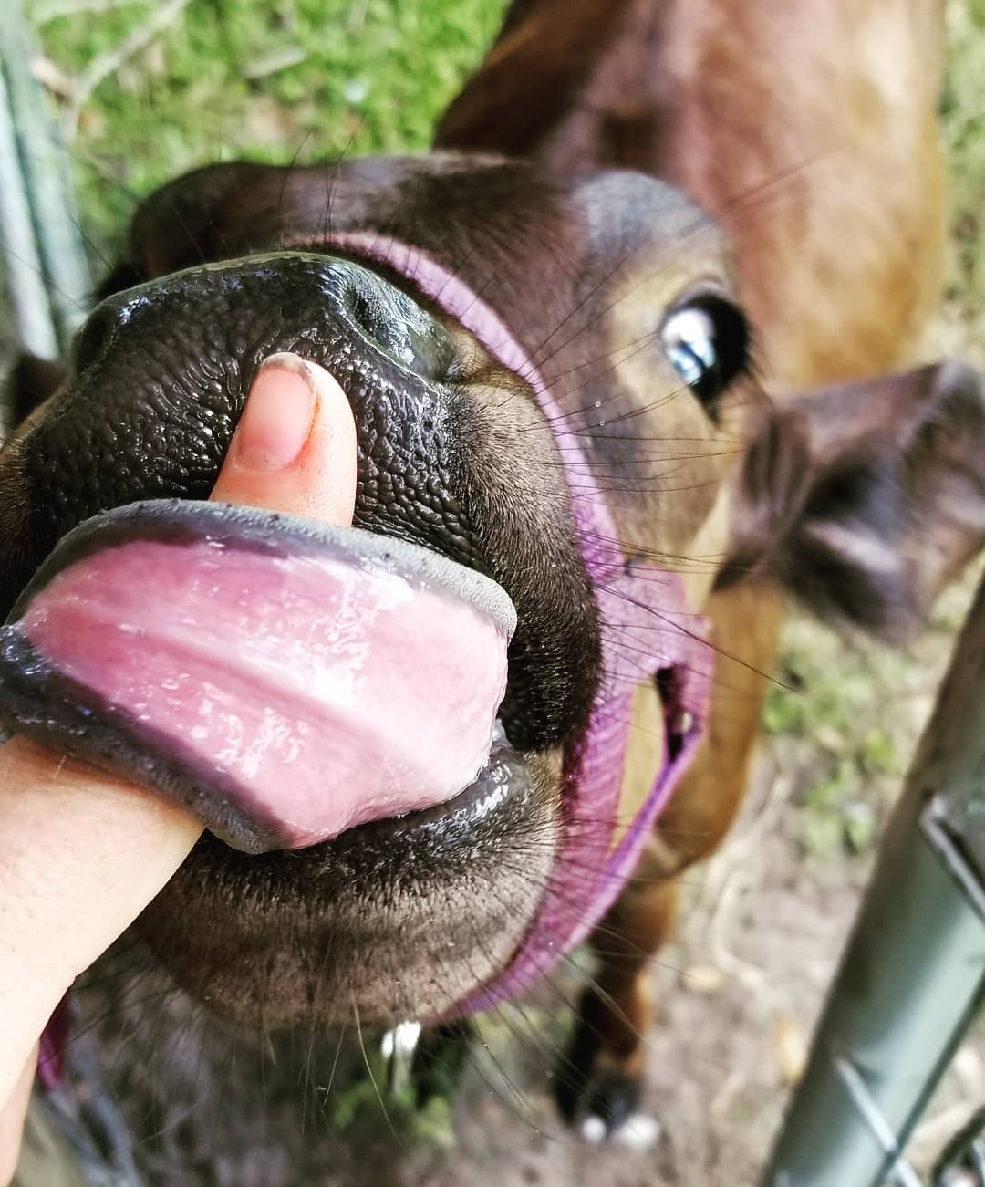
Contact
  alanwells@gmail.com
  Read me at RawCharge.com
  Read me at HockeyGraphs.com
  Follow me @loserpoints

