Slide 1
This week in Pseudoscience
Optimizing Lineup Usage with PBP data

Slide 2
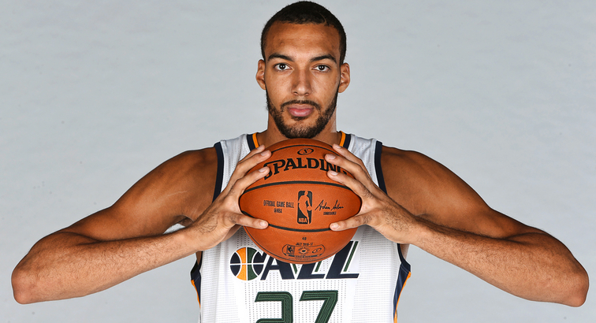
Let’s talk hoops
Here’s Rudy Gobert.
7’3 with a 7’9 wingspan
1st in Defensive Rating, 2nd in Defensive Player of the year voting

Slide 3
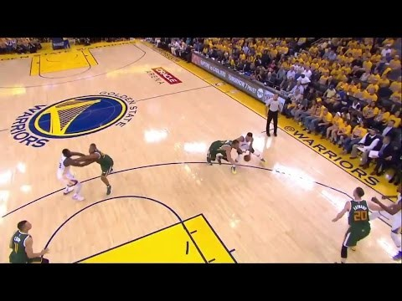
But against Steph Curry…..

Slide 4
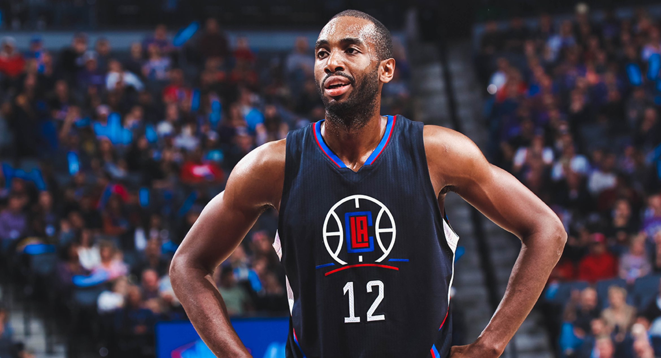
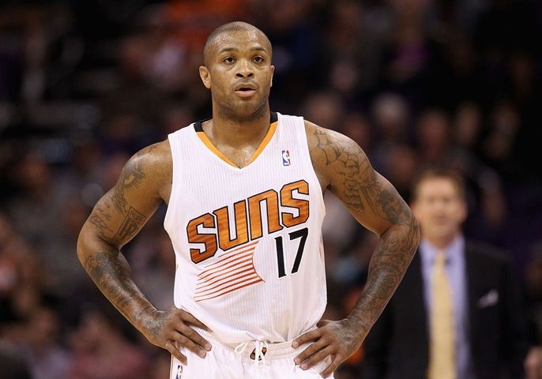
How do you beat that?
Darryl Morey acquires future HOF Chris Paul
Also acquires Luc Mbah-Moute and P.J. Tucker (marginal veterans with zero all star appearances)
Who closes the game against the greatest team in NBA history?
5 players who can hit threes and play defense

Slide 5
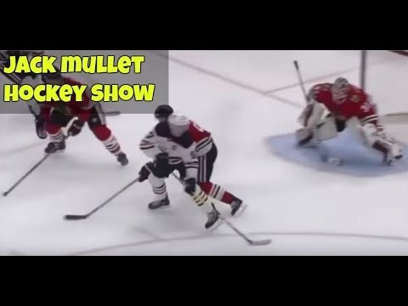
So now, hockey: How do you beat Connor McDavid?
Elite Playmaker
League’s fastest skater with the puck
Ridiculous ability to process reads and make decisions

Slide 6
Methodology
Parsed PBP data from Corsica.hockey
Looked to identify seven key categories:
Shooting
Passing
Skating
Physicality (hits, shot blocking, etc…)
Shot Creation
Transition Play (Zone Entries, Zone exits, etc….)
2-Way Play/Defense

Slide 7
Methodology…
  Used KNN means cluster analysis with Star Players as the primary centroids
    Kaner-oos – High playmaking kill, minimal physical presence (Gaudreau, Panarin)
    Benn-ites – Good Rush/Reb stats with high shot ratios and hits (Wayne Simmonds,
    Bergeroni – Great Transition Stats, high offensive impact
    Shutdown Dmen – High DZS%, High Corsi Rel (Vlasic, Hjalmarsson, Tanev)
    Speedsters – High shots to hits against ratio, great at drawing penalties

Slide 8
Methodology continued…
Used Skill Categories to identify ratios and metrics that made sense
  Penalties Drawn + Rush Shots/60
  On-ice Usage rate (what percent of total on ice shots did a player take)
  DZ%+CF.Rel
  Physicality (hits, shot blocking, etc…)
  Regressed Shooting Pct%
  Etc….

Slide 9
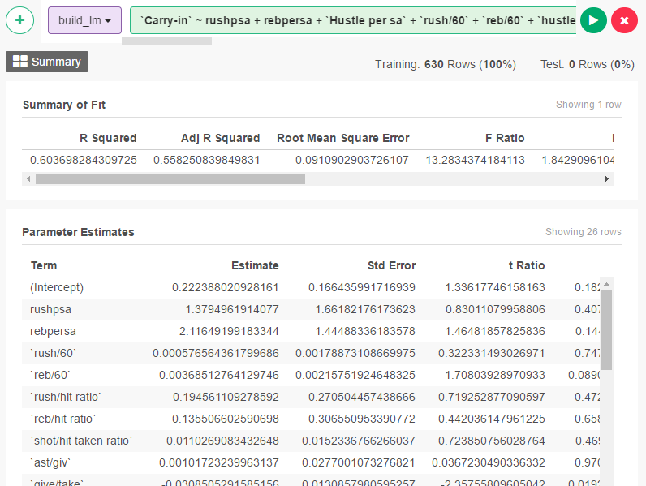
Looked externally to validate outputs

Slide 10
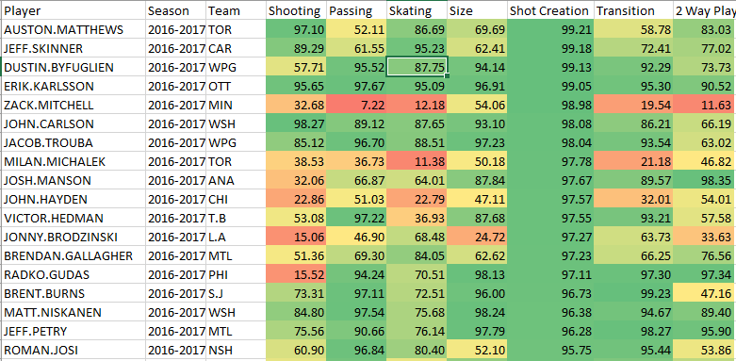
Looking at the top Shot Generators in the league

Slide 11
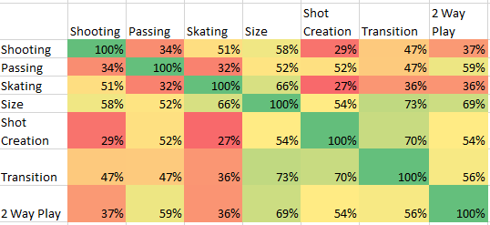
Is this MECE (mutually exclusive, yet collectively exhaustive)?

Slide 12

Sanity Checks: Does this make sense?

Slide 13
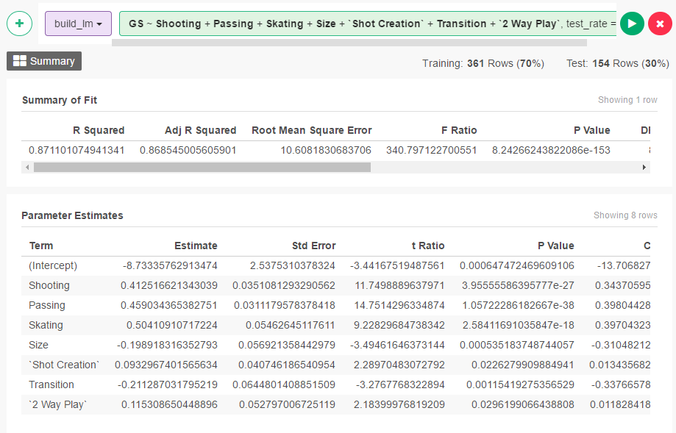
Sanity Checks: Does this make sense?

Slide 14
Back to how to beat Connor:

Slide 15
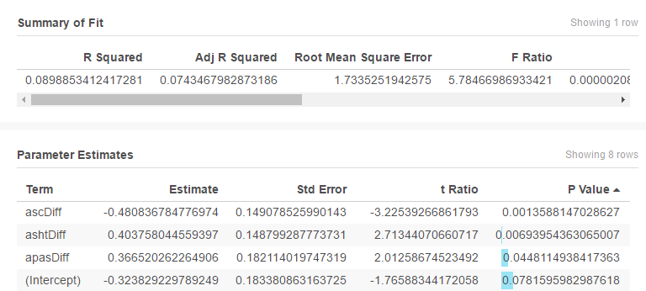
Back to how to beat Connor:

Slide 16
Next Steps
  Looking at synergies of skillsets
    Does a fast skating lineup outperform its expected shot differential?
    Do shot creators cancel each other out?
    Can you pair a weak transition player with a strong one?
  Lineup decisions
    Can you play your fast fourth line against a first line?
    How does fatigue play into performance?
  Trading and Free Agents
    Can you replace a Jeff Skinner with a player with a similar skillset?
    What is undervalued in the market?

