Slide 1
NHL Player Development Modelling
Means and Methods to Projecting Player Contributions
S. Burtch, 2017

Slide 2
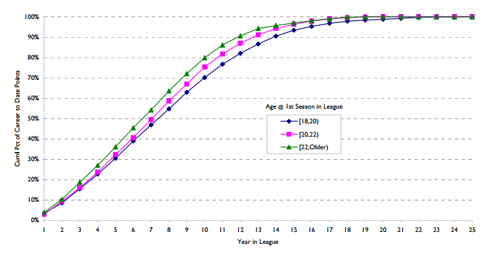
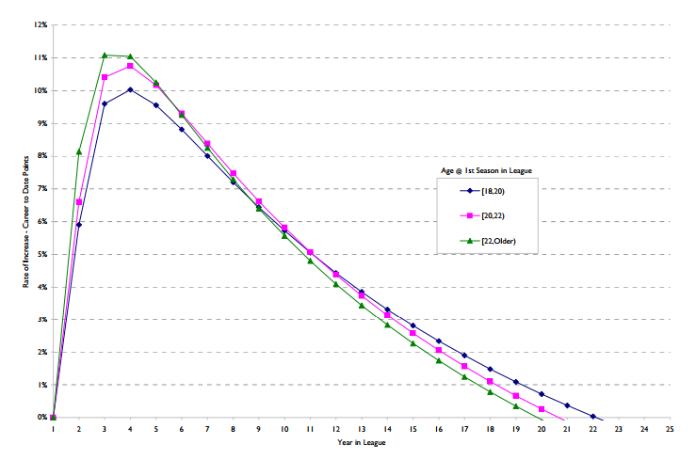
Player Career Trajectory Description
Useful for Generalization
Player Production vs Age
  Cumulative Points (Krzywicki, 2008)

Slide 3
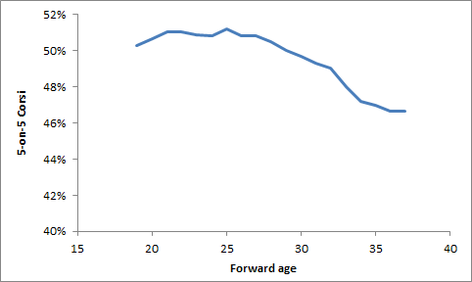
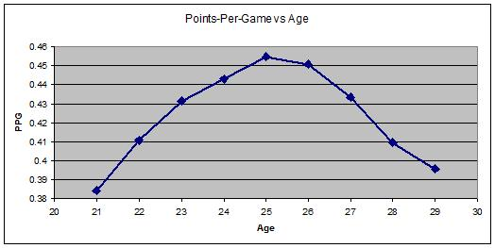
Player Career Trajectory Description
Useful for Generalization
  Points Per GP / Per 60 (Desjardins, 2010; Tuslky, 2013, 2014)
  Shot Rates (Tulsky 2014)

Slide 4
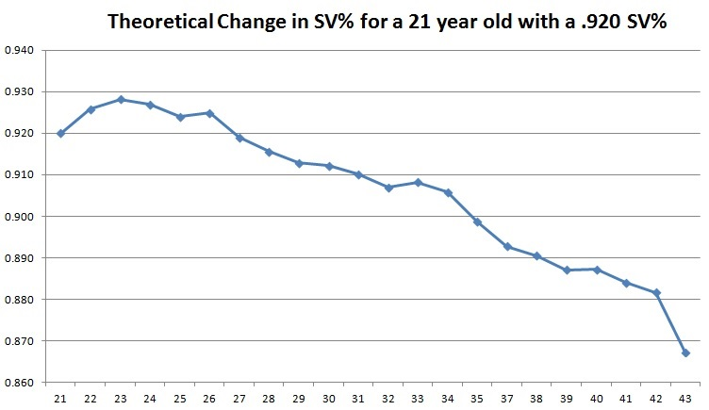
Player Career Trajectory Description
Useful for Generalization
  Save Percentage (Burtch, 2013; Tulsky 2013)

Slide 5
Projection as a Statistical Exercise
Marcel Projections
    “The Marcel the Monkey Forecasting System (or the Marcels for short) is the most advanced forecasting system ever concieved.”
    “Not.”
    “Actually it is the most basic forecasting system you can have, that uses as little intelligence as possible.”
    (Tom Tango, 2012 – Marcels first introduced in 2004)
  Projecting Goaltender Performance
    Marcels (Garik16, 2014; Tulsky, 2014)
  Projecting Skater Performance
    Marcels (Galimini, 2015)

Slide 6
More Detailed Projections in Other Sports
PECOTA / Steamer / ZiPs (baseball)
CARMELO (basketball)
APROPOS (soccer)
All employ a similar logic
  Try to project player development by exploring trajectory of similar players
  This raises 3 key questions…

Slide 7
1. How Do We Identify Similar Players?
Player Similarity Scores
  (Hockey/Basketball/Baseball/Football-Reference.com, 2008)
  Uses overall career “score” and “shape” similarity
  Does not account for variation by age
Euclidean Distance
  Most recently applied in Hockey Statistics by
    Corsica.Hockey Statistically Similar Players (Perry, 2016)
    Identifying Playing Styles With Clustering (Stimson, 2017)
    Examining Which Players are Most Similar To Current Red Wings (Iyer, 2017)

Slide 8
1. How Do We Identify Similar Players?
Using K-Nearest Neighbours Algorithms to identify similar player types/styles
We seek to identify similarity by age/season across a variety of GAR metrics
  KNN Matrix Data using GAR data (courtesy Dawson Sprigings, 2008-2017)
  Weight each GAR metric according to year-over-year auto-correlation
  Scale each GAR metric to account for players with limited GP and thus maximize the size of the sample
    This was accomplished by modeling the underlying relationships between GP and individual GAR components to account for individual skaters with low GP

Slide 9
1. How Do We Identify Similar Players?
Using K-Nearest Neighbours Algorithms to identify similar player types/styles
We seek to identify similarity by age/season across a variety of GAR metrics
  We thus obtain our KNN Age Matrix
    1479 Individual Skaters
    6 GAR metrics per year of age
    Spanning ages 18 to 44 (Jaromir Jagr will boost the upper bound to 45 this year)
    1479 x 6 x 27 = 239,598 data points of fun for comparison

Slide 10
1. How Do We Identify Similar Players?
For each individual skater we compare them to all other skaters filtered by position (F or D) using their GAR data from age 18 to the age of the skater last season (2016-17)
  This is done using a KNN Algorithm in R – identifying the 5 most similar skaters
Issues with this method as applied
  Some skaters have peers of the same current age within their 5 most similar players
  e.g. William Nylander’s 2 most similar skaters were Christian Dvorak of the Arizona Coyotes and Brayden Point of the Tampa Bay Lightning. All 3 skaters are in the midst of their age 21 season.

Slide 11
2. How Do We Project Into The Future?
Two obvious options exist
  1 Forecast using the average outcomes of most similar skaters in the following season
  2 Forecast using the average proportional change for the most similar skaters in the following season
The third possibility is a blending of the two aforementioned methods

Slide 12
Projection of GAR by Age

Slide 13
Projection of GAR by Age

Slide 14
What Do We Call It?
Goals
Above
Replacement
Projection
Employing
Newly
Leveraged
Observations &
Variance
GARPENLOV

Slide 15
Thank You

