Slide 1

Opposition Analysis:
Methods for Forecasting Style of Play in Soccer
Devin Pleuler
Manager of Analytics
Toronto Football Club
Bret Myers
Analytics Consultant
Toronto Football Club
Villanova University

Slide 2
Motivations
Provide data-driven tactical insight

Slide 3
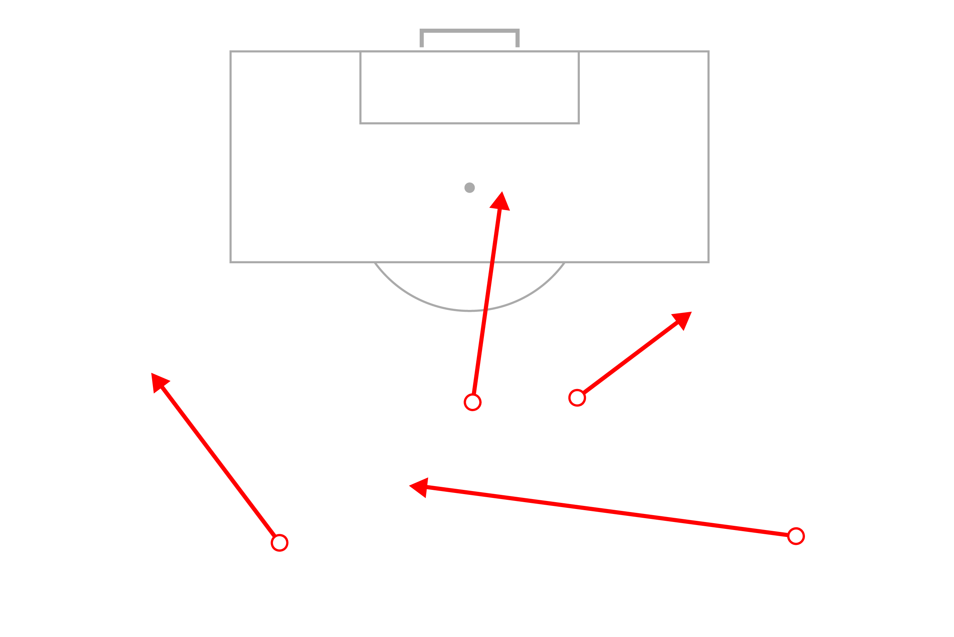
The Data

Slide 4
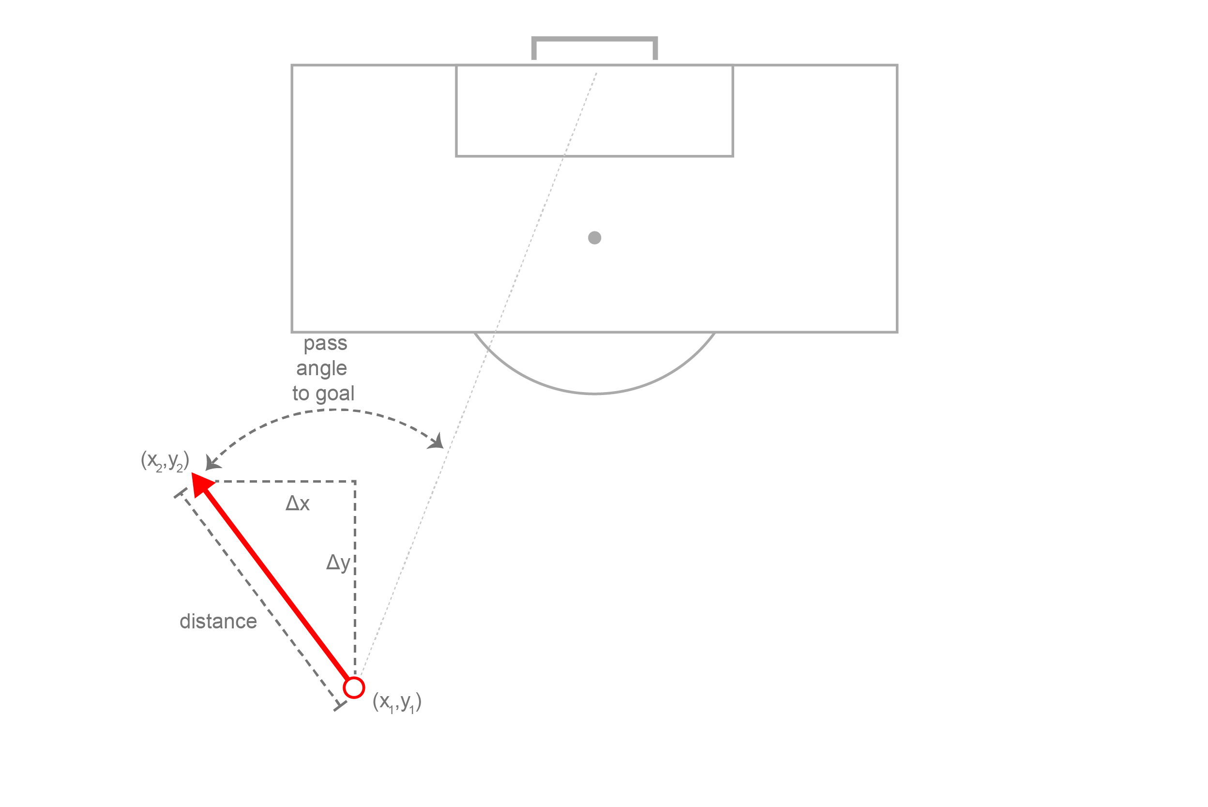
Pass Components

Slide 5
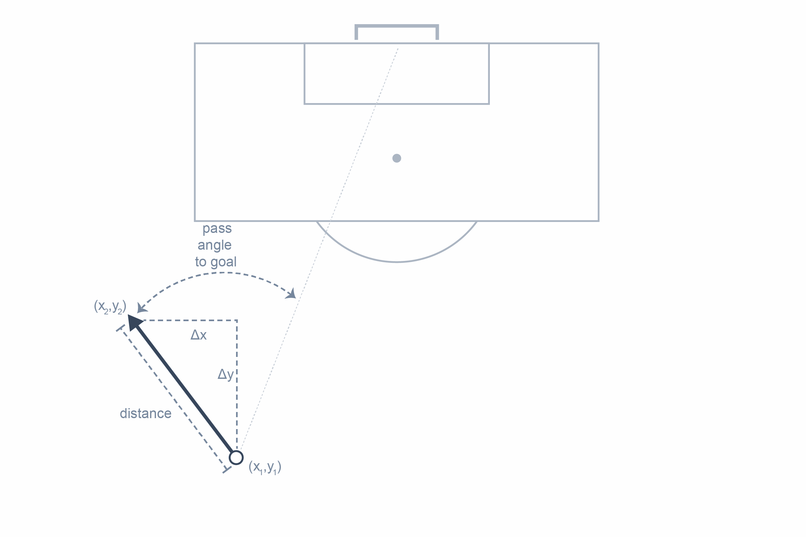
k-Means Clustering (in python)
from sklearn.cluster import KMeans
model = KMeans(n_clusters=50).fit(training_data)
for pass in test_data:
cluster = model.predict(pass)
n = 214,340

Slide 6
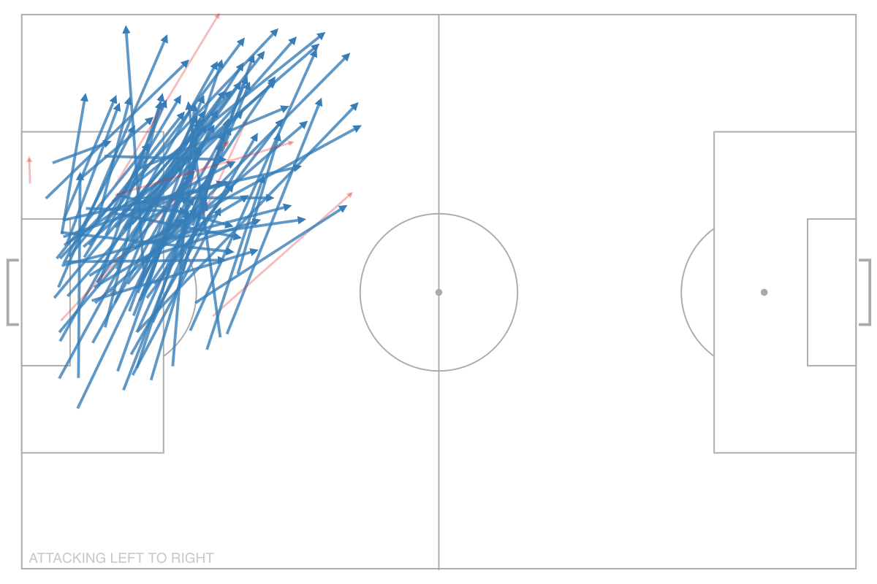

Example Cluster

Slide 7
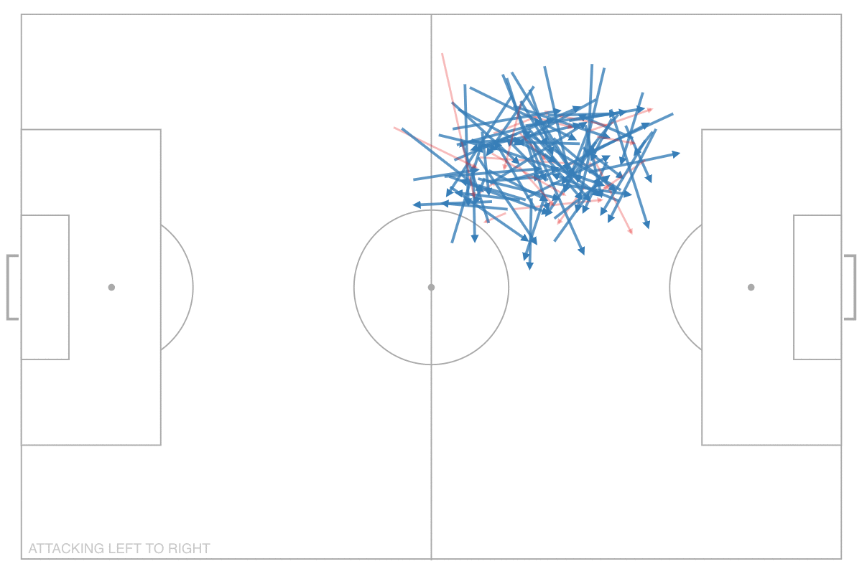
Example Clusters

Slide 8
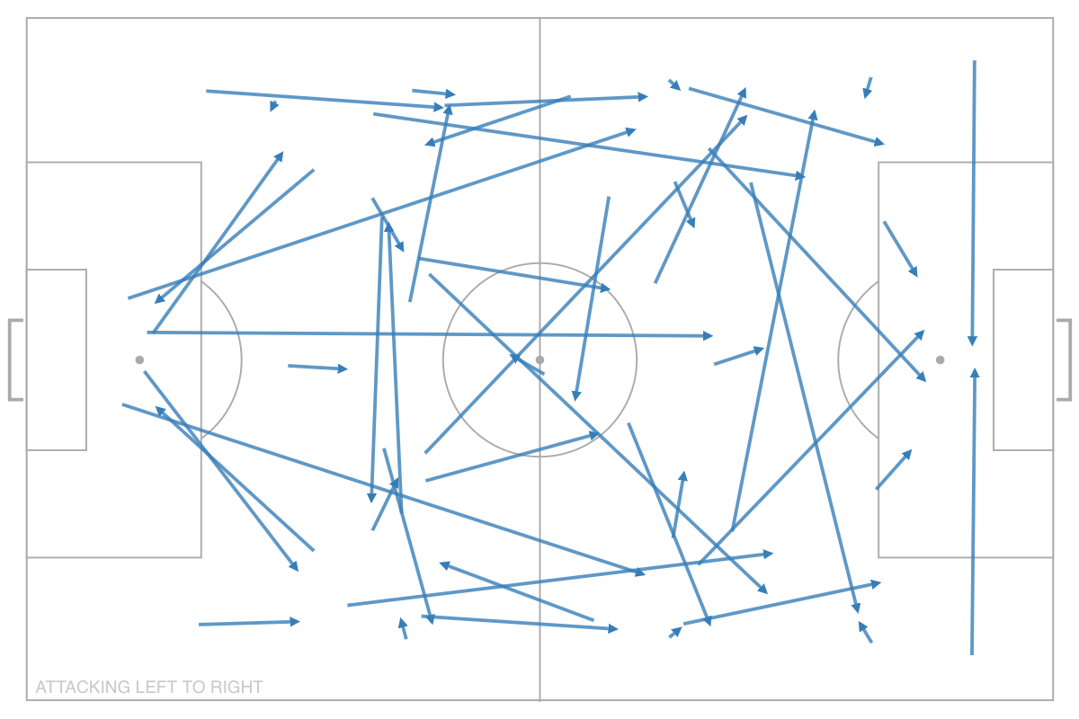
Average Position of Clusters

Slide 9
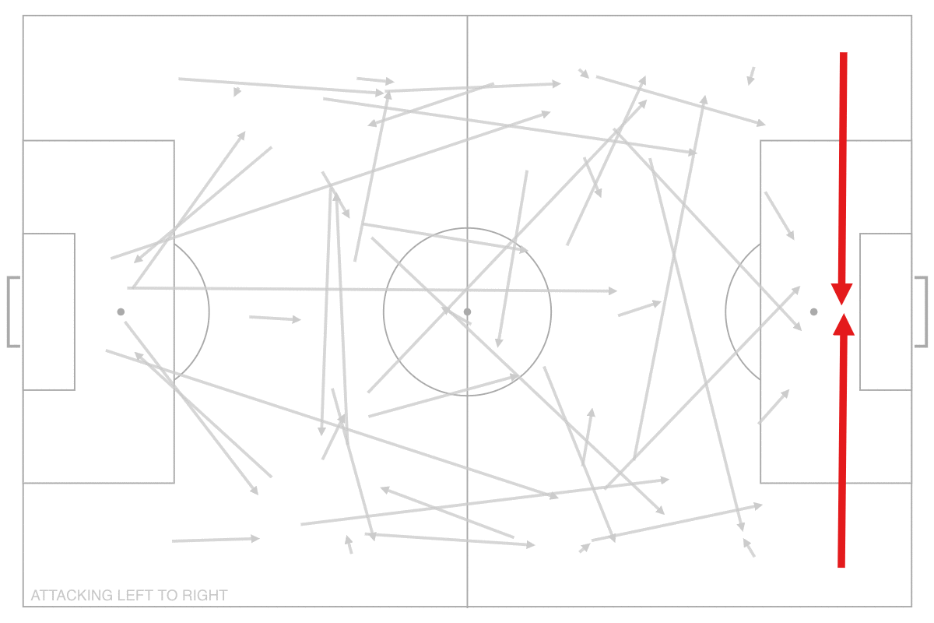
Cluster Symmetry

Slide 10
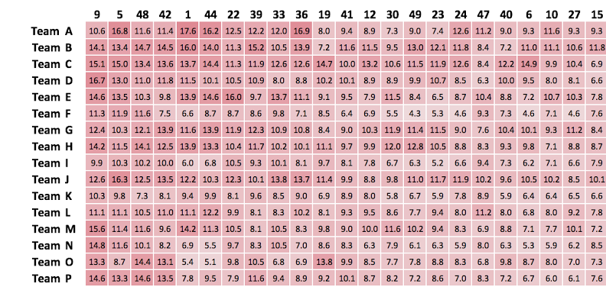
Team Passes per Cluster

Slide 11
Is this predictive?
Can past tactics predict future tactics?
(and how do we measure it?)

Slide 12
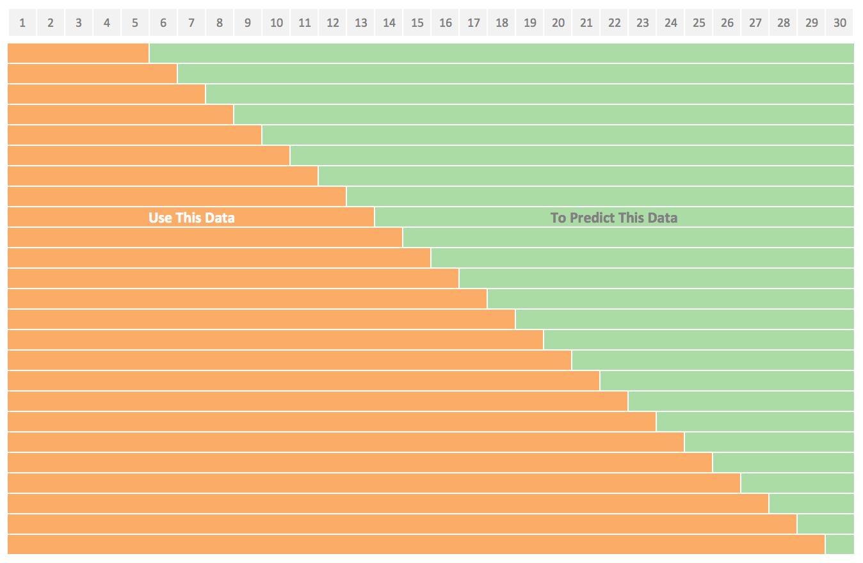
Is this predictive?
Game Number

Slide 13

Is this predictive?
where A_{t} is the actual value and F_{t} is the forecast value.
Mean absolute percentage error

Slide 14
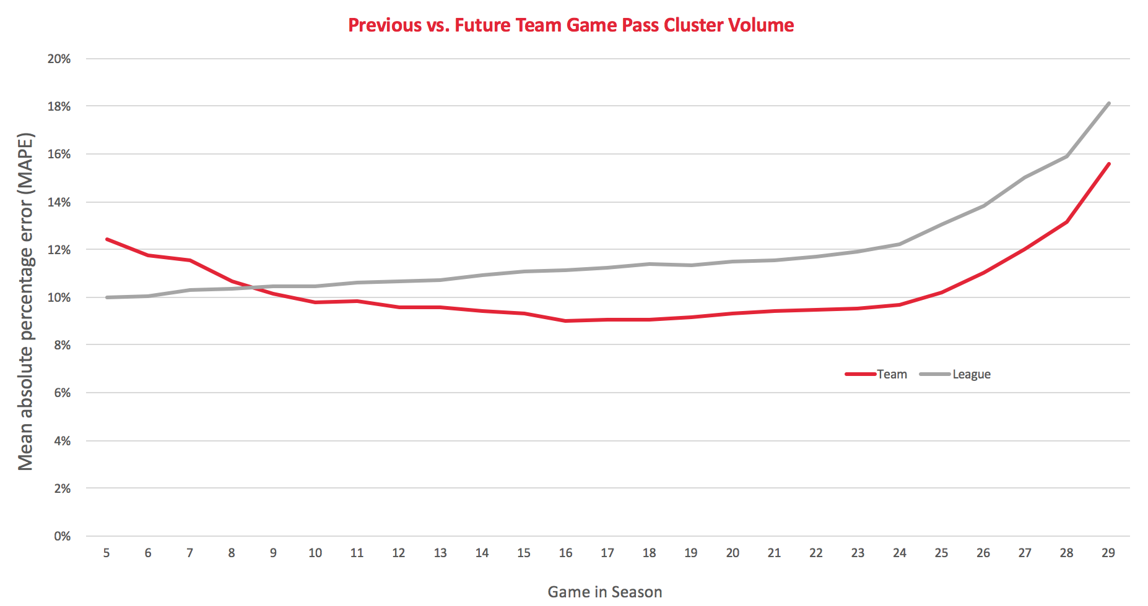
Is this predictive?

Slide 15
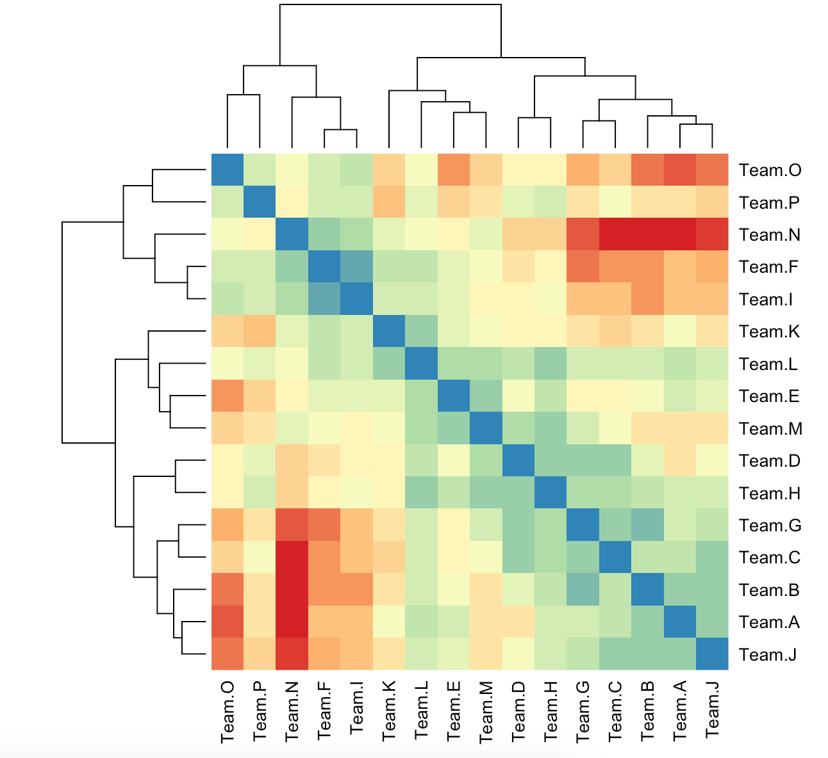
Team Similarity
(Pearson Correlation)

Slide 16
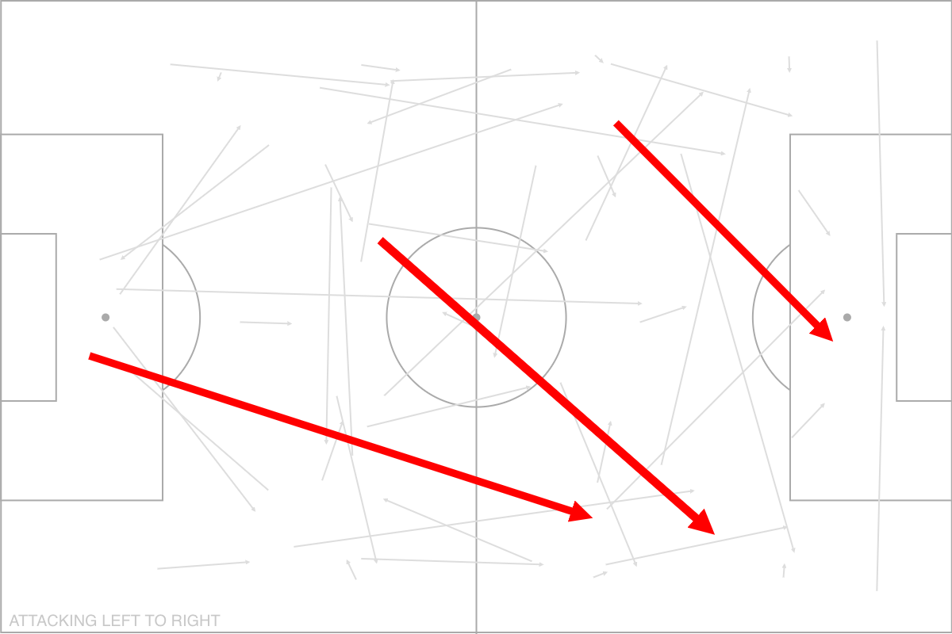
Example Team Clusters

Slide 17
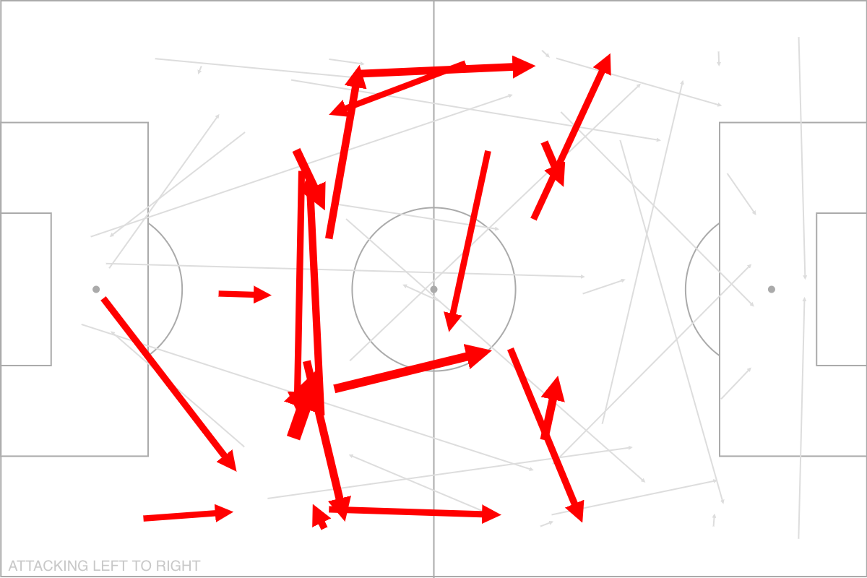
Example Team Clusters

Slide 18
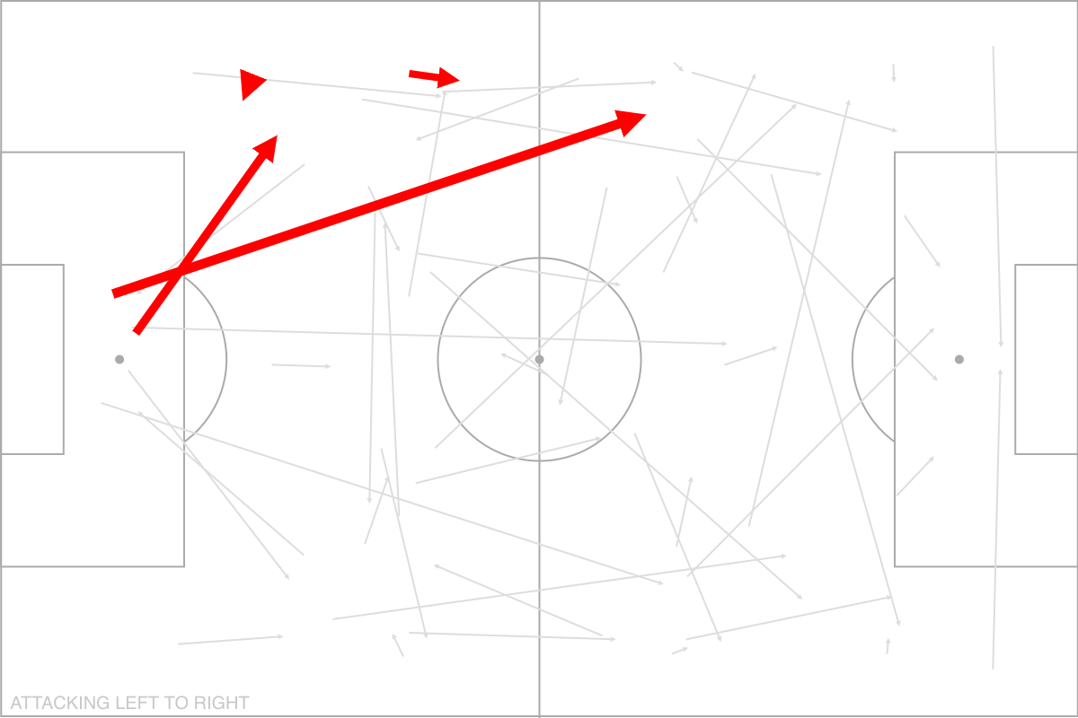
Example Team Clusters

Slide 19
What’s Next?
Chaining Passes into Sequences

Slide 20
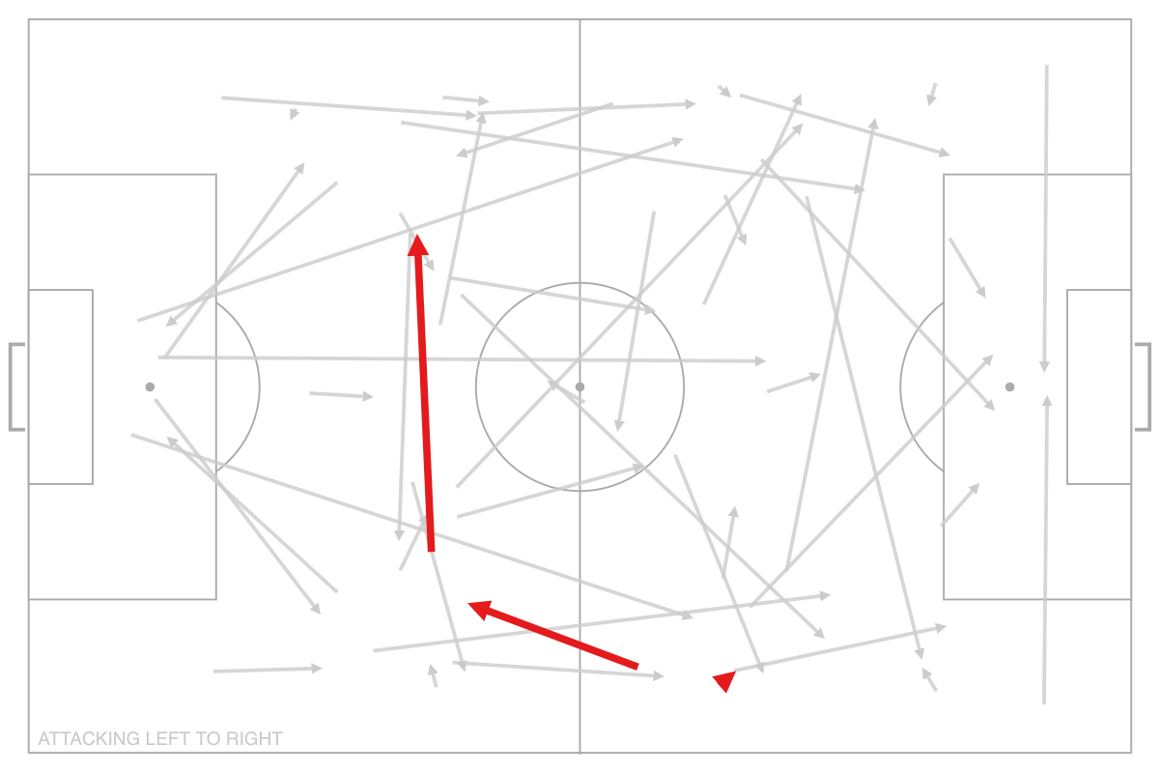
Pass Chaining

Slide 21
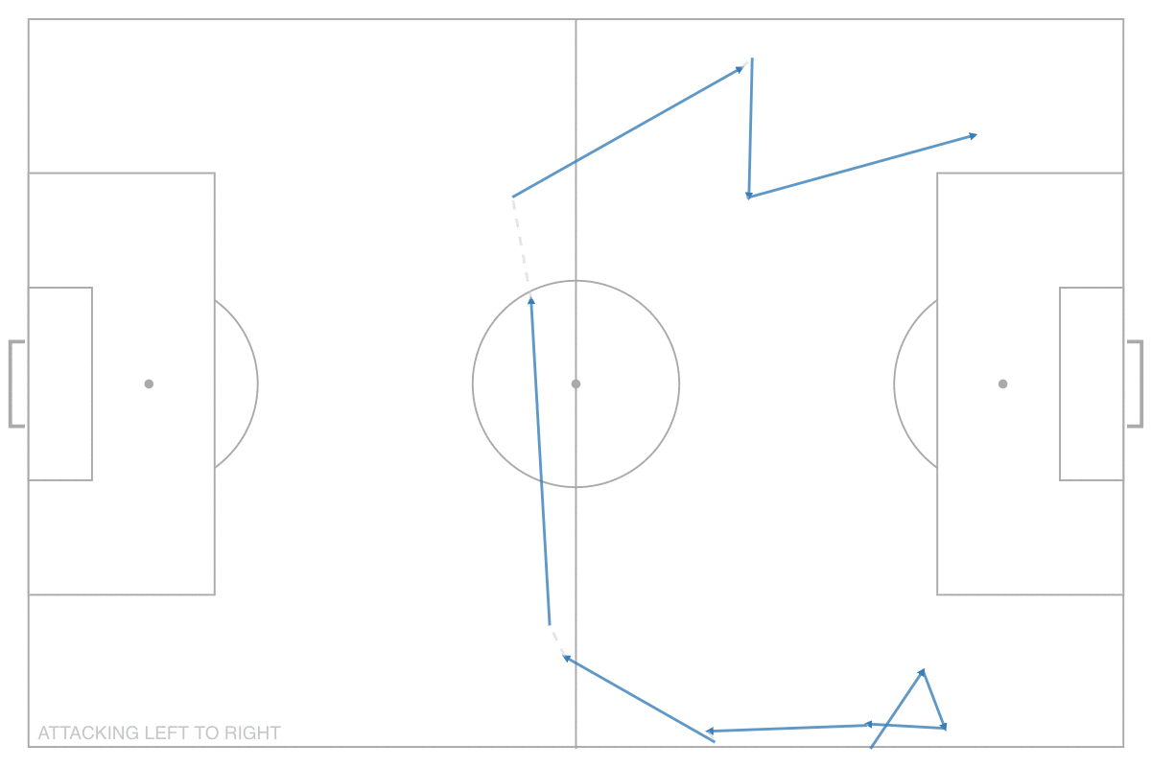
Pass Chaining

Slide 22

Thanks!

