Slide 1
Establishing Foundations of Transitional Play
Alex Novet
@AlexNovet
RITHAC
October 21, 2017

Slide 2
Key Takeaways (tl;dl)
1
Passes are the ideal zone exit, but carry outs are almost as good
On the breakout, possession is key
On the forecheck, pressure is key
We have a lot more to learn
2
3
4

Slide 3
Agenda
Neutral Zone Tracking 101
Zone Exits Smorgasbord
Neutral Zone Transitions

Slide 4
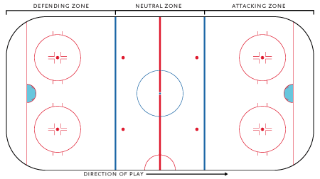
A Brief Intro to Neutral Zone Play
Zone Exit
Zone Entry
Zone Transition

Slide 5
Zone exits are a trackable event with distinct quantitative results
Notes:
This sample covers about half of the 2016-2017 season. It includes all games for a few teams and at least 25 games for every team

Slide 6
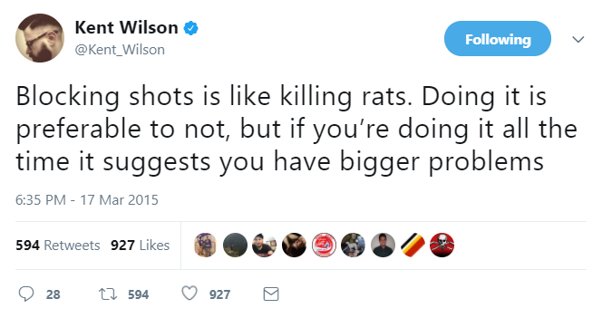
Our judgment of zone exits should include the next entry

Slide 7
Agenda
Neutral Zone Tracking 101
Zone Exits Smorgasbord
Neutral Zone Transitions

Slide 8
The key to turning a zone exit into an entry is possession
If the exiting team recovers the puck after a dump-out, their success rate rises to 87%

Slide 9
Exits that start in the center of the zone are more likely to maintain possession
Exit Direction
Once the exit type occurs, there’s no further difference in success rate

Slide 10
Exit behavior is almost identical across periods
Period
Exit pace and success rate are also nearly identical across periods

Slide 11
Pressure has a preposterously large impact on what type of zone exit occurs (or doesn’t)
Exit Pressure?

Slide 12
Pressuring zone exits continues to exert a small influence on carries in the neutral zone

Slide 13
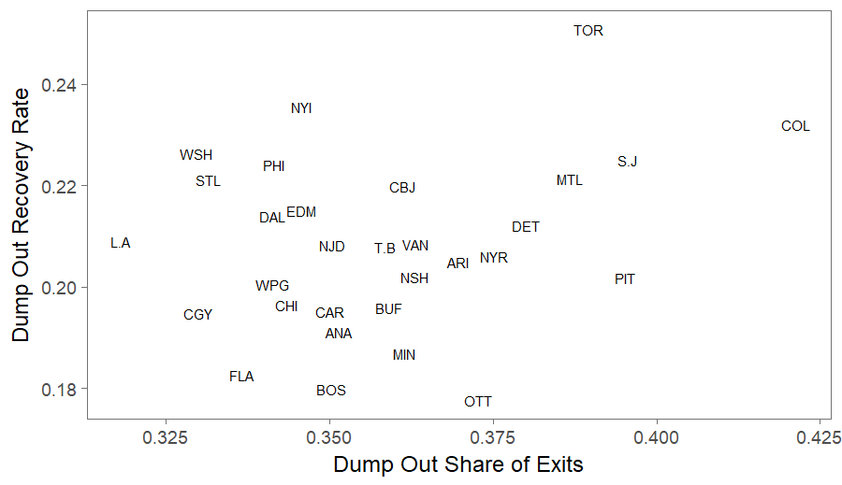
Teams that dump the puck more often don’t seem any better at recovering it
Notes:
Dump Out Share is repeatable but Dump Out Recovery Rate is not

Slide 14
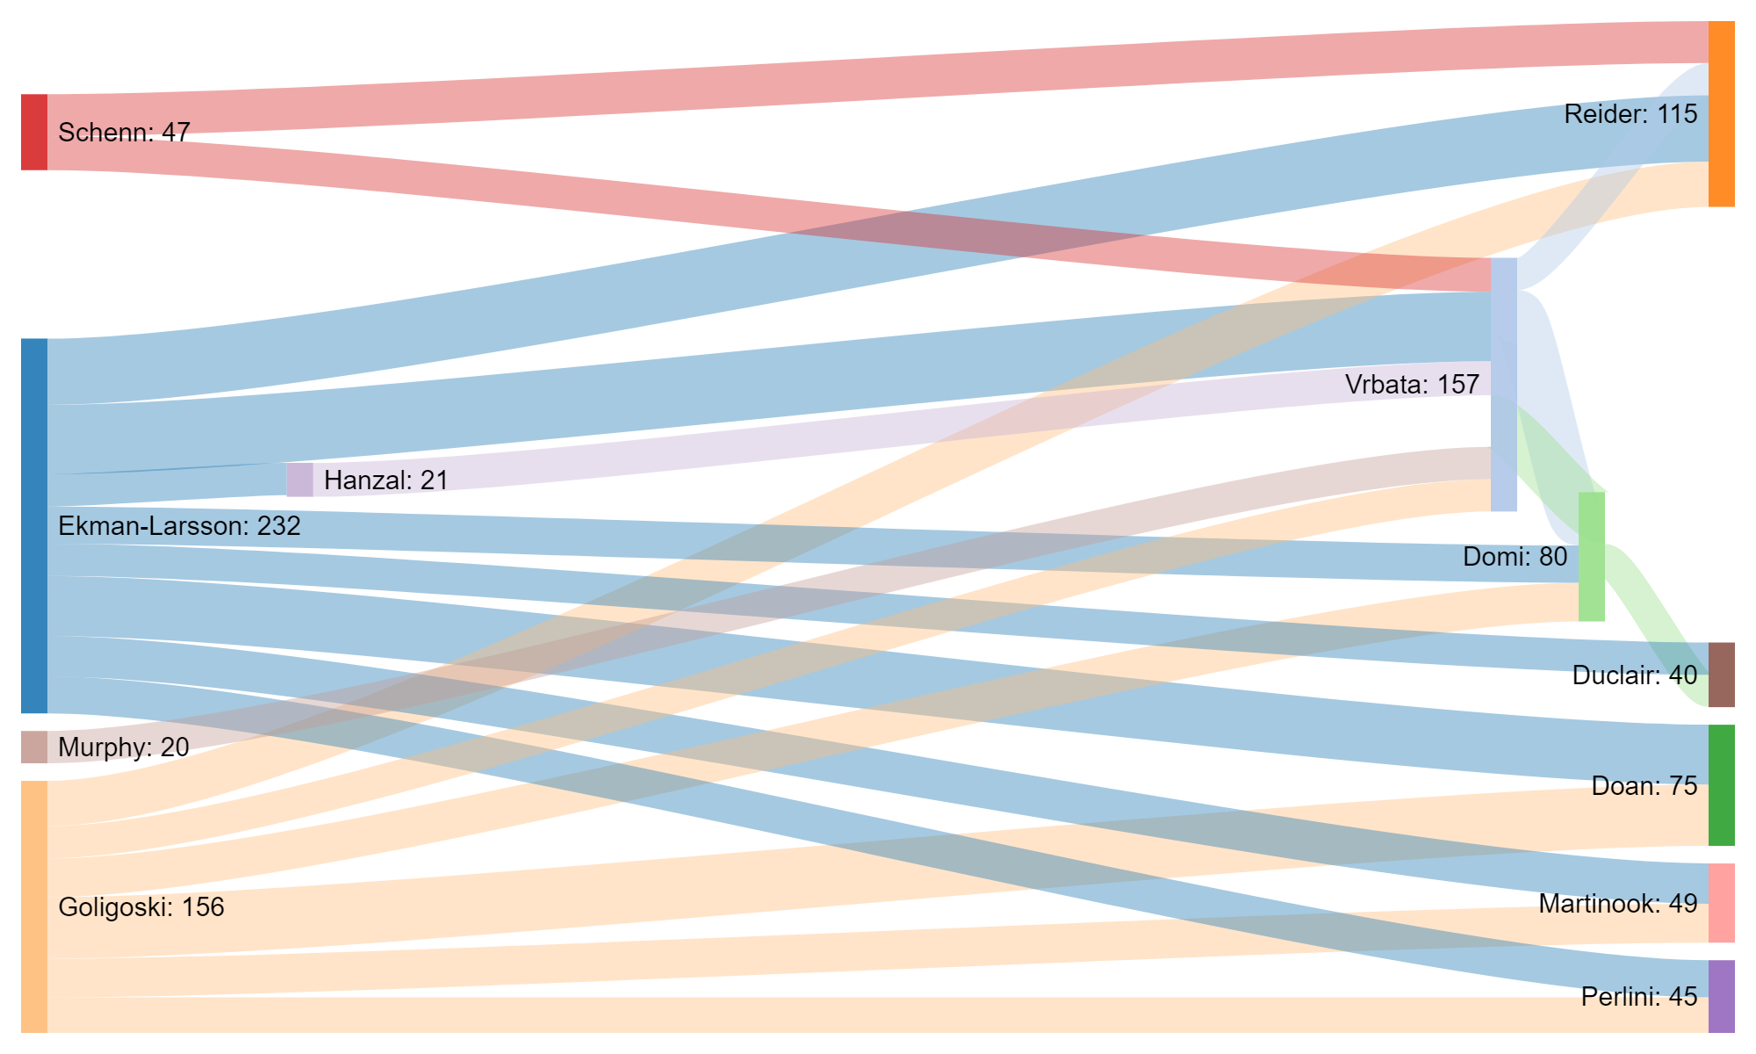
Notes:
ARI Passing network: All connections with >= 20 passing exits last year.

Slide 15
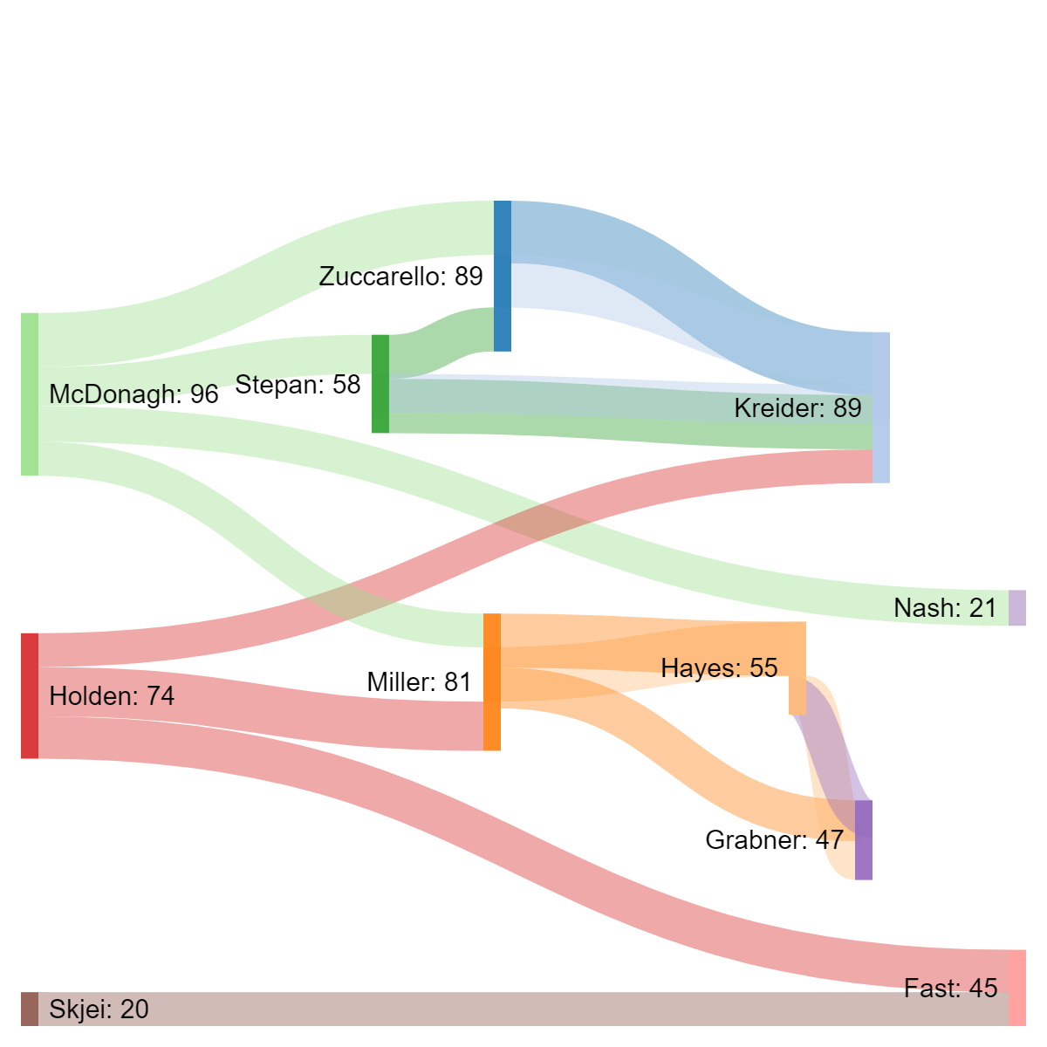

Slide 16
Time to Transition
Neutral Zone Tracking 101
Zone Exits Smorgasbord
Neutral Zone Transitions

Slide 17
Exits with possession lead to entries with possession, and therefore more shots

Slide 18
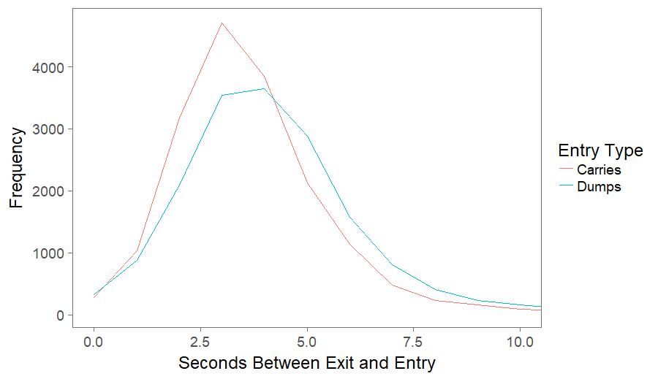
Successful neutral zone transitions are fast

Slide 19
While there are sample size limitations, speed does not seem to impact shots

Slide 20
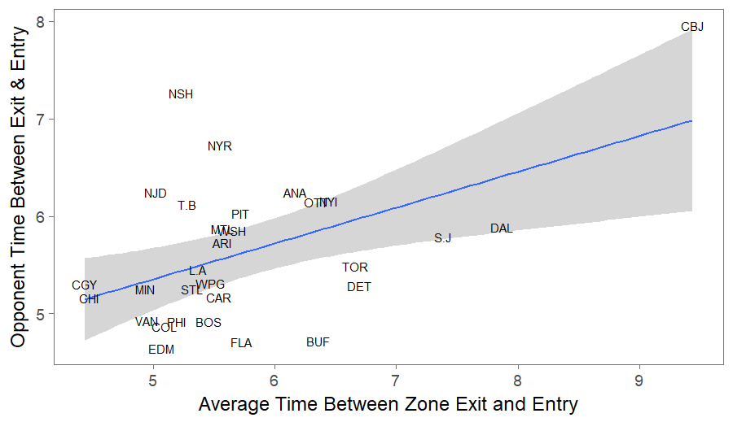
This transitional data gives us a new look at team style and results
Warning: Probably not repeatable
Notes:
Descriptive Only

Slide 21

Conclusion: Let’s get to work

