Slide 1
The Use and Effectiveness of the Dump and Change in the NHL
Joshua P. Smolow
Hockey-Graphs (as Garik16)

Slide 2
The Dump-and-Change as a Tactic
The Dump and Change is a standard NHL tactic to the point where every NHL fan pretty much knows what it roughly is: where the team with the puck dumps the puck into the opponents’ zone with the intention of buying time to complete a change of players.
In this presentation, we will be examining the Dump and Change a bit more in depth as a type of “Zone Entry” – an entry of the puck into the Offensive Zone. When is it used? How effective is it? This presentation aims to take a crack at answering at least part of these questions

Slide 3
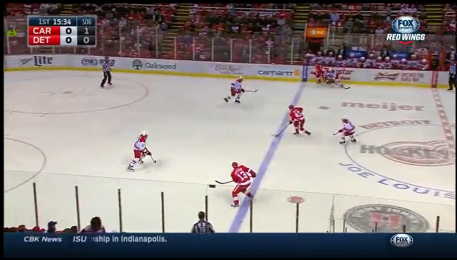
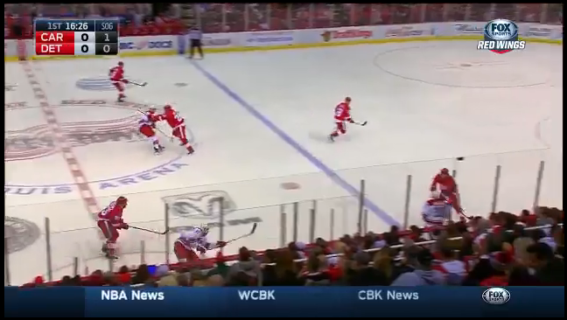
Neutral Zone Tracking AND ZONE ENTRIES
Back during the 2011-2012 season, Geoffrey Detweiler and Eric Tulsky of Broad Street Hockey decided to try and fix that by tracking play in the Neutral Zone.
Their Method: In every Flyers Game that season, Geoff would record each time each team moved the puck out of the neutral zone and into the opponents’ zone. (Zone Entries)
For each Zone Entry, Geoff would record the time, player making the entry, and most importantly, the TYPE of entry: Was it a controlled entry (entering by Carry-in or Pass-in) or an uncontrolled entry (entering by Dump or Tip-In)
Carrying-In
Dumping the Puck In

Slide 4
Neutral Zone Tracking (Continued)
When a Season’s worth of Data was collected, Eric Tulsky analyzed the data and found several interesting results.
In particular he found that entering the zone with control resulted in over TWICE as many unblocked shot attempts as uncontrolled entries (Dump-Ins).
In Addition, he noticed that failed attempts at carrying-in weren’t as detrimental as previously thought, suggesting teams are resorting to dumping in too often.
Using the average fenwick values for each type of Entry, Eric created a statistic he called “Neutral Zone Score” which could measure on-ice neutral zone results for players.

Slide 5
Neutral Zone Tracking (Continued)
When Tracking the Neutral Zone, Trackers only tracked entries that were intended to create offense.
So for example, if the puck left the zone and then was immediately shot back in offsides, this dump-in would not be recorded as an entry.
This was because the goal of the project was simply to measure the effectiveness of Neutral Zone Tactics designed to lead to offense.
As a result, Dump-and-Change plays were not tracked by Neutral Zone Trackers

Slide 6
Tracking Dump-and-Change Plays For This Project
For This Project, I watched 41 games (21 Islanders’ Games and 5 games of each of FLA, S.J, N.J, and DAL) and tracked the Neutral Zone Play of both teams in those games.
As a Result, I obtained data from 28 of the 30 NHL teams in the League (by Happenstance, no Bruins or Penguins games were tracked)
However, in addition to tracking Neutral Zone Play as normal, I also tracked Dump-and-Change plays as an Additional Type of Entry.

Slide 7
What is a Dump and Change?
For Tracking Purposes, Figuring out what is and what isn’t a Dump and Change isn’t as simple as one would think.
When a Team Dumps the Puck in and sends two men after the puck but three change is it a D&C? What about one man? What about when that one man has a head start on the defender?
For this Project, again, I came back to trying to decipher the purpose of the entry – if I felt the primary goal was offense, it wasn’t a D&C. Otherwise it was. Obviously this leads to some subjectivity here.
A Problem of the Sample Size I had was that I was unable to split D&Cs by the type of D&C (All 5 change, 4 change 1 forechecks, etc.). As such, all D&Cs are taken together in the following analysis.

Slide 8
When Do Teams Dump and Change?
Dump and Change Plays are actually not that common. In the Sample tracked, there were only 13.8 Dump and Change Plays per Game, with one game having as few as 4, and another as many as 23.
Obviously, Dump-and-Change plays may be dictated by particular game circumstances, such as extremely long shifts, Icings, etc.
Anecdotally at least, it seems that Complete Dump and Change plays (all 5 players Change) are in fact pretty rare.

Slide 9
When Did Teams Dump and Change?
In What Period would you expect teams to Dump and Change the most?
  The First Period, where teams are trying to be careful at the start?
  The Second Period, due to the long change?
  Or the Third Period, as the leading team becomes more and more conservative and tries to be safe?

Slide 10
When Do Teams Dump and Change?
Dump and Change % For Each Period:
  First Period: 9.96% of Entries are Dump and Changes
  Second Period: 9.52% of Entries are Dump and Changes
  Third Period: 9.91% of Entries are Dump and Changes
  So the long change results in LESS Dump-and-Change plays than in the other period (This isn’t just a tracking quirk – Dump-in rate also drops in the second, so it’s not that the extra D&Cs are being misrecorded as Dump-Ins).

Slide 11
When Do Teams Dump and Change
Score Effects
Naturally team Neutral Zone Behavior also change as the Score Changes.
  In this Sample, Teams Dump & Change on:
    11.1% of Entries when Tied
    11.0% of Entries when Leading
    7.2% of Entries when Trailing
Time Left in the Game also would seem to matter as well:
  Based upon the amount of entries made in each score state in each Period in the sample, we would expect there to be only a 9.45% D&C Rate in the 3rd period, instead of 9.91%.

Slide 12
The Effectiveness of a Dump-and-Change
How would we measure the effectiveness of a Dump-and-Change play?
Two Ways:
  Evaluating the Results of a Dump-and-Change itself
  Evaluating what happens in the Subsequent Entries after a Dump-and-Change

Slide 13
Effectiveness of a Dump-and-Change
The Dump-and-Change Itself
In this Sample, the results for each type of Entry was as follows:
  Carry-Ins resulted on average in .64 Unblocked Shots per Entry
  Dump-Ins resulted on average in .28 Unblocked Shots per Entry
  Faceoffs resulted on average in .27 Unblocked Shots per Faceoff
How about Dump-and-Change plays?
  Around 10% (9.96%) of Dump-and-Changes resulted in the Dumping team gaining possession of the puck before the puck left the Offensive Zone.
  The Result on average is that a Dump and Change averages 0.097 Unblocked Shots Per Entry.

Slide 14
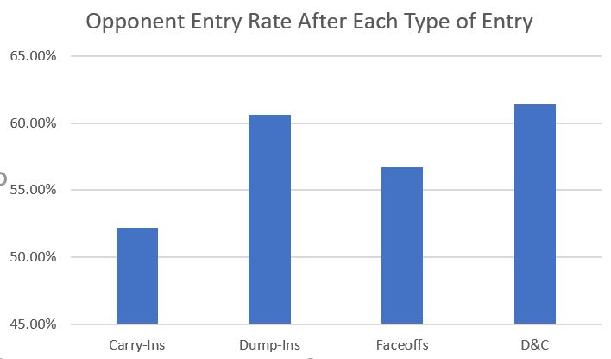
Effectiveness of a Dump-and-Change
Subsequent Entries
Who makes the next entry after each type of Entry?

Slide 15
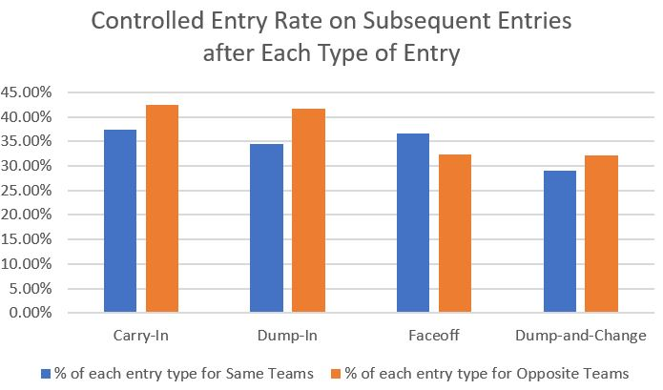
Effectiveness of a Dump-and-Change
Subsequent Entries
How Often Do Teams Carry-In on Subsequent Entry Types after a Zone Entry?

Slide 16
Effectiveness of a Dump-and-Change
Subsequent Entries
Using the Expected Results of Each Type of Zone Entry (and Now Including the Expected Results for Dump and Change plays), we can come up with the Neutral Zone Score for the subsequent entry following each Entry Type.
  NZ Score* For the Entry Following Each Entry Type:
    Carry-Ins: 43.5%
    Dump-Ins: 35.5%
    Faceoffs: 42.4%
    D&Cs: 40.7%
* Weights per Entry Type in this Sample: 0.64 per Controlled Entry, 0.28 per Uncontrolled, 0.27 per Faceoff, 0.097 per D&C

Slide 17
Conclusions
For Obvious Reasons, teams should still try and limit dump-and-change plays as much as possible. Regrouping in a team’s own zone to allow for a change may be a more productive alternative (although Risky in their own way) because D&Cs still result in giving up possession of the puck and a brief opponent edge.
However, the Dump-and-Change does have some value in that it does allow for teams to set up their Neutral Zone Defense to deny opponents the abilities to carry-in with speed (while also getting fresh players on the ice).
As a result it shouldn’t be surprising to see that the Dump and Change is used more often by Leading Teams and especially in the Third Period.

Slide 18
Further Research
In addition to duplicating this work over a larger sample covering all thirty teams, further research should differentiate between the different types of Dump and Changes to measure effectiveness.
In addition, exits following Dump and Changes or exits made with the intent to change should also be tracked in the future.
Finally, given the showing that the Long-Change seems to at most decrease the use of the D&C, further research into the Long Change’s effects on the Neutral Zone should be conducted.

Slide 19
Credits
Much Thanks is Needed to the Following for their Support and Aid in this Project:
Muneeb Alam, for helping translate my data into more useful formats.
Eric Tulsky for starting the whole field of Neutral Zone Study.
And the Whole Gang at Hockey-Graphs for their Support.
Without these Individuals, none of this work would’ve been possible.

