Slide 1
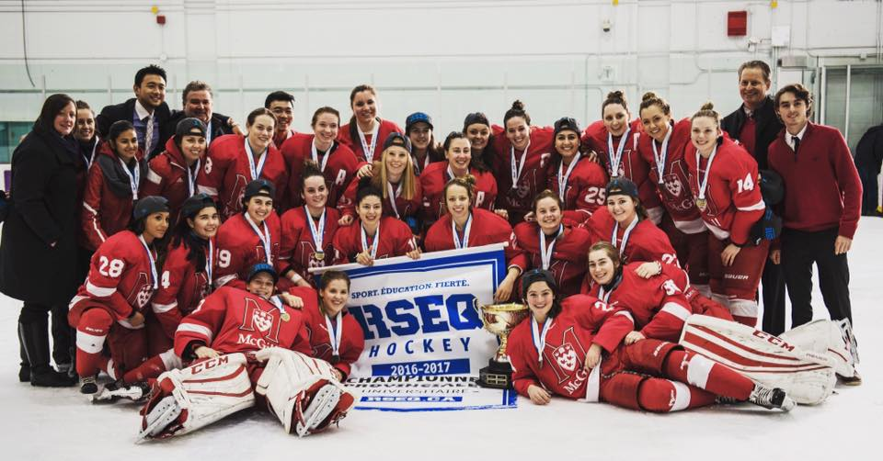

Slide 2

Can Corsi Be Coached?
Identifying tactics which drive shot volume – a 3-year study
Jack Han – Video & Analytics, McGill Martlet Hockey
@ML_Han

Slide 3
What is hockey?
“Playing keep-away” (w/ the puck)
“Playing take-away” (w/out the puck)
What leads to offense, what leads to defense?
@ML_Han

Slide 4
What are good hockey tactics?
Players are in position to get pucks
Playing without the puck becomes a fun & rewarding experience*
*Playing with the puck should always be fun & rewarding
@ML_Han

Slide 5
Does Corsi Even Matter?
- Consider Causality:
  - Does out-shooting make you good?
- Consider Randomness:
  - Is it preferable be in O-zone or D-zone?
@ML_Han

Slide 6
Our Theory:
“Equal skill achieves better results when playing closer to the opposing goal.”
@ML_Han

Slide 7
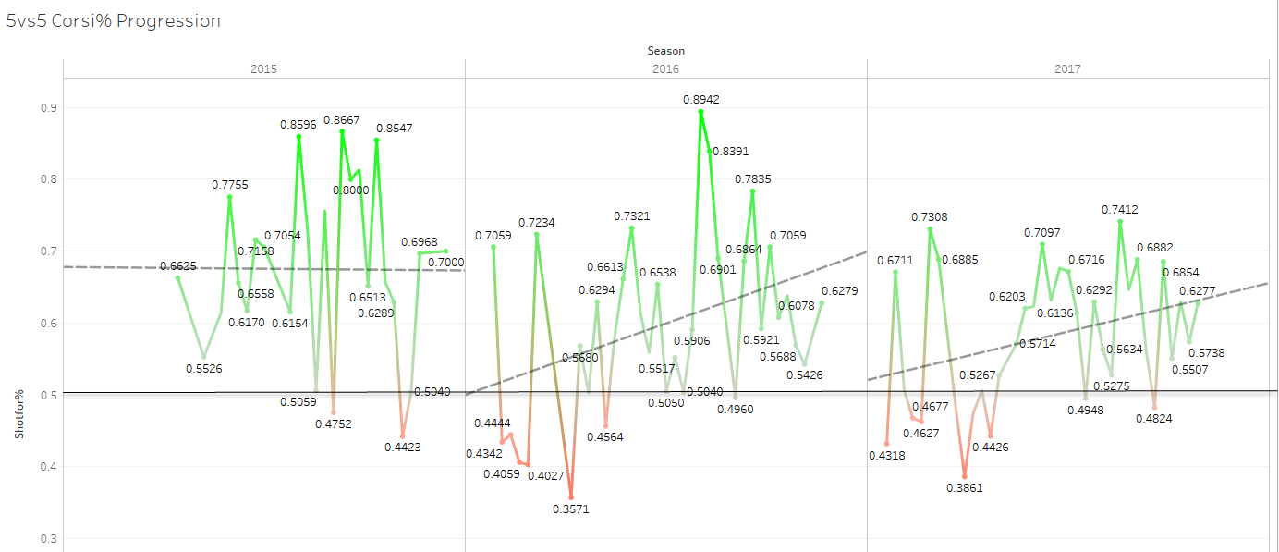
McGill Martlets 2014-17:
Overall Record: 75-44 (47-16 in-conference)
@ML_Han

Slide 8
Our Process @ McGill
(30,000 game events over 3 yrs, logged to video)
Practice planning
Learning from failure
  Team-level
  Individual level
Opposition pre-scouting
@ML_Han

Slide 9
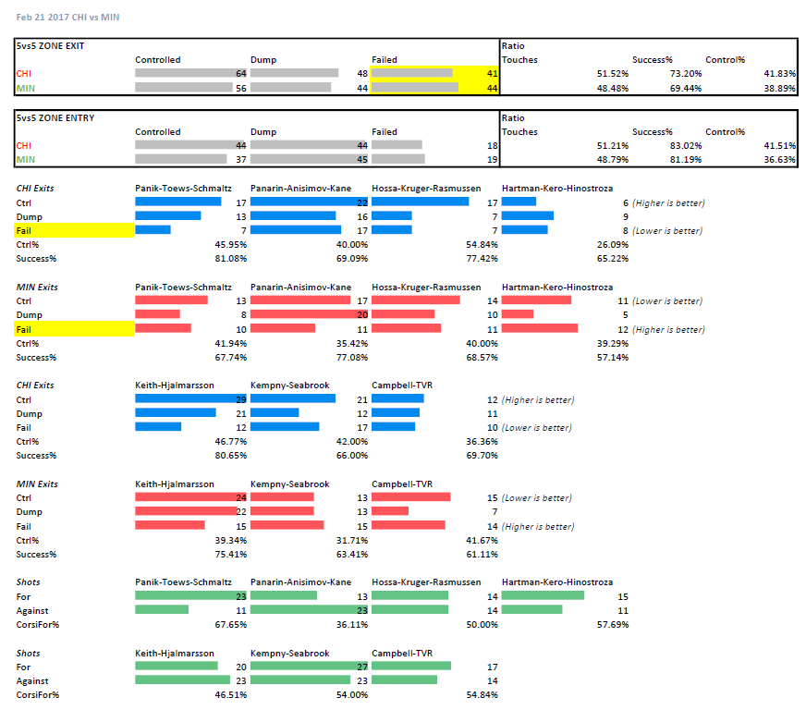
@ML_Han

Slide 10


Slide 11
Why Forechecking Matters
Can be improved in-season (It’s coachable)
Highly correlated with Shot Rates at team-level (It drives success)
Better players do it better (It’s a skill)
@ML_Han

Slide 12
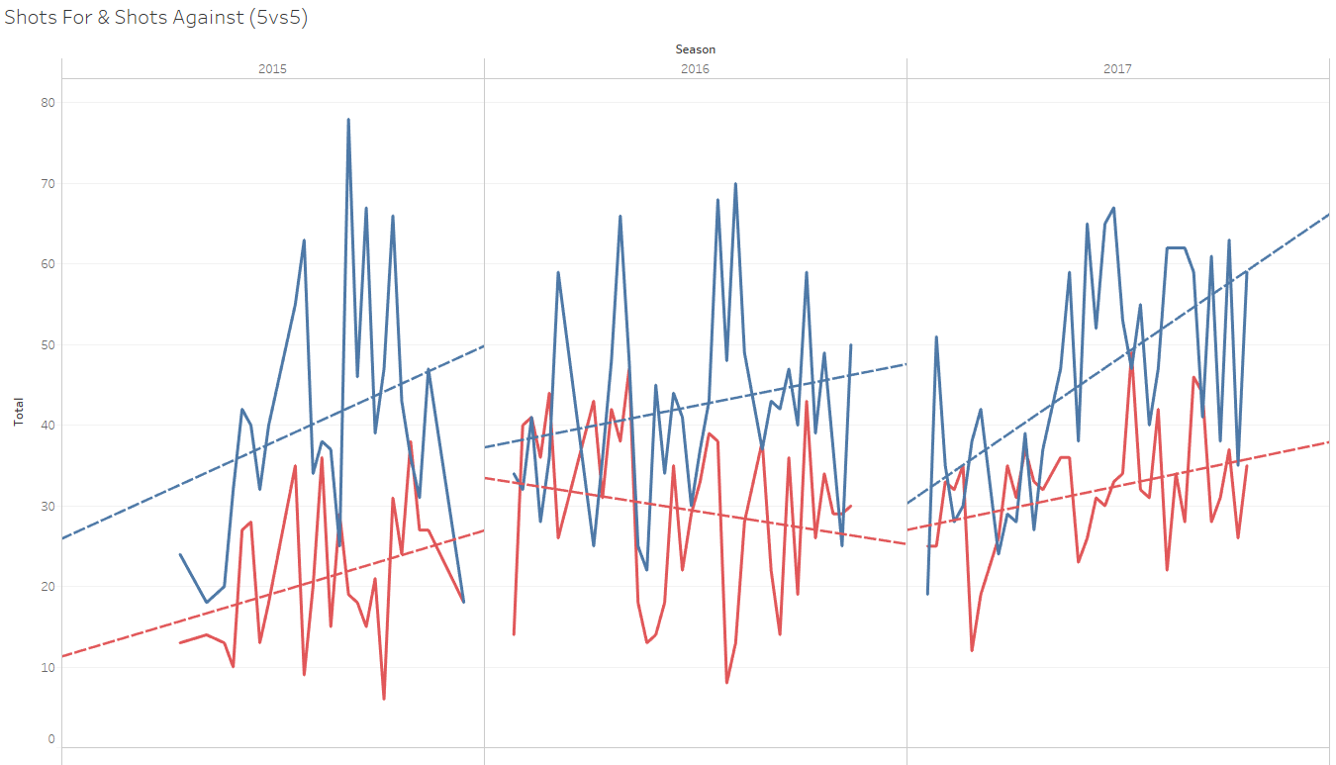
@ML_Han

Slide 13
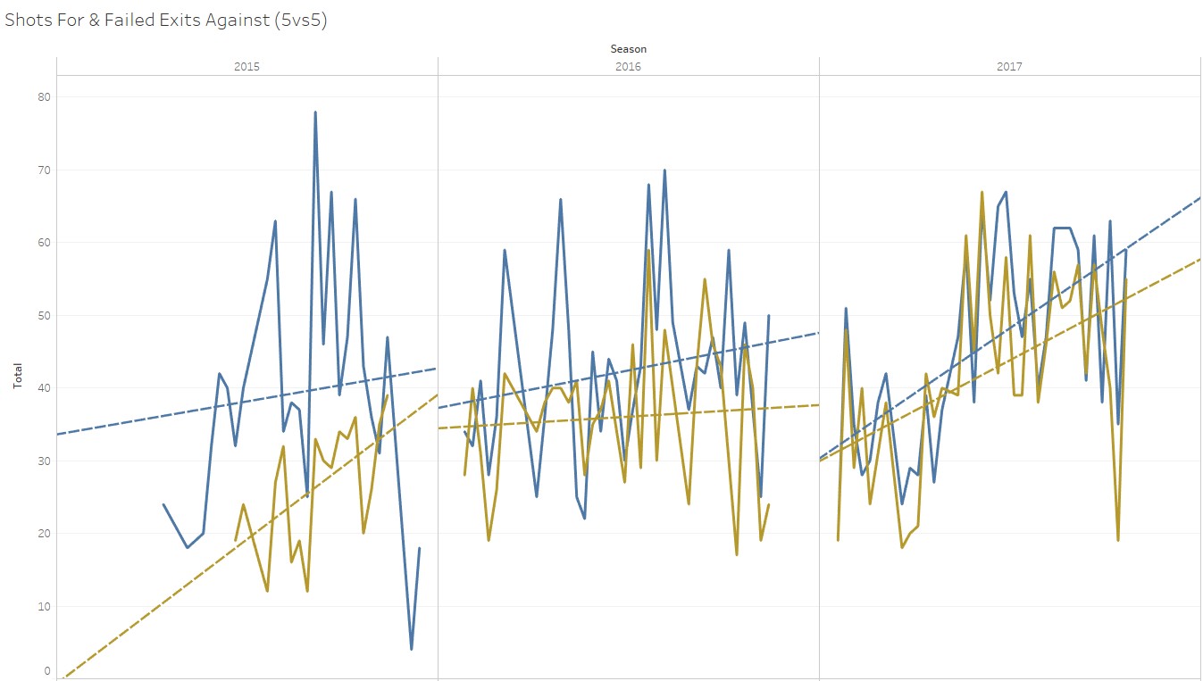
@ML_Han

Slide 14
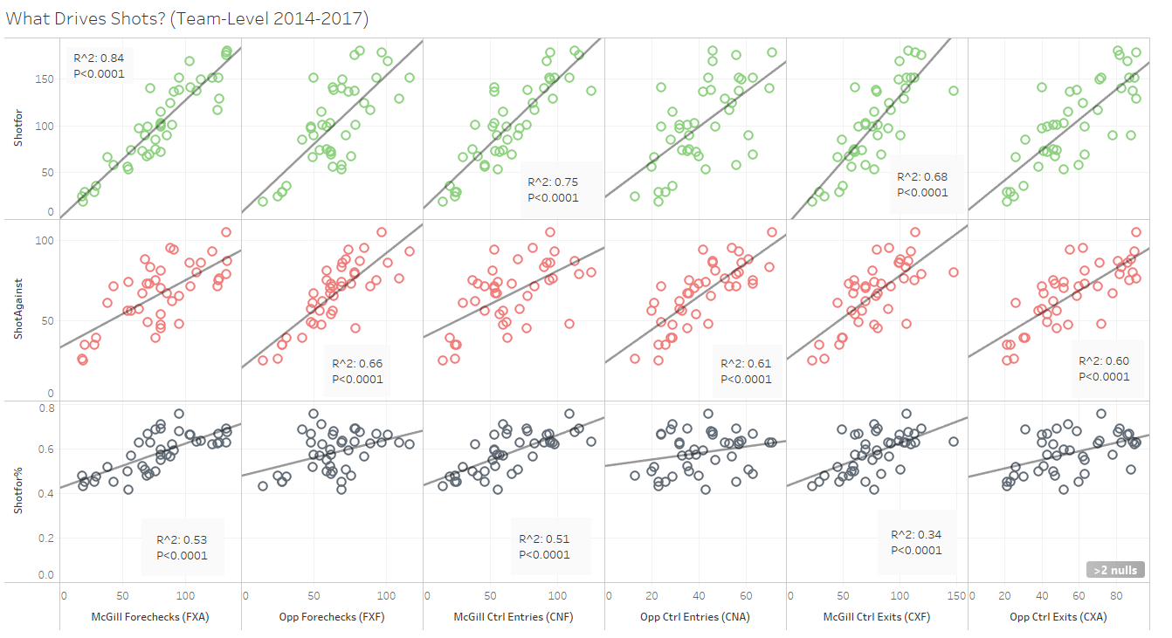
@ML_Han

Slide 15
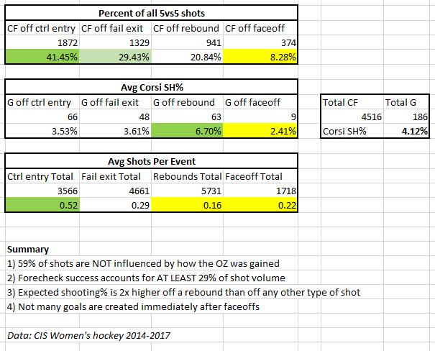
@ML_Han

Slide 16
Further Discussions
Improving tactics (Breakout + Forecheck)
Measuring progress in practice
Select for traits or develop them?
Does it matter if I’m wrong?
What next?
@ML_Han

Slide 17
Acknowledgements
Adrienne Crampton | Emilia Cotter | Kelsie Moffatt | Olivia Sutter
Alexandra Lafrance | Emily Davies | Laura Strenger | Pam Psihogios
Alexandria Serpico | Erica Starnino | Lauren Bowman | Peng Han
Alison Mackenzie | Erika Pyke | Lea Dumais | Peter Smith
Alyssa Cecere | Gabrielle Davidson | Leslie Oles | Rachel Santini
Amey Doyle | Hong Meng | Logan Murray | Rachelle Champion
Brittany Smrke | Jade Downie-Landry | Marie-Philip Lavoie | Shana Walker
Brittney Fouracres | Jean Hyunh | Marie-Philip Poulin | Sidonie Chard
Cassidy Bell | Joanne Cagianos | Melanie Desrochers | Stefanie Pohlod
Catherine Legault | Jordan McDonell | Melodie Daoust | Stewart McCarthey
Charline Labonte | Jordanna Peroff | Michelle Daigneault | Taylor Hough
Cora Constantinou | Kate Devries | Nicole Howlett | Thomas Cote-Miller
Derek Drummond | Katia Clement-Heydra | Olivia Atkinson | Tricia Deguire
Elizabeth Hillier | Kayla Loberg | Olivia Ramos | Zoe Todd
@ML_Han

Slide 18
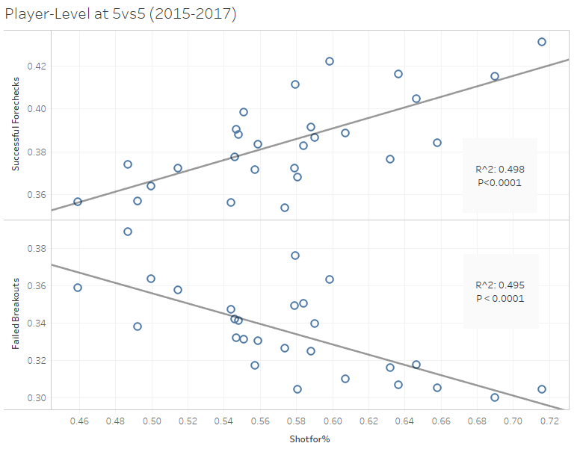
@ML_Han

Slide 19
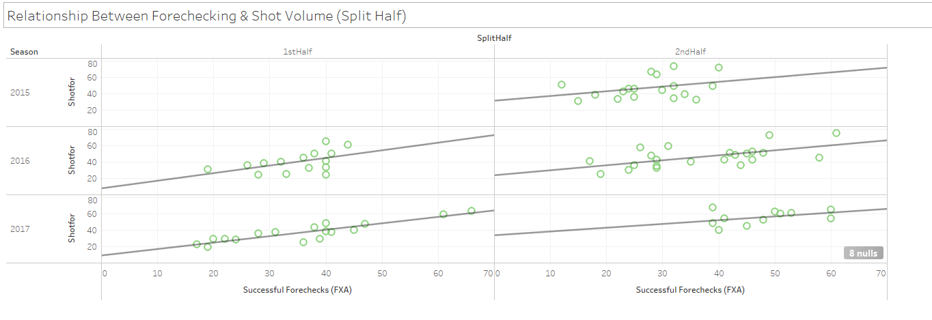
@ML_Han

Slide 20
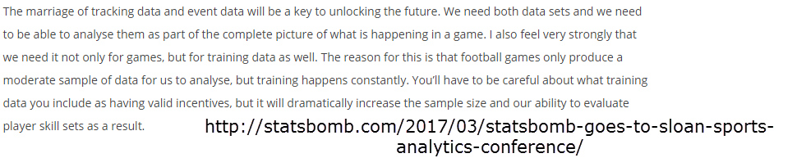
@ML_Han

Slide 21
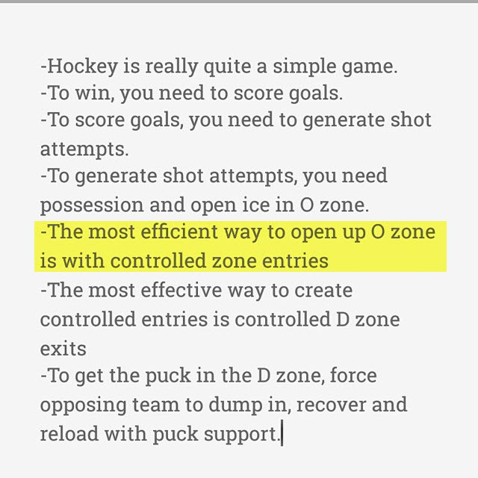
@ML_Han
(March 2015)

