Slide 1
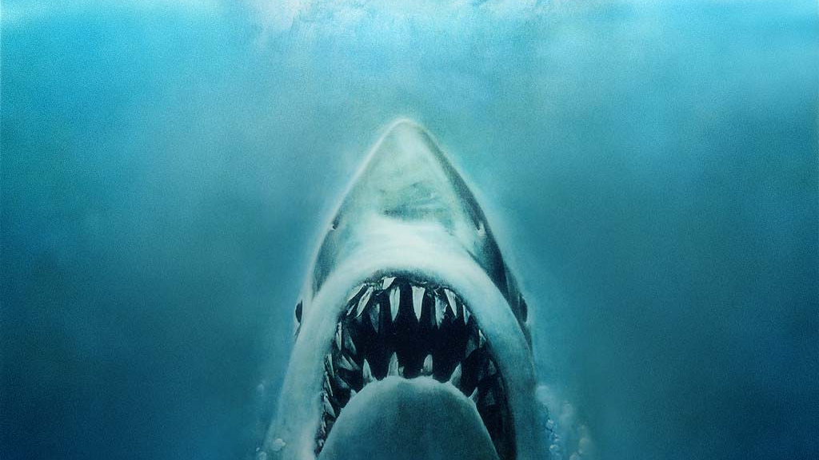
Jumping the Shark:
How nOx (net Opponent XG) helps explain the 2015-2016 Sharks Season

Slide 2
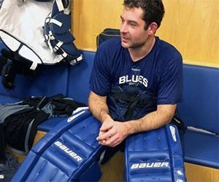
THE MUSE
Brian Elliot
Bad Hombre
Probably double dips in salsa
Is eager for a Creed/Nickelback reunion tour
Finished 2011-2012 with a .940 save pct, the highest ever for any goalie w/ 30 + appearances
I saw right through his lies…..

Slide 3


Slide 4
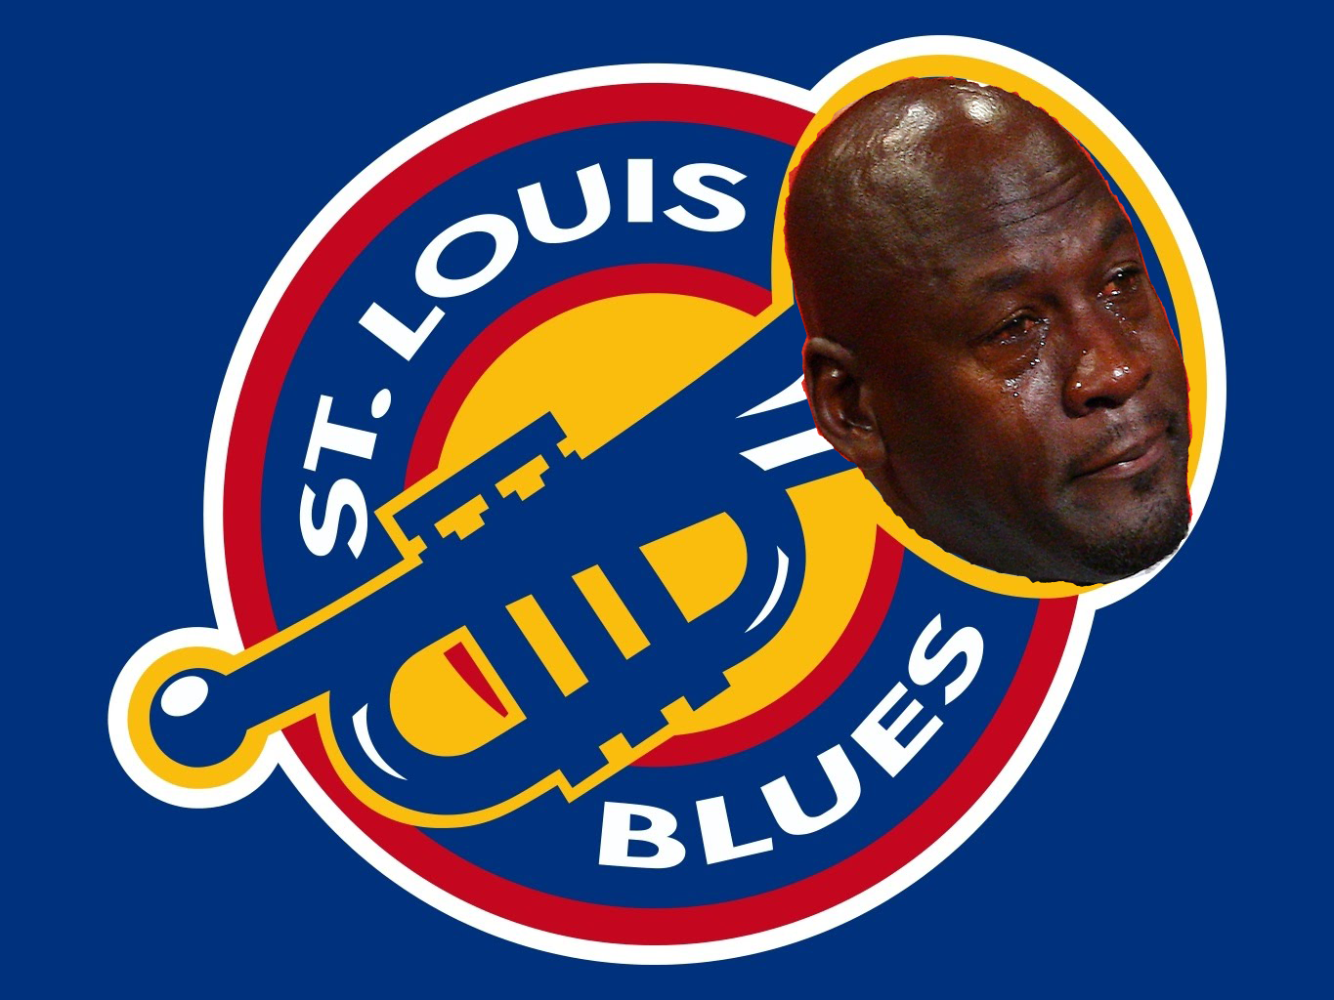
THE ORIGINAL PROCESS
Looked up the shooting percentage of every team Elliot faced that season
Multiplied that with the # of shots Elliot faced
Subtracted Elliot’s goals allowed – expected goal number for True Save %
Concluded Elliot’s save percentage was due to St. Louis defenses
Elliot finished the playoffs with .904 sv%

Slide 5
CALUCULATING NOXG pt. 1
For a game between the Sharks and Rangers:
Take the season average score-adjusted xgF and xgA of both teams (making sure to remove that games opponent from calulations)
Subtract xGF – opp’s avg xGA to get Weighted xGF
Subtract opp’s avg xGF – xGA to get Weighted xGA
Subtract Weighted xGA – Weighted xGF to get Net Opponent xGs (NOxG)
Can be done on a per 60 basis (I only use the first 3 periods)
 | Sharks | Canucks
In-game expected goals | 3 | 4
Average xGF | 3.5 | 3
Average xGA | 2 | 2.5
Weighted xGF | 3-2.5 = .5 xG above avg. | 4-2 = 2 xg above avg.
Weighted xGA | 3-4 = -1 xG below avg. | 3.5-3 = .5 xg above avg.
NOx | .5 – 1 = -.5 below avg. | 2 + .5 = 2.5 xg above avg.

Slide 6
CALUCULATING NOXG pt. 2
Normalize the data by taking the z-score of the NOxGs across all seasons
  You can either then average out or regress the Weighted Offense and Defense OR the NOxG to get a team rating relative to historical average
  Other potential adjustments – Shooting and Goaltending, 5v5, Shots by lines, players
    Basically DTMA’s and Manny Elk’s GSAA models
      For Goaltending
        Subtract in game Goals Allowed from in game xGA and divide by CA
      For Shooting
        Subtract in game Goals xGF from in game Goals for and divide by CA (not really useful….)
        Normalize as stated above

Slide 7
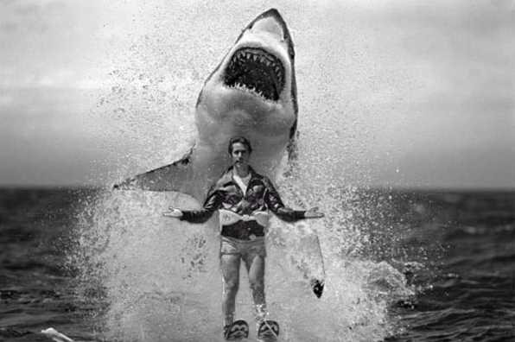
Pt. 2 – The run to the finals

Slide 8
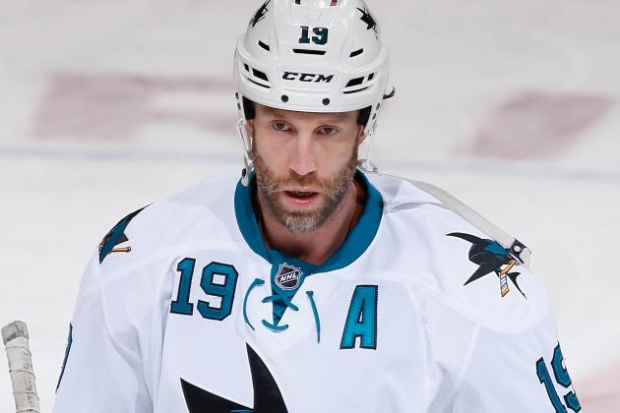
THE SCAPEGOAT
“[Shark’s GM Doug Wilson] been around long enough to know that Marleau and Thornton are perennial playoff underachievers, but that didn’t stop him from giving them each three-year extensions with complete non-movement protection earlier this season.
With Pavelski, Couture and Vlasic already locked up to long-term deals, this same team which has consistently failed to get over the hump will be at it again next season and several more after that. ”
— HTTP://BLEACHERREPORT.COM/ARTICLES/2048381-SAN-JOSE-SHARKS-CHOKE-REPUTATION-GROWS-LEGENDARY-WITH-COLLAPSE-WHATS-NEXT

Slide 9
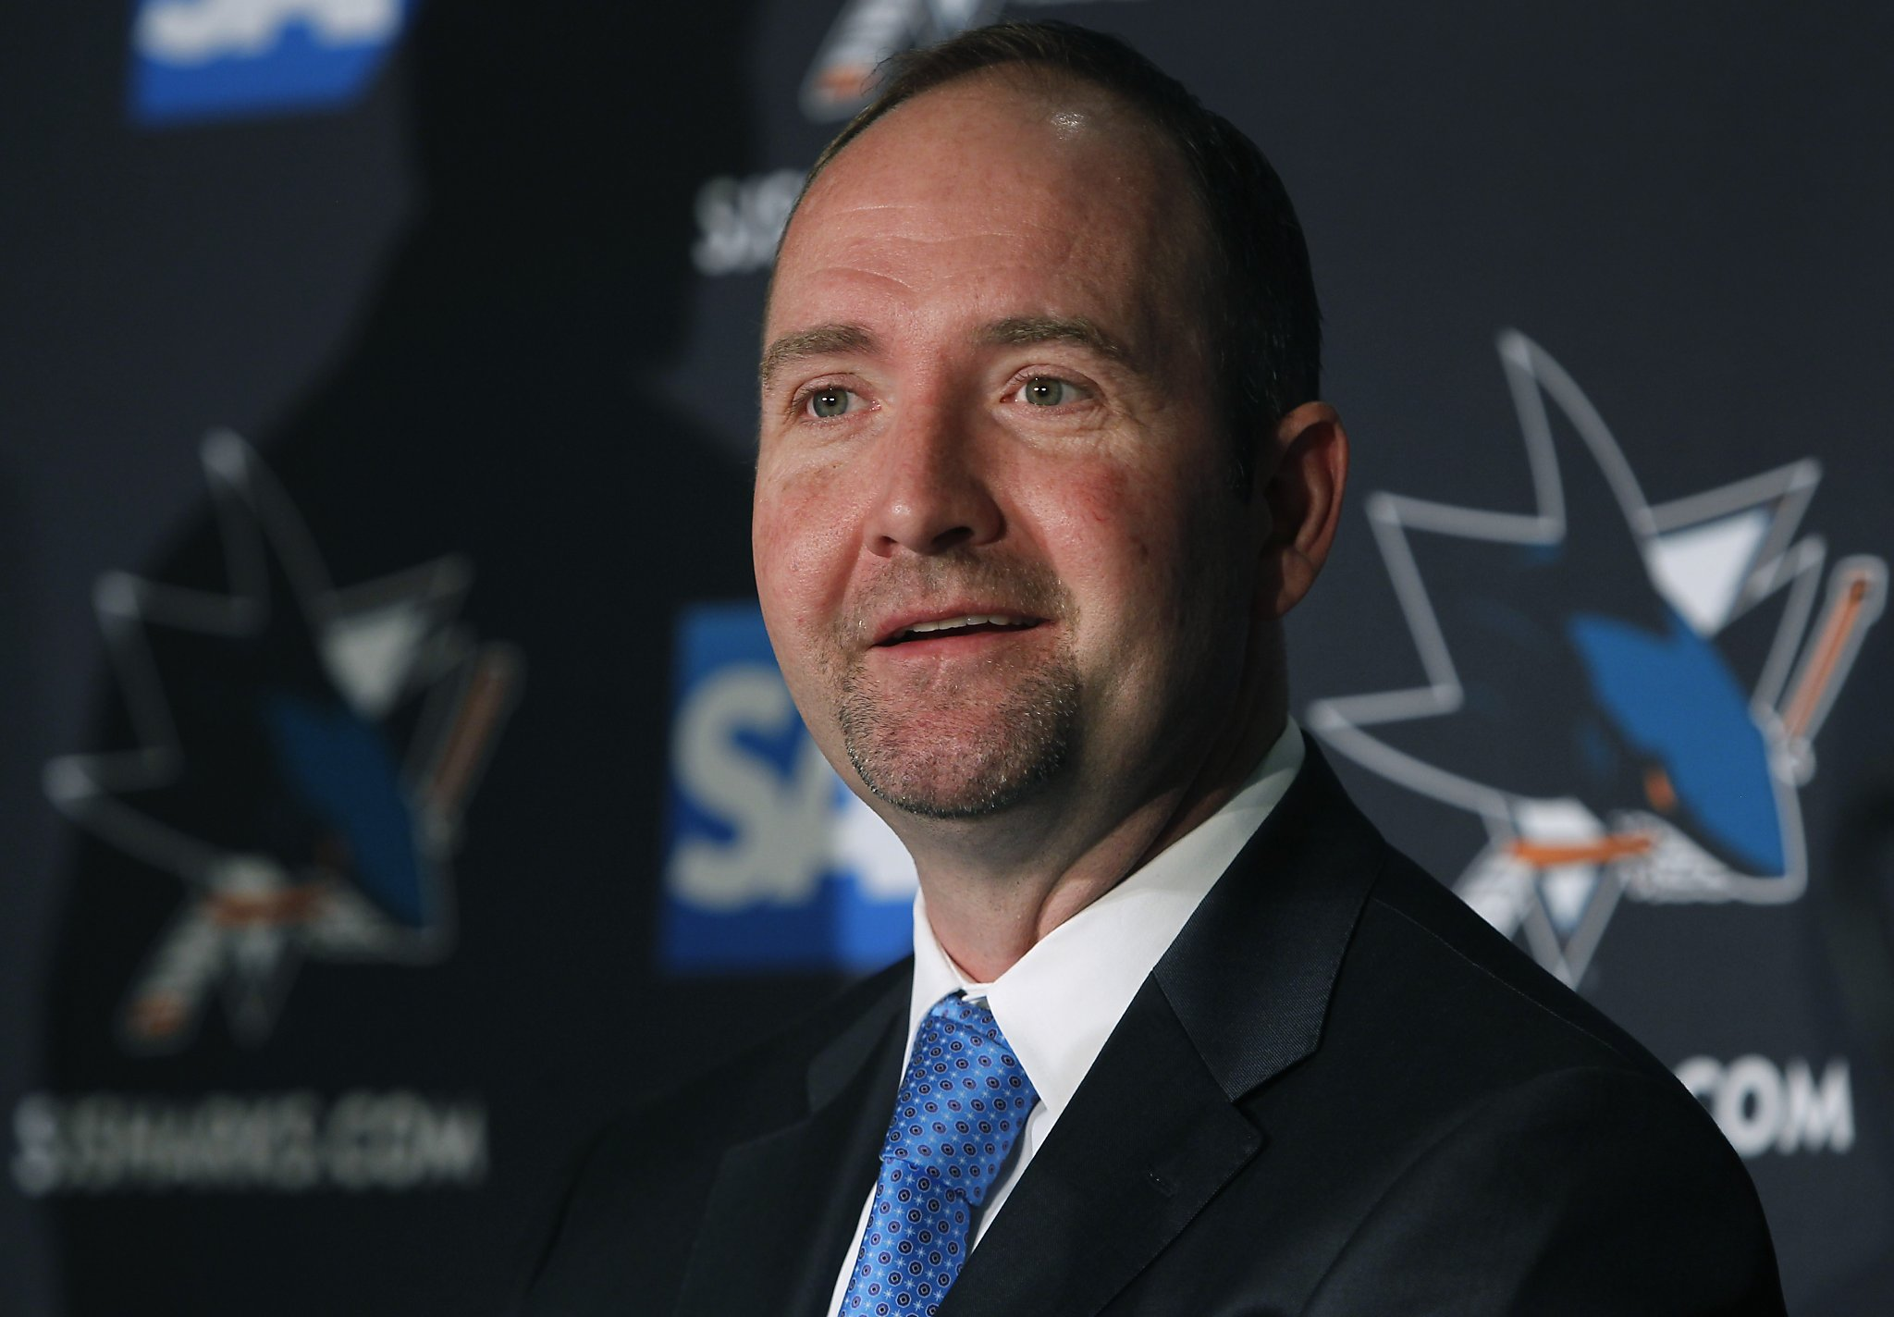
THE COACHING CHANGE
Sharks missed the playoffs in 2014-2015, a year after the Kings collapse
Todd McClellan out, Peter Deboer in
DeBoer’s Devils team’s were like the Bizzaro sharks
New Jersey finished above the 90th percentile in defensive performance in 3 of his 4 years with the team

Slide 10
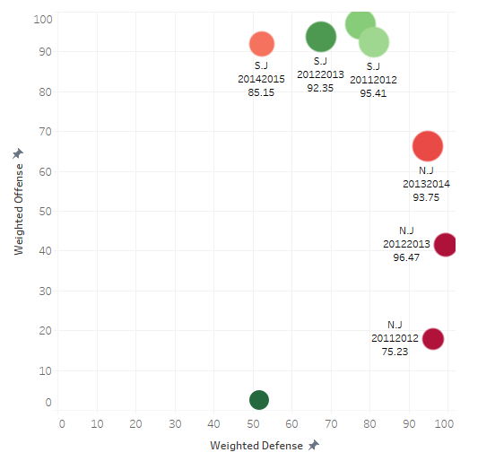
THE COACHING CHANGE
While the Sharks under McClellan masterfully mixed good offenses w/ responsible defenses….
Peter DeBoer basically continued Jacques Lemaire’s life long goal to ruin hockey forever.

Slide 11
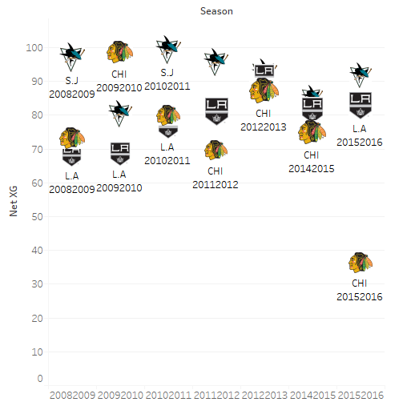
THE POWER VACUUM
So why did the Sharks make the finals after years and years of heart break?
There a couple of reasons to point to, but let’s start with the most obvious:
The path through the western conference was not the same gauntlet it is year after year.

Slide 12
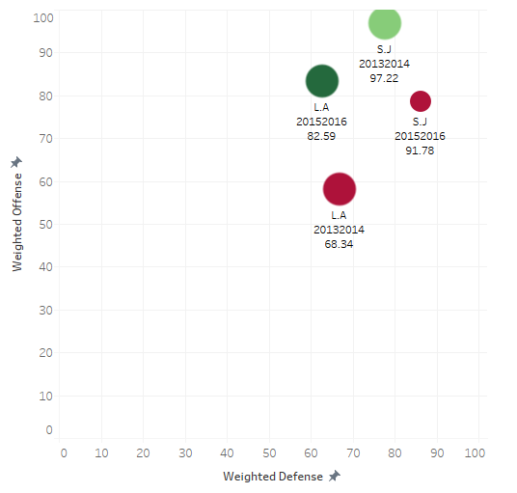
THE SIGH OF RELIEF
Let’s first give the Sharks credit
They beat a superior Kings team that many (including myself picked for the Cup Finals)
While their execution on the power play was often cited as a key contributor, they only scored two more PP goals than the Kings
The big difference was the switch from the inconsistent and unrealiable Antii Niemi (.884 sv% in 2013-2014 playoffs) to Martin Jones (.923 sv%)

Slide 13
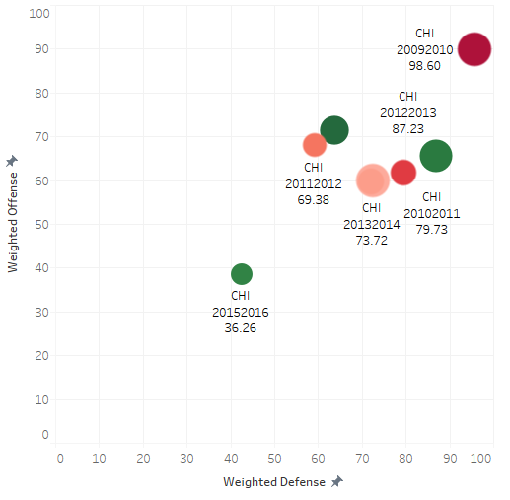
THE HAS BEENS
Meanwhile, the rival Blackhawks were a shell of themselves
Toews was declining
Seabrook was declining
No reliable bottom pair
No more speed advantage
Couldn’t make up for loss of Saad and Sharp

Slide 14
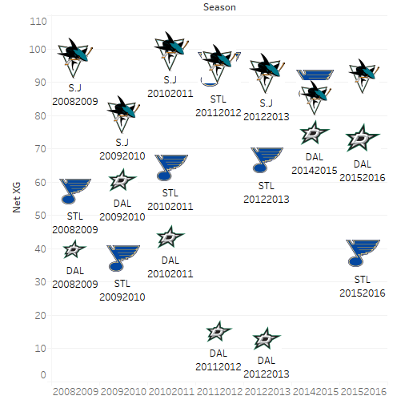
THE LUCKY BREAK
Even after beating L.A. and a good Nashville team, the Sharks were still on track to play the West’s top seed, the Dallas Stars
Dallas = Bad Defense + Home Ice + Avg. Goaltending (!!!) + Explosive Offense = potential upset alert…
Oh wait….Tyler Seguin got injured….
Instead they got a match up with pseudo-contender St. Louis

Slide 15
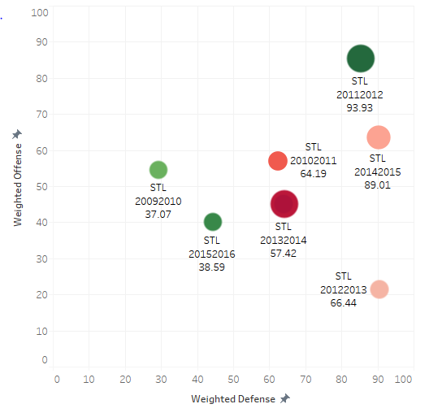
THE NEVER WERE’S
The Blues won a set of favorable matchups to also advance further than they ever had under Ken Hitchcock
However, this version of the Blues several orders of magnitude worse than previous versions
Plus Hitch was doing that weird don’t play your two best players enough thing (Parayko and Tarasenko)

Slide 16
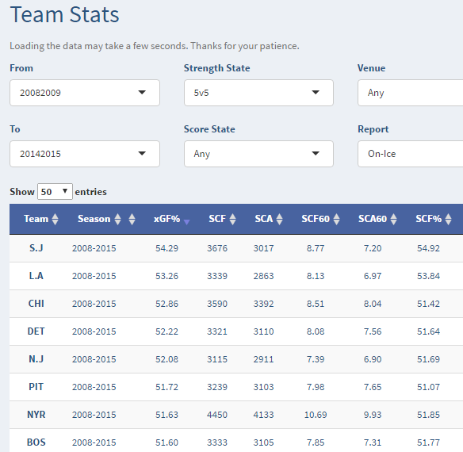
THE TRUTH IS….
The Sharks were good all along….they just had dig deep for 60 mins….yada yada
In reality, the Sharks have been a very good to great team that lost to several other very good to great teams
The 2015-16 playoffs were a perfect storm of good team play, declining rivals and timely injuries
“On the whole, though, the players who have led San Jose to a 3-2 lead in the conference final are the same players who previously couldn't get the team over the hump in the playoffs year after year after year.” – Johnathan Willis, Sportnet

