Slide 1
Strong and Weak Links:
Talent Distributions within Teams
Alex Novet
Hockey Graphs
@ghostofnyles

Slide 2
Teams with similar total talent levels can look very different
Red Team
Blue Team
P.A. Parenteau
Sidney Crosby
Joel Ward
P.A. Parenteau
Boone Jenner
Joel Ward
GAR: 6.8
GAR: 17.2
GAR: 5.4
GAR: 6.8
GAR: 7.1
GAR: 5.4
Dan Girardi
Ben Hutton
Dmitry Orlov
Ben Hutton
GAR: -3.2
GAR: 6.0
GAR: 7.2
GAR: 6.0
Total GAR: 32.2
Total GAR: 31.1
My goal today is to convince you to pick the red team

Slide 3
Strong Link Game: The team with the best player usually wins
Weak Link Game: The team without the worst player usually wins

Slide 4
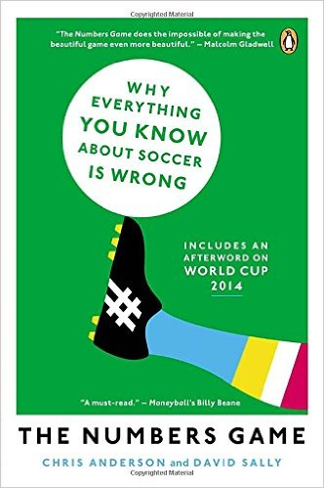




Strong Link vs. Weak Link is a way of understanding how a system works and how to improve performance
OR
OR

Slide 5



It is not immediately clear if hockey is a strong link game like basketball or a weak link game like soccer
Strong Link Game
Weak Link Game
The team with the best player usually wins
The team without the worst player usually wins
One player can easily get possession
Few players are on the court at once
Each player has the ball a small fraction of the game
1 goal can win a game, so mistakes matter
Few players are on the ice at once
Weakest player can be hidden with limited ice time
1 goal can win a game, so mistakes matter
Best skaters only play a fraction of the game

Slide 6
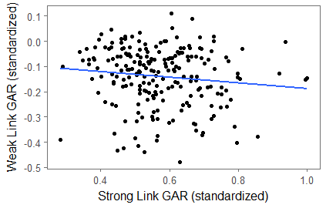
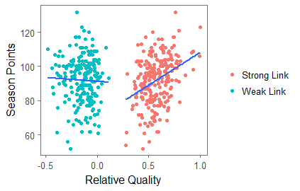
We can begin to test this by examining the best and worst player on each team as measured by GAR
The Strong and Weak Link are Uncorrelated
The Strong Link is More Related to Success
Correlation = -0.121
Strong Link Correlation = 0.348
Weak Link Correlation = -0.037

Slide 7
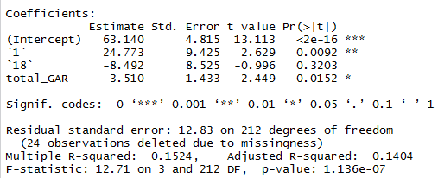
More formally, we can use a regression to show the strong link is the more explanatory player

Slide 8
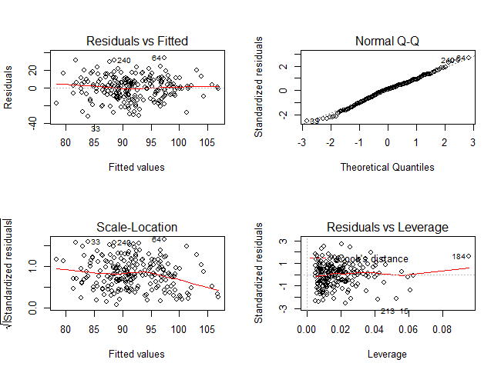
The regressions aren’t perfectly leveraged but seem suitable

Slide 9
If we think about talent as a resource, there are several techniques from other fields we can apply
Many fields have ways to measure the distribution of resources
1
Statistics: Standard Deviation or Range
2
Business: Herfindahl-Hirschmann Index (HHI)
3
Economics: Gini Coefficient
These have been used in sports before, but not in quite this way

Slide 10
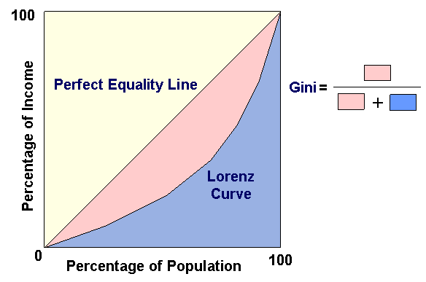
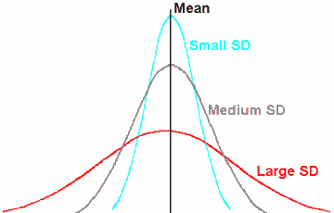
Each of these measures looks at the distribution of talent throughout the entire team

Slide 11
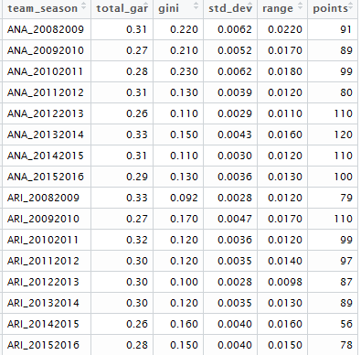
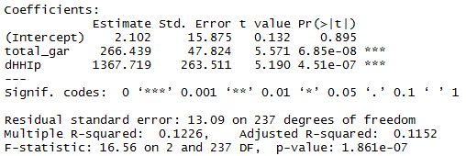
Each of the regressions indicate that more extreme talent distributions do better than balanced ones

Slide 12
Implications
Trades
    Choose quality over quantity
Free Agency
    If you have to choose, spend money on the star, not the bench
Draft
In the current draft system, tanking works
Coaching
Hockey is about creating plays, not avoiding mistakes

Slide 13
Next Steps
Review by a real statistician
Incorporate goalies
Improve on ranking system and address colinearity
Incorporate marginal cost of improving a player given their role
Thank you to Dom Luszczyszyn, Micah Blake McCurdy, and Dawson Sprigings for data collection help

