Slide 1

Stupid Goalie Stuff
Nick Mercadante (@nmercad)

Slide 2
Describe? Maybe.
Predict? Come Now.
Entanglement – The information black hole
  Team Effects
  Under-explained and unexplained variables impacting publicly available goaltender statistics
  Goalie shelf-life
RANDOMNESS

Slide 3
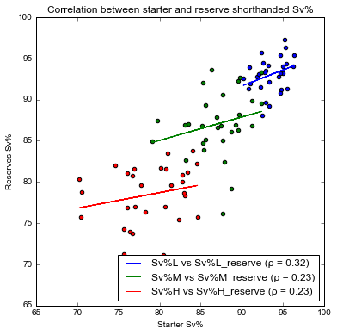
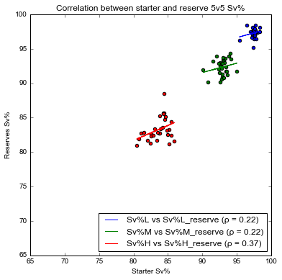
Team Effects Are Real viz courtesy of - Http://oddacious.github.io/one-man-down

Slide 4
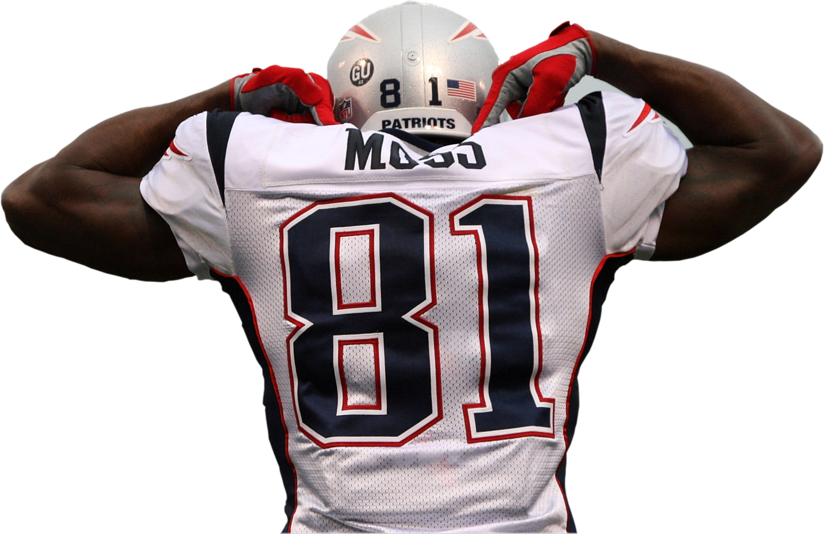
Randy Moss on “Impact”
“I don’t think numbers stand … [2012] has been a down year for me statistically. [2010] was a down year, and Oakland [in 2006] was a down year. I don’t really live on numbers. I really live on impact and what you’re able to do on that field.”

Slide 5
Goalie WOWY?
-GAA is a TEAM STAT – But what if we look at Δ for D with and without goalie?
Caveat: This is a bad idea, generally
  WOWYs - Variables, variables, variables
  But let’s just take a look. Maybe goalies at extremes are impacting team D to a measurable degree
Are there NHL versions of the Randy Moss Effect?

Slide 6
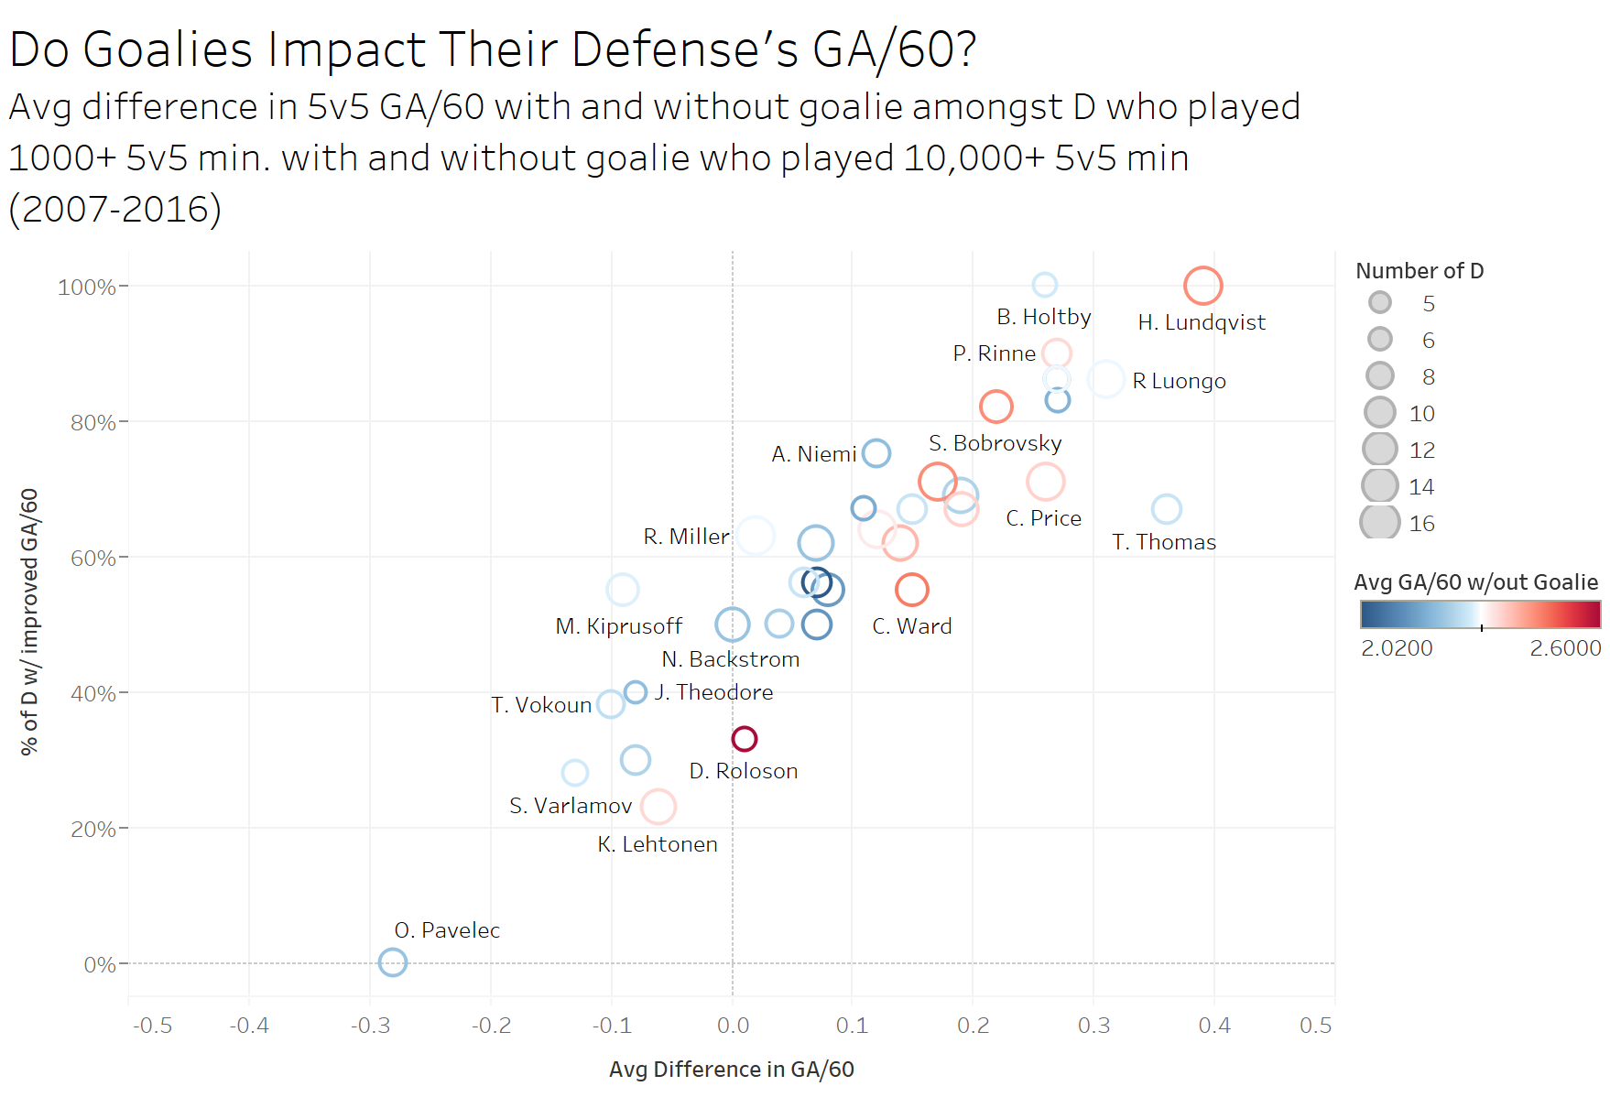

Slide 7
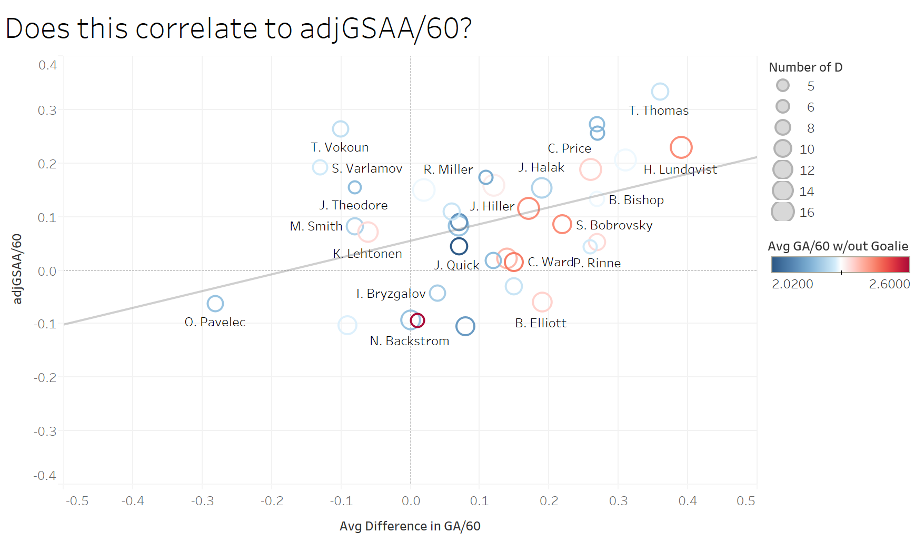
R-Squared = .17
P-Value = .02

Slide 8
WIN THRESHOLD %
How often a goalie does enough at 5v5 to win an average NHL game?
  NHL Average 5v5 goals per team since 2013-14: ~1.75
  NHL Average total 5v5 TOI per game since 2013-14: ~48 min
  NHL Average 5v5 shots against per team since 2013-14: ~23
Win Threshold:
  Eliminate all non-starts from sample (>= STDEV below avg 5v5 TOI per game, or ~38+ min)
  Manny Perry’s xG version of GSAA
    3 yr avg for starts where goalie allows 1 goal = +.755

Slide 9
Why?
Put to rest wins as a stat
Replacement for quality starts, which does not consider actual performance against type/number of shots faced
“Impact”

Slide 10
Thanks
“RDJ” (@GentlePutsch) - http://oddacious.github.io
http://www.corsica.hockey/goalies/
http://stats.hockeyanalysis.com
Hockey-Graphs for putting up with my nonsense
Henrik Lundqvist and Steve Mason – my muses
Follow me on Twitter: @nmercad

