Slide 1
Loading up the Blue Line
Eric Cantor

Slide 2
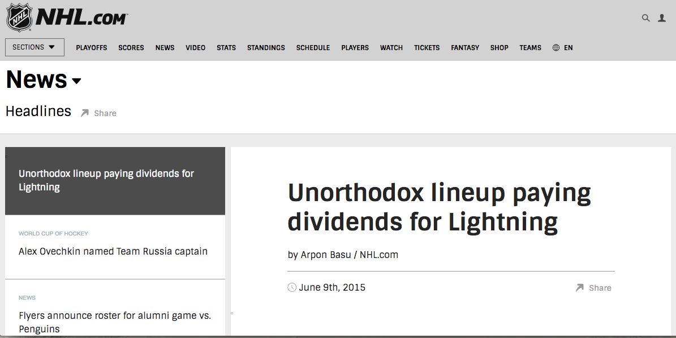
Introduction

Slide 3
Background
What:
  Identify if performance differences exist with a roster structured with 7 defensemen rather than 6
How:
  Analyze Tampa Bay Lightning game data from 2013-2016
Why:
  Determine if a measurable advantage is obtained when implementing a roster structure with 7 defensemen

Slide 4
Outline
293 total games (2013-16)
  92 (7D) & 201 (6D)
7D Games Distribution
Season | Regular (7D) | Playoffs (7D) | Total (7D)
13-14 | 82 (41) | 4 (2) | 86 (43)
14-15 | 82 (0) | 26 (14) | 108 (14)
15-16 | 82 (25) | 17 (10) | 99 (35)
Totals | 246 (66) | 47 (26) | 293 (92)
Areas of Focus:
Relation to Injuries
TOI distribution
Team stats
Defensemen stats
Top 6 Forward stats
Zone Entries
Passing Project stats

Slide 5
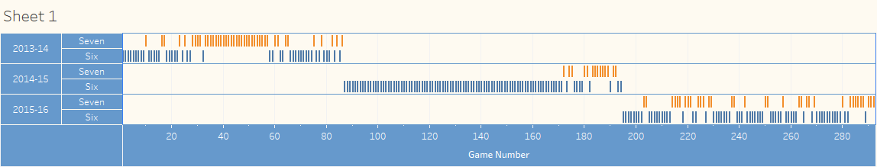
7D Games Distribution

Slide 6
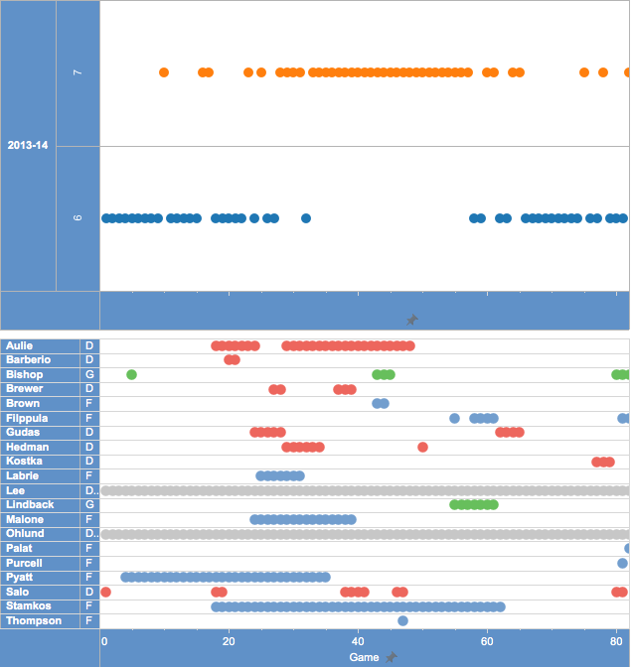
Injuries
(2013-14)

Slide 7
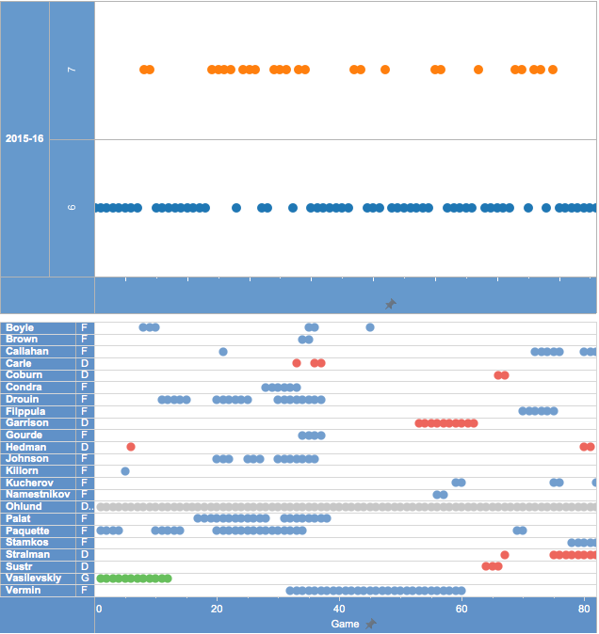
Injuries
(2015-16)

Slide 8
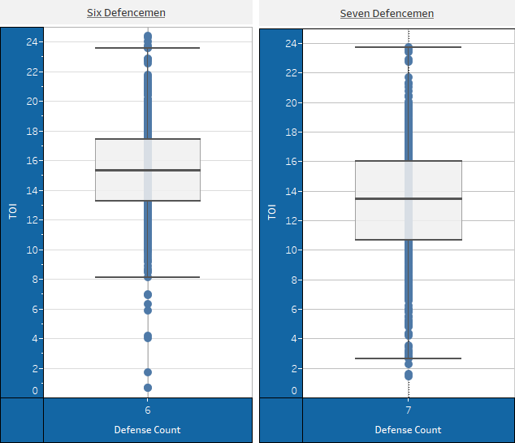
Defense
TOI
Statistic | 6D | 7D
Upper Whisker | 23.60 | 23.73
Upper Hinge | 17.42 | 16.05
Median | 15.35 | 13.50
Lower Hinge | 13.25 | 10.66
Lower Whisker | 8.11 | 2.65

Slide 9
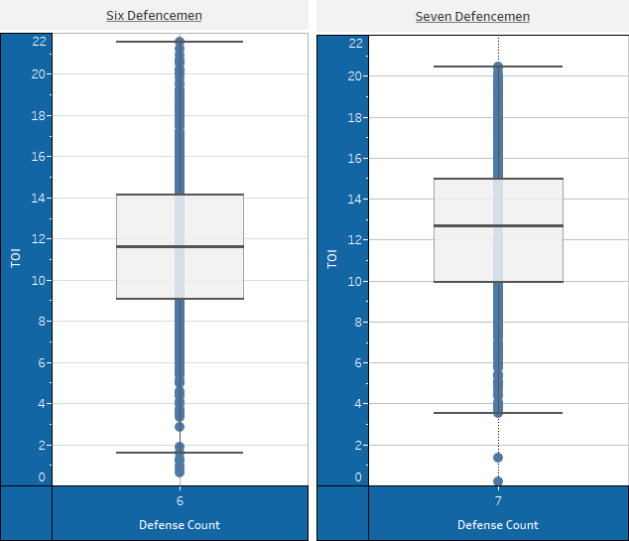
Top Six
Forwards
TOI
Statistic | 6D | 7D
Upper Whisker | 21.55 | 20.94
Upper Hinge | 14.16 | 14.96
Median | 11.64 | 12.72
Lower Hinge | 9.07 | 9.55
Lower Whisker | 1.57 | 3.56

Slide 10
Overall Team
Statistics
Statistic | 6D | 7D | Change
CF60 | 56.04 | 60.07 | +4.03
CA60 | 53.25 | 54.79 | +(1.53)
CF% | 51.28% | 52.31% | +1.03
FF60 | 41.50 | 44.92 | +3.42
FA60 | 40.28 | 40.99 | +(0.71)
FF% | 50.88% | 52.30% | +1.42
SCF60 | 7.37 | 8.01 | +0.64
SCA60 | 7.21 | 7.65 | +(0.44)
SCF% | 51.01% | 51.12% | +0.11
xGF60 | 2.32 | 2.54 | +0.22
xGA60 | 2.24 | 2.36 | +(0.13)

Slide 11
Top Six Forwards
Statistic | 6D | 7D | Change
CF% | 50.92% | 52.73% | +1.81
FF% | 50.42% | 52.65% | +2.22
xGF | 0.53 | 0.63 | +0.10
xGA | 0.53 | 0.59 | +(0.06)
xGF60 | 2.35 | 2.60 | +0.25
xGA60 | 2.35 | 2.40 | +(0.05)
Defense
Statistic | 6D | 7D | Change
CF% | 51.09% | 52.17% | +1.08
FF% | 50.58% | 52.04% | +1.46
xGF | 0.59 | 0.55 | -0.04
xGA | 0.58 | 0.52 | -0.05
xGF60 | 2.31 | 2.51 | +0.20
xGA60 | 2.26 | 2.40 | +(0.14)
Notes:
Defense--- xGF – xGA = 0.03 (SEVEN)
and 0.01 (SIX)

Slide 12
Zone Entries
(2013-14)
Statistic | 6D | 7D | Change
5V5 Entry% | 50.65% | 50.89% | +0.24
Carry-in% | 49.61% | 57.02% | +7.41
Shots per entry | 0.44 | 0.50 | +0.06
OPP Carry-in% | 47.07% | 47.15% | +(0.07)
OPP Shots per entry | 0.46 | 0.47 | +(0.01)
Passing
(2015-16)
Statistic | 6D | 7D | Change
A1 | 42.67 | 44.41 | +1.75
SC | 15.41 | 16.71 | +1.30

Slide 13
Conclusion
The potential competitive advantage of the 7D roster structure should hold much intrigue and appeal for hockey management of all levels
Many potential applications and complements exist for the 7D strategy
  Current trend of more mobile defensemen
  Injury situations
  Much more…

Slide 14
Future Exploration
Ideas for future exploration include:
  The factor of fatigue
  Additional injury analysis
  Individual player analysis
  Further zone entry and exit analysis
  Other forms of tracking data
  Informative models
  Predictive models

Slide 15
Acknowledgements
Ryan Stimson, Matthew Hoffman, and RIT
Doug Ensley
Michael Peterson
Michael Schuckers
Data Sources:
Corsica.Hockey
Corey Sznajder’s All Three Zone Project
Ryan Stimson’s Passing Project
NHL Injury Dataviz

