Slide 1
Maximizing NHL Player Usage Using a Linear Optimization Model
Dawson Sprigings

Slide 2
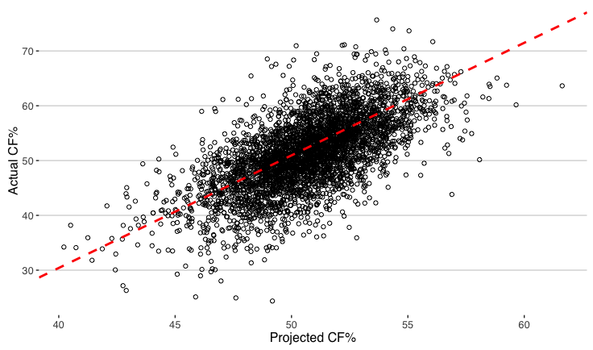
What is wrong with a linear model?
Notes:
You can use any metric you would like - Corsi/xG/WAR

Slide 3
Is a linear model the right choice?
Theoretical
Residual Analysis
  Residual = Observed - Predicted
  Example:
    Fake model to predict how many goals a player will score
    Model Predicts -> 5
    Player Actually Scores -> 7
    Residual -> 2

Slide 4
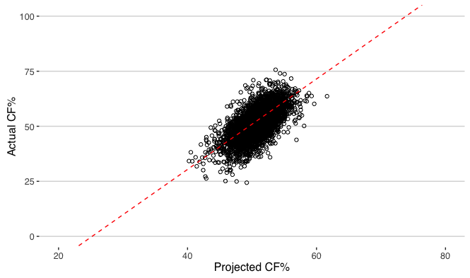
Theoretical

Slide 5
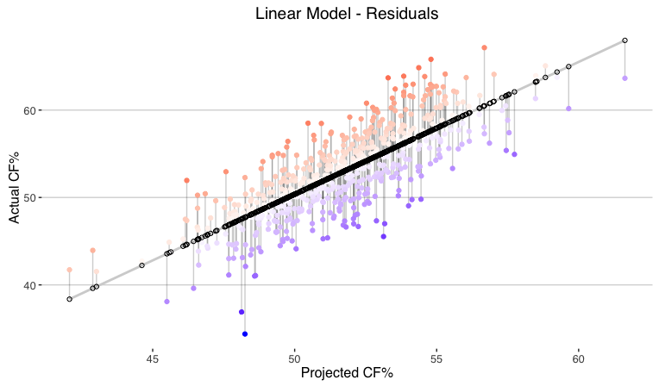
2. Residual Analysis

Slide 6
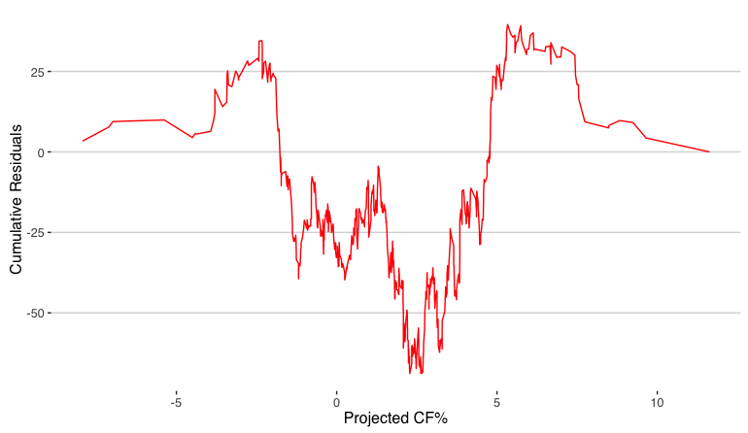
2. Residual Analysis - Cumulative Residual Plot

Slide 7
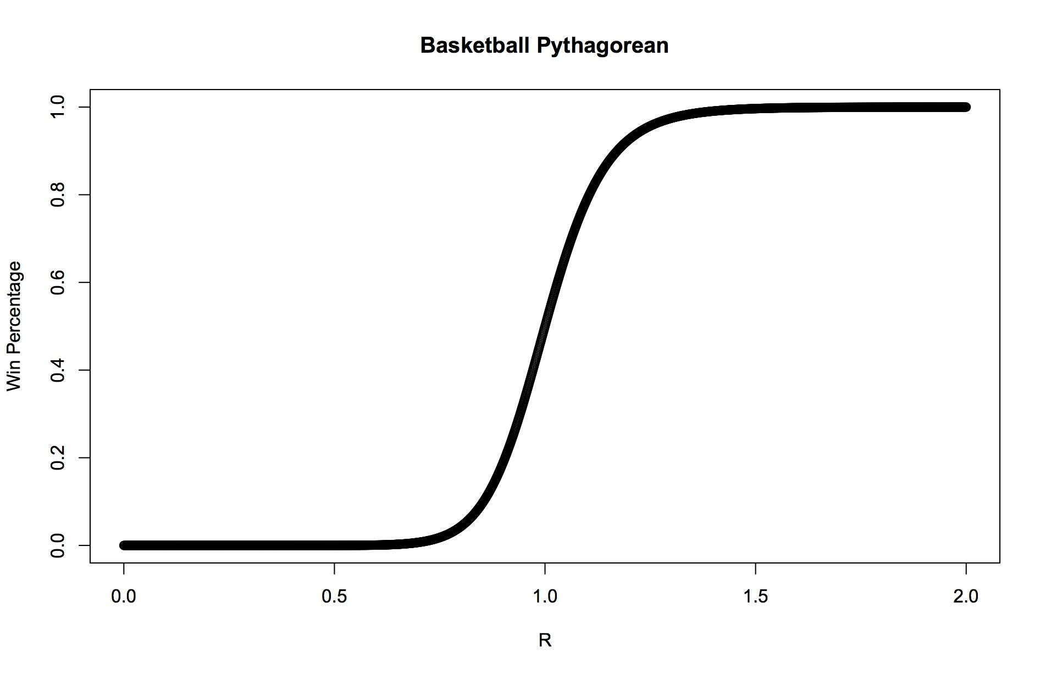
Solution: Non-Linear Model
Notes:
You can use any metric you would like - Corsi/xG/WAR

Slide 8
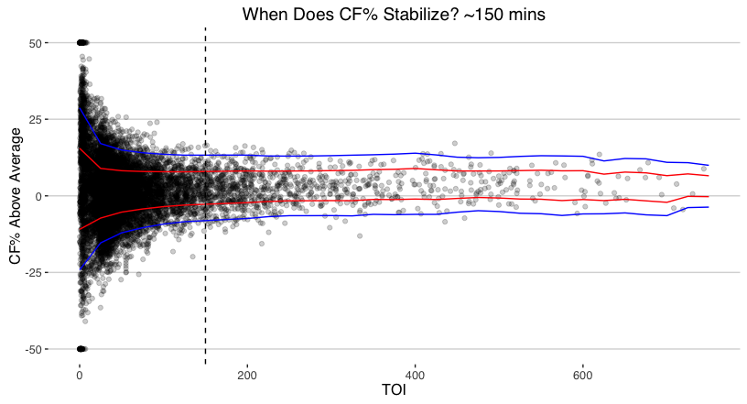
Finding a Time-On-Ice Cutoff
Notes:
You can use any metric you would like - Corsi/xG/WAR

Slide 9
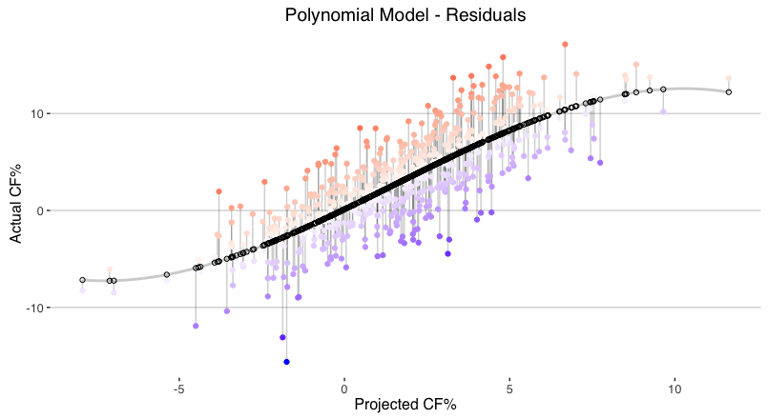
Polynomial Regression

Slide 10
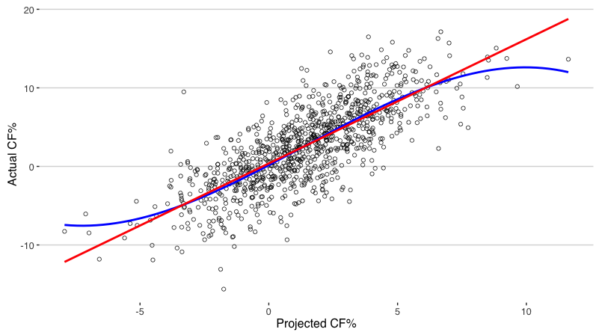
Basic Linear vs. Polynomial Regression

Slide 11
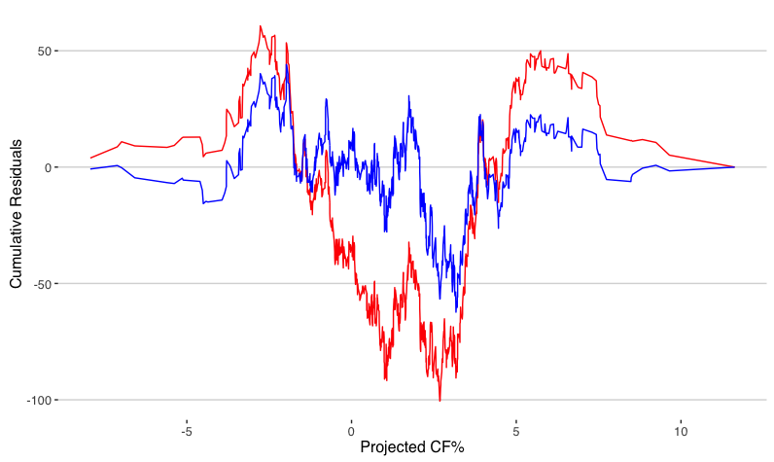
Linear vs. Polynomial - Cumulative Residual Plot

Slide 12
Should you play your best players together?
Short Answer: NO
Better Answer: It depends
7 Models
All - Average
3 Bad Players
2 Bad Players
1 Bad Player
3 Good Players
2 Good Players
1 Good Player
Good = CF%RelTM > 1 SD
Bad = CF%RelTM < -1 SD

Slide 13

Good Player - Brad Marchand

Slide 14

Bad Player - Zac Rinaldo

Slide 15
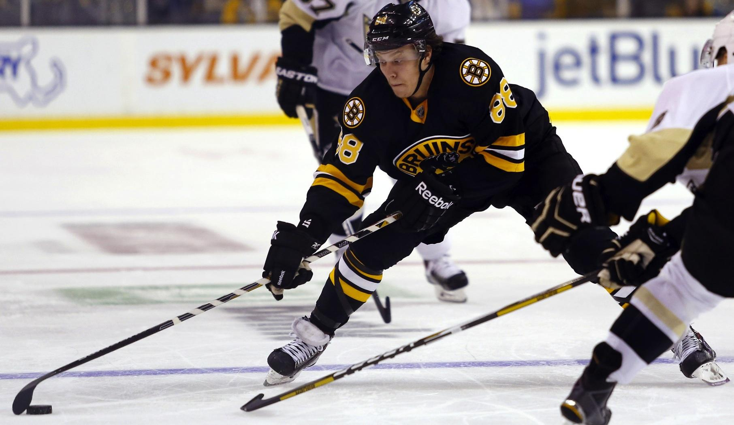
Average Player - David Pastrnak

Slide 16
Diminishing Returns
Model:
Dependent Variable
  Actual Line CF%
Independent Variable
  Estimated Line CF%
  Est. Line CF% = (P1 CF%RelTM + P2 CF%RelTM P3 CF%RelTM)/3
Model | Beta Coefficient
3 Good Players | 0.51
2 Good Players | 0.87
1 Good Player | 1.3
All Average | 1.58
1 Bad Player | 1.41
2 Bad Players | 1
3 Bad Players | 1.02

Slide 17
Linear Optimization
Maximize under a certain set of constraints
Gives us the “best” possible lines
Can use “best” lines as a baseline to see how much value is being lost
Unfair to compare actual lines to best
Compare to “basic” model instead

Slide 18
Basic Model vs. New Model
Basic Model
  Uses straight line approach
  Output
    Sub-optimal lines
    Incorrect performance projections
New Model
  Uses polynomial approach
  Uses 7 different models to account for line makeup
  Output
    “Best” lines
  Can apply to the lineup created by the basic model to give correct predictions

Slide 19
Basic Model vs. New Model - Effect
Incorrect Projections
Basic Model overestimated
  Minnesota
  Los Angeles
  Arizona
Basic Model underestimated
  Florida
  Nashville
  Montreal
Cost of Bad Lineups (Goals)
Minnesota - 7.88
Los Angeles - 6.05
Carolina - 4.79
Boston - 3.25

Slide 20
Summary & Future Work
Polynomial regression is more appropriate than standard linear model
Try to spread talent throughout lineup to maximize impact
Offense vs. Defense
Improve the 7 models approach
Apply different metrics
  xG / WAR

Slide 21
Thank You

