Slide 1
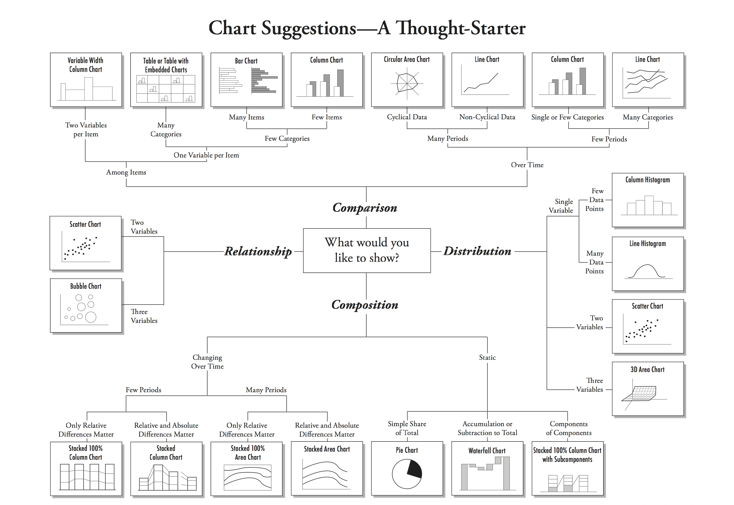
“Choosing a Good Chart.” by Andrew Abela <http://extremepresentation.typepad.com/files/choosing-a-good-chart-09.pdf>

Slide 2
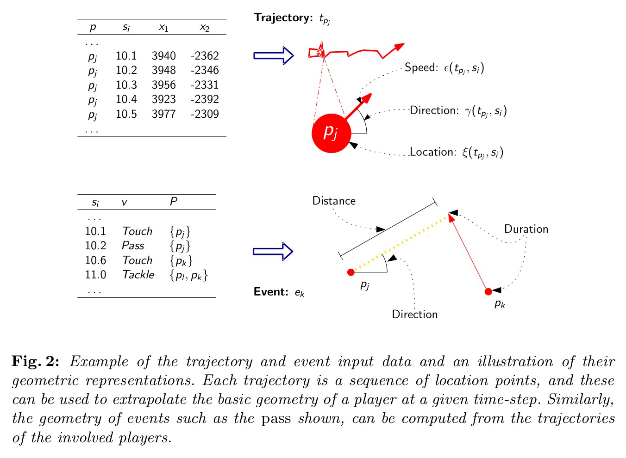
Gudmundsson, Joachim and Michael Horton. “Spatio-Temporal Analysis of Team Sports - A Survey.” CoRR abs/1602.06994 (2016): n. pag.

Slide 3
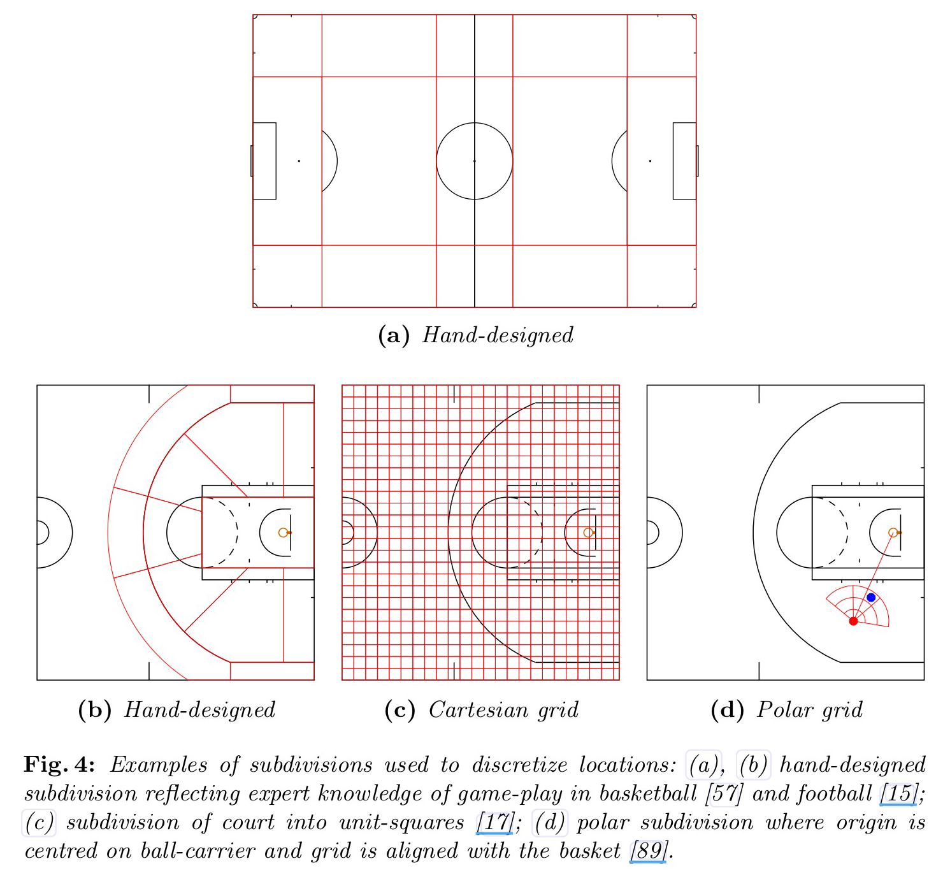
Gudmundsson, Joachim and Michael Horton. “Spatio-Temporal Analysis of Team Sports - A Survey.” CoRR abs/1602.06994 (2016): n. pag.

Slide 4
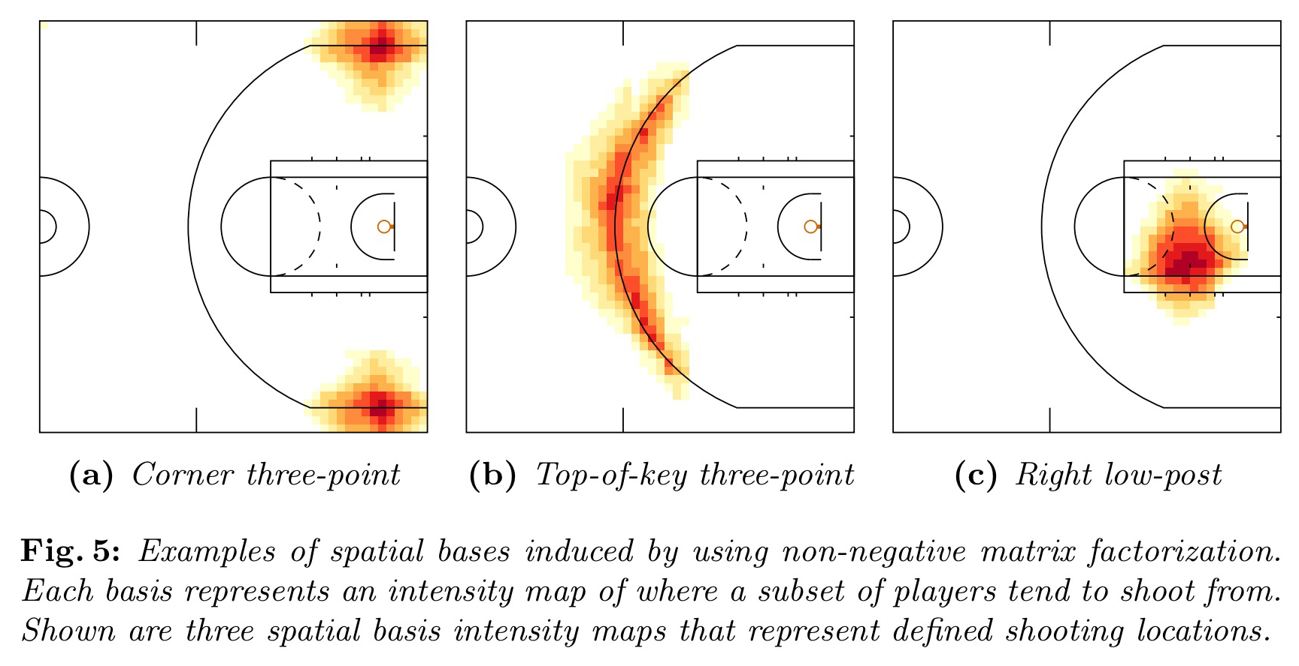
Gudmundsson, Joachim and Michael Horton. “Spatio-Temporal Analysis of Team Sports - A Survey.” CoRR abs/1602.06994 (2016): n. pag.

Slide 5
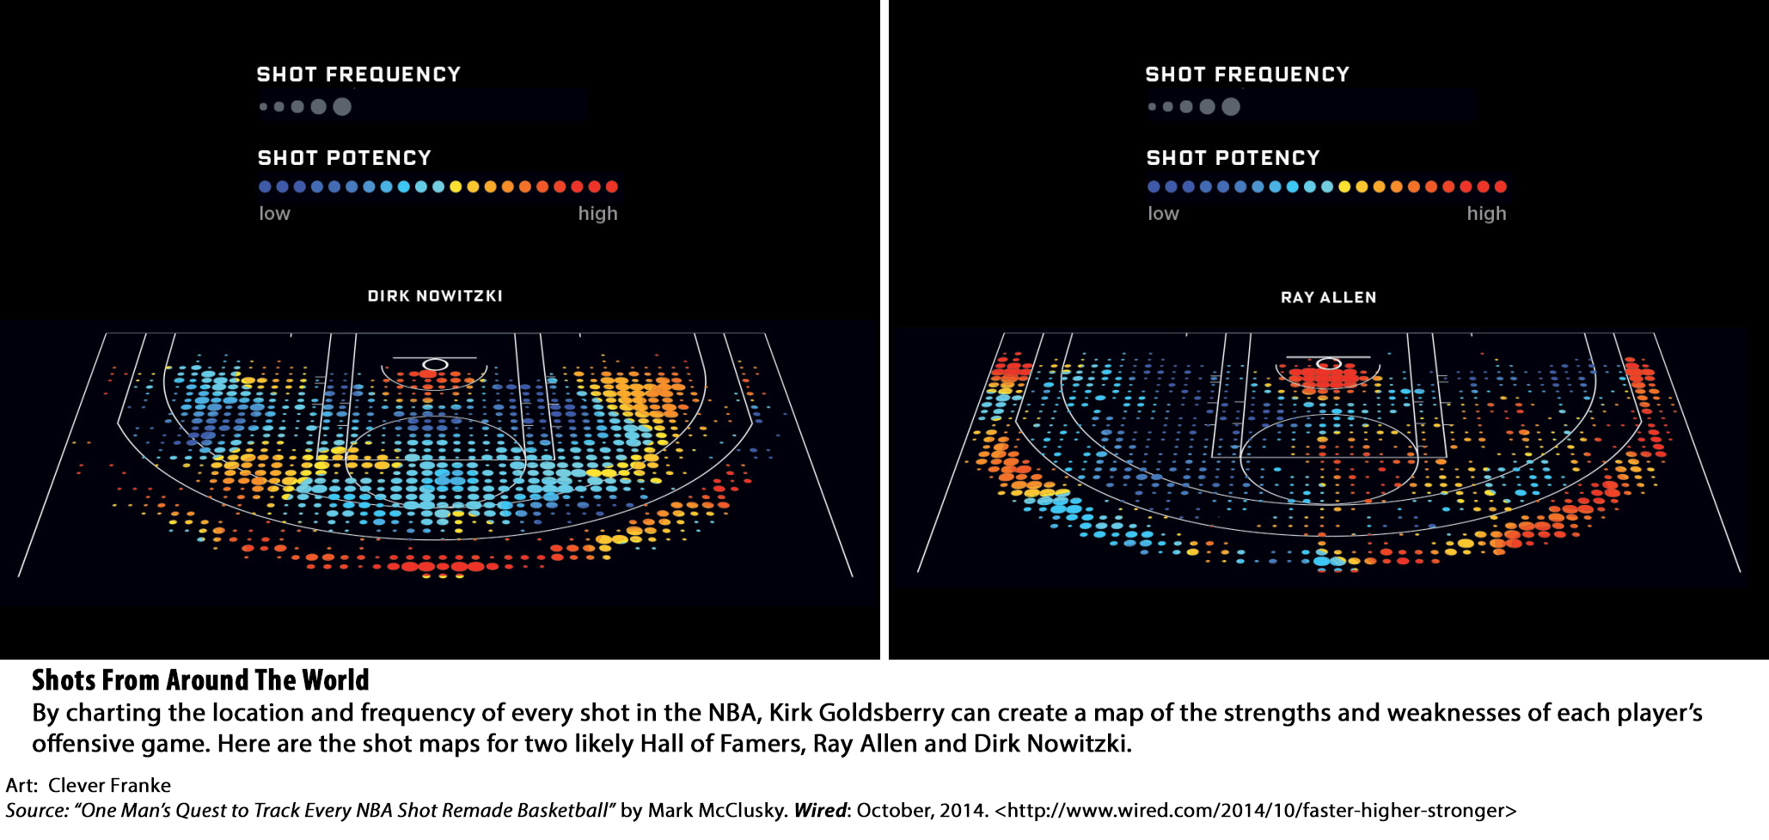

Slide 6
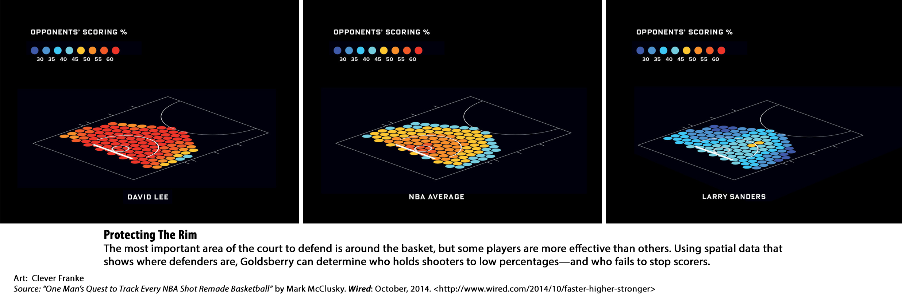

Slide 7
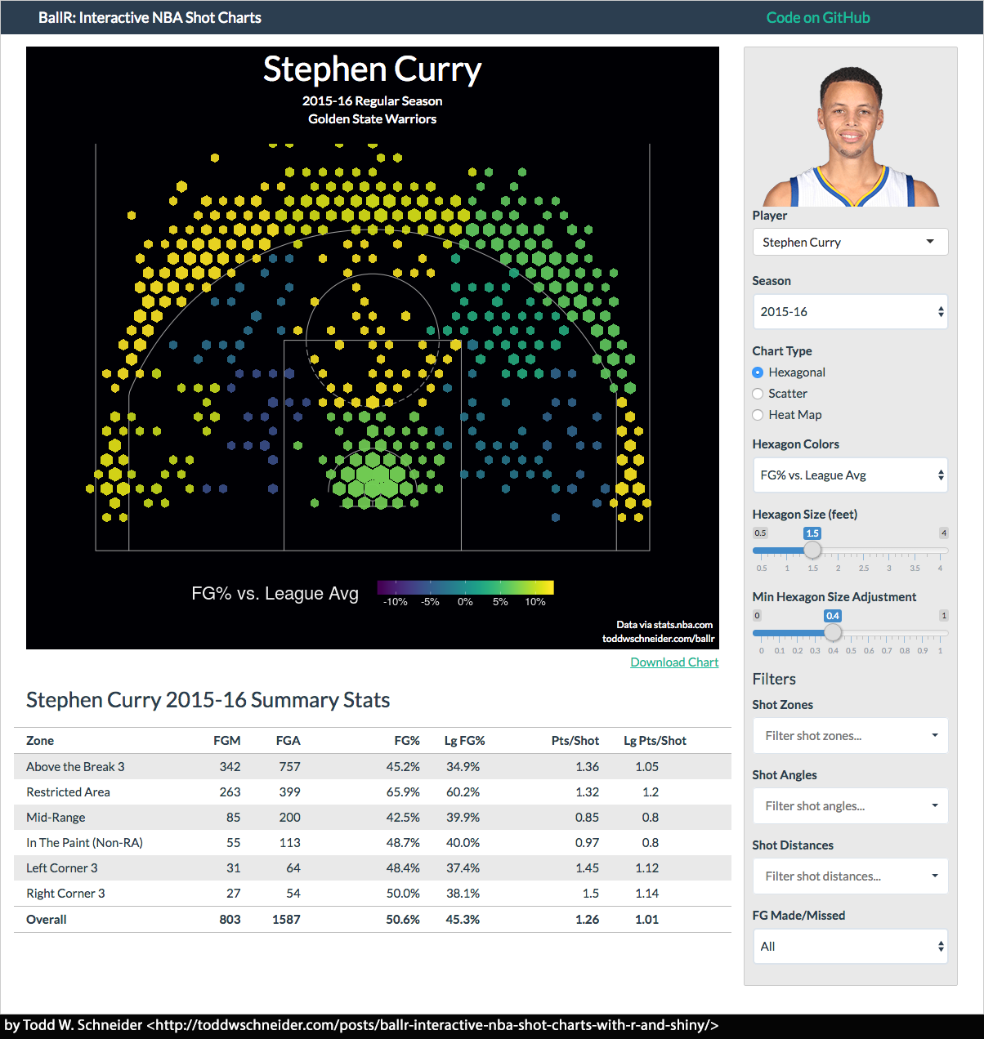

Slide 8
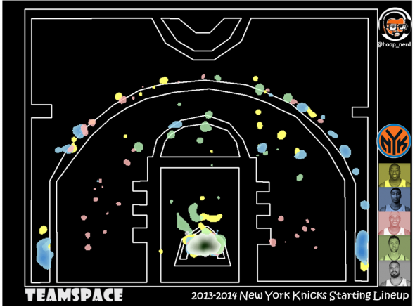
NBA Hunting Grounds: An Introduction to TeamSPACE by Matt D’Anna
“In animal movement theories, a Hunting Ground is an area a predator regularly visits find prey. Applied to principals of law enforcement and crime analysis, a Hunting Ground is an area a serial criminal attacks victims in a regular, patterned, and predictable manner.”
“We can extrapolate from point-based events (attacks/crimes/shots) using kernel densities based on observed mean nearest neighbor distances of each individual’s collection of points across the study area, weighted by success…”
<http://nyloncalculus.com/2014/07/21/nba-hunting-ground-new-york-knicks-introduction-teamspace/>

Slide 9
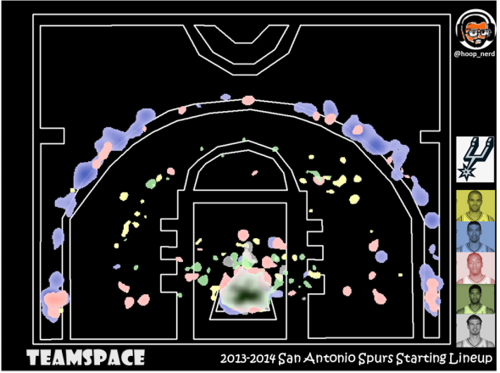
NBA Hunting Grounds: An Introduction to TeamSPACE by Matt D’Anna
“So what? The point is this — if we render the Hunting Grounds for a given lineup on the court at the same time, a successful team should exhibit little-to-no overlap; a rainbow of unique color across the court (the past two San Antonio Spurs teams come to mind). Less successful teams/lineups should experience chronic overlap and/or a general lack of activity; anecdotally this is the 2013-2014 Detroit Pistons (The Josh Smith Experience).”
<http://nyloncalculus.com/2014/07/21/nba-hunting-ground-new-york-knicks-introduction-teamspace/>

Slide 10
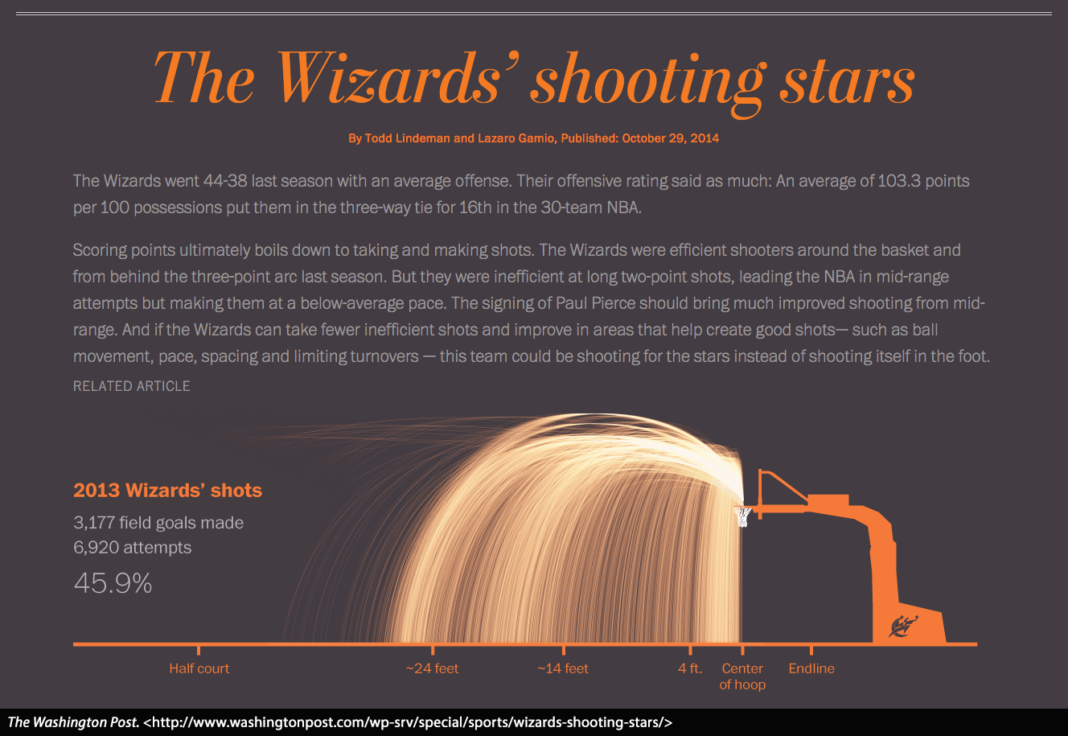

Slide 11
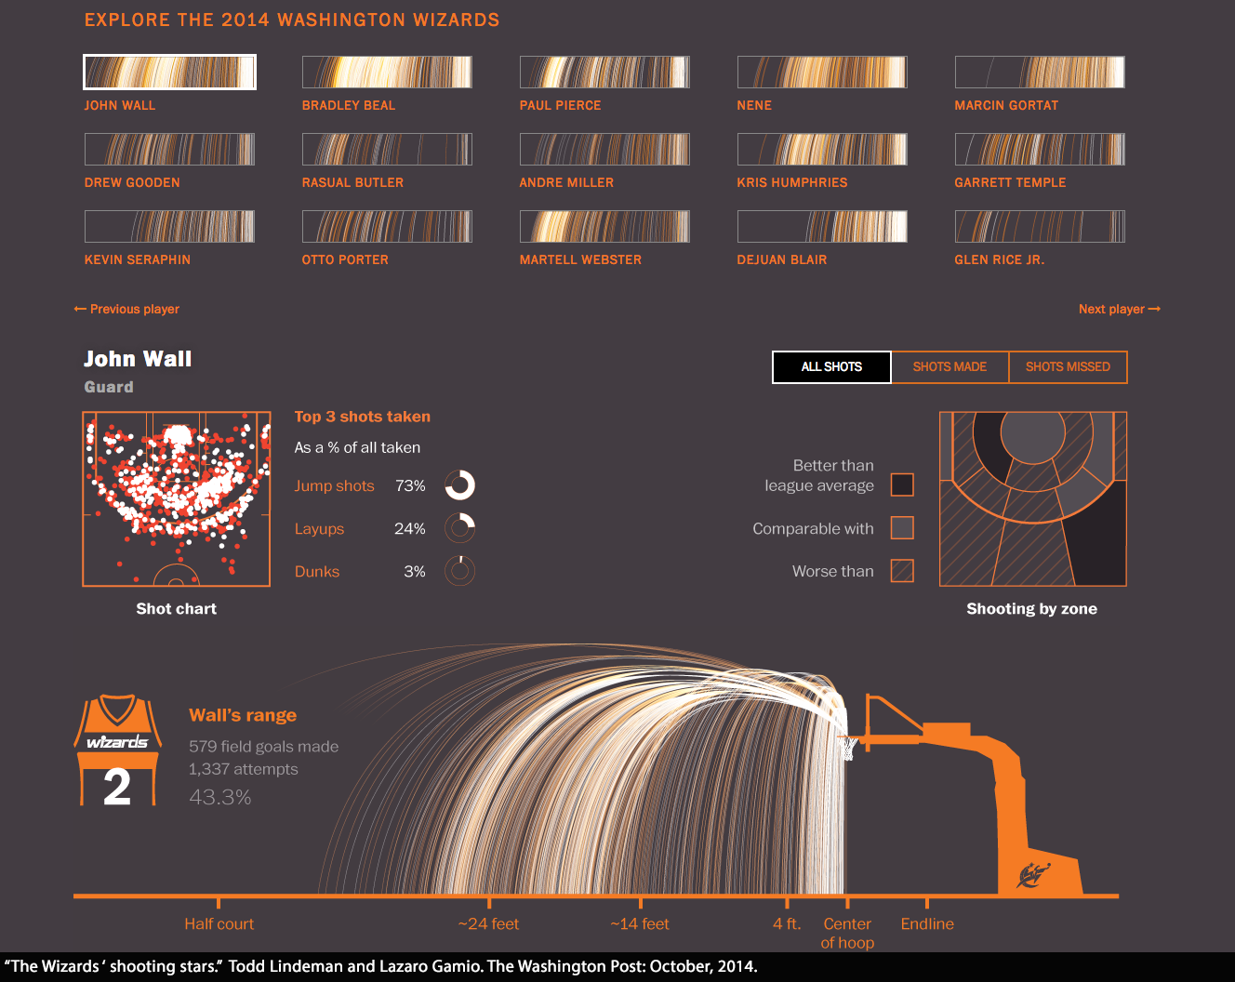

Slide 12
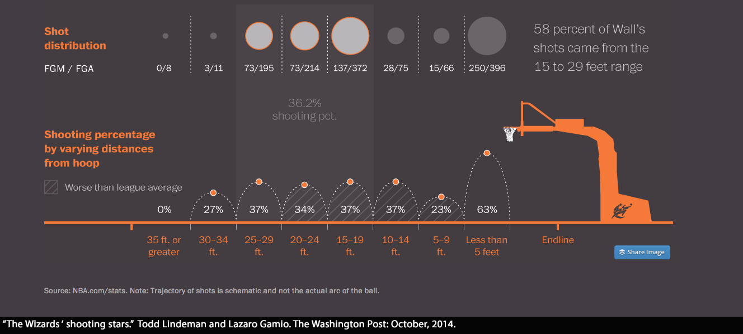

Slide 13
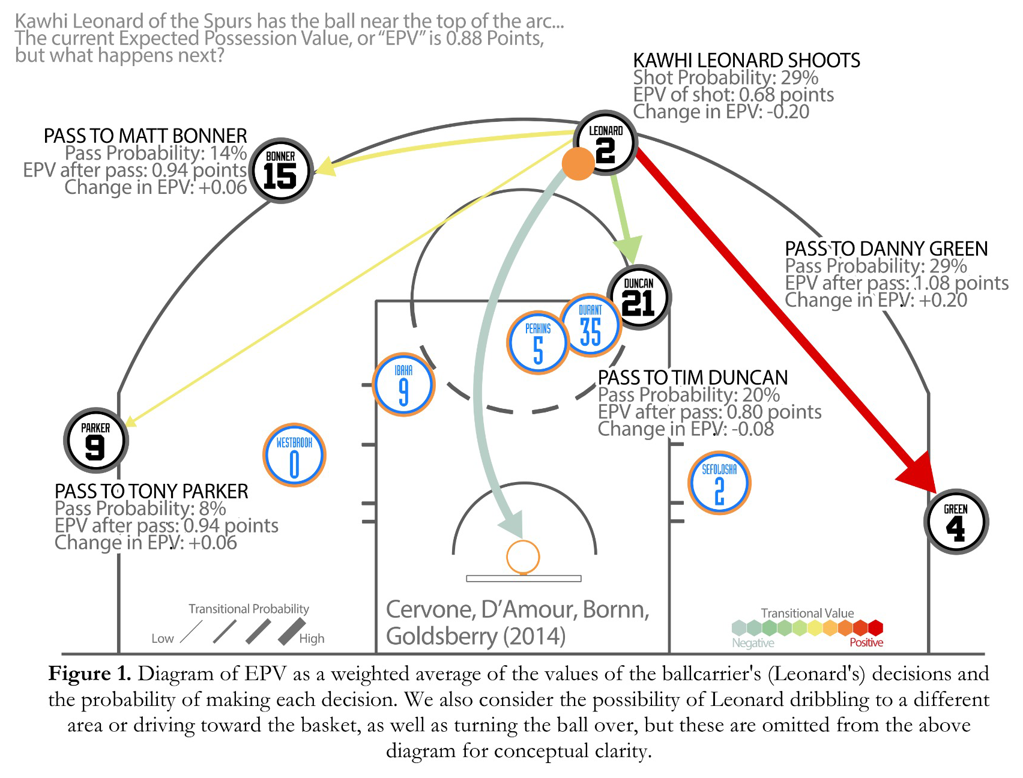
Cervone, D., D’Amour, A., Bornn, L., & Goldsberry, K. (2014). POINTWISE: Predicting Points and Valuing Decisions in Real Time with NBA Optical Tracking Data. Sloan Sports Analytics Conference, 1–9.

Slide 14
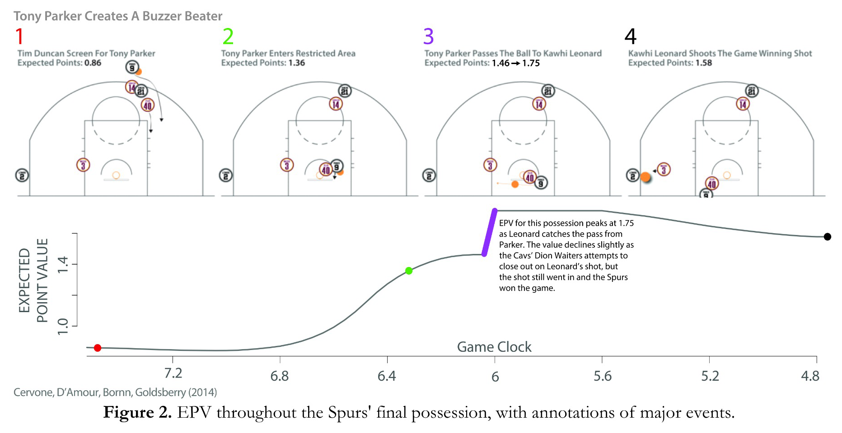
Cervone, D., D’Amour, A., Bornn, L., & Goldsberry, K. (2014). POINTWISE: Predicting Points and Valuing Decisions in Real Time with NBA Optical Tracking Data. Sloan Sports Analytics Conference, 1–9.

Slide 15
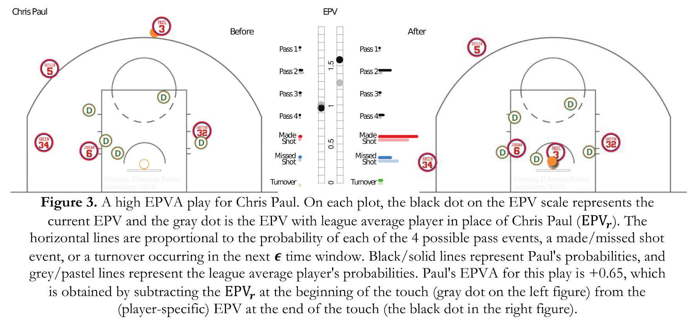
Cervone, D., D’Amour, A., Bornn, L., & Goldsberry, K. (2014). POINTWISE: Predicting Points and Valuing Decisions in Real Time with NBA Optical Tracking Data. Sloan Sports Analytics Conference, 1–9.

Slide 16
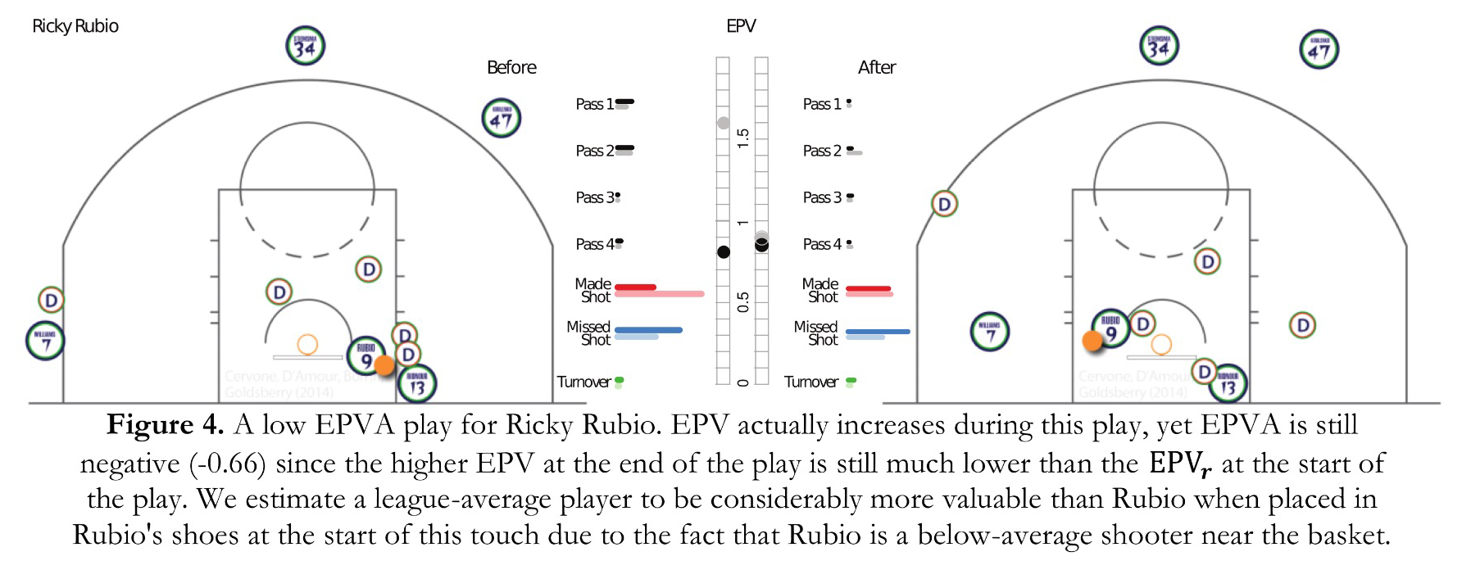
Cervone, D., D’Amour, A., Bornn, L., & Goldsberry, K. (2014). POINTWISE: Predicting Points and Valuing Decisions in Real Time with NBA Optical Tracking Data. Sloan Sports Analytics Conference, 1–9.

Slide 17
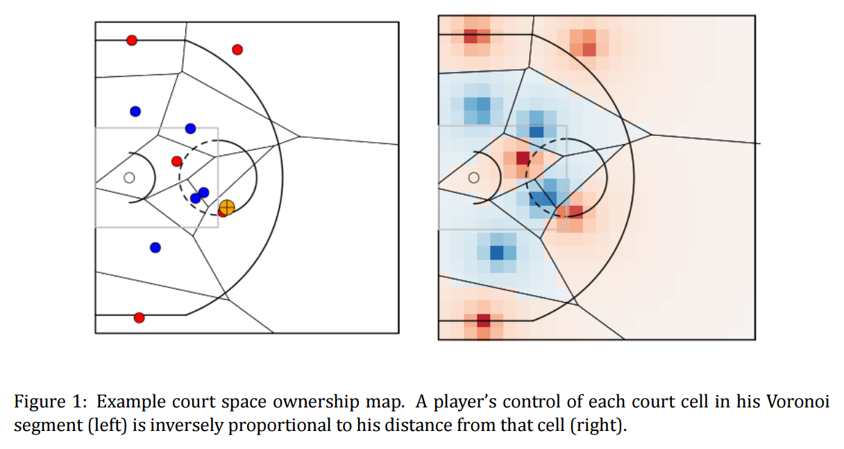
Cervone, D., Bornn, L., & Goldsberry, K. (2016). NBA Court Realty Intro: the Basketball Court is a Real Estate Market. In MIT Sloan Sports Analytics Conference (pp. 1–8).

Slide 18
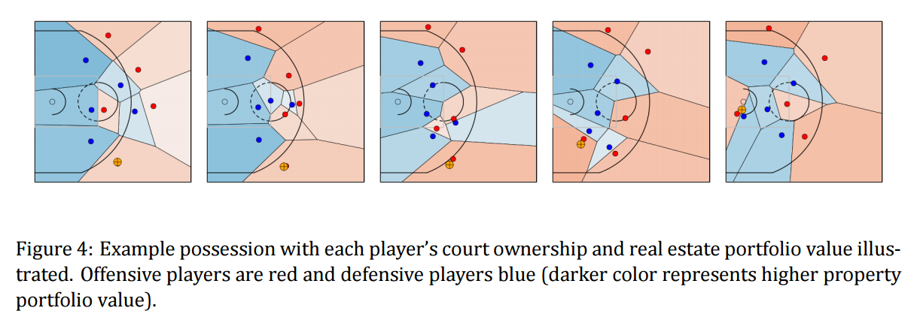
Cervone, D., Bornn, L., & Goldsberry, K. (2016). NBA Court Realty Intro: the Basketball Court is a Real Estate Market. In MIT Sloan Sports Analytics Conference (pp. 1–8).

Slide 19
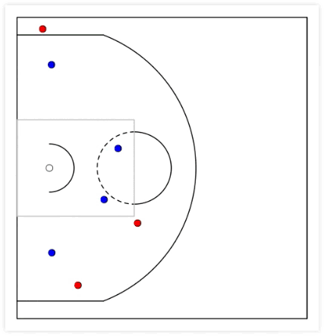
NBA Court Realty
Dan Cervone
September 26, 2015
NESSIS 2015
Work in collaboration with:
Luke Bornn, Alex D'Amour, Alex Franks, Kirk Goldsberry, Andrew Miller
<http://dcervone.com/slides/court_realty.html>

Slide 20
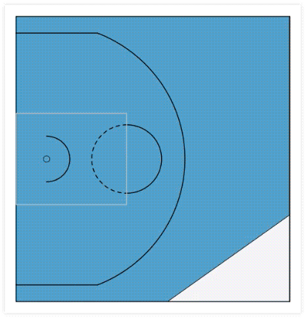
NBA Court Realty
Dan Cervone
September 26, 2015
NESSIS 2015
Work in collaboration with:
Luke Bornn, Alex D'Amour, Alex Franks, Kirk Goldsberry, Andrew Miller
<http://dcervone.com/slides/court_realty.html>

Slide 21
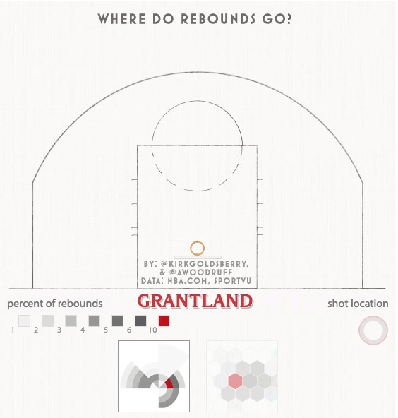

Slide 22
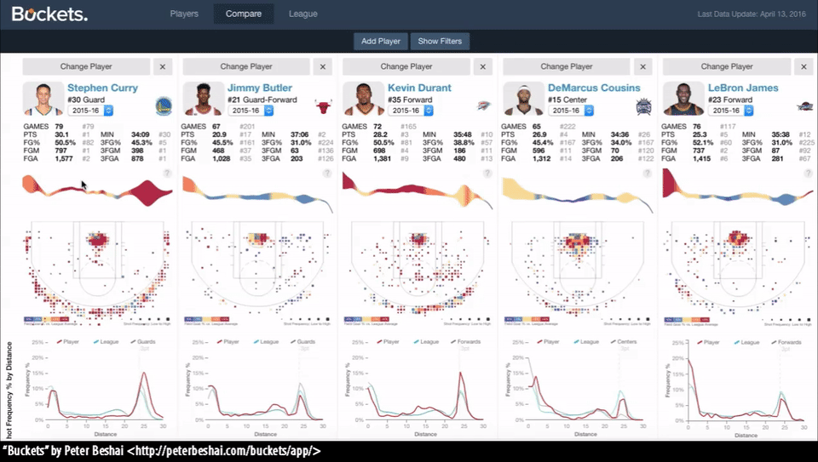

Slide 23
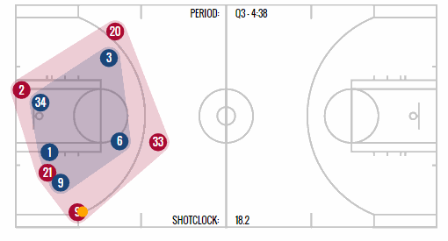
Spurs (red) vs. Heat (blue) – Game 4, 2014 NBA Finals.
<http://stats.nba.com/featured/movement_animations_2014_10_27.html>

Slide 24
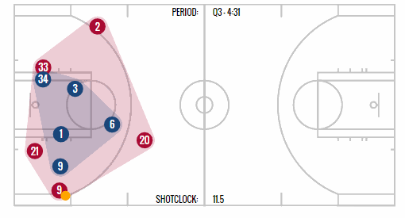
Spurs (red) vs. Heat (blue) – Game 4, 2014 NBA Finals.
<http://stats.nba.com/featured/movement_animations_2014_10_27.html>

Slide 25
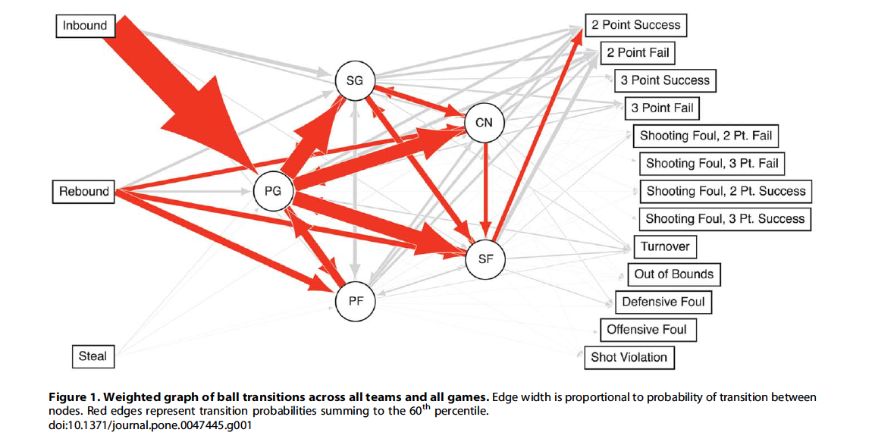
Fewell, J. H., Armbruster, D., Ingraham, J., Petersen, A., & Waters, J. S. (2012). Basketball Teams as Strategic Networks. PLoS ONE, 7(11). http://doi.org/10.1371/journal.pone.0047445

Slide 26
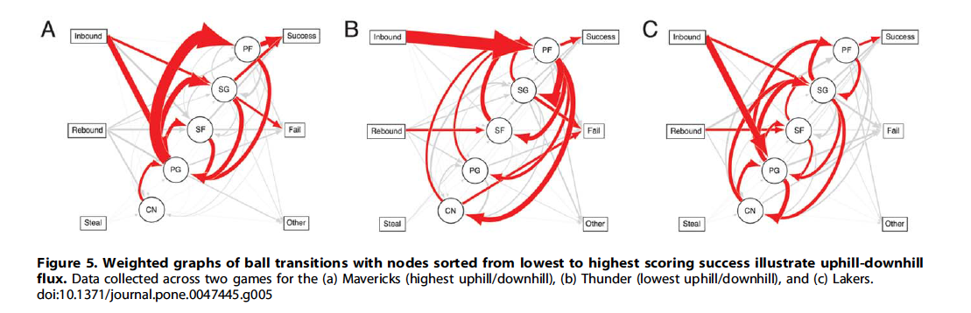
Fewell, J. H., Armbruster, D., Ingraham, J., Petersen, A., & Waters, J. S. (2012). Basketball Teams as Strategic Networks. PLoS ONE, 7(11). http://doi.org/10.1371/journal.pone.0047445

Slide 27
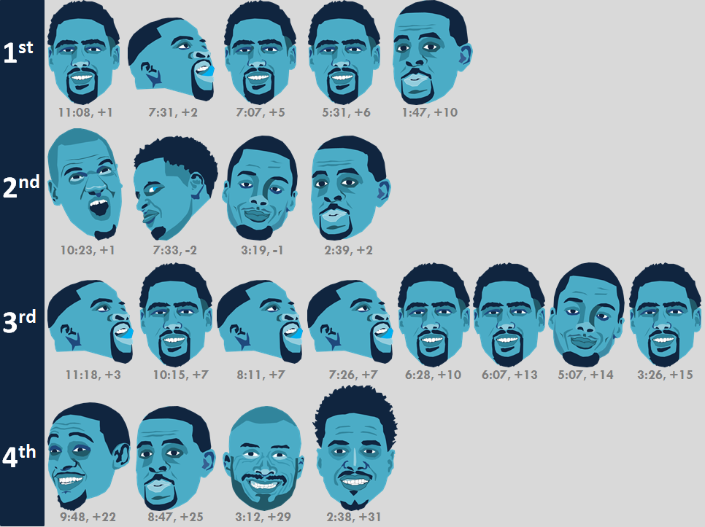
Introducing the Graphic Box Score
By Todd Whitehead (aka @CrumpledJumper)
https://crumpledpaperjumper.com/2016/04/25/introducing-the-graphic-box-score/

Slide 28
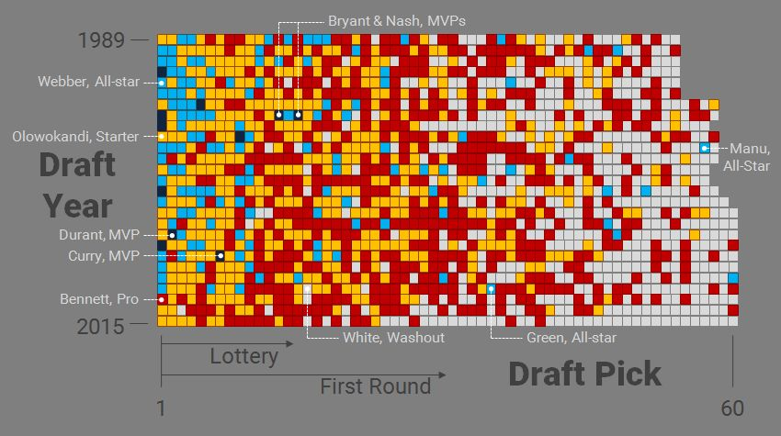
HOW FREE AGENCY CHANGED NBA TEAM BUILDING
Or how Tom Chambers invented super-teams and ruined the NBA
by Todd Whitehead
http://fansided.com/2016/09/07/free-agency-changed-nba-team-building/

Slide 29
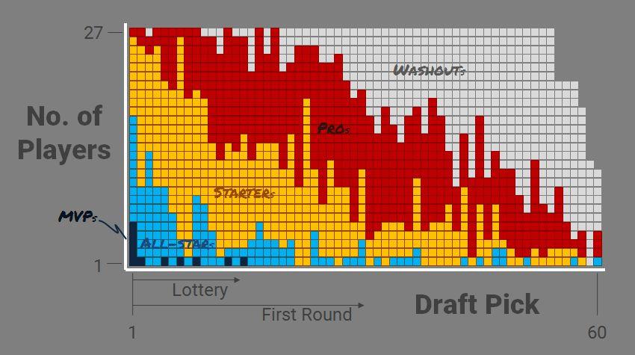
HOW FREE AGENCY CHANGED NBA TEAM BUILDING
Or how Tom Chambers invented super-teams and ruined the NBA
by Todd Whitehead
http://fansided.com/2016/09/07/free-agency-changed-nba-team-building/

