Slide 1

SPECIALIZED TRACKING
Finding new ways to optimize performance

Slide 2
ESTABLISHED PRINCIPLES OF SUCCESS
PUCK POSSESSION
SHOT GENERATION
SHOT SUPPRESSION

Slide 3
PROGRESSIVE APPROACH
SHOT SUPPRESSION
TRANSITION
SHOT GENERATION
TRANSITION

Slide 4
MICROSTATS
OFFENSIVE
DEFENSIVE
Neutral Zone
Passing
Puck Retrieval
Touches – Passing, Puck Battles
Turnovers
Turnovers
Defensive Zone Exit
Traditional Metrics
Traditional Metrics
Turnovers
Offensive Zone Entry
Touches – Passing, Puck Battles
Defenseman Targeted
Forward Assist
Game Situation
TRANSITION

Slide 5
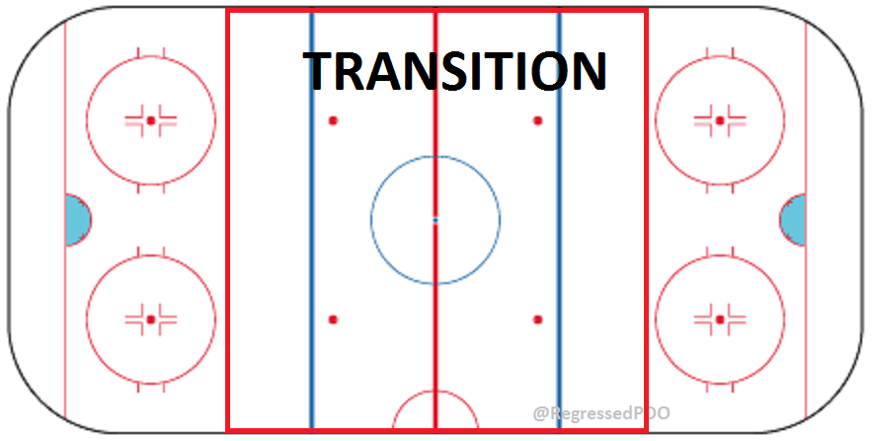
TRANSITION METRICS
OFFENSIVE ZONE ENTRY
DEFENSIVE ZONE EXIT
TARGETED DEFENSEMEN
FORWARD ASSIST
PASSING
TURNOVERS
TRADITIONAL METRICS
GAME SITUATION

Slide 6
PLAYER EVALUATION
SCORER
HIGH SCORER
OFFENSIVELY CREATIVE
POSSESSION DRIVER
-TEAM EFFECTS
SUPPRESSES SHOTS
GENERATES SHOTS

Slide 7
TRACKING
ESTABLISHED ANALYTICS PRINCIPLES
KNOWLEDGE OF HOCKEY SYSTEMS
INTUITIVE DEVELOPMENT OF NEW TRACKING METHODS

Slide 8
SKILL SET TRACKING
FORWARD SKILL SETS
  FINDS SOFT AREAS OF COVERAGE
  PLAYMAKER, CREATES CHANCES
  SPEED
  CREATIVITY
  PUCK HANDLING
  PASSING
  SKATING & AGILITY
  PHYSICALITY
  FORCES TURNOVERS
  “SNIPER”

Slide 9
RESULTS
ALL-AROUND
DIY’ERS
FINISHERS
FOUNDATIONAL PLAYERS TO AN ORGANIZATION
PLAYMAKERS
SHOT GENERATION
SHOT SUPPRESSION
BUILDING BLOCKS OF SCORING LINES
DYNAMIC SCORERS
OPPORTUNISTS
RUSH SCORERS
TURNOVER CREATORS
SNIPERS
FIND SOFT AREAS IN COVERAGE
DECEIVE DEFENDERS
ACCURACY

Slide 10
TYPES OF FORWARDS
ALL AROUND
FINISHER
DO IT YOURSELF’ER

Slide 11
ARTEM ANISIMOV | MIKHAIL GRABOVSKI | GABRIEL LANDESKOG | TYLER SEGUIN
JAMIE BENN | TAYLOR HALL | EVGENI MALKIN | JEFF SKINNER
PATRICE BERGERON | ADAM HENRIQUE | SEAN MONAHAN | JASON SPEZZA
NICK BJUGSTAD | JONATHAN HUBERDEAU | RICK NASH | MARTIN ST. LOUIS
RYAN CALLAHAN | JIRI HUDLER | JAMES NEAL | ERIC STAAL
JEFF CARTER | JAROME IGINLA | RYAN NUGENT-HOPKINS | STEVEN STAMKOS
LOGAN COUTURE | RYAN JOHANSEN | GUSTAV NYQUIST | DEREK STEPAN
SIDNEY CROSBY | MARCUS JOHANSSON | KYLE OKPOSO | VLADIMIR TARASENKO
PAVEL DATSYUK | TYLER JOHNSON | ALEX OVECHKIN | JOHN TAVARES
MATT DUCHENE | EVANDER KANE | MAX PACIORETTY | JOE THORNON
JORDAN EBERLE | PATRICK KANE | ZACH PARISE | JIRI TLUSTY
FILIP FORSBERG | RYAN KESLER | DAVID PERRON | JONATHAN TOEWS
MARIAN GABORIK | PHIL KESSEL | COREY PERRY | KYLE TURRIS
ALEX GALCHENYUK | ANZE KOPITAR | JASON POMINVILLE | JAMES VAN RIEMSDYK
JOHNNY GAUDREAU | DAVID KREJCI | BOBBY RYAN | THOMAS VANEK
RYAN GETZLAF | ANDREW LADD | JADEN SCHWARTZ | ANTOINE VERMETTE
ZEMGUS GIRGENSONS | JORI LEHTERA | DANIEL SEDIN | JAKUB VORACEK
CLAUDE GIROUX | MILAN LUCIC | HENRIK SEDIN | BLAKE WHEELER
 |  |  | HENRIK ZETTERBERG

Slide 12
Zone Time & Player Possession Time
ZONE TIME
  Under 00:03.5: Breakaway, Usually 1 Player With Possession From Blue Line To Goal
  00:03.5-00:04.5: Oddman Rush, 1 Pass/Shot Prior To Goal
  00:04.5-00:06.0: Oddman Rush, +1 Passes/Shots Prior to Goal
  00:07.0+: Multiple Passes/Shots, Higher Zone Time = Cycle
POSSESSION TIME
  00:00.4 – 00:00.5: One Timer, Deflection, Tip-In
  00:00.6-00:00.8: Toe Drag, Receive/Settle Puck, Backhand to Forehand
  00:00.9-00:01.1: Wrap-Around, Quick Move, Aim
  00:01.2-00:01.5: Shake Off Coverage, Aim
  00:01.5+: Picking Spot, Moving To Slot

Slide 13
Zone Time

Slide 14
2012-2013 GOALS
GRABOVSKI
O

Slide 15
2013-14 GOALS
O

Slide 16
2014-15 GOALS

Slide 17
ZONE TIME

Slide 18
GOALS VS ASSISTS

Slide 19
RESULTS
ALL AROUND
CROSBY
TOEWS
BERGERON
TAVARES
DATSYUK
KOPITAR
DIY’ERS
NYQUIST
DUCHENE
TARASENKO
HALL
KANE E.
SKINNER
FINISHERS
LEHTERA
SEDIN H.
SEDIN D.
PARISE
KESLER
ST. LOUIS
JOHNSON
TLUSTY
GIROUX

Slide 20
FUN STUFF
HIGHEST ZONE TIME:
  ASSIST: TYLER JOHNSON 2/1/14 T.B v NYR 02:26.4
  GOAL: ANDREW LADD 1/31/15 WPG v DAL 01:26.0
HIGHEST POSSESSION TIME:
  GOAL: GUS NYQUIST 12/27/14 DET v OTT 00:28.6
HIGHEST # OF PASSES PRIOR TO GOAL: 16
  TURRIS (G), STAAL E. (G), DUCHENE (A), HALL (A)
HIGHEST # OF SHOTS PRIOR TO GOAL: 8
  DUCHENE (G & A)
HIGHEST # OF PASSES BY PLAYER: 5
  DATSYUK, JOHANSSON
HIGHEST # OF SHOTS BY PLAYER: 3
  KESSEL, TURRIS (X2), STEPAN, TAVARES, OVECHKIN, GETZLAF, COUTURE

Slide 21
POSSESSION TIME - GOALS
00:00.4-00:00.5
VANEK 81% S T. LOUIS (75%)
JOHANSEN 20% SKINNER 22%
00:00.6-00:00.8
GAUDREAU 31% SEDIN H. 29%
JOHNSON (0%) PACIORETTY (2%)
00:00.9-00:01.1
THORNTON (18%) NYQUIST, STAAL E., TAVARES,GAUDREAU (13%)
VANEK, ZETTERBERG,GIRGENSONS,FORSBERG,LADD,KANE E. (0%)
00:01.2-00:01.5
LEHTERA (18%) KESLER (14%)
KANE E., GIRGENSONS, VANEK,VERMETTE,SEDIN H.,TLUSTY,HUBERDEAU,LUCIC, HALL, GAUDREAU (0%)
00:01.6-00:02.0
GIROUX (17%) OKPOSO, JOHANSEN (16%)
LEHTERA, ZETTERBERG,MONAHAN,GRABOVSKI,SEDIN H., HENRIQUE (0%)
00:02.0-00:04.0
NASH (37%) KANE E. (36%) CROSBY, NYQUIST (32%)
SEDIN H., LEHTERA (0%) LUCIC (4%)
00:04.0+
GRABOVSKI (11%) BJUGSTAD (10%)
NASH, TOEWS (1%) SCHWARTZ, JOHANSEN, KOPITAR, MALKIN, BERGERON, TARASENKO, KESSEL, STAMKOS, PACIORETTY (2%)

Slide 22
HIGHS AND LOWS
OZ PASSES PER ASSIST
SEDIN H. 4.22 (14-15)
ANISIMOV 3.76 (14-15)
PLAYER PASSES PER ASSIST
SEDIN H. 1.88 (14-15)
HALL 1.66
OZ PASSES PER GOAL
NUGENT-HOPKINS
NYQUIST 0.75 (12-13)
MONAHAN 0.625 (13-14)
(12-13)
LANDESKOG
THORNTON
SEDIN D.
SEDIN H.

Slide 23
IMPORTANT
GUS NYQUIST DOESN’T NEED YOUR PASSES OR YOUR ASSISTS
MALKIN, SKINNER, DATSYUK, PERRY AND BJUGSTAD DON’T NEED YOUR ASSISTS EITHER

Slide 24

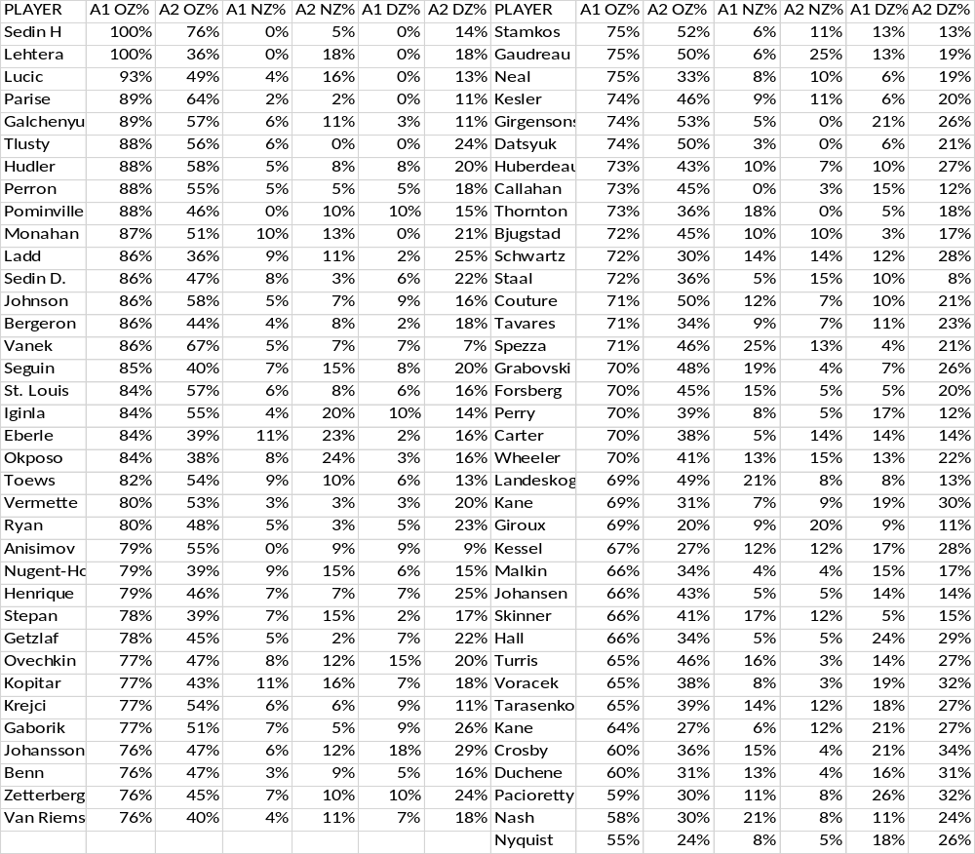

Slide 27
THANK YOU SO MUCH!
The wonderful volunteers who donated their time to help with this project. (YOU’RE THE BEST!!!)
RIT and the organizers for hosting

