Slide 1
MoneyPuck: Player Valuation, Team Spending & Predicting Value
Carolyn Wilke
Salary Nerd

Slide 2
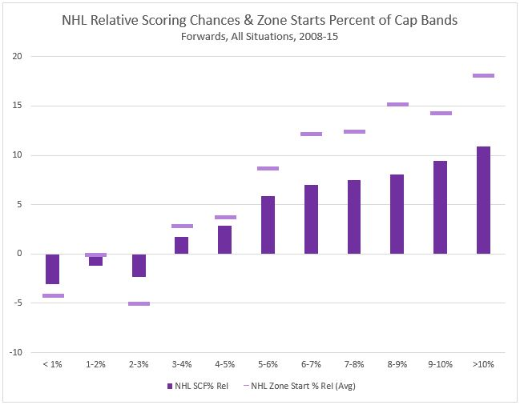
Salary Bands: A Starting Point
All data used is from 2008-2015
  All Situation, Score Adjusted, only players over 500 minutes per season
  Courtesy of War-on-Ice
Assumptions
  Bad deals are the exception, not the norm
  Salary inflation is real
    Use Percent of Cap instead
Must evaluate players versus their peer group
  TOI%, Points/60, Zone Start % Rel all rise along with % of Cap

Slide 3
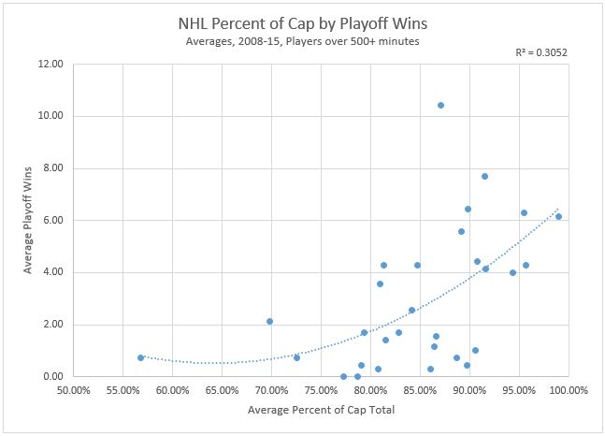
Does Salary Relate to Success?
Add up “Percent of Cap Spending” for each team over the last 7 seasons
  Will NOT equal 100%, does double count in-season trades
  NHL Average: 84.74%
Clear Top 6 & Bottom 6 in Playoff Wins
  Avg playoff wins/year
    Top 6 = 7.1
    Bottom 6 = 0.24
  Avg Percent of Cap Spending
    Top 6 = 92.02%
    Bottom 6 = 81.93%
Also correlates to Regular Season Wins (R^2 = 0.218) and Regular Season Points (R^2 = 0.23)

Slide 4
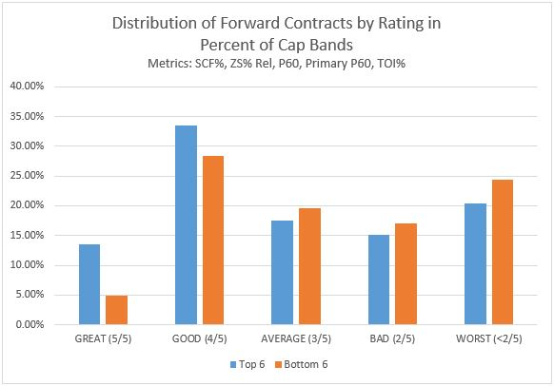
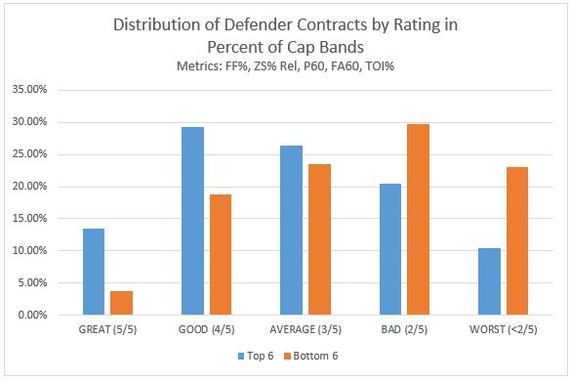
Are the Top 6 Spending Smarter?
Rate every contract year vs their Percent of Cap peers
  Forwards: SCF%, P60, Primary P60, TOI%, ZS% Rel
  Defenders: FF%, FA60, P60, TOI%, ZS% Rel
  Combined some bands due to similar averages (ex: fwds 6-8%)
  Attempted to control for ELCs in the 1-2% band by excluding players 23 & under from these ratings

Slide 5
Finding Top 6 “Spending Best Practices”
Pulled out Trades & UFA signings from the Top 6
Metrics both Career, and year prior to Trade/Signing ONLY up to the date of Trade or Signing
Sample Make Up
  Forwards
    20 “Good” Contracts
      10 lower ZS% Rel than % of Cap Avg, 10 higher
    14 “Bad” Contracts
      10 lower ZS% Rel than % of Cap Avg, 4 higher
  Defenders
    13 “Good” Contracts
      7 lower ZS% Rel than % of Cap Avg, 6 higher
    11 “Bad” Contracts
      8 lower ZS% Rel than % of Cap Avg, 3 higher

Slide 6
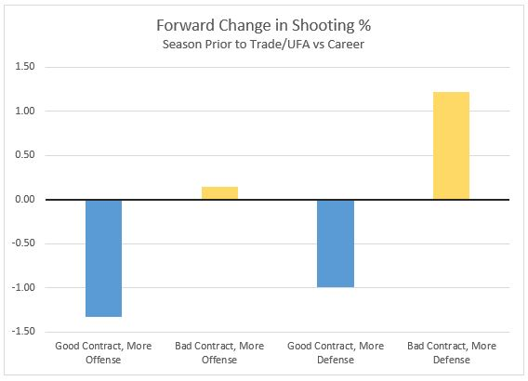
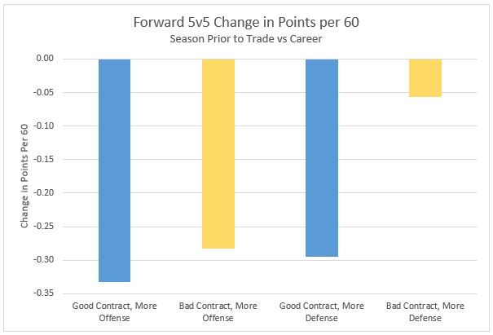
Patterns to Signing “Bad” Contracts: Forwards

Slide 7
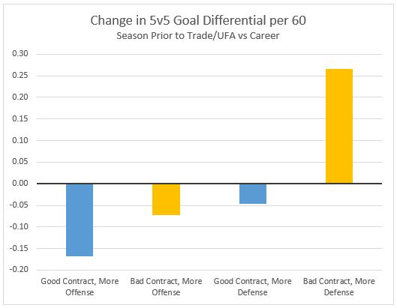
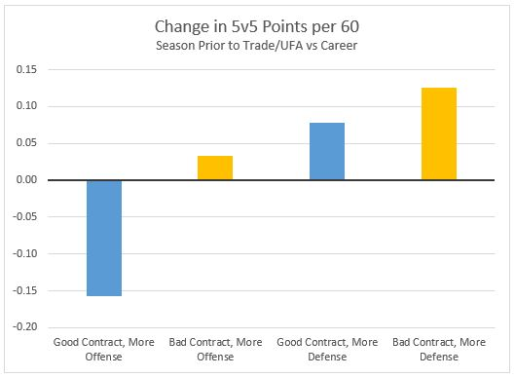
Patterns to Signing “Bad” Contracts: Defenders

Slide 8
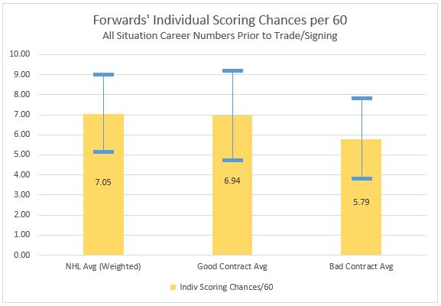
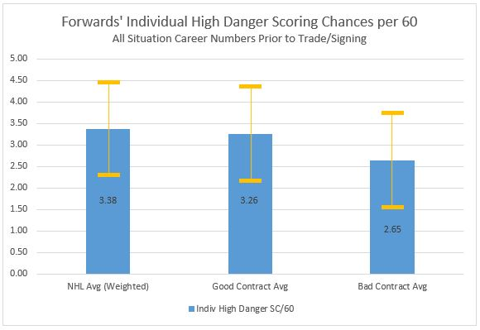
Patterns to Signing “Good” Contracts: Forwards

Slide 9
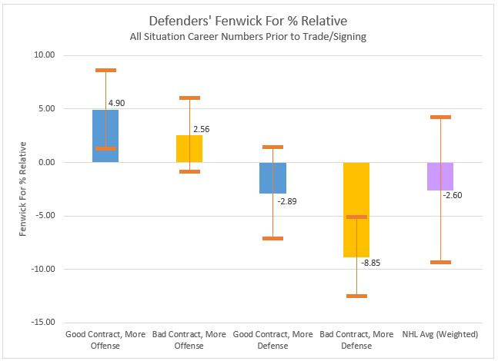
Patterns to Signing “Good” Contracts: Defenders

Slide 10
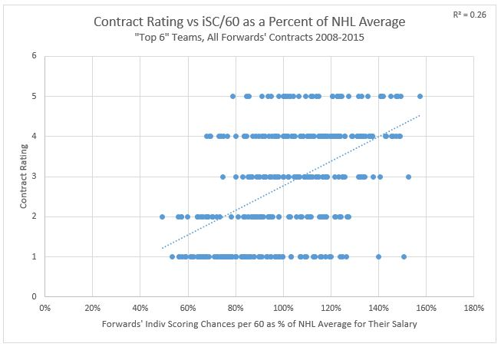
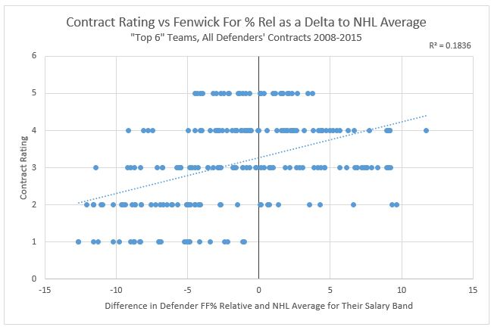
Upping the Sample Size
Forwards
Defenders

Slide 11
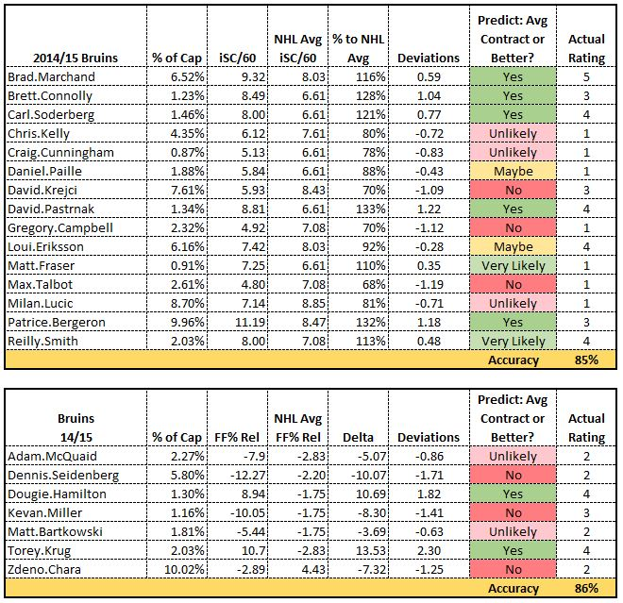
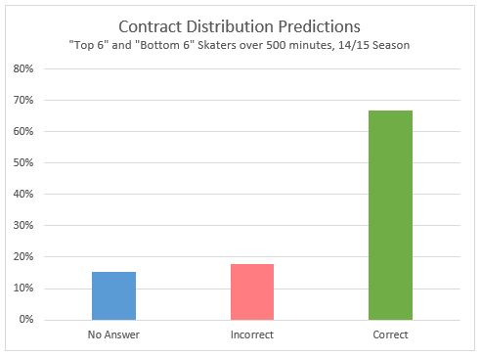
Can We Use this to Predict Contract Efficiency?
Applied a prediction based on the standard deviation from the large sample to each contract from the 12 teams last year
After discarding the “maybes” it returned 80% accuracy

Slide 12
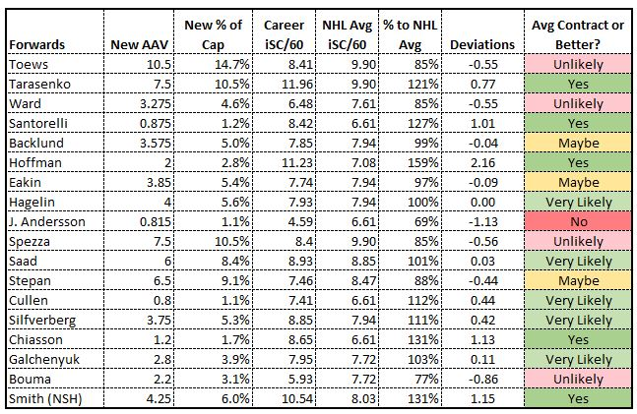
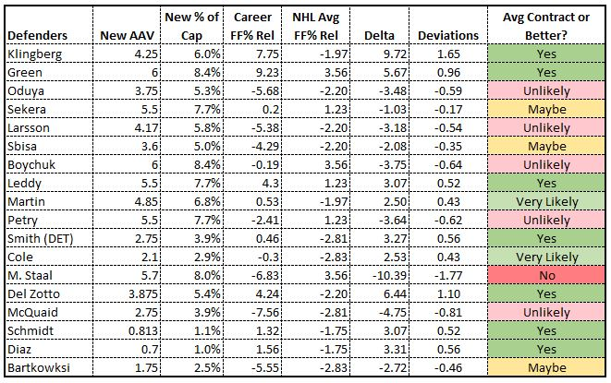
Next Steps
Apply to new contracts to set expectations
Create an “ideal” player profile per % of Cap Band
Goalies ¯\_(ツ)_/¯
Spending shifts over time
  Ex: Uptick in pay of “defensive” forwards

Slide 13
Thank you!
Micah & Asmae for audiencing my presentation
Ryan and The Rochester Institute of Technology for hosting this event

Slide 14
More Fun Stuff

Slide 15
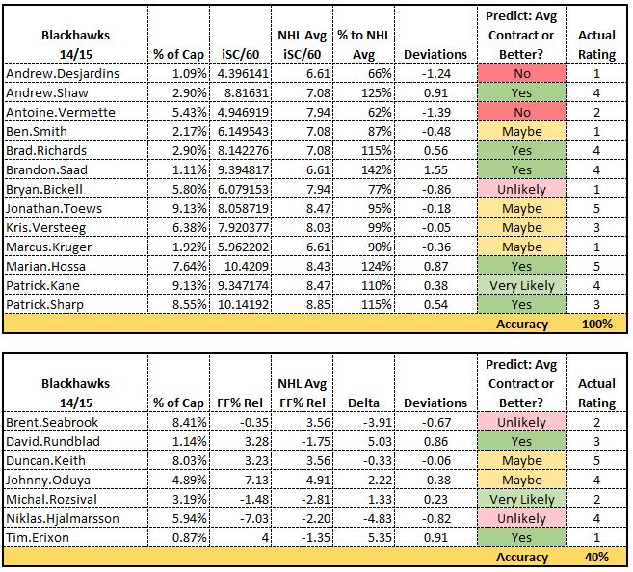

Slide 16
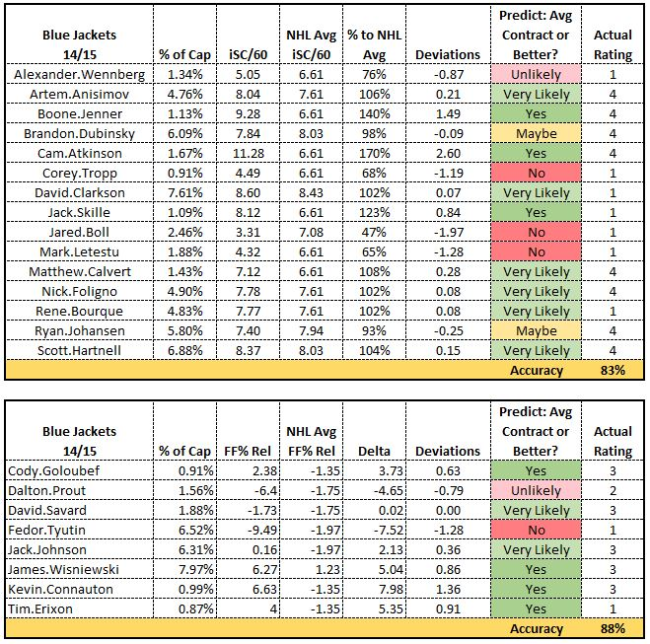

Slide 17
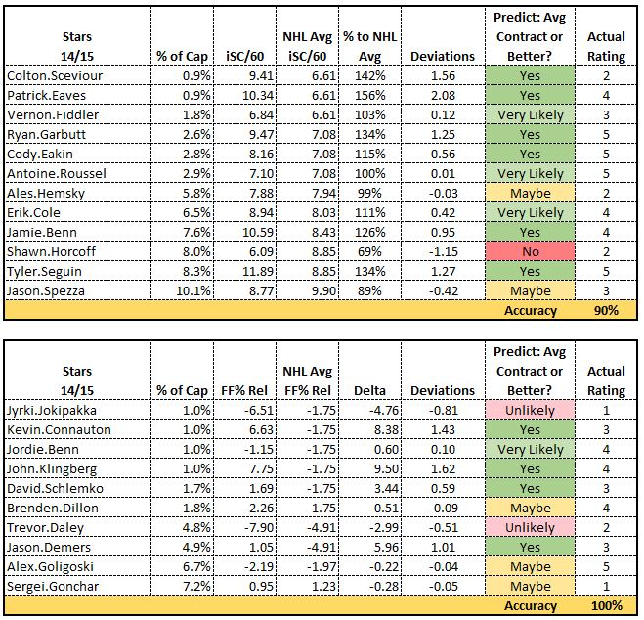

Slide 18
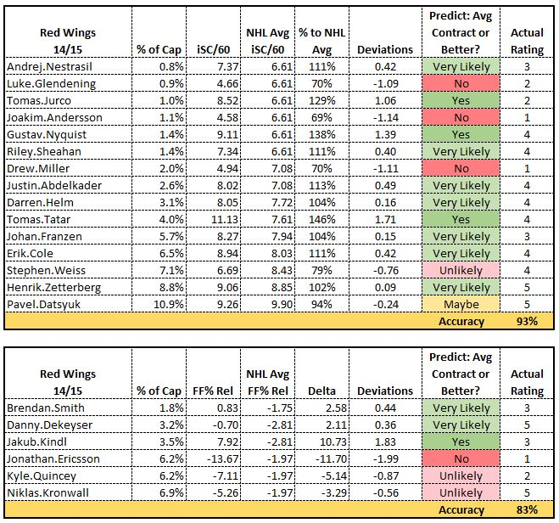

Slide 19
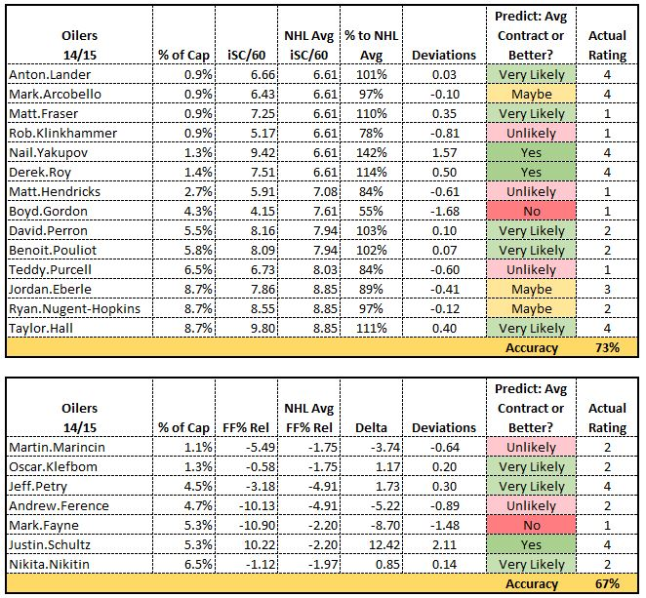

Slide 20
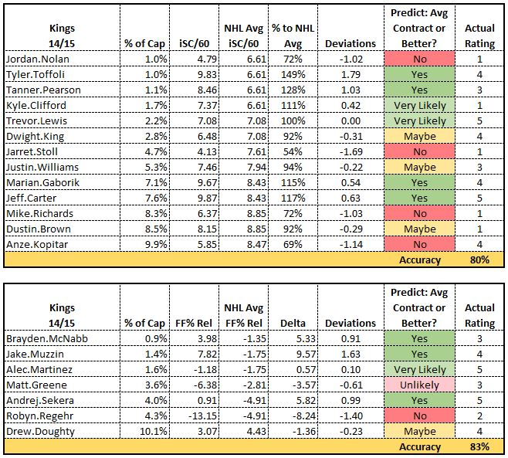

Slide 21
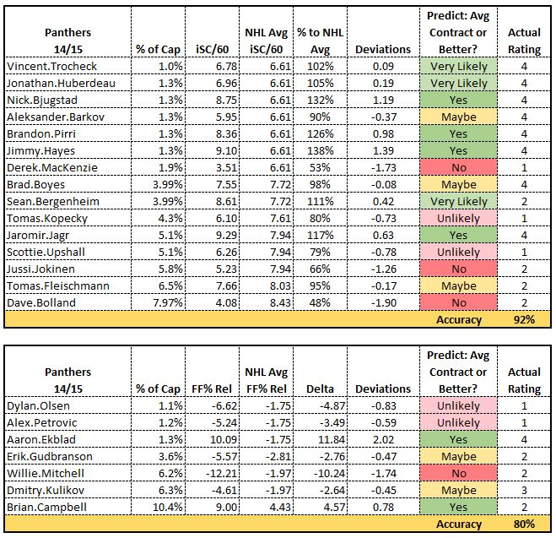

Slide 22
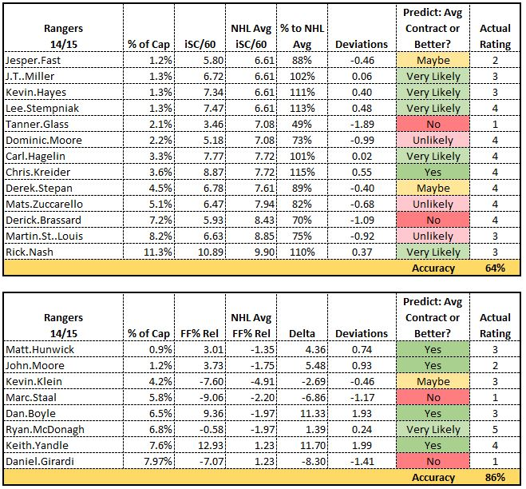

Slide 23
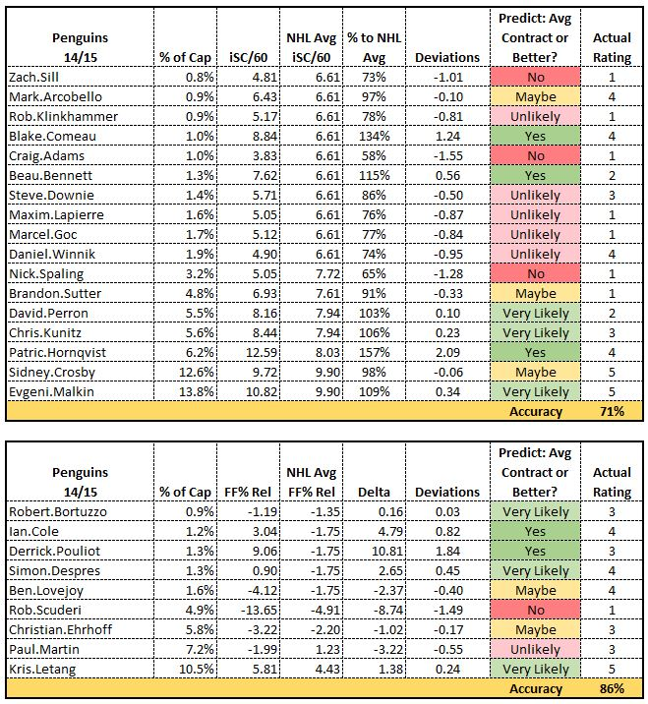

Slide 24
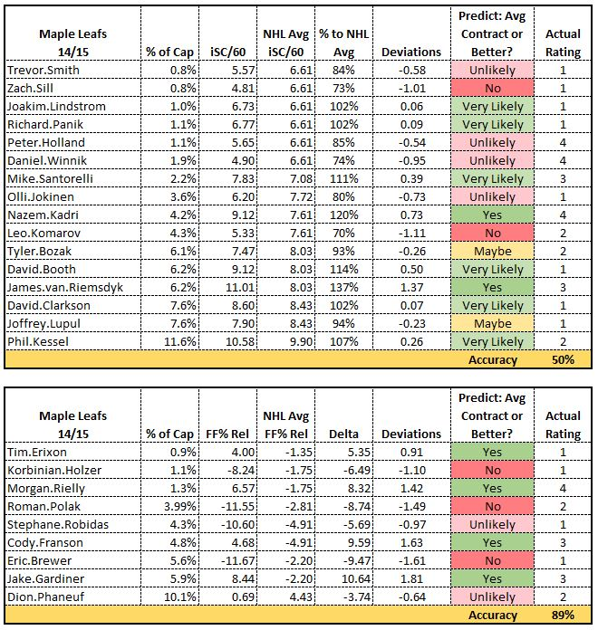

Slide 25
