Slide 1
Passing Networks in Hockey
RIT Analytics Conference 2015
S Burtch
Diagrams and Statistical Analysis

Slide 2
Classical Passing
Influence & Metrics
Originally Hockey was an On-Side game similar to Rugby – only backwards passes were allowed
Transition to allowing forward passes began in 1927-28 in the DZ and NZ.
Forward passing INTO the OZ from the NZ allowed in 1928-29 (but no forward passing once in the OZ).
Forward passing permitted in all zones but not across blue line in 1929-30.
Modern passing standard achieved in 1929-30, awarding of Assists quickly increased.

Slide 3
Assists
Originally credited to the last scoring team player to shoot, pass, deflect or make contact with the puck immediately prior to the goal scorer.
2nd Assists weren’t recorded in the 1920’s but they were being included on score sheets by the 1931-32 season.
In 1945 off-season the NHL made a rule change to restrict awarding of 2nd assists.

Slide 4
Limitations of Assist Data
While 1st and 2nd assists do capture relevant performance data, some have disputed the relative value of them.
Fs are more likely to record 1st assists than D, so excluding 2nd assists likely understates offensive contribution of defenders.
Passing specifically for the purposes of breakouts and zone entry goes unrecorded and is thus ignored.

Slide 5
What Can Be Done?
All Three Zones Project
  (C. Sznajder – 2014-15)
  Recording of all Zone Entry / Exit touches and passes by skater
The Passing Project
  (R. Stimson et al – 2014-15)
  Recording of shot attempt primary and secondary assists by skater

Slide 6
How do we best Analyze?
Passing Network Suggestion (P. Power of ProZone Sports – 2014)
Built upon research in Social and Neural Networks
Applied to Football (Soccer) as far back as 2010
  S. Sarangi, E. Unlu (2010)
  J.L. Pena, H. Touchette (2012)
Allows visualization and statistical analysis of passing networks and flow.

Slide 7
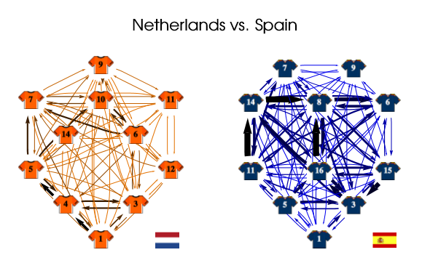
First the Visual
Network Theory and Anaysis of Football Strategies, J.L. Pena – University College London

Slide 8
First the Visual
What Is a Network?
  A collection of nodes (or vertices) that are connected by edges.
  Edges can be directional and/or weighted.
  For our purposes nodes represent skaters / the goal, edges represent passes / shot attempts

Slide 9
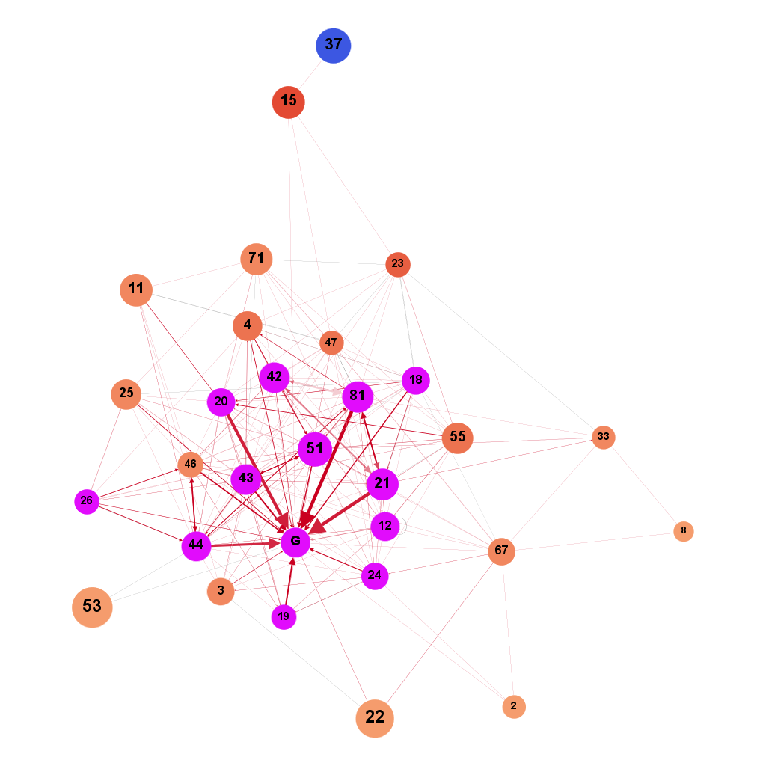
First the Visual
Leafs 5v5 Passing Network for games tracked in 2014-15 as part of The Passing Project.

Slide 10
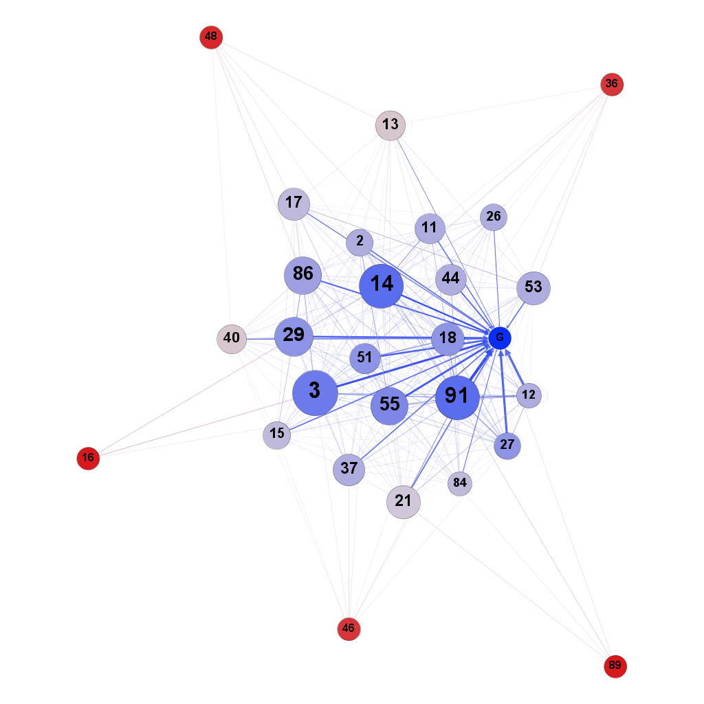
First the Visual
Islanders 5v5 Passing Network for games tracked in 2014-15 as part of The Passing Project.

Slide 11
Now the Statistical
We can use a variety of metrics to assess performance of individual skaters and compare teams
    Centrality Measures
    Clustering
    Degree Measures

Slide 12
Centrality Measures
Closeness Centrality
  Average Path Distance from a node to other nodes in the network

Slide 13
Centrality Measures
Closeness Centrality
  Average Path Distance from a node to other nodes in the network

Slide 14
Centrality Measures
Betweenness Centrality
  How the Network would suffer if a Node is removed
  Popular nodes are linked to other popular nodes
  If these nodes are removed they present a DANGER to the network
  Targets for Opposition?

Slide 15
Centrality Measures
Betweenness Centrality
  How the Network would suffer if a Node is removed
  Popular nodes are linked to other popular nodes
  If these nodes are removed they present a DANGER to the network
  Targets for Opposition?

Slide 16
Centrality Measures
PageRank
  A recursive assessment of value of the node to the Network
  The probability of a pass or shot involving this player within the network

Slide 17
Centrality Measures
PageRank
  A recursive assessment of value of the node to the Network
  The probability of a pass or shot involving this player within the network

Slide 18
Centrality Measures
Eigenvector Centrality
  Description of the central actors within the network structure
  Ignores “Local” patterns

Slide 19
Centrality Measures
Eigenvector Centrality
  Description of the central actors within the network structure
  Ignores “Local” patterns

Slide 20
Clustering within Networks
Clustering Coefficient
  Describes how tightly connected the neighbouring nodes are for every node in the network
  Higher values represent more distinct cliques (groupings / lines / units) within the neighbouring nodes

Slide 21
Clustering within Networks
Clustering Coefficient
  Describes how tightly connected the neighbouring nodes are for every node in the network
  Higher values represent more distinct cliques (groupings / lines / units) within the neighbouring nodes

Slide 22
Comparison of Teams
Average Clustering Coefficient
  NYI = 0.698
  PIT = 0.442
  ANA = 0.442
  TOR = 0.422
Average Path Length
  NYI = 1.439
  PIT = 1.774
  ANA = 1.829
  TOR = 1.987

Slide 23
Limitations / Next Steps
Lack of data
  Full season data sets would be ideal
  Automated tracking would improve data reliability
Broaden Scope
Reliability / Repeatability of Metrics
Assess tactical applications
THANKS TO RIT, Ryan and Matt

