Slide 1

Goalies Are Voodoo.
1

Slide 2
The End.
2

Slide 3
Just kidding.
(kind of)
3

Slide 4
Establishing New Baselines For Goaltender Analysis
2015-16 Predictions
5v5 adjGSAA/60
Application





Cat Photo
Cat Photo



Concept
Predictive Model
Ratings Chart
4

Slide 5
5v5 adjGSAA/60
What is 5v5 adjGSAA/60?

Adjusted for Danger Zone
How many more/fewer goals allowed by Our Hero than if a league average goalie faced the same LD, MD, and HD shot volume?

+/- 60 Minute Rate
League average is 0.

Control For Situation and Environment
5v5; empirical league-wide sh%.
5

Slide 6
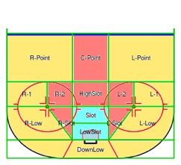
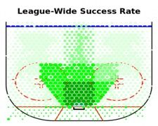
Danger Zones
Peter Mark

Slide 7
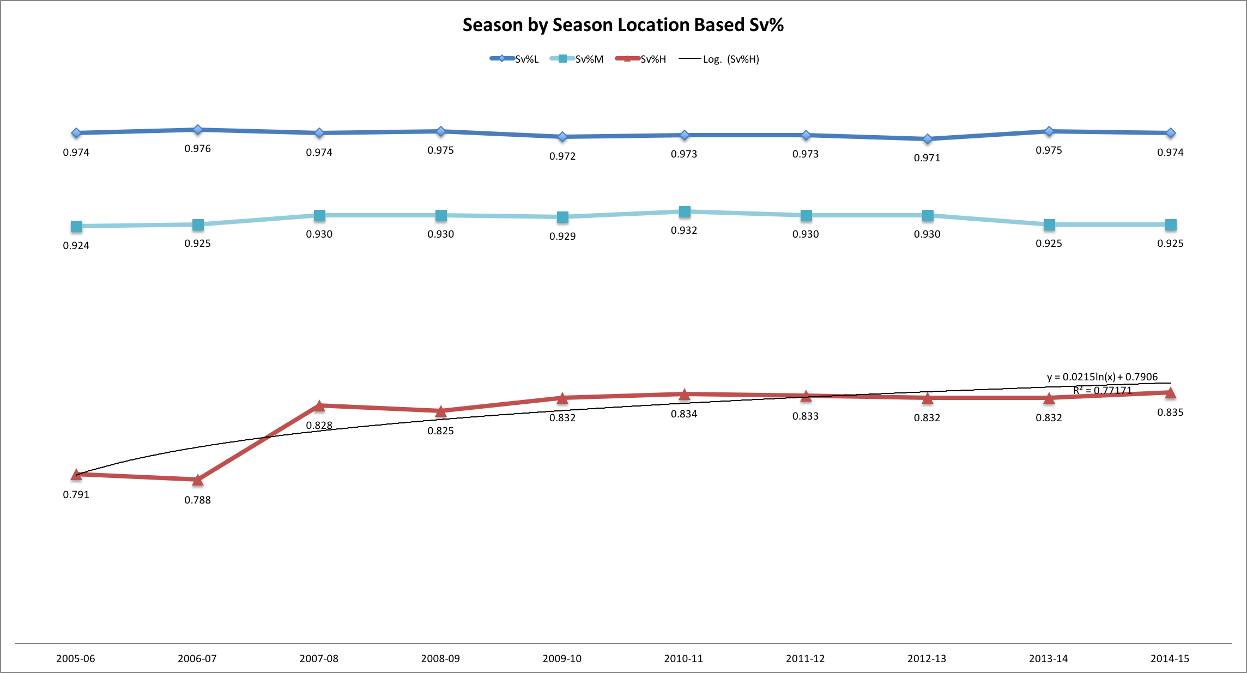
Improving Comparative Tools
7

Slide 8
5v5 adjGSAA/60
What is 5v5 adjGSAA/60?

Adjusted for Danger Zone
How many more/fewer goals allowed by Our Hero than if a league average goalie faced the same LD, MD, and HD shot volume?

+/- 60 Minute Rate
League average is 0.

Control For Situation and Environment
5v5; empirical league-wide sh%; compare across seasons
8

Slide 9
Formula
(total LD shots faced by Our Hero)*(1 - LD lg avg sv%) - LD goals allowed by Our Hero = LGSAA
(total MD shots faced by Our Hero)*(1 - MD lg avg sv%) - MD goals allowed by Our Hero = MGSAA
(total HD shots faced by Our Hero)*(1 - HD lg avg sv%) - HD goals allowed by Our Hero= HGSAA
((LGSAA+MGSAA+HGSAA)/goalie TOI)/60 = adjGSAA/60
9

Slide 10
adjGSAA/60
Cat Voodoo
10

Slide 11
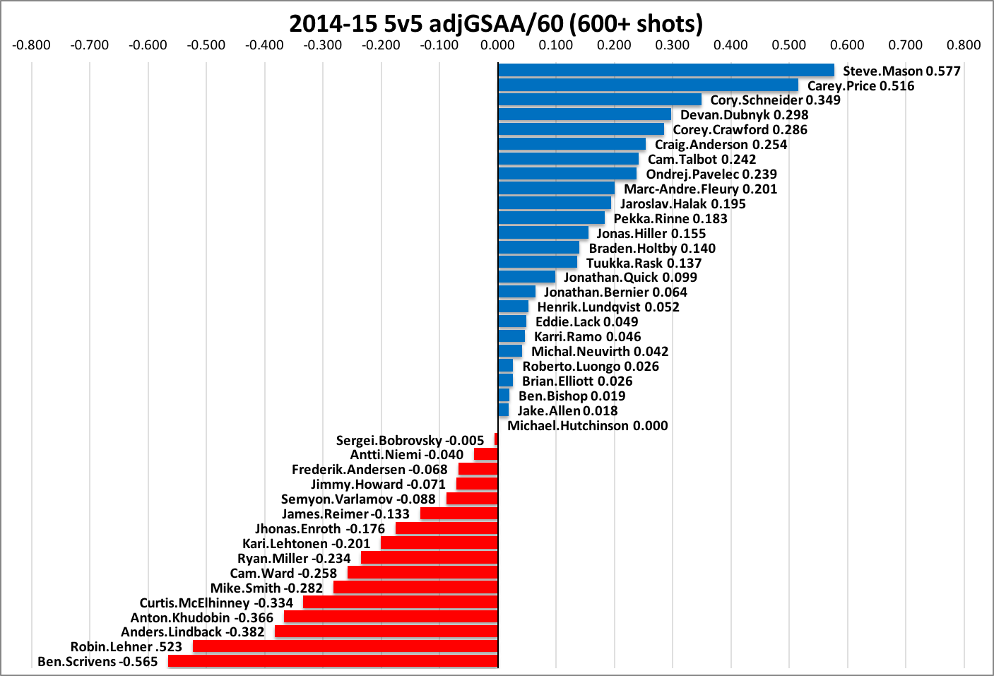
adjGSAA/60
2014-15
61%
Above Average
11

Slide 12
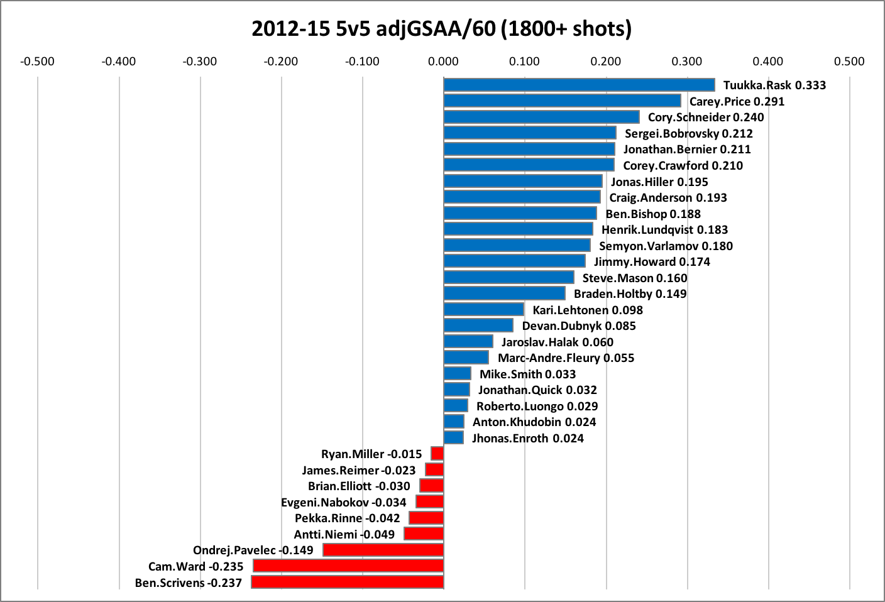
adjGSAA/60
2012-15 (3 yr)
71%
Above Average
12

Slide 13
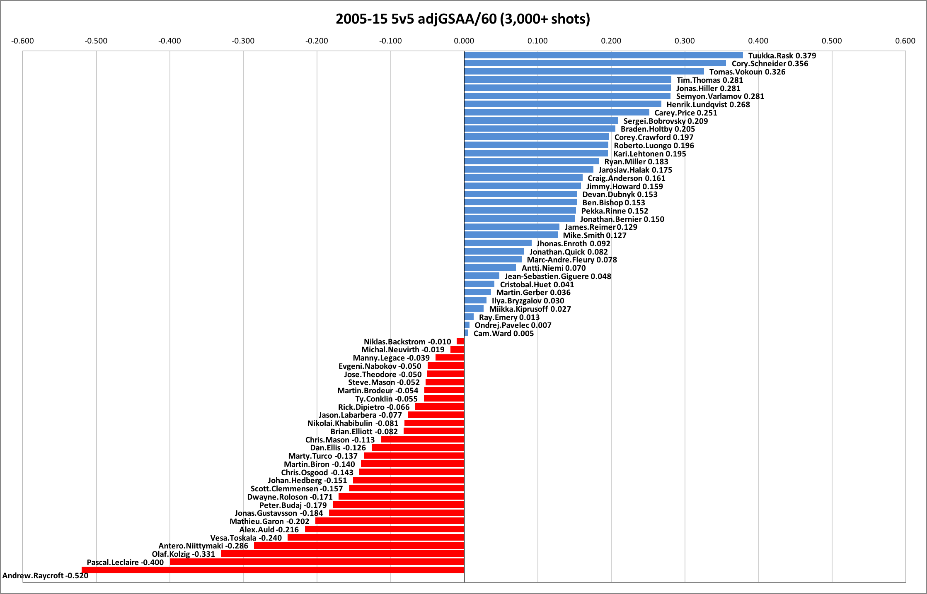
adjGSAA/60
2005-15
54%
Above Average
13

Slide 14
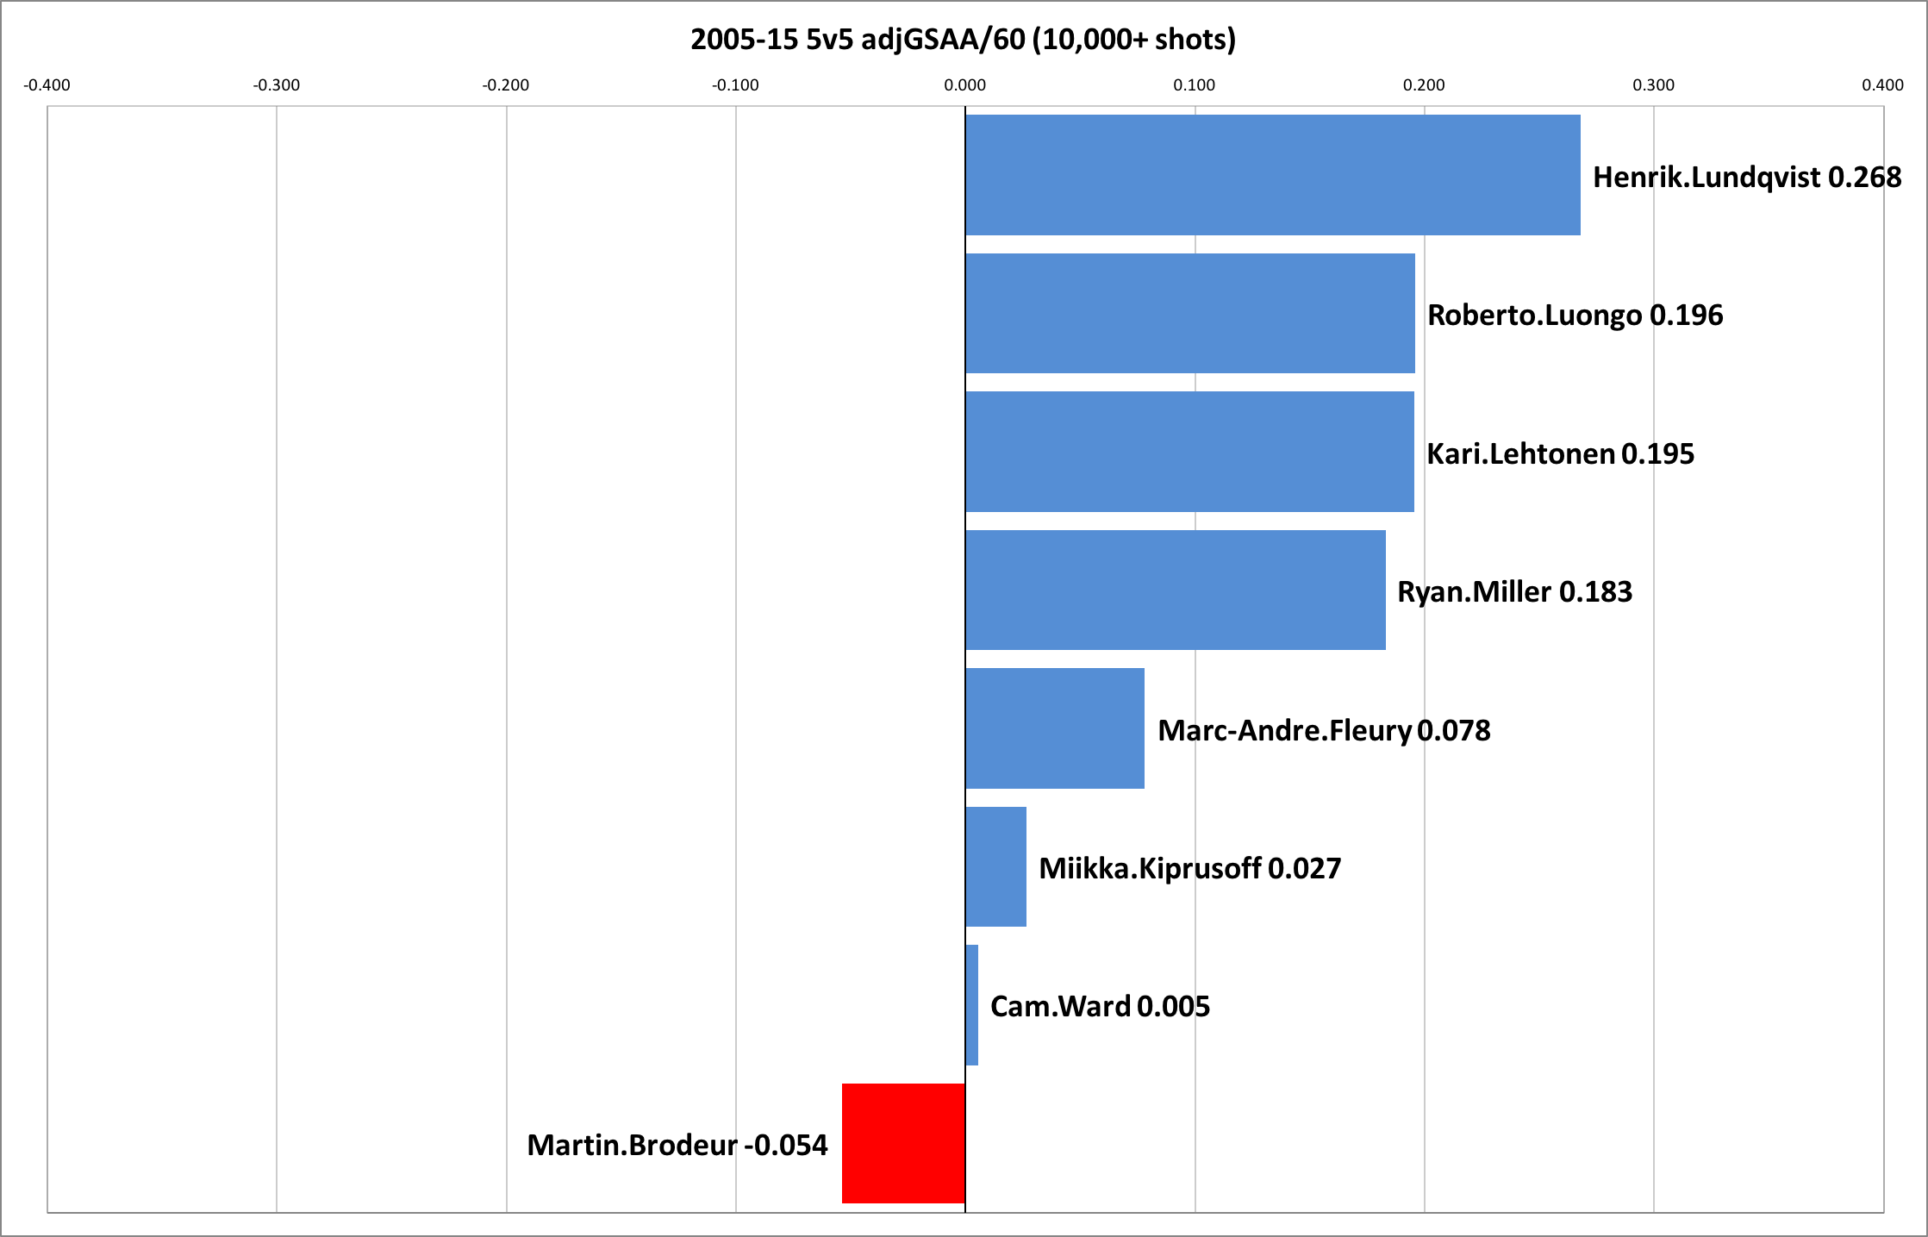

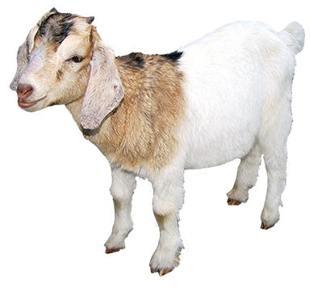
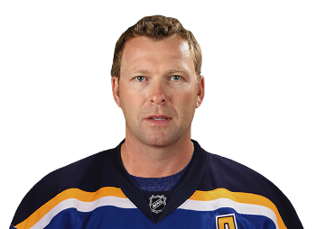
adjGSAA/60
G.O.A.T.
=
14

Slide 15
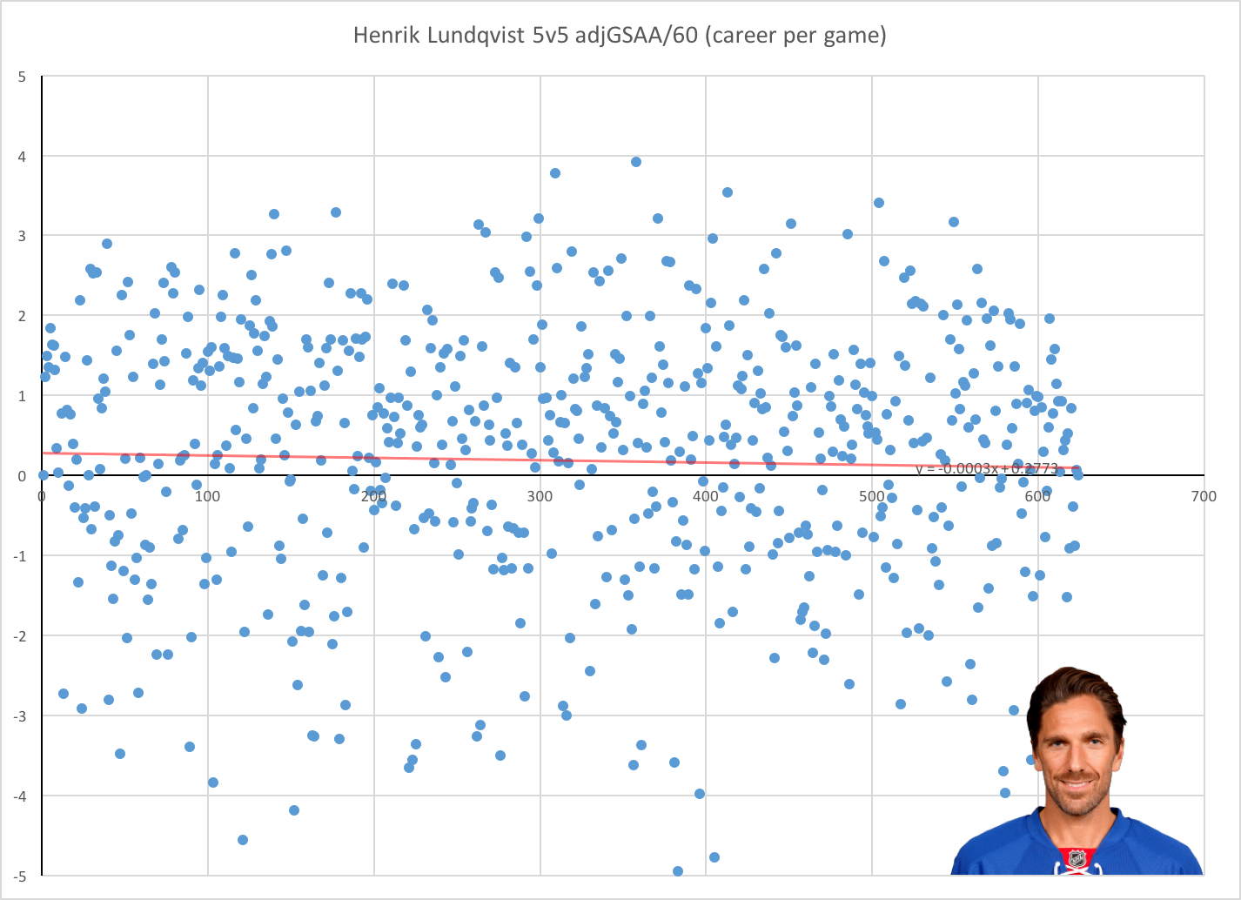
Goalie Stats Are
Not Created Equally
62.7%

Inconsistency = Bad

Consistently Above Avg = Rare

Elite = 60%+ Above Avg.

Slide 16
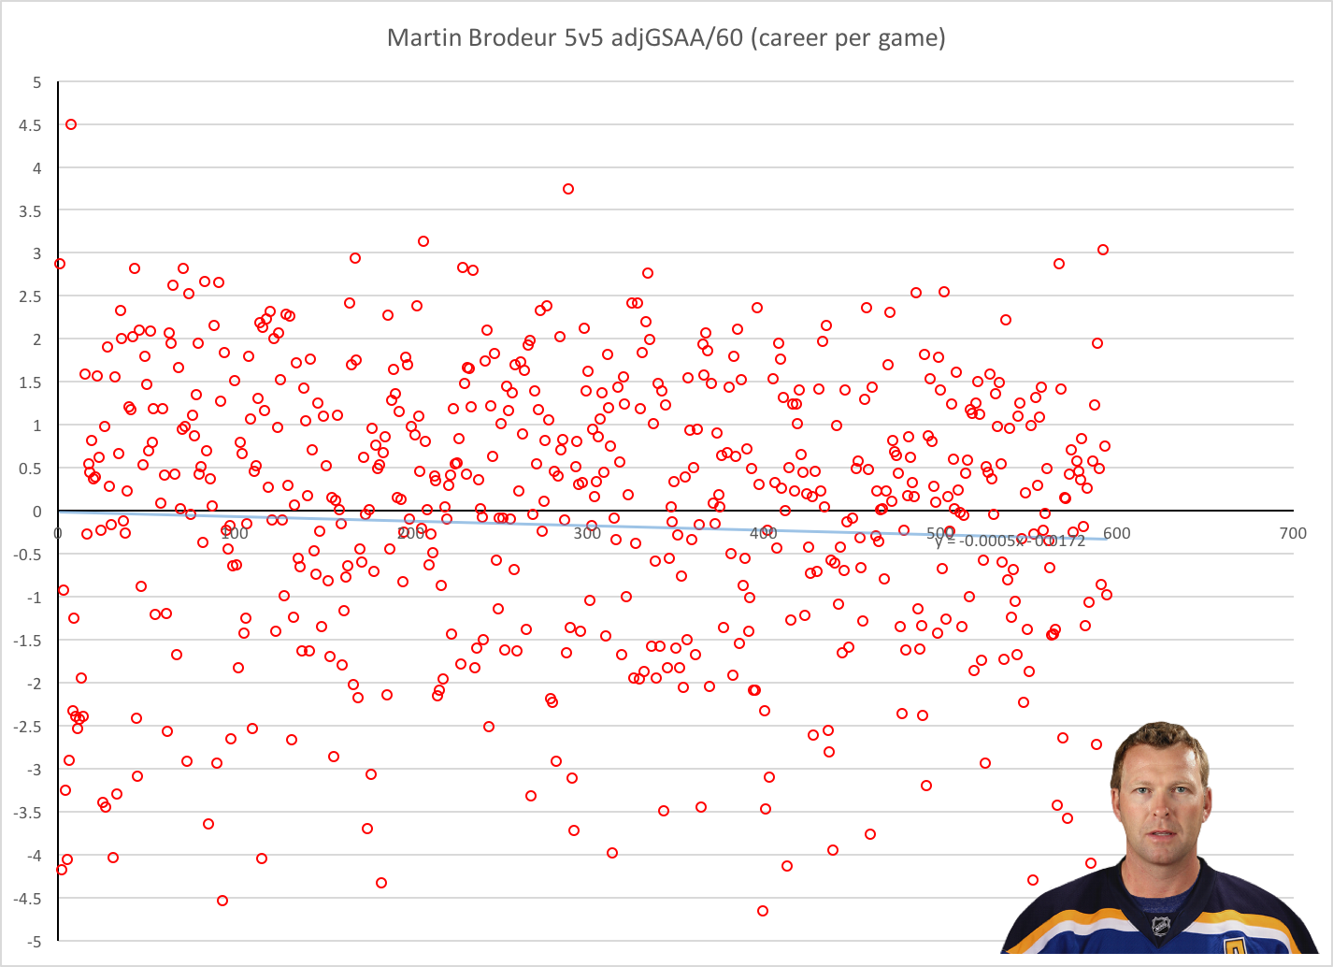
56.4%
Above avg start %
26.4%
“Bad” Start %

Slide 17
Sample
Multivariate Regression
Weight
n-1 = 6
n-2 = 3
Regress Shots
Adjust For Age
Coefficient n-1 = .596
Coefficient n-2 = .257
Coefficient n-3 = -.143
24% to the mean
143 LDS
90 MDS
93 HDS
n-1 400+ shots
n-2, n-3 400+






R² = .395
P value n-1 = .049
P value n-2=.372
2013-14
2014-15
2015-16
Marcel The Monkey – “Simple” Predictive Model

Slide 19
2012-15
3 yr – 5v5
Voodoo Chart – Jonathan Quick(LAK)
.032
3 yr adjGSAA/60
Bottom 4th
Below Avg
Above Avg
Elite
.021
2015-16 Projected adjGSAA/60
51%
3 yr Above Avg Start % Rank
72%
25%
3 yr Bad Start % Rank
% of team TOI
Trend Line:
19

Slide 20
2012-15
3 yr – 5v5
Voodoo Chart – Jonathan Quick(LAK)
.032
3 yr adjGSAA/60
Bottom 4th
Below Avg
Above Avg
Elite
.021
2015-16 Projected adjGSAA/60
51%
3 yr Above Avg Start % Rank
25%
3 yr Bad Start % Rank
Trend Line:
20

Slide 21
2012-15
3 yr – 5v5
Voodoo Chart – Jonathan Quick(LAK)
.032
3 yr adjGSAA/60
Bottom 4th
Below Avg
Above Avg
Elite
.021
2015-16 Projected adjGSAA/60
51%
3 yr Above Avg Start % Rank
25%
3 yr Bad Start % Rank
Trend Line:
21

Slide 22
Thanks:
War-On-Ice.com
Hockey-Graphs.com
@garik16
Rob Vollman
Dominic Galamini

