Slide 1
Evaluating Defensive Zone Play with Microstats
Jessica Schmidt

Slide 2
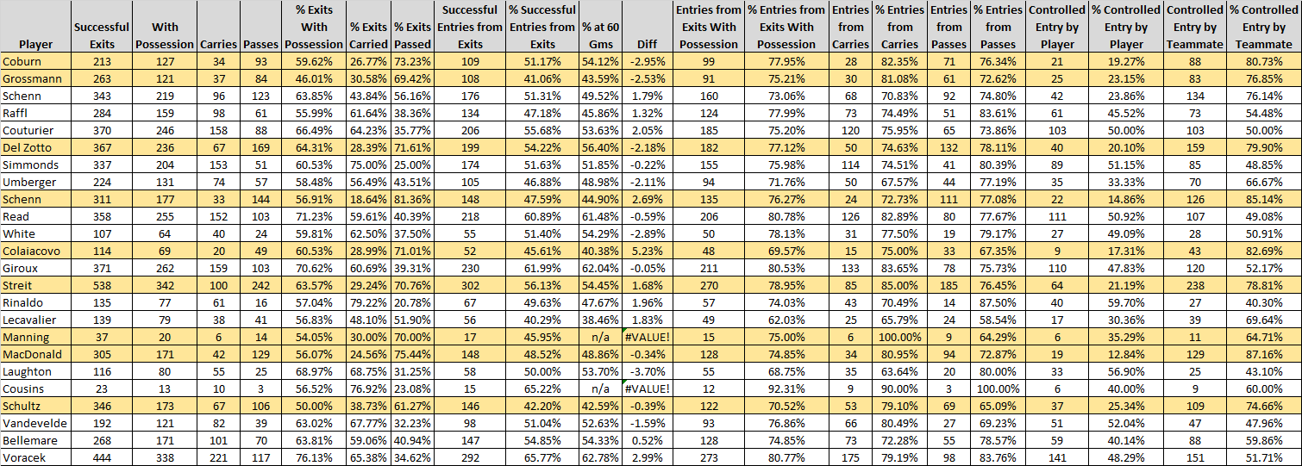
ZONE EXIT AND TRANSITION DATA OVERVIEW
Notes:
Discuss current zone exit parameters and limitations
Why I decided to add pressure (and adjust the way it’s viewed) and transition data
Give brief overview on new parameters that are being implemented this year

Slide 3
CHANGES FOR 2015-2016 SEASON
Breaking down pressure into four different categories.
Adding primary and secondary assists to exit attempts.
Incorporate transition data as a part of zone exits rather than treating them as a separate entity.
Track the impact of score effects, line combinations, and defensive pairings.

Slide 4
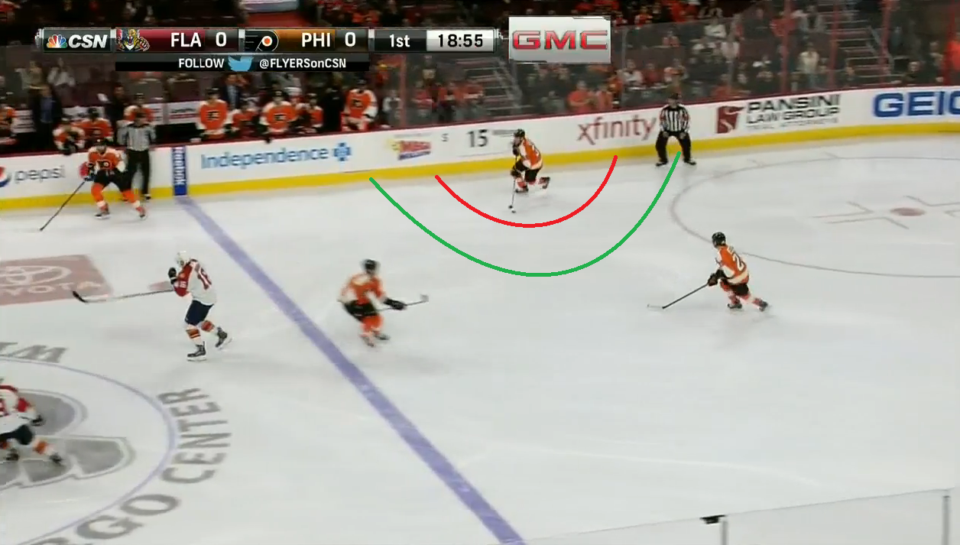
HOW DO PLAYERS PERFORM UNDER DIFFERENT PRESSURE SITUATIONS?
Category 1 – Immediate forechecking pressure
Category 2 – Close forechecking pressure
Category 3 – Lax forecheckecking pressure (often occurs after teams make line change or protecting a lead)
Category 0 – No forecheck pressure or opposing player in the vicinity of player attempting to exit the zone.

Slide 5
Team Level Success Under Pressure
Categories 1 and 2 are most frequent.
On a player level, more concerned with what happens with their exit attempts under Category 2
Most common exit attempts:
  Cat 0 – Carry
  Cat 1 – Chip/Turnovers
  Cat 2 – Chips/Passes
  Cat 3 – Carry/Passes
Notes:
-Player level cat. 2 – get an idea of players’ decision making and awareness in the dzone based on type of exit attempts

Slide 6
Player Level Success Under Pressure

Slide 7
Position Level Success Under Pressure

Slide 8
Score effects

Slide 9
How Do Score Effects Impact Transition?

Slide 10
Analyzing Players’ Contributions in the Defensive Zone
Average 1.71 players involved in zone exit attempt from the 30 game data set
Find out which players are most involved and successful at setting up teammates
Wanted an additional way to evaluate defensemen outside of just their exit attempts.
Find success of line combinations and pairings.
Notes:
-Notice tendencies within d pairings (Streit refusing to pass the puck to Grossmann which led to more TO against)

Slide 11
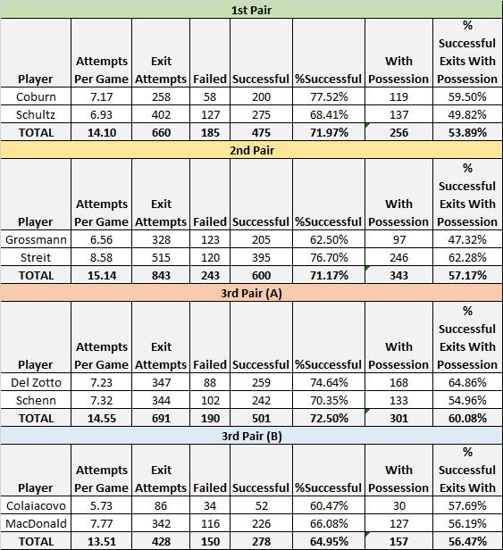
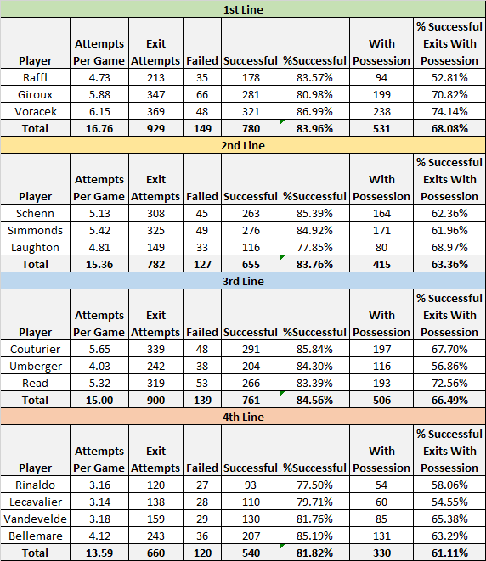
Notes:
Tracking line combos to find overall success rate as a group

Slide 12

Transition Data
About 25% of Flyers’ zone entries came from zone exits
About 41% of their zone exits led to successful entries
Add another layer of perspective to zone exits.
Notes:
-Corey’s data touched on this a bit
-Discuss finding value in Luke Schenn that went unrecognized

