Slide 1
IT and Knowledge Management for Elite Hockey Teams
Jack Han
Video & Analytics, McGill Martlet Hockey (CIS)

Slide 2
KEY CONSIDERATIONS
Time Management: 100-10-1
IT Strategy: Simple, reliable, flexible
Knowledge Retention: Organizing insights
It’s not about having more data,
it’s about putting some of it to good use.
@ML_Han

Slide 3
MY ANALYTICS STACK
Data collection (Steva)
Data interpretation (Excel, R, Tableau, etc.)
Cloud storage (YouTube, Vimeo, Dropbox)
Content organization & sharing (Trello)
Communication & ideation (Slack, Twitter)
@ML_Han

Slide 4
DATA COLLECTION
Steva Hockey: used by coaching staff in NHL/AHL, CIS/NCAA and European leagues
Reprogrammed to generate exportable PBP data & microstats
= Time/manpower efficiencies (20%)
= Augmenting traditional coaching & Eye Test
@ML_Han

Slide 5
CLOUD STORAGE (VIDEO)
YouTube: simple, reliable, flexible
Preferable to hockey-specific solutions (cost, accessibility)
Upload as unlisted or private video & add link to Trello
= Players can watch content anywhere on any platform
@ML_Han

Slide 6
CONTENT ORGANIZATION & SHARING
Trello: Freemium collaboration/project management software
“A wall of Post-It Notes”
Card: title + description + link + comments
Membership settings (admin, coaches, players)
= The lynchpin of our analytics program
@ML_Han

Slide 7
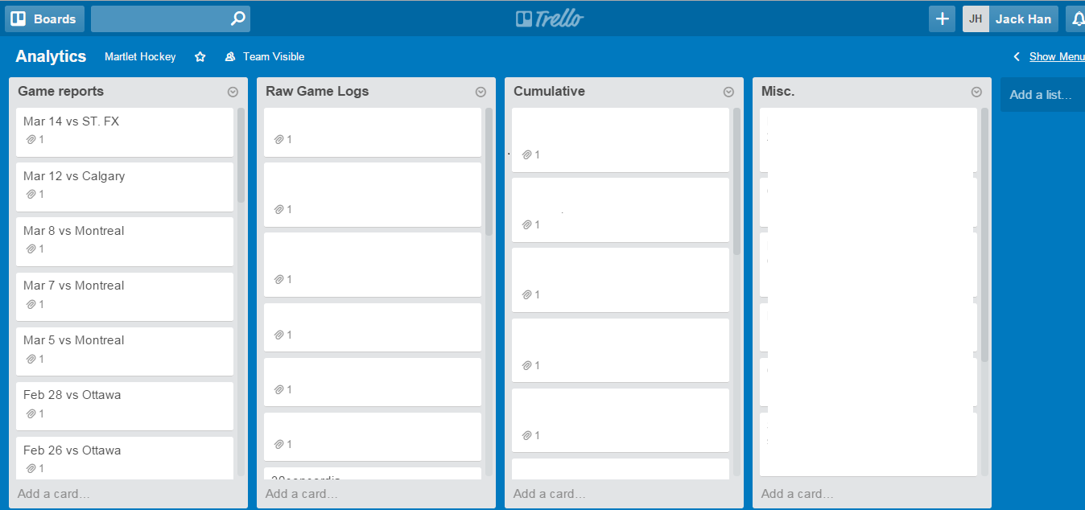
@ML_Han

Slide 8
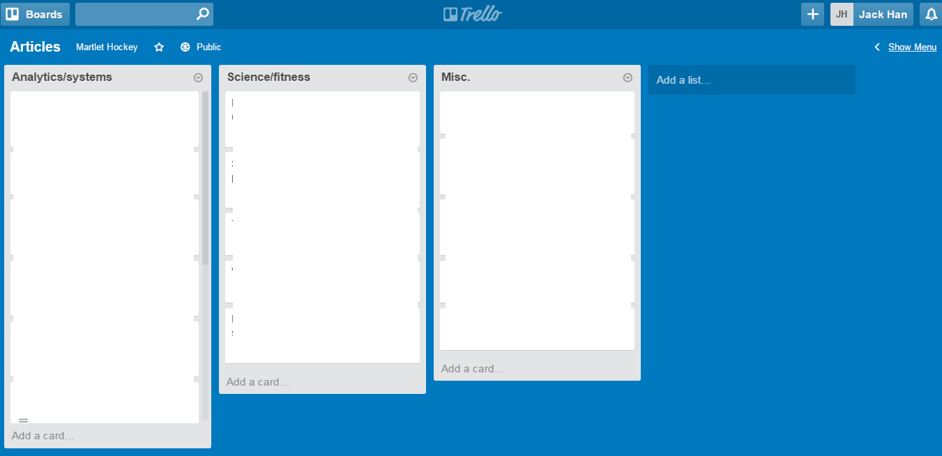
@ML_Han

Slide 9
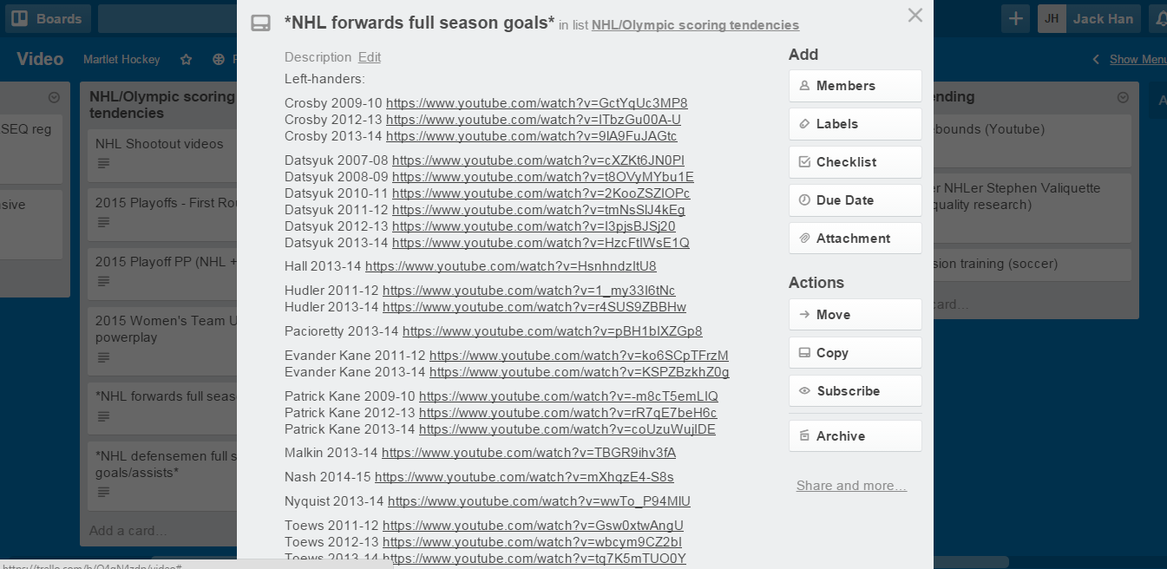
@ML_Han

Slide 10
COMMUNICATION & IDEATION
Slack: teamworking/messaging app
Great for cross-functional communication
  Analysts, coaching, scouting, strength & conditioning, equipment
Hang out, talk shop, then archive insights
= Build relationships; create & record new knowledge
@ML_Han

Slide 11
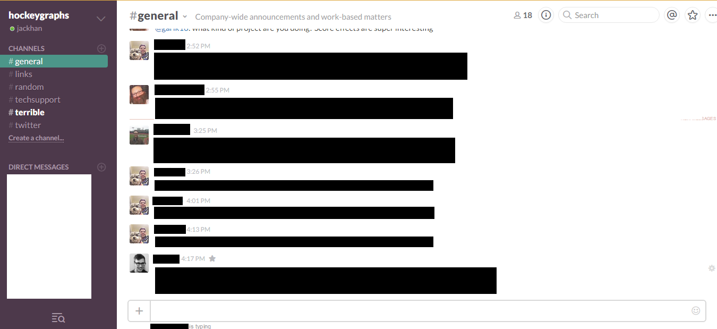
@ML_Han

Slide 12
FINAL THOUGHTS
Create a structure
Keep it simple
Build it, then sell it
@ML_Han

