Slide 1
Integrating Hockey Analysis
Stefan Wolejszo
RIT Hockey Analytics Conference
10 Oct 2015

Slide 2
Summary
Types of hockey information
Why integration?
  3 disconnects
Data integration continuum
  Qualitative mixed
  Quantitative mixed
  Full integration
Recommendations
Conclusion

Slide 3
Types of Hockey Information
Directly Known | Mediated by Teams, Media, etc.
Goals/Assists/Points/GP Saves Shot attempts Shot location Hits Faceoffs | Team/organizational culture Interpersonal dynamics Psychosocial measures (leadership, motivation, resiliency, confidence) Fitness
Tracking Projects | Proprietary Data
Zone entries Zone exits Neutral zone Passing Player salary | Internal scouting reports Informal evaluations Work done by team analysts, consultants, and sports consultant firms (e.g. Catapult)

Slide 4
Why Integration?
Current analytics provides partial picture
Focus on available data (i.e. not mediated or proprietary)
Curiosity-driven
  Refining measures (GAR, DCorsi, WOWY, etc)
  Tracking projects (direct observation)
  Applying measures
Results in three important disconnects (information, emphasis, integration)

Slide 5
Disconnect 1: Different Info Available
If/when an analyst is hired the rules change
  Access to different info
  Asked specific questions
  May have small sample sizes
  May have to give answers despite small sample size
  Silos
  Zero-sum game (focus on proprietary)

Slide 6
Disconnect 2: Different emphasis
Different emphasis/goals
  Have 45-50 contracts in organization
  Player development
  Training, avoiding injuries
  Positive team culture

Slide 7
Disconnect 3: Results are Only as Good as the Integration
Variety of information available (data smog)
  Coaches
  AGMs
  Ownership
  Analysts
  Contractors
How does analytics fit into the big picture?
Integration of all this info left to GMs
Unhappiness when analyst is ignored

Slide 8
How GMs Typically Integrate Info

Slide 9
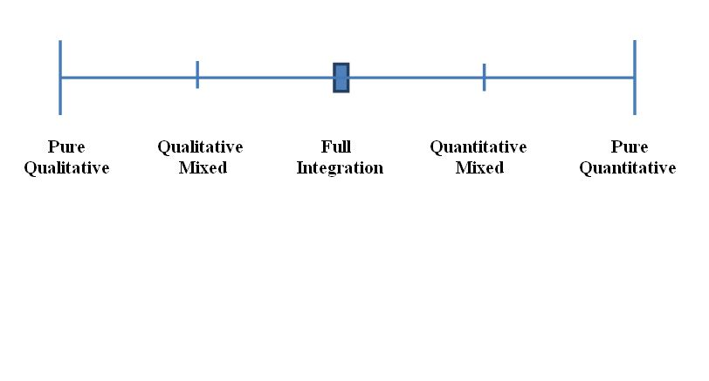
Data Integration Continuum

Slide 10
Qualitative Mixed
Quantitative used to confirm Qualitative
Drunken lampposts
Likely most common approach in NHL
Hard question: Are GMs likely have expertise in qualitative analysis? (i.e. Are they likely to do it badly)

Slide 11
Quantitative Mixed
Qualitative used to confirm quantitative
Not widely used (if at all)
Analytics is used as main factor in decisions
Hard question: Are all of the most important components quantified? (i.e. How meaningful are the results)

Slide 12
Full Integration
How this is done depends on skill set
  Can use complex systems approach (teams as complex workplaces) – e.g., BEM model
  Can also focus solely on players – e.g. SEM
Mix of latent and manifest variables
  E.g. What is relationship between training regimen and injuries?
  Integrated answer involves training, psychometrics, behaviors, outcomes

Slide 13
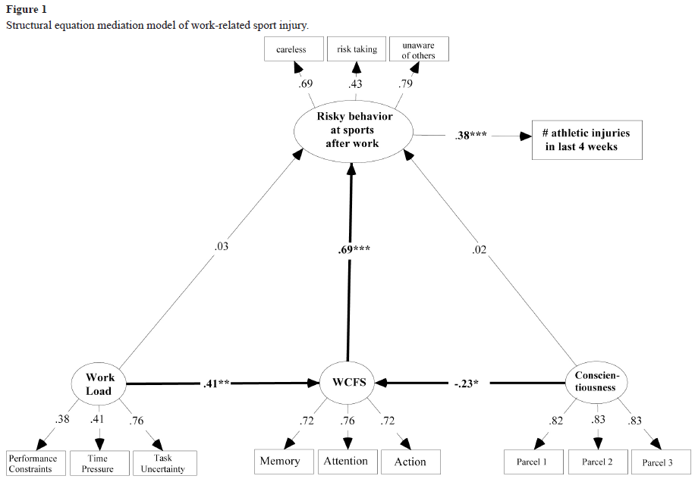
Full Integration (Quant) Example
Elfering et al . 2014. “Sports after Busy Work: Work-Related Cognitive Failure Corresponds to Risk Bearing Behaviors and Athletic Injury” Escritos de Psicología, Vol. 7, nº 1, pp. 43-54.

Slide 14
Reconnection (“think big” edition)
Disconnect | Reconnect
Different info available | -be conscious that analytics job description is being created -look at research in other areas -track professional hiring -develop applicable skill sets
Different goals (emphasis) | -direct application dealing with: improving player selection, player development, team culture, interpersonal dynamics -“speak the same language” as team management
Integration not stellar | -hit as many areas as possible to provide a holistic and integrated approach -interface with other staff

Slide 15
Conclusion
Even the best analysis has little or no value if it is not integrated well
Analytics is in process of defining itself
Extend reach by broadening scope of analysis
Integrate whatever can be quantified
Integrated analysis is harder to ignore

