Slide 1
Going Mainstream
Bringing analytics to a larger audience and how it can help fans, writers, data analysts and front offices

Slide 2

The Brad Boyes Theory
Everyone wants to know: Is the narrative on a player actually true?
Boyes was said to be a bust in Buffalo because he was washed up
The real explanation: Lindy Ruff took away his power play time
The article angered mainstream media , which caught the eye of fans who also hated Boyes
Readers wanted to know if more of the mainstream opinions on players were BS
- Thus, kicked off a stats series about each Sabre and grew a following of readers

Slide 3
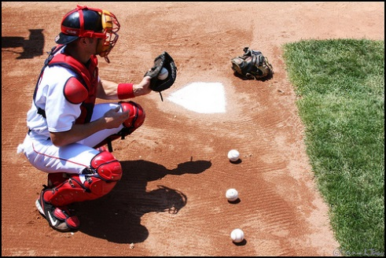
Pitch framing
Readers have to be able to connect data to watching the game
Ben Lindbergh’s series of articles on pitch framing gave viewers/front offices something they could notice – made it easy to recognize the impact
Jonathan Willis piece on Ovechkin plus-minus
Rob Vollman’s Player Usage Charts, another example. Watch for zone starts, matchups
Discover ideas by….wait for it….watching the game! Listen to players/announcers/analysts and question them

Slide 4

Writing for mainstream
AP style
BOLD – USE FREAKING BOLD to separate ideas
Don’t write like lawyer
Don’t write down to audience, but simplify
Use all mediums – Vines/GIFs

Slide 5
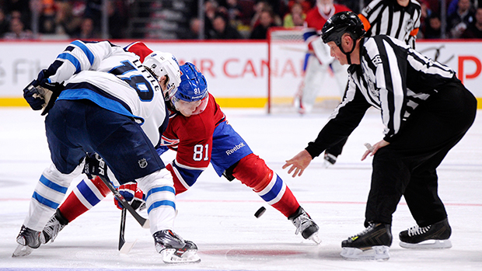
Find a niche
“numbers guy” at WGR turned into “player evaluation guy”
If the Sabres were targeting a player, hosts would ask about him
Find a focus, then expand – maybe it’s a team or part of the game
Why should I consider you an authority or give a crap what you say?
Find a way to add YOUR PERSONALITY to your writing

