Slide 1
Cap Hell: An Illustration
Alexandra Mandrycky
@alexgoogs

Slide 2
Disclaimers
This presentation has in no way been endorsed by the NHL nor any NHL teams. Material presented is based on my own as well as others' interpretation of the CBA, based on publicly available data. All data used in this presentation is available via war-on-ice.com.
The off-ice event which contributed to the LA Kings’ "Cap Hell" will not be discussed in this presentation, only the cap implications. I will not present an opinion on how this was handled by the league or the Kings.

Slide 3
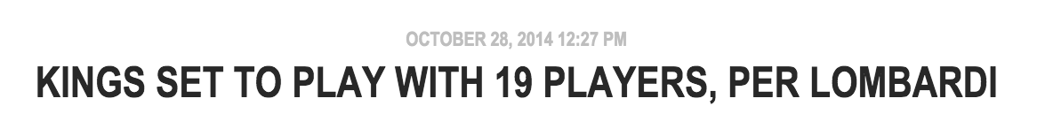
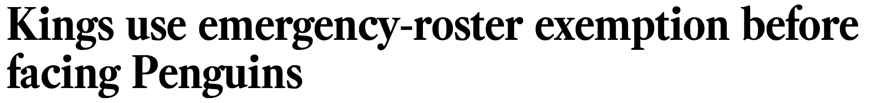
In the News

Slide 4

It Started Off Fine! – 10/8/2014
1/186
Roster Breakdown:
  23 players on active roster.
    22 healthy (14 F, 6 D, 2 G)
    1 (Muzzin, D) injured
  1 “Injured Non-Roster” player (Andrew Bodnarchuk)
    We’re going to ignore him, but he did recover and was sent to the minors 11/17/14.
    No cap implications.
Upper Limit = $69m – ($0.05m) = $68.95m

Slide 5

Lewis Down – 10/11/2014
4/186
Trevor Lewis was hurt during the first game (10/8/2014).
What are the options when a player is hurt?
With Lewis out, down to 21 healthy players.
Status | Can Return… | Roster Spot? | Cap Relief?
Injured | Anytime | Yes | No
Injured Reserve | 8th day after injury | No | No
Long Term Injured Reserve | 24th day after injury | No | Yes

Slide 6
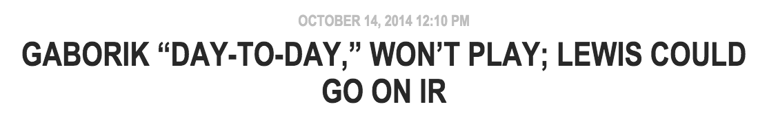
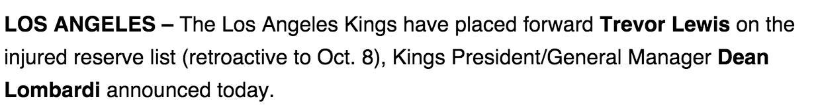
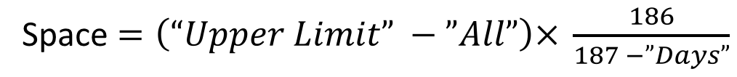
Gaborik, too! – 10/14/2014
7/186
lakingsinsider.com
kings.nhl.com
Status | Spots | Cap
Injured | 2 (1 F, 1 D) | $5,875,000
Injured Reserve | 1 (1 F) | $1,525,000
Active, Healthy | 20 (12 F, 6 D, 2 G) | $61,091,894
All | 22 Active, 1 Inactive | $68,491,894
Space |  | $473,376
Space $=\left(“Upper Limit” −”All”\right)× \frac{186}{187 −”Days”}$

Slide 7
Voynov Suspended – 10/20/2014
13/186
nhl.com
Status | Spots | Cap
Injured | 2 (1 F, 1 D) | $5,875,000
Injured Reserve | 1 (1 F) | $1,525,000
Suspended | 1 (1 D) | $4,166,667
Active, Healthy | 19 (12 F, 5 D, 2 G) | $56,925,227
All | 22 Active, 1 Inactive | $68,491,894
Space |  | $489,700

Slide 8
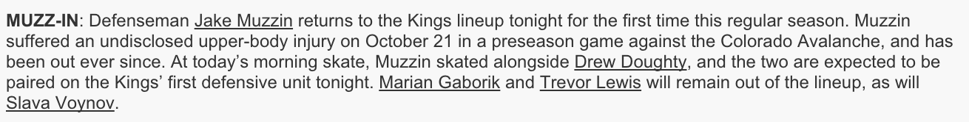
Muzzin Returns! – 10/23/2014
16/186
kings.nhl.com
Status | Spots | Cap
Injured | 1 (1 F, Gaborik) | $4,875,000
Injured Reserve | 1 (1 F, Lewis) | $1,525,000
Suspended | 1 (1 D, Voynov) | $4,166,667
Active, Healthy | 20 (12 F, 6 D, 2 G) | $57,925,227
All | 22 Active, 1 Inactive | $68,491,894
Space |  | $498,291

Slide 9
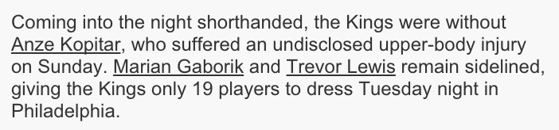
Koping without Kopitar – 10/28/2014
21/186
kings.nhl.com
Status | Spots | Cap
Injured | 2 (2 F, Gaborik, Kopitar) | $11,675,000
Injured Reserve | 1 (1 F, Lewis) | $1,525,000
Suspended | 1 (1 D, Voynov) | $4,166,667
Active, Healthy | 19 (11 F, 6 D, 2 G) | $51,125,227
All | 22 Active, 1 Inactive | $68,491,894
Space |  | $513,299

Slide 10
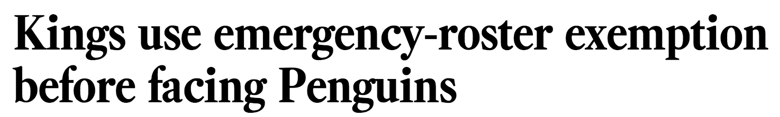
Emergency! – 10/30/2014
23/186
latimes.com
See CBA 50.10 --- This is allowed because of the Kings dressed less than 18 skaters, 2 goalies during the previous game & their cap situation.
Status | Spots | Cap
Injured | 2 (2 F, Gaborik, Kopitar) | $11,675,000
Injured Reserve | 1 (1 F, Lewis) | $1,525,000
Suspended | 1 (1 D, Voynov) | $4,166,667
Active, Healthy | 19 (11 F, 6 D, 2 G) | $51,125,227
Emergency! | 1 (1 F, Van der Gulik) | $0
All | 22 Active, 1 Inactive | $68,491,894
Space |  | $519,559

Slide 11
Breathe a little, maybe. – 10/31 – 11/5/2014
29/186
10/31 – Lewis returns and is removed from IR.
  Note that the earliest he could have returned from Long Term Injured Reserve is 11/2.
11/2 – Gaborik & Kopitar recover.
11/2 – 11/5 – Jordan Nolan is suspended two games for boarding.
  Because who said life was that easy?
Status | Spots | Cap
Suspended | 1 (1 D, Voynov) | $4,166,667
Active, Healthy | 22 (14 F, 6 D, 2 G) | $64,325,227
All | 23 Active | $68,491,894
Space |  | $539,289

Slide 12
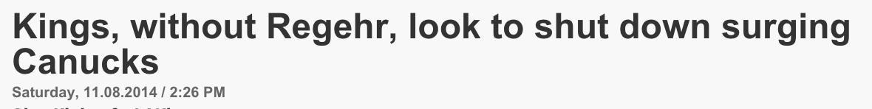
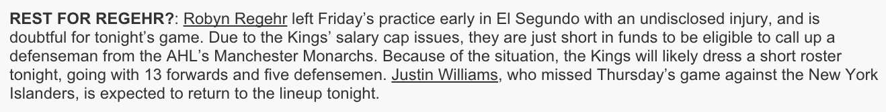
Short, but kind of better– 11/8 – 11/10/2014
34/186
kings.nhl.com
Status | Spots | Cap
Injured | 1 (1 D, Regehr) | $3,000,000
Suspended | 1 (1 D, Voynov) | $4,166,667
Active, Healthy | 21 (14 F, 5 D, 2 G) | $61,325,227
All | 23 Active | $68,491,894
Space |  | $556,913

Slide 13
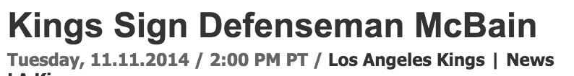
McJes-…Bain – 11/11/2014
35/186
kings.nhl.com
Status | Spots | Cap
Injured | 1 (1 D, Regehr) | $3,000,000
Suspended, Non-Roster | 1 (1 D, Voynov) | $4,166,667
Active, Healthy | 21 (14 F, 6 D, 2 G) | $61,771,732
All | 23 Active, 1 Inactive | $68,938,399
Space |  | $14,196

Slide 14
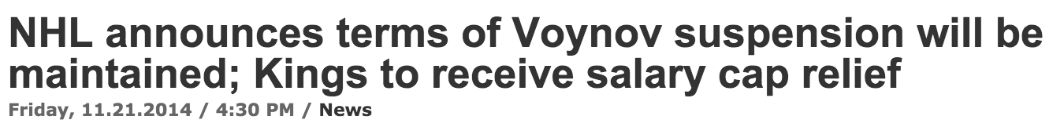
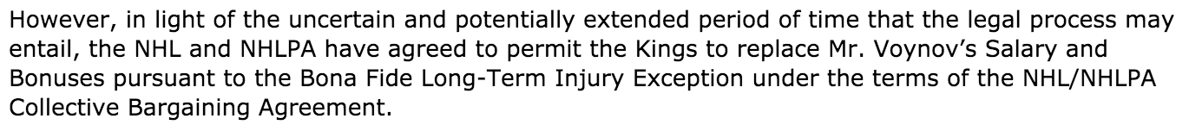
Voynov Relief – 11/21/2014
45/186
nhl.com
Status | Spots | Cap
Injured | 1 (1 F, Martinez) | $1,100,000
LTIR | 1 (1 D, Voynov) | $4,166,667
Active, Healthy | 22 (13 F, 7 D, 2 G) | $63,671,732
All | 23 Active, 1 Inactive | $68,938,399
New Upper Limit |  | $73,105,066

Slide 15
Conclusions
No matter how you feel, hard to argue the Kings weren’t in a tough spot all last fall.
The “plan” at the beginning of the season is rarely how things end up.
Injuries stink.

Slide 16
Thanks
Organizers!
CapGeek
Andrew & Sam at WAR On Ice
Jack Eichel

